Slide 1
Jeremiah J. Brown
Best-Selling Author - Financial Freedom: My Only Hope
Tech Founder & CEO | Bezelhub.com

Slide 2
Born and raised in Brooklyn, NY

Slide 4
High School / College life
3 Different High schools
3.5 GPA through high school
ELON UNIVERSITY
Martha & Spencer Love School of Business

Slide 5
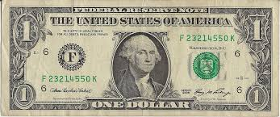
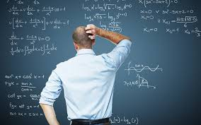
Degree in Finance
How Money Works
What are you learning when you pursue a degree in finance ?
VS.
Math

Slide 6
QUICK ACTIVITY

Slide 7
Match each person with their net worth!
(Please no Phones)
Jay –Z
Dr. Dre
3. Jeff Bezos
4. Oprah
5. Larry Ellison
6. LeBron James
7. Evan Speigel
8. JK Rowling
9. Sheldon Allison
10. Steve Schwarzman
11. Jack Ma
12. Carl Icahn
A. $100 billion
B. $61 billion
C. $39 billion
D. $37.9 billion
E. $16.4 billion
F. $12.3 billion
G. $3.5 billion
H. $2.8 billion
I. $1 billion
J. $830 million
K. $810 million
L. $450 million

Slide 8
Jeff Bezos→ (Technology) →
Larry Ellison → (Technology) →
Sheldon Allison → (Real Estate) →
Jack Ma → (Technology) →
Steve Schwarzman → (Private Equity) →
Carl Icahn → (Investor) →
Evan Speigel→ (Technology) →
Oprah→ (Media proprietor) →
J.K Rowling→ (Author) →
Jay –Z→ (Entertainment) →
Dr. Dre→ (Technology) →
LeBron James→ (Sports) →
A. $100 billion
B. $61 billion
C. $39 billion
D. $37.9 billion
E. $16.4 billion
F. $12.3 billion
G. $3.5 billion
H. $2.8 billion
I. $1 billion
J. $830 million
K. $810 million
L. $450 million

Slide 9
What Do These Professionals All Have In Common
(Take a guess)

Slide 10
They Are All…..
But what is an entrepreneur ? →

Slide 11
Create
Ideas
Money

Slide 12
MY FIRST APP
Launched App at age 21
Initial Investment $800
25,000 downloads week 1
Sold for $75K

Slide 13
Wrote a Financial
Education book
Amazon
iBooks
Barnes & Noble
Nook
Kindle
Distribution pipeline

Slide 14
ACTIVITY
Your Turn!
Think of 10 ideas that you could turn into MONEY!

