Slide 1
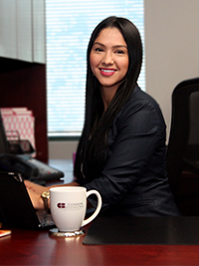
Griselda De Mel
Vice President
Relationship Manager
Notes:
My name is Griselda De Mel and I am 33 years old.
I work for Citizens Business Bank (CBB).
CBB is the largest financial institution headquartered in the Inland Empire region of California. The Bank has $8.3 billion in assets and over 50 business centers throughout the state.
My role at Citizens Business Bank is the Vice President & Relationship Manager
Every day I manage my existing portfolio of clients and finds ways to bring in new clients

Slide 2
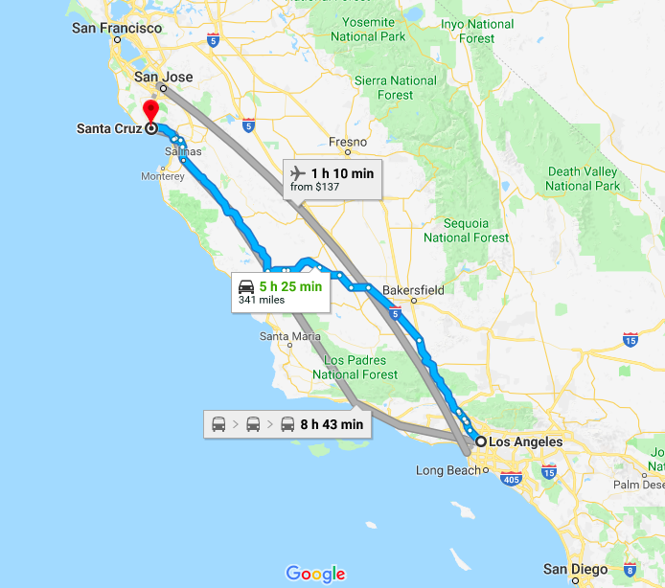
Background
I was born and raised in Santa Cruz, CA, which is in north of Los Angeles, CA
I am the middle child of 3, all girls
My first public speaking experience was when I was in 3rd grade

Slide 3
Background and Education
I have been working full-time (40-hours per week) since I was 18 years old
First in my family to graduate from undergrad
First in my family to graduate graduate school

Slide 4
Career
Started as a part-time Teller at age 18, while I worked as a “sandwich artist” part-time
Deciding on a major
Career Challenges
Volunteering / Giving back

Slide 5
Launching your dream
If you could start your own business, what would it be? And why?

Slide 9
Popular crowdfunding websites
Visit popular crowdfunding websites such as
Kickstarter (https://www.kickstarter.com/)
Indiegogo (https://www.indiegogo.com/)

