Slide 1
Youth Business alliance
Craig heiting, SVP deluxe entertainment
November 2017

Slide 2
Agenda:
Background
Career path
Deluxe Entertainment
Keys to Success
Q&A

Slide 3
Background
Born and raised in Milwaukee, WI
Public school, blue collar
First in family to attend college
Marquette University (B.A. in Journalism/Film)
Moved to Los Angeles (dream since childhood)
Married father of four (2 boys and 2 girls now in their 20’s)
Current Position
SVP Business Development Deluxe Entertainment
Volunteer Work
US Paralympic Ski Team
Musical Director at St. Jude
Notes:
Born and raised in Milwaukee, WI. Grew up in the 70’s. Never thought of going to college.

Slide 4
CAREER PATH
Milwaukee Journal reporter
Time Warner
Programming
Marketing
Operations
BigBand Networks (start-up, 6th employee) – Ops then sales
Created Switched Digital Broadcast technology
Wave Broadband - President
BigBand Networks – VP Worldwide Business
Deluxe Entertainment
Notes:
Born and raised in Milwaukee, WI. Grew up in the 70’s. Never thought of going to college.

Slide 5
“Color by Deluxe”
For over100 years and running, Deluxe is recognized for the highest quality of service -- from capture to editing, processing and distribution -- for every form of entertainment
Trusted partner to every major studio
Worldwide relationships with every 200+ content providers
Post-production for six of the past seven Oscar best-picture winners
Finished over 50% of Super Bowl spots
Largest supply of master source files
Handle, manage and distribute millions of minutes of content each week.
Infrastructure and scale
Deluxe.
The Ecosystem of Media & Technology.

Slide 6
Notes:
----- Meeting Notes (4/24/17 20:22) -----
(following introductions) Thank you for having us here today. I'd like to start our meeting by telling you a little bit about Deluxe.
----- Meeting Notes (4/24/17 20:24) -----
Deluxe is the worldwide leader in theatrical delivery. There is not a single blockbuster release that isn't distributed by Deluxe.
----- Meeting Notes (4/24/17 20:33) -----
Every major studio, including NBC/Universal, utilizes Deluxe services for everything from localization to mastering to processing to delivery. Deluxe is a solid, reputable trusted content partner with over $1B in revenues annually.

Slide 7
Notes:
----- Meeting Notes (4/24/17 20:34) -----
In recent years, Deluxe has evolved into becoming the leader for in home delivery as well.
----- Meeting Notes (4/24/17 20:36) -----
With over 92 MVPD partners worldwide, Deluxe reaches 68% of homes with some form of content delivery.

Slide 8
KEYS TO SUCCESS - Build your brand
Public persona
Business persona
Internal Persona
Community Persona

Slide 9
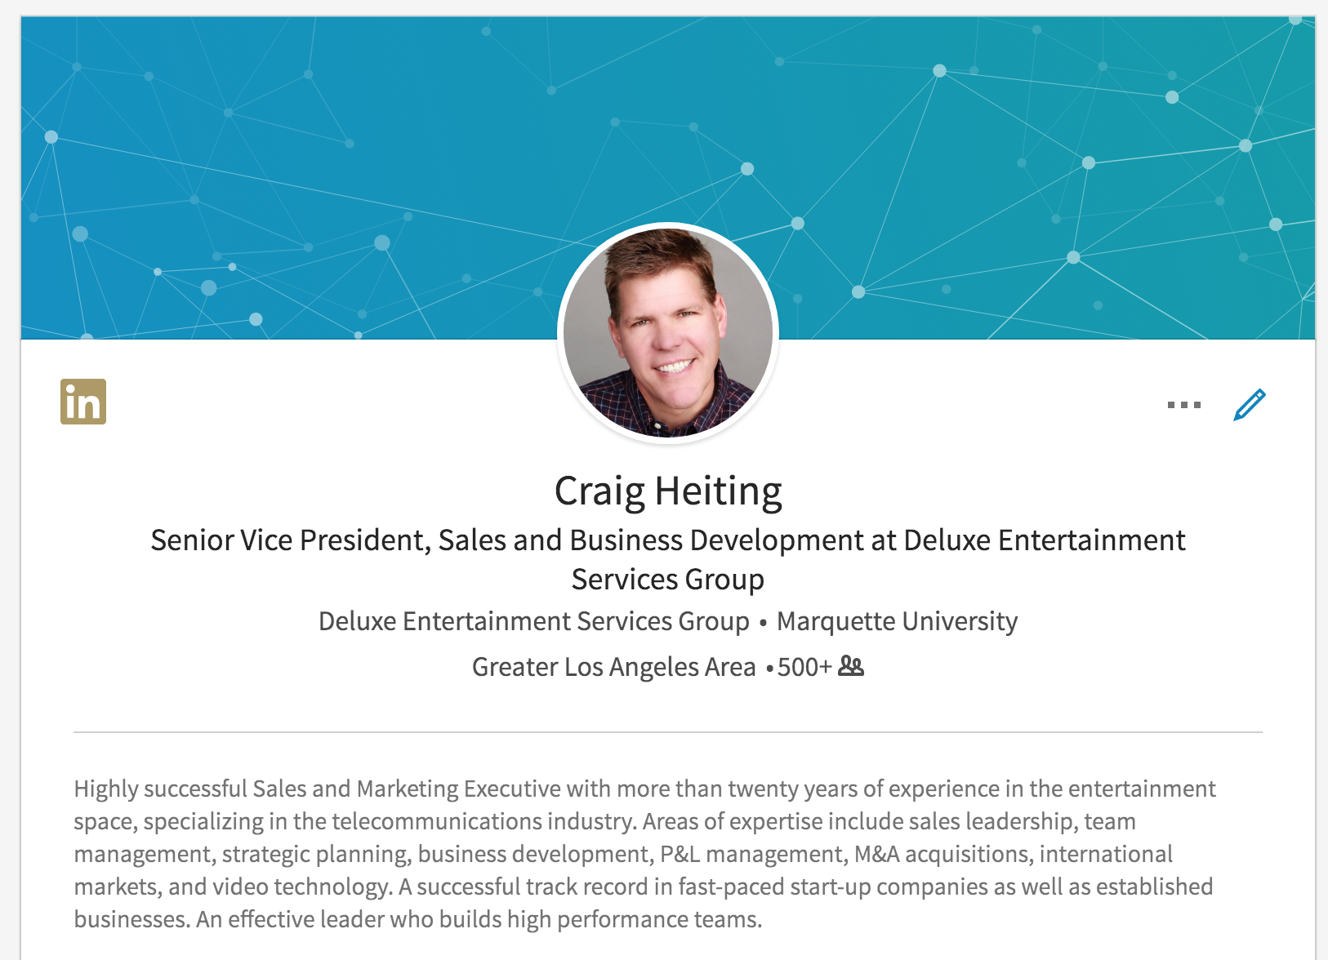
Public persona
What you want the world to see…

Slide 10
Public Persona: Be aware of the brand you are building
LinkedIn, not just for your parents
Keep it updated
Share articles of interest
Add every contact right away
Facebook, Snapchat, etc.
Be careful of what you permanently present to the world!
Personal and professional resume
Use proper grammar
Strictly Speaking by Edwin Newman ($3.79 at Thriftbooks.com)

Slide 11
Business persona: Do’s and don’ts
Don’t be a flake, follow through
Answer every email and call promptly
Don’t burn bridges
Accept help (and seek it if you need it)
Treat everyone with respect
Always do your best work

Slide 12
Internal persona: Do something you enjoy!
Figure out what makes you happy and put your happiness first!
“If you find something you love to do, you will never have to work a day in your life!”
Notes:
If you don’t know exactly what that is, don’t worry. Just make sure that if you find yourself in a job or a situation that doesn’t feel right, the longer you stay with it, the more you will feel trapped. I never thought I would be working in the film distribution business. I thought I would be an actor or the host of the Tonight Show. You don’t the job’t feel like this is possible today, but life is indeed short. You may not get the exact job you are dreaming of, but if you stay within the areas you enjoy, you will find happiness.

Slide 13
Internal Persona: Make it happen
Don’t wait for good things to happen to you
When you hear “no”, find out why and look for ways to get to “yes”
Look for wins, don’t focus on losses

Slide 14
Internal persona: Be able to look at yourself in the mirror
Don’t get even, make yourself better
Win, but not at the cost of others
Practice what kind of person you really want to be
Earn respect by treating others with respect
Provide excellent service to everyone who relies on you
Always be professional
Notes:
If you feel badly about yourself at the end of the day, I guarantee you will not be successful. No matter how you feel about politics, I’m sure almost everyone would agree that our current president does not adhere to these guidelines. I would submit that his presidency is not very successful at the moment because of this. You could say that he made billions of dollars doing the opposite of this list, but like all of us, he wants to be admired and respected and his billions haven’t bought him true happiness. Money does not necessarily equal success!

Slide 15
Community persona: Give back!
Volunteer
Your rewards will span in all areas of your life
Networking opportunities
Create a well-rounded you!
Be a Good Citizen
Notes:
Find something you are passionate about an help others through that passion.

Slide 16
Q&A
Notes:
Find something you are passionate about an help others through that passion.

