Slide 1
INTRODUCTION
My name is Robert Burnett and I am 59 years old.
I have worked for Citizens Business Bank (CBB) for 34 years.
CBB is the largest financial institution headquartered in the Inland Empire region of California. The Bank has $8 billion in assets and 52 branches throughout the state.
My role at Citizens Business Bank is the Service Manager and
Vice President
Some of the key areas of activity in my position consist of; customer calls, managing daily center operations, mailing or emailing info to existing business owners, develop new opportunities through my existing customer base, managing staff and customer issues. We provide services that businesses may need to grow or improve.

Slide 2
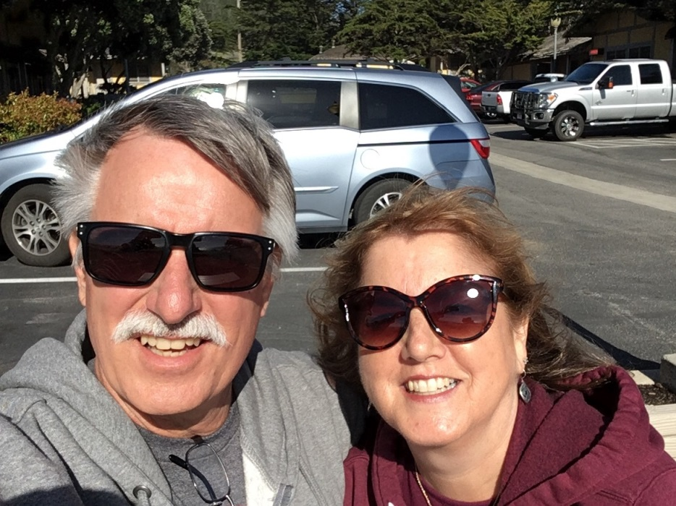
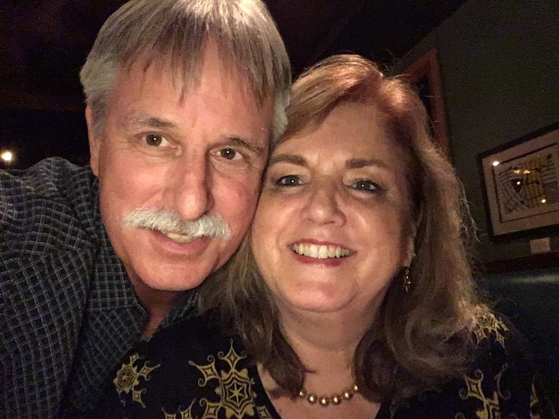
My Family
I was born in Pasadena, CA and grew up in Arcadia , CA which is approximate 20 miles northeast of downtown L.A. I have a beautiful wife and two incredible daughters.

Slide 3
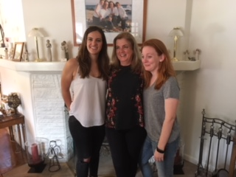
My family
A little about my family…
My parents and my brother were born here in the U.S. My wife is 1 of 10 children growing up in Southern California also. My mom and dad live about 1 mile from my wife and I. My oldest daughter works at a large hospital and my other daughter will graduate from college this spring.

Slide 4
MY HIGH SCHOOL
I attended Arcadia High School in Arcadia, CA.

Slide 5
High School
As a high school student I was very social. I loved sports and I made the High School Varsity tennis team for all 3 years. I was involved in several clubs and this was a great way of meeting new friends. ……………………………………………………………….

Slide 6
High School
Things that I really liked in High School were:
Classes: History, Political Science, Civics, English.
Playing sports.
I was a member of several clubs including the Key Club; Civics Club; and the Honor Senior Men’s Club, an academic honor roll service club.
Staying out of trouble. My parents made sure that I followed the rules, both at home and at school. Sports and the Service Clubs kept me very busy and out of trouble. I think when I did get in trouble it was because my friends and I really didn’t think things through at the time. Being involved and active in high school activities kept me focused and on the right track.

Slide 7
High School
Things that were difficult or challenging for me while I was in High School were:
Science, geometry, and calculus.
Focusing on homework and completing it in a timely manner.
Regret not making friends or acquaintances outside my circle of friends or activities.
Speaking in Public or having all the attention at the moment, like winning an award and having to walk up to some stage.

Slide 8
Getting in to College
The top few things I did to ensure I continue my education:
Applied to a few different colleges (Cal Poly San Luis Obispo, Cal Berkley, San Diego State, Santa Clara University.)
Was accepted and attended California Polytechnic State University at San Luis Obispo, graduating with a Bachelor of Arts
I made sure I kept my visits with my Counselors to stay on track.
Like many of you, I didn’t know what I wanted to do. So I kept going to school, doing some graduate work.

Slide 9
College
Things I enjoyed
in College
Things I didn’t enjoy in College
Making new friends
Playing Intermural Sports and participating in several college clubs including Model United Nations and PAC
Exploring the campus and surrounding areas close to school
Free time
Studying for mid-term and final examinations
Staying up late to finish term papers or homework

Slide 10
College
Favorite classes
Least favorite classes
Political Science
History
Anthropology
English
Writing
Science
Statistics
Psychology
Communications

Slide 11
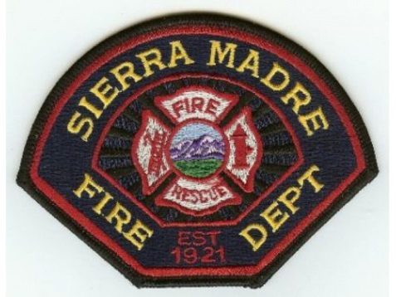
Getting a job after College
The top few things I did to ensure I got a good job after college were:
Attending continuing education classes and seminars.
Learn through my experiences and stay in touch with key influential people.
I became a Volunteer Firefighter/EMT in my community.
I knew I enjoyed interacting with and helping people, so I attended and graduated first in my class from the Rio Hondo Fire Academy after college.

Slide 12
This is My Company
Every day at my company:
Citizens Business Bank started in August 1974 with one branch in Chino, CA. Along the way, and after many years of success and progress, the Bank changed their name from Chino Valley Bank to Citizens Business Bank. Currently, the Bank employs over 800 individuals and is headquartered in Ontario, CA.
I work with many Business Owners and local community groups to ensure that we offer, educate and expand our Banking Services and relationships that we serve. In addition, my job is to provide new products, solutions, deposits and services to Business Owners within the state of California and build new relationships for our bank.

Slide 13
My role within organization
CEO
SVP CM
EVP SDM
SM VP
SVP RM
Notes:
Use this graph to give more description of your role specifically (responsibilities, typical work week, direct reports, etc.)

Slide 14
Compensation at my company
President and Executive Vice Presidents
($500K - $1M)
Senior Vice Presidents
($250K - $400K)
Vice Presidents
($100K - $200K)
Entry Level to Non-Officer Positions
($40K - $75K)
Notes:
Use this graph to show general compensation ranges for people in various roles in your company

Slide 15
More than just work
When I am not at work I like to:
Spend time with my wife and kids.
Spend time with my parents.
Hang out with friends.
Travel.
Work out.
Volunteering in my community.
Enjoy the company of family and friends!

Slide 16
Do it all over again?
If I could talk to my high school self, what would I say?
Realize that life is more than just the here and now. Take an eternal perspective of yourself and the people you meet.
Make new friends, outside my circle.
Be more involved in activities that were new for me.
Expand your horizons by trying different activities will lead to personal growth, meeting new people and travel.
Learn to enjoy each moment no matter where you are at.
Continue to make goals and take steps to achieve them. However, also take time to enjoy the path to each goal and reward yourself no matter how small the accomplishment.
Staying away from drugs, tobacco and alcohol.

Slide 17
QUESTION AND ANSWER

