Slide 1
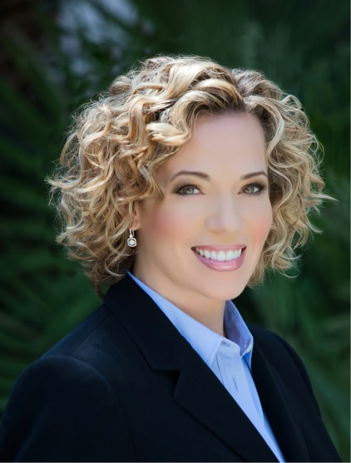
INTRODUCTION
My name is Cameronne Mosher and I am 46 years old.
I work for Citizens Business Bank (CBB).
CBB is the largest financial institution headquartered in the Inland Empire region of California. The Bank has $8.5 billion in assets and 51 branches throughout the state.
My role at Citizens Business Bank is Senior Vice President and Financial Center Manager.
I oversee the management of two commercial financial centers for the bank, both located in Greater Los Angeles, and I manage a team of 20 people.

Slide 2
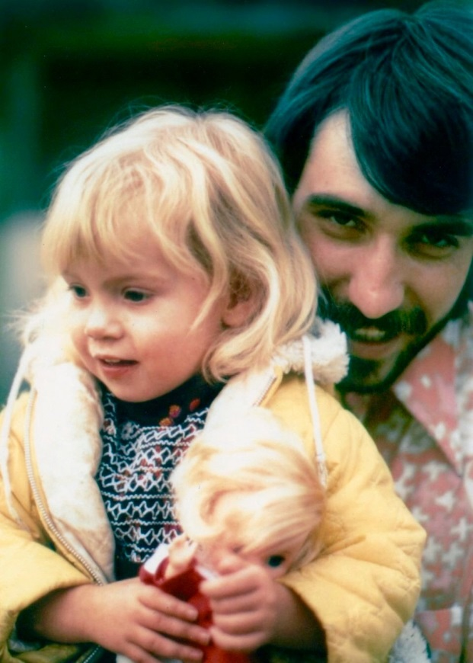
My childhood
I was born in Fontana, CA and grew up primarily in West Covina, CA. My parents divorced when I was a year and a half old and I was raised by my father. My brother who is three years older than I am lived with my biological mother.
This is a photo of my father and me when I was about two.

Slide 3
My family
A little about my family…
My family was not traditional. My parents were very young when my brother and I were born and times were difficult for them. Unfortunately, they were not able to keep the family unit together. I was so young when my parents divorced that I had no memory of my mother and did not “meet” her until I was in my late teens. As a result of this arrangement, I only saw my brother every few years when my grandfather would intervene.
My father was a hard worker but wasn’t able to be as present or as involved in my childhood activities as would have been ideal.
I did not have a female role model to speak of as a young person.
Although my family life was challenging as a young person, my father did teach me a deep sense of ethics and the passion to work hard, so I stayed out of trouble and started working when I was 15 years old.

Slide 4
MY HIGH SCHOOL
I attended West Covina High School

Slide 5
High School
As a HS student I was fairly outgoing and participated in many activities. I had a small but very close group of friends that were much like a surrogate family to me.
During my first three years of HS, I was pretty middle of the road as far as my academics; mostly B’s and C’s. I went to summer school one year to retake Geometry because I did not do well with it during the school year (but got an “A” in summer school!).
At the start of my senior year, my father offered me $100 for every “A” I received at graduation. I got straight A’s in my Senior year, including three electives that I signed up for. I received $1000 at graduation from my Dad (although I think he had to take out a loan to pay me!). This lesson was particularly valuable in a non-monetary way as well; it showed me what I was truly capable of if I applied myself. ☺
Here is a picture of me in HS

Slide 6
High School
Things that I really liked in High School were:
Classes: History, English, Drama and Concert Choir
Competing on the Swim Team.
Working at the local mall with my best friend after school and on the weekends.
Staying out of trouble. My father provided me with a great amount of latitude to make my own decisions so the choice of being a good student and a good person could have just as easily gone the other way. Luckily, my father also showed me that I needed to work hard and particularly as a female, that I needed to be able to provide for myself.

Slide 7
High School
Things that were difficult or challenging for me while I was in High School were:
I did fairly well in all of my studies, so none of my classes (other than Geometry that one year!) were really that difficult.
Bullying – I was sort of the kind of girl that other girls loved to hate; I was athletic, a bit of a Tom Boy, and just wasn’t interested in being a part of any particular “girl group”; I sort of did my own thing and sometimes other girls don’t appreciate that. I also worked so I had a little bit of money and was able to buy myself something nice now and then. I’m sure those girls thought my parents just gave me whatever I wanted…not true! I had to work for it!
Lack of family involvement in my school activities was sad for me. My father was working and my mother wasn’t involved in my life, so I did most things by myself. No one attended my swim meets, plays or concerts.

Slide 8
High School
Jobs I worked while I was in High School were:
Quick Test Opinion Centers – I was one of those annoying people in the mall that would try to get people to participate in a survey!
Waitressing.

Slide 9
Getting in to College
The road to college was a tough one:
I graduated high school when I was 17; that summer my father told me that he was moving to Florida with his new wife. I lived in our family home for one year until it sold. During that year, I attended Mt. San Antonio College and found a job as a teller at a local Credit Union.
Once my father left for Florida, I had to pay for my own housing and everything else along with it. I was only earning $1000 per month and could no longer afford to attend college so I focused on work.
I did well with the credit union; within one year I was promoted to New Accounts. The next year I made it to Operations Officer. By the end of year three, I was 22 years old and promoted to Branch Manager.
At 25 years old, I had made the transition to commercial banking and was an Assistant Vice President for a small business bank. I could finally afford to go to college! I worked full time and attended night school.

Slide 10
College
I attended college at University of Phoenix.

Slide 11
College
Things I enjoyed
in College
Things I didn’t enjoy in College
I attended business school so I really enjoyed the real world setting and group dynamics of working with other professionals.
My study group members were just like me in that they were not able to attend a traditional college either.
Going to school three nights a week after work for four long years!
Paying for college!
Spending all my free time studying.

Slide 12
College
Favorite classes
Least favorite classes
Economics
Sociology
Business Management
Electives – I had to get additional elective credit in order to graduate. I took up SCUBA diving and earned credit for Open Water Diver, Advanced Diver and Rescue Diver Certifications.
Any class having to do with computation math (and I’m a banker!!). ☺

Slide 13
College
Jobs I worked while I was in College were:
I worked full time in banking for a few different business banks.

Slide 14
College
Things that felt difficult or challenging for me while I was in College were:
The time and financial investment. I essentially gave up my twenties because I needed to work and go to school full time. There wasn’t much time or money to just go have fun. I had to really work hard.
The loss of my father; my father died unexpectedly just before I graduated. He wasn’t able to attend most of my activities and events growing up, so his absence at the culminating event of both my educational and professional lives was excruciatingly painful. At the time, I was aware that I was going to graduate with honors but kept it a secret from my dad so that I could surprise him at the ceremony; unfortunately, I wasn’t able to share that accomplishment with him.

Slide 15
Getting a job after College
The top few things I did to ensure I got a good job after college were:
I achieved very good grades in college and graduated with honors – Magna Cum Laude – 3.87 GPA (not that big of a deal today, but it was then!).
I was already doing well with my career, however, my degree helped me earn the title of Vice President.

Slide 16
This is My Company
Every day at my company:
Citizens Business Bank was founded in August 1974 with one branch in Chino, CA. Along the way, and after many years of success and progress, the Bank changed their name from Chino Valley Bank to Citizens Business Bank. Currently, the Bank employs over 800 individuals and is headquartered in Ontario, CA.
Today, CBB is a $8.5BN commercial business bank serving business clients that have annual revenues of up to $200MM throughout the State of California.

Slide 17
My Career Path
AVP and Relationship Manager for a business bank during college.
Teller at a CU and worked my way up to management.
Today, Senior Vice President and Financial Center Manager for CBB.
Notes:
You may use this chart to describe your journey to the current career

Slide 18
My Career
Challenges I have had to overcome throughout my career are:
Having to work the first six years of my career without the benefit of a college degree.
Even after having my degree, I still had to work really hard to prove my value and get ahead.
In many fields, women do not earn as much as men working in the same position; this is true in my world! In my current position however, with a lot of determination I have worked my way up and I do believe that I earn near the same as my male counterparts.

Slide 19
My role within organization
CEO
EVP of Sales
SVP,
Regional Manager
ME
SVP,
Financial Center Manager
Notes:
Use this graph to give more description of your role specifically (responsibilities, typical work week, direct reports, etc.)

Slide 20
Compensation at my company
President and Executive Vice Presidents
($500K - $1M)
Senior Vice Presidents
($175K - $400K)
AVP & Vice Presidents
($100K - $175K)
Entry Level to Non-Officer Positions
($40K - $75K)
Notes:
Use this graph to show general compensation ranges for people in various roles in your company

Slide 21
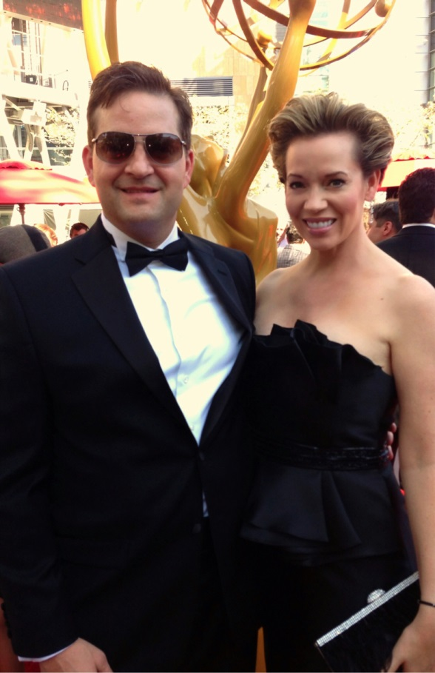
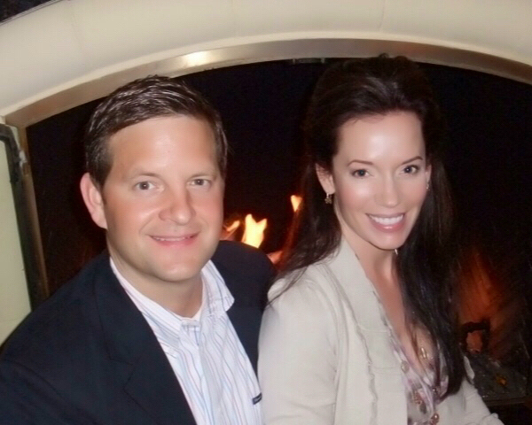
My Family Today
I have been with my partner, Adam, for over ten years.

Slide 22
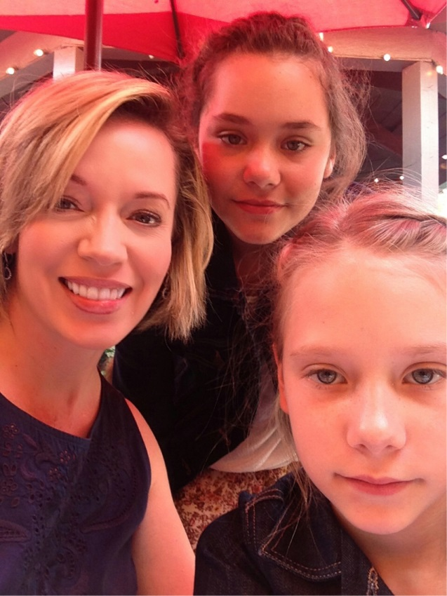
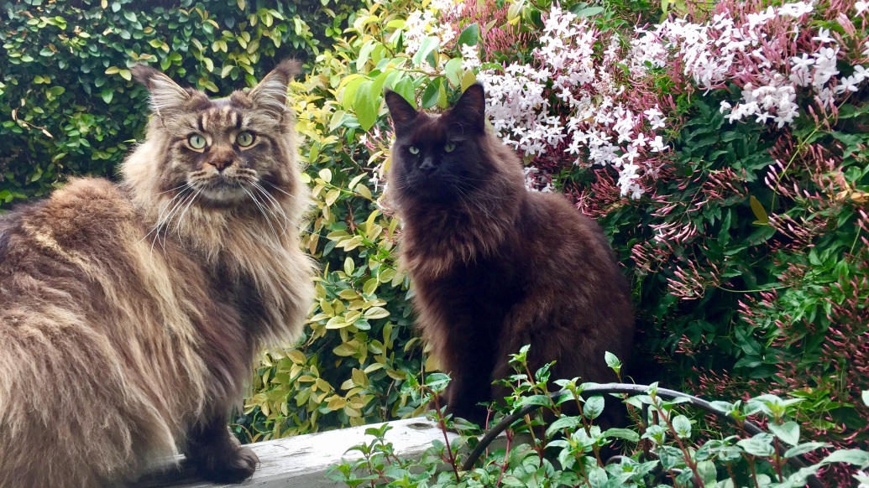
My Family
In lieu of children, I have two Maine Coon cats and two beautiful nieces (and many nieces and nephews from Adam’s side of the family!).

Slide 23
Do it all over again?
If I could talk to my high school self, what would I say?
Don’t be so hard on yourself and take everything so seriously.
Be present.
Value yourself and your accomplishments even if no one else sees what you have done.
Find your voice.
Look up!

Slide 24
QUESTION AND ANSWER

