Slide 1
NOVEMBER 2017
YOUTH BUSINESS
ALLIANCE

Slide 2
Agenda
Backstory
Career Summary
Career Journey
Typical Day for Me
Examples of Work
Q&A

Slide 3
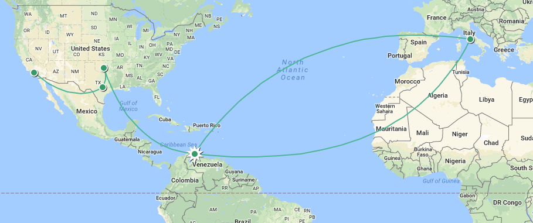
BACKSTORY – WALTER PESENTI
2
6
4
5
3
1
1
Punto Fijo, Venezuela → Born from Italian parents
2
Rome, Italy → Travel with aunt until the age of 8
3
Punto Fijo, Venezuela → School, petroleum technical school
4
Norman, Oklahoma → Arrived in 1980 to learn English and study
5
Austin, Texas → Opened two Italian restaurants at the age of 22
6
Los Angeles, California → Arrived in 1985. Worked, attended school, married Rosa in 1989 (retired executive from XEROX and currently Executive Board director at Boys and Girls Club), and had Alex in 1995 (graduating from Cal-Poly Pomona this year with BS in agricultural science).

Slide 4
CAREER SUMMARY – WALTER PESENTI
A 30-year record of successful business management and manufacturing experience with strengths in management consultancy, strategy, operational excellence, finance, performance improvement, operations, asset management, engineering and capital projects at oil, gas, and chemicals facilities worldwide.
Root-cause analysis and corrective action implementation for many end-to-end transformations, which have resulted in reducing risk exposure and savings ranging from $50 million per year up to $1,400 million per year.
First-hand experience in management and budgetary responsibility for projects to include capital projects, turnarounds, operations, and maintenance in excess of $2,300 million.
Experience developing, implementing, and managing Operations Integrity Management System and Global Reliability System at two global integrated oil companies.
EDUCATION
Executive MBA and BS, Business Administration, Pepperdine University
BS, Industrial Engineering, University of California, Los Angeles
LANGUAGES
Italian
Spanish
English
MANAGING DIRECTOR/
PARTNER
OIL, GAS, AND PETROCHEMICALS
CAPITAL PROJECTS AND OPERATIONAL EXCELLENCE GLOBAL LEAD

Slide 5
CAREER JOURNEY – WALTER PESENTI
KEY LEARNINGS
IT IS ALL ABOUT EFFECTIVELY AND EFFICIENTLY DELIVERING VALUE (MONETARY AND NON-MONETARY) TO CLIENTS
CLEAR VISION OF WANTING TO HAVE A CAREER IN OIL AND GAS
TECHNICAL LEARNING
GENERAL BUSINESS EXPERIENCE
EDUCATION
ENERGY-SPECIFIC EXPERIENCE
ADVISORY EXPERIENCE
16–17 years-old
Now
TIME

Slide 6
TYPICAL DAY – WALTER PESENTI
Prepare for client calls
Client calls
Plan or deliver work at client
Implement work
Schedule client calls and/or delivery meetings
Plan next-day work
Prepare delivery material and respond to emails
Research and/or read news and/or technical information
Sometimes calls with Europe
(afternoon their time)
Sometime calls with Asia Pacific
(morning their time)
5:00– 6:00 a.m.
6:00– 7:00 a.m.
8:00– 9:00 p.m.
9:00– 11:00 p.m.
TIME
Typical day

Slide 7
OPERATIONS AND DIGITAL TRANSFORMATION
A Major Integrated Energy Company in North America
THE SETTING
KEY GOALS
KEY Successes
Multiyear enterprise transformation program operations, maintenance, supply chain, finance, human resources, and information management
Operating model redesign
Process alignment
Technology integration
Stakeholder engagement
Solution development through assessment and analysis
Alignment on priorities and gaps
Leverage BPM library
Change management as integral component
Extensive coaching
Clear metrics and framework
Benefits captured
Sustainability reviews
Simplified master data integration and more accurate master data
Process accountabilities with defined cadence
Improved reliability (~5 point increase in utilization) through more effective planned maintenance, reliability analysis, and equipment strategy execution
Effective controls through improved management to enhance security and minimize schedule and cost overruns
OUTCOME
Stable maintenance execution at lower cost (~30% reduction in OPEX)

Slide 8
OPERATIONS AND DIGITAL TRANSFORMATION
A Major Integrated Energy Company in North America
Benefits
Stable maintenance execution at lower cost (~30% reduction in OPEX)
= $ 1.2 to $1.4 billion/year

Slide 9
OPERATIONAL AND DIGITAL TRANSFORMATION
Leading Global Refining and Chemical Company
THE SETTING
KEY GOALS
KEY Successes
Need for a globally consistent operating model to leverage a shared service model
Project included operating model definition, business process optimization, and pilot activities across supply chain, product lifecycle management, engineering data management, and maintenance
Work process assessment: 6+ years of work history and cost performance analysis
Design and development of SAP-based solutions required to enable process changes
Organizational maturity assessment
Pilot test of new organization model
Organization, process, and technical improvements were endorsed across refining and chemicals
Solution delivered integrated environment, allowing for simplified processes across the core business such as procurement, product development, and engineering data management
Capabilities delivered will enable company to achieve and exceed cost-reduction targets while positioning organization for continued growth
OUTCOME
~ 50% return on investment

Slide 10
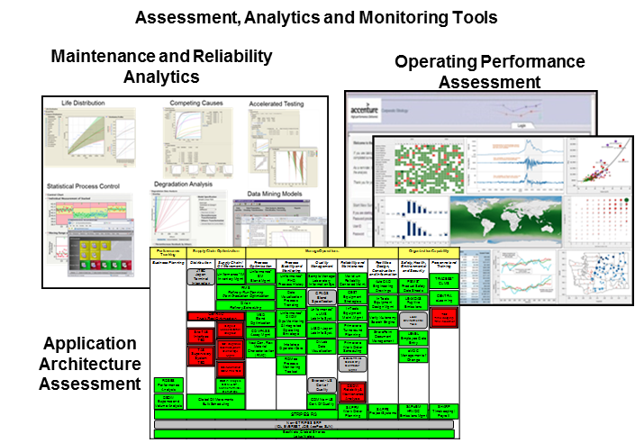
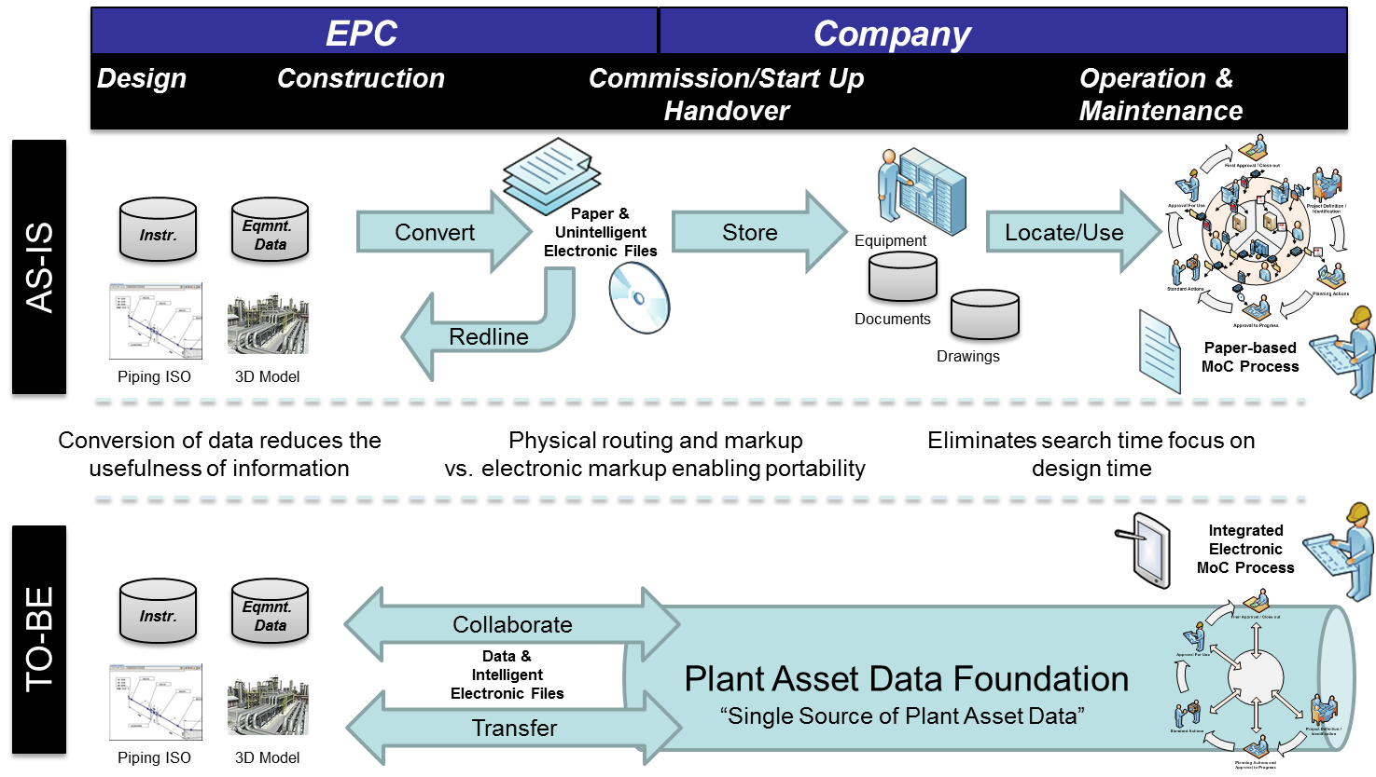
OPERATIONAL AND DIGITAL TRANSFORMATION
Leading Global Refining and Chemical Company
Engineering Data Management
Benefits
Program has been established with each member project having an expected return of more than 50%
= $ 650 to $700 million/year

Slide 11
VISIONING DIGITAL FOR FUTURE OF MANUFACTURING
Large Integrated Oil Company - Manufacturing Future State
THE GOAL
The VISION
Real-time access to consolidated information on the field and at the office, together with a global collaboration platform, will empower high-graded manufacturing personnel and enable centralized technical, engineering, and operations support
Common portal aggregates information from multiple systems/data sources
Centralized functional support centers leverage enhanced access to information to increase efficiency and effectiveness
Regional support centers for Operations provide monitoring and offload the control centers
Global center provides back-office Engineering support and development
Common mobile platform for Operations, Maintenance, Engineering, enabled by full-plant WiFi deployment
Deployment of a Universal Field device:
Simplified interface for data entry
Access to work schedule and critical procedures/drawings/documents
Ability to focus on operator-driven diagnostics and troubleshooting, allowing for rich diagnostic/as-found info capture
Global platform for information and knowledge preservation
Console operators and planners high graded
One-stop shop for reporting and stewardship

Slide 12
Q & A

Slide 13
WWW.THINKBRG.COM

