Slide 1
INTRODUCTION
My name is William (Bill) Jones and I am 42 years old.
I work for Citizens Business Bank (CBB).
CBB is the largest financial institution headquartered in the Inland Empire region of California. The Bank has $8 billion in assets and 52 branches throughout the state.
My role at Citizens Business Bank is the Chief Appraiser and Vice President
Every day I administer all of the Bank’s Appraisal activities for commercial and residential real estate. Citizens Business Bank make loans secured by homes, farms and dairies, and commercial/investment properties .

Slide 2
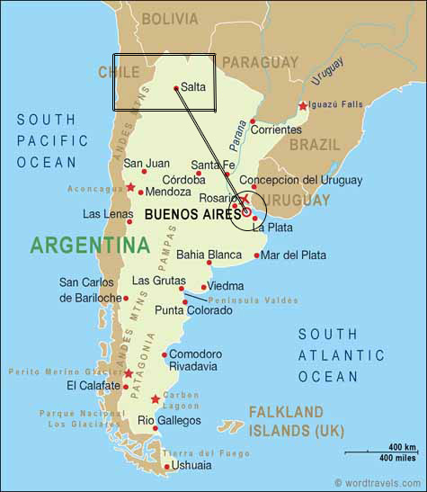
My childhood
I was born in a city called Salta, in Salta Province, Argentina and moved to the United States when I was 13 years old.

Slide 3
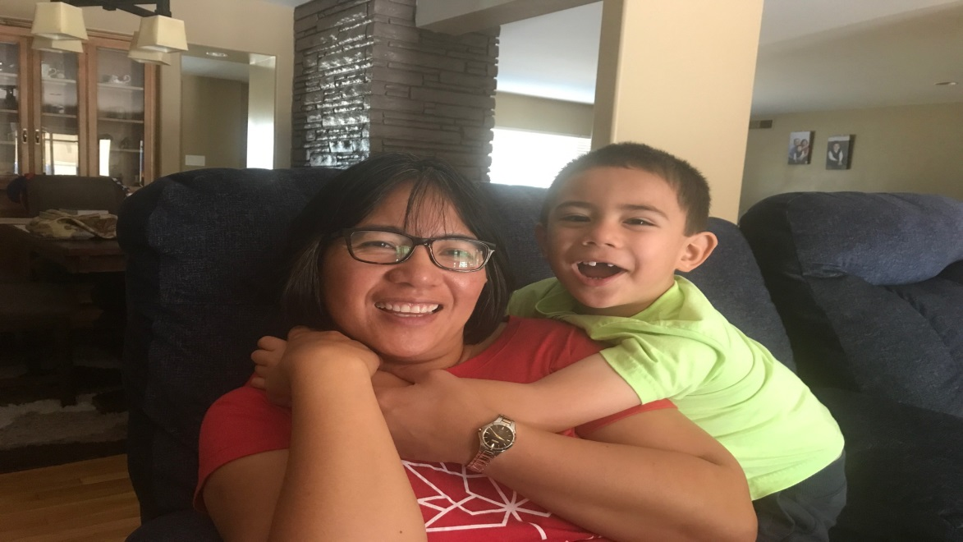
My family
A little about my family…
My parents lived in Argentina for about 25 years. Both were born in the United States. I am the youngest of three children. I grew up learning Spanish and English at the same time. I have been happily married to Juliet for five years and we have a little boy named Samuel (Sammy)
Juliet and Sammy

Slide 4
MY HIGH SCHOOL
I attended La Mirada High School in La Mirada, California – won’t tell you when I graduated

Slide 5
High School
As a HS student I was involved in band for two years but I became very interested in speech and debate, and that is what I enjoyed most about high school. I learned to speak in front of people and to get organized before speaking. Unfortunately I do not always do that! I played tennis but I wasn’t very good at it. ……………………………………………………………….

Slide 6
High School
Jobs I worked while I was in High School were:
I didn’t have any jobs during high school but I occasionally did chores for money.
The summer after I graduated High School, I got a job working for a trucking school in the office. The school taught people how to drive big trucks and of course charged them for it. We would run commercials on television and after the commercials ran we would get a lot of phone calls. This was back in the day before computers and web sites…

Slide 7
Getting in to College
The top few things I did to ensure I got into college were:
Studied hard – but not as consistently as I should have. Some subjects were interesting – like History, English, and Speech and Debate – but some I did not care for as much like Chemistry and Trigonometry.
I went to class every day. I would have had a hard time with my parents had I not gone!
I took one AP class so I could get college credit – but my college did not give me credit for it! AP Classes are great!
I took my SAT and applied to a college that I really wanted to go to. It was in California. I thought of leaving the state – but I ended up staying local. If you get into a good school it can be worth it to travel – see a little more of the world that way!

Slide 8
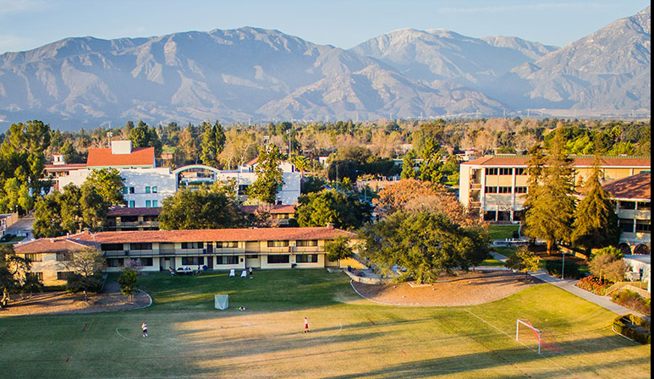
College
I attended Claremont McKenna College and graduated with a degree in International Management.

Slide 9
College
Things I enjoyed
in College
Things I didn’t enjoy in College
Exploring interesting subjects
Showing old movies to film classes
Spending time in the “Village” area of Claremont
Libraries and free time
Making new friends
Paying for college
Staying up late to finish term papers

Slide 10
College
Favorite classes
Least favorite classes
International Politics
History
Microeconomics
Religion
Mathematics
General Science
Russian!

Slide 11
College
Jobs I worked while I was in College were:
I tutored Spanish for students taking introductory Spanish
I had a great internship at Atlantic Richfield Company, which was the parent company of ARCO. Today ARCO is owned by someone else and Atlantic Richfield Company no longer exists. In the summer it turned into a full time job with good pay. I worked on State and Local Government issues.
I showed movies – this was when videos were just coming out and a lot of movies were still shown on big reels.

Slide 12
College
Things that felt difficult or challenging for me while I was in College were:
I felt a little out of touch with my peers. I had spent a lot of my childhood outside the United States, and my parents were not as well off as the parents of some other students.
The cost of college was stressful – even though I got scholarships/grants and borrowed a small amount of money I worried about paying for it.

Slide 13
Getting a job after College
The top few things I did to ensure I got a good job after college were:
I went to every class
I earned the best grades I could
I utilized the career center to land an internship which led to my first job after graduation

Slide 14
This is My Company
Every day at my company:
Citizens Business Bank started in August 1974 with one branch in Chino, CA. Along the way, and after many years of success and progress, the Bank changed their name from Chino Valley Bank to Citizens Business Bank. Currently, the Bank employs over 800 individuals and is headquartered in Ontario, CA.
I work with many account officers inside the bank and appraisers and environmental experts outside the Bank. Much of my work is coordinating the flow of information, answering questions, and ensuring that work gets done in a timely, professional manner.

Slide 15
My Career Path
I became and appraiser and worked in the Appraisal Group with CB Commercial in Downtown L.A.
I started out as a trainee at Coldwell Banker in Downtown Los Angeles
I became an Appraisal Manager at a bank in Pasadena
I became a Chief Appraiser for a Taiwanese owned bank in Chinatown
I became Chief Appraiser at Citizens Business Bank in Ontario
Notes:
You may use this chart to describe your journey to the current career

Slide 16
My Career
The first job I had after college was:
I worked for the Veterans Administration as a “temp” in their distribution warehouse in Commerce. My work involved coordinating the flow of paperwork between the warehouse and field offices. Job market was very tight when I got out of college.
The worst job I have ever had was:
Just after college I worked at a Department Store. It’s not a bad job at all, but it was not a good fit for me.

Slide 17
My Career
Challenges I have had to overcome throughout my career are:
I am not a “people person” – knowing how to network/interact with people is a vital skill for job success. I have friends that are very good at it – I’ m not ☹
I was laid off a few times. One time was when the Bank I was working for went broke and was taken over by the Federal Government. Another time was when the company I was working for got sold. The second layoff was great because I got very good severance!!!
Dealing with people who don’t understand my work – or don’t like it when I do my job, as it means saying “No” to people a good amount of the time.

Slide 18
My role within organization
CEO
Lending Compliance Mgr. & EVP/Chief Risk Officer
ME
Notes:
Use this graph to give more description of your role specifically (responsibilities, typical work week, direct reports, etc.)

Slide 19
Compensation at my company
President and Executive Vice Presidents
($500K - $1M)
Senior Vice Presidents
($250K - $400K)
Vice Presidents
($100K - $200K)
Entry Level to Non-Officer Positions
($40K - $75K)
Notes:
Use this graph to show general compensation ranges for people in various roles in your company

Slide 20
More than just work
When I am not at work I like to:
Spend time with my wife and child
Spend time with extended family
Read
Travel (this year – Canada and Mexico)

Slide 21
Do it all over again?
If I could talk to my high school self, what would I say?
If you really want to do it, do it now. Don’t wait for “someday.”
Where you start is not where you’ll end up.
Be more involved in sports.
Reach out to people more.
Take more risks – sometimes doing uncomfortable things is good for you.
Develop good habits – stay away from bad ones!

Slide 22
QUESTION AND ANSWER

