Slide 1
What you sow, you shall reap
PRESENTED BY: Elvis Huerta

Slide 2
ROAD TO A SOLID FOUNDATION
Notes:
3 kids = generate all these kids

Slide 3
PERSISTENCE
Notes:
3 kids = generate all these kids

Slide 4
What you sow, you shall reap
PRESENTED BY: Elvis Huerta
Real Estate Consultant

Slide 5
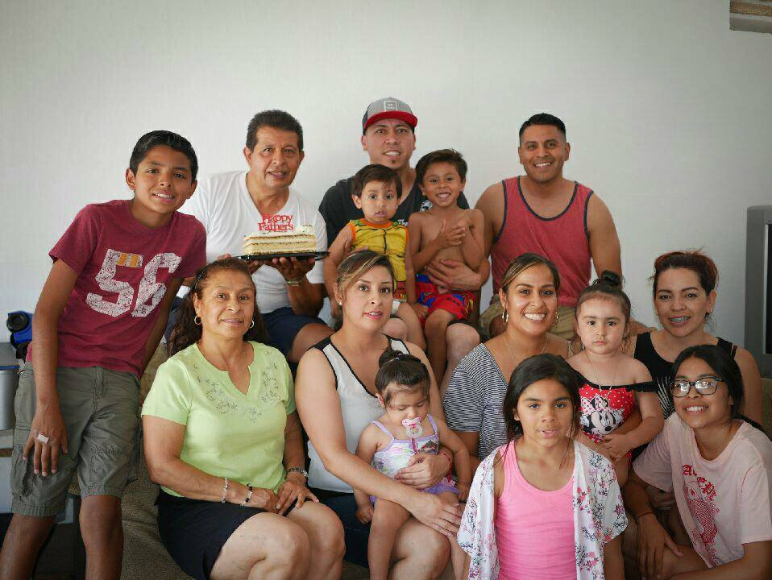
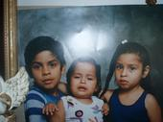
BACKGROUND
Notes:
3 kids = generate all these kids

Slide 6
BACKGROUND
Notes:
One of my favorite pictures. 2012

Slide 7
BACKGROUND

Slide 8
BACKGROUND

Slide 9
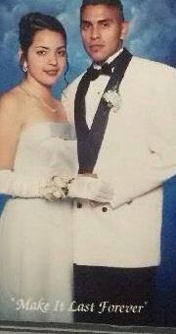
BACKGROUND
Notes:
Prom … all boys school

Slide 10
BACKGROUND
How Many Think I Married My
High School Sweetheart?
Notes:
Prom … all boys school

Slide 11
BACKGROUND
Notes:
pregnancy

Slide 12
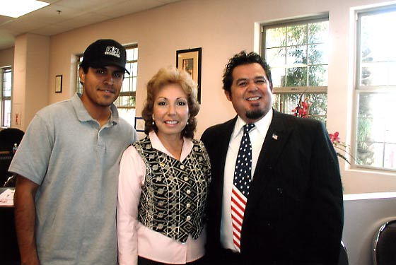
BACKGROUND
2005 @ 25years of age
Notes:
Who knows what a staffing agency is?

Slide 13
BACKGROUND
Businesses
Aver Business Management
ilink Management
ilink Business Management
SmartHire Employee
Management
Notes:
34 had 4 start up build
Last one LIFE CHANGED

Slide 14
BACKGROUND
Hobbies
Soccer

Slide 15
BACKGROUND
Favorite Activities
Soccer
DudesGotta - YouTube

Slide 16
BACKGROUND
Hobbies
Soccer
DudesGotta
Family Time

Slide 17
career

Slide 18
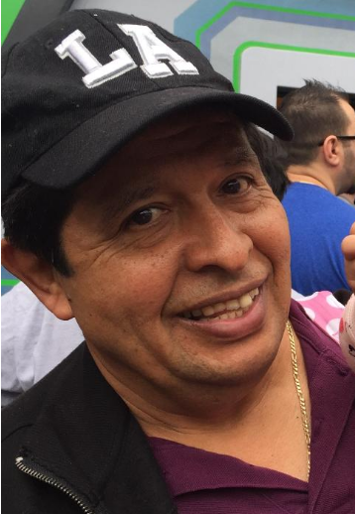
Career
DAD
ROMAN MEZA

Slide 19
Career
Real Estate

Slide 20
Career
Real Estate
Habits & Routines
Notes:
Role Play
Get on the phones and call until 2pm
Lunch
Door Knock 3-6
6-8 phones and follow up

Slide 21
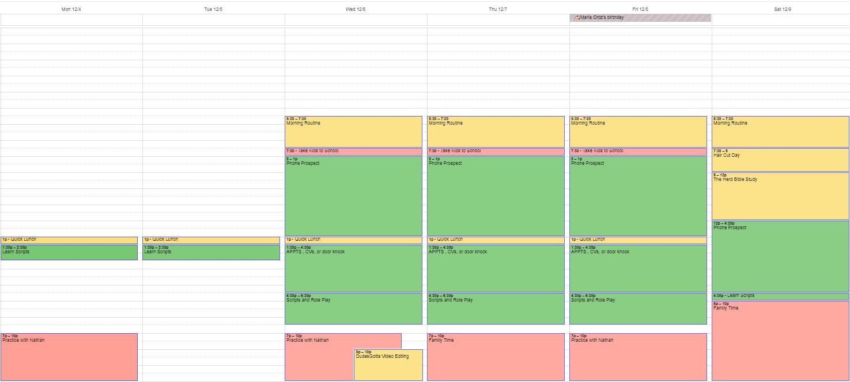
Career
Real Estate
Notes:
Role Play
Get on the phones and call until 2pm
Door Knock 3-6pm
Phones 6-8pm
Sacrifice Family Time

Slide 22
What is prospecting?

Slide 23
What is prospecting?

Slide 24
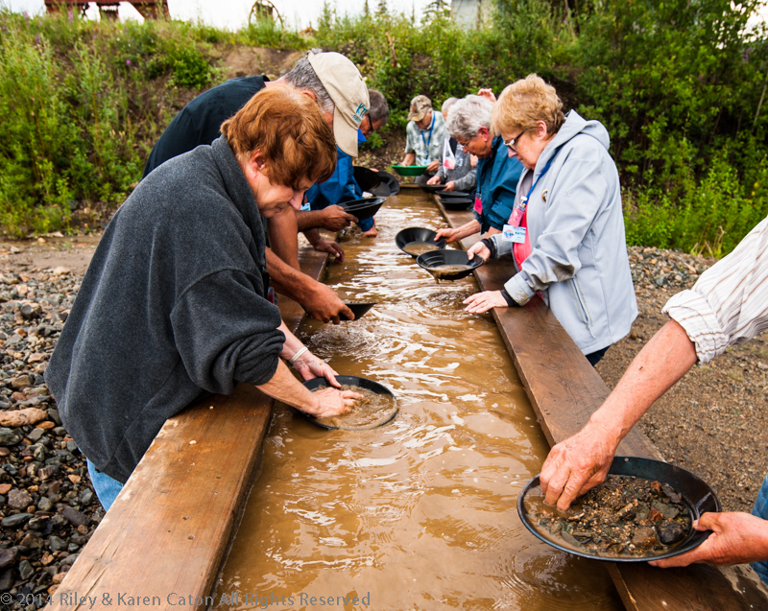
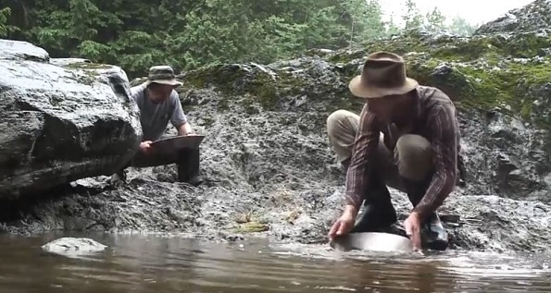
Career
Real Estate
Notes:
Looking for gold
Its long, painful. Not selling chocolates
Biggest Challenge: REJECTION ALL DAY LONG

Slide 25
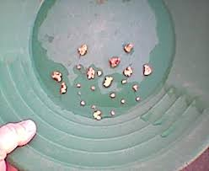
Career
Real Estate
Notes:
Once we get someone that would like to sell or buy, we struck gold!

Slide 26
Career
Real Estate
Skills to Excel
1. Good writing and speaking skills
2. Desire to serve
3. Hard work
4. Imagination, heart, passion

Slide 27
Career
Real Estate
A Day in My Life
VIDEO
Notes:
Role Play
Get on the phones and call until 2pm
Lunch
Door Knock 3-6
6-8 phones and follow up

Slide 28
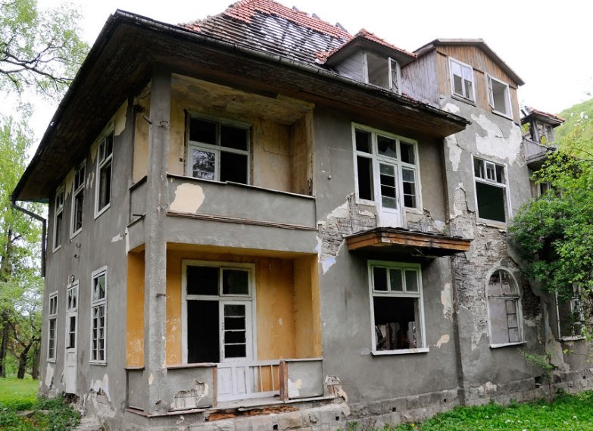
Career
Real Estate
Notes:
END IN MIND: Help Families in Selling and Buying homes

Slide 29
Career
Real Estate
Notes:
END IN MIND: Help Families in Selling and Buying homes

Slide 30
Why keep the end in mind?

Slide 31
Career
Real Estate
Notes:
In everything that you do…….
Sniper mentality
Focus + targeted actions = end result
Cut up Gym People

Slide 32
So why talk about target and focus?

Slide 33
In order for me to obtain this ….

Slide 34
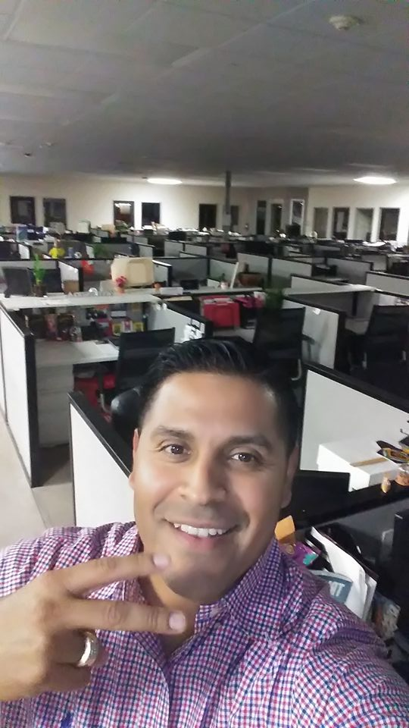
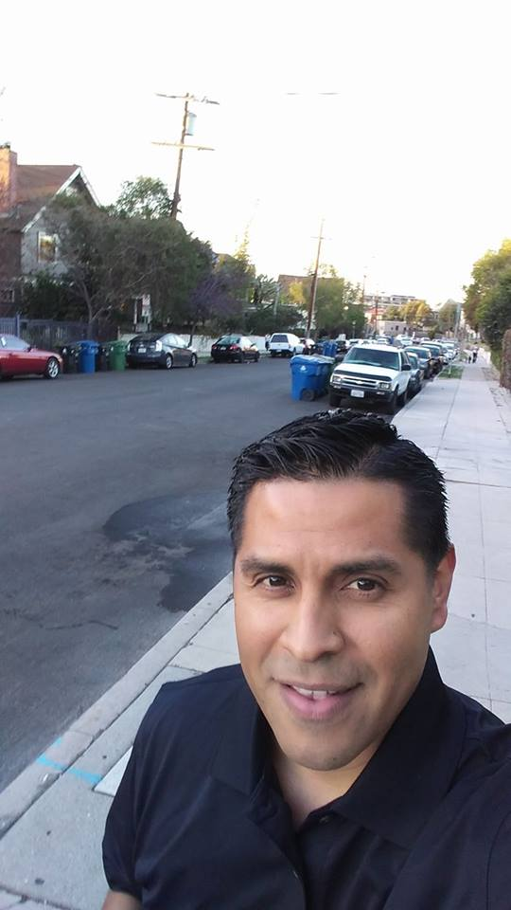
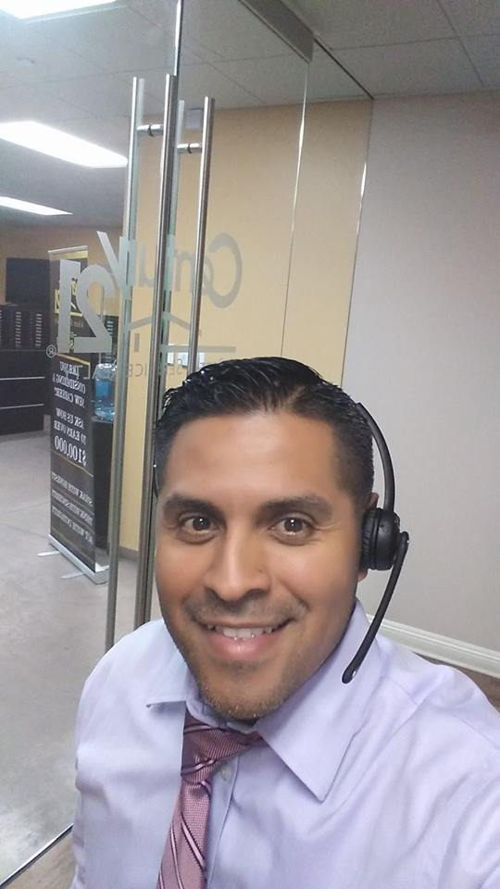
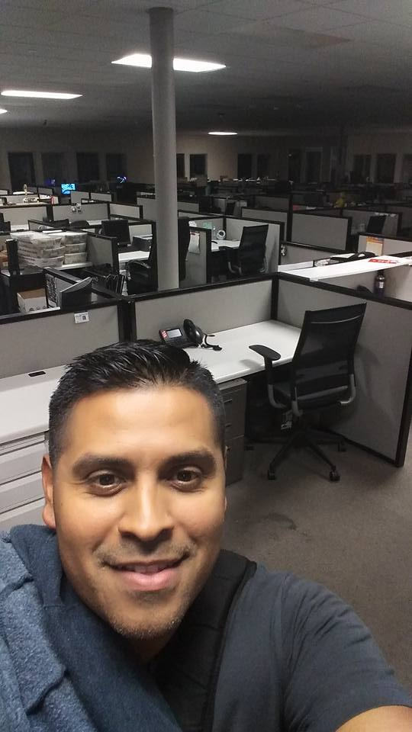
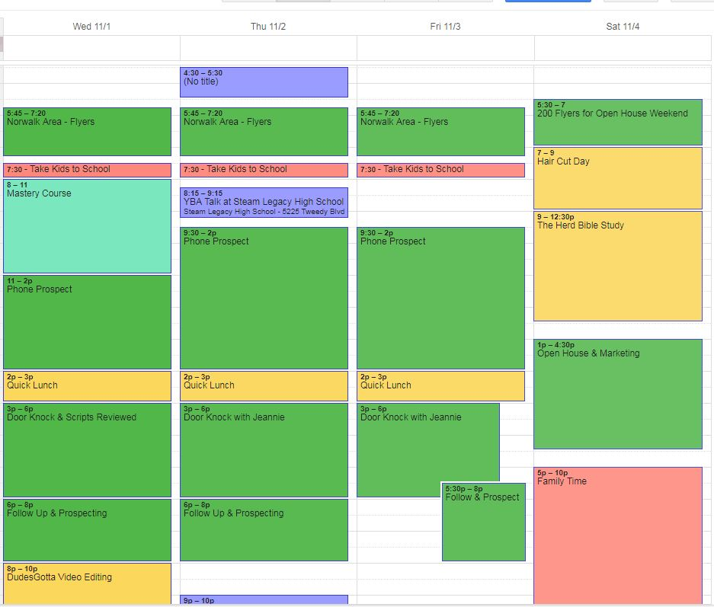
I need to do all this ….
Notes:
Focused Actions Specially at the beginning

Slide 35
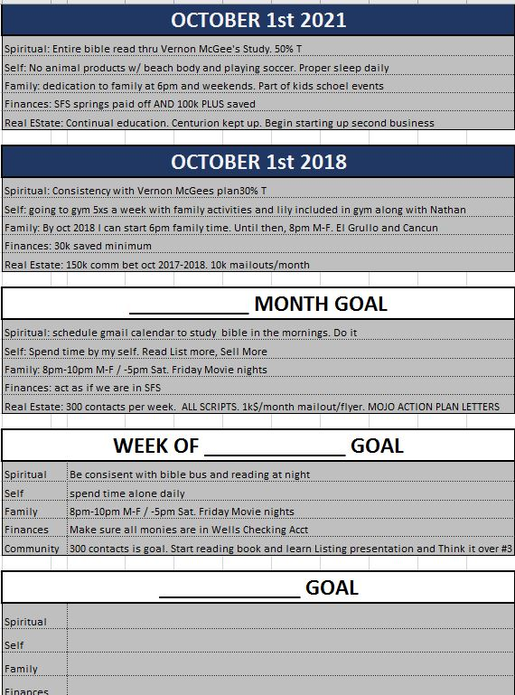
Notes:
GOALS

Slide 36
What happens when you don’t have a plan to reach your vision, Vision, or focus?

Slide 37
Notes:
Life takes you like the wind

Slide 38
Vision needs To be:

Slide 39
remember this ….
Notes:
What you put in, it what you will get out
What you sow is what you will reap.

Slide 40
activity

Slide 41
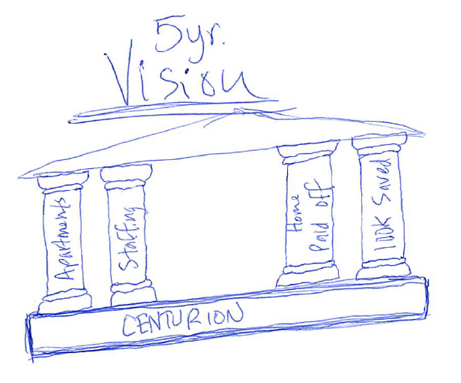

Slide 42
Final Note

Slide 43
Questions

Slide 44
Thank you
ELVIS HUERTA
REAL ESTATE CONSULTANT

