Slide 1
INTRODUCTION
My name is Michael Spinelli and I am 42 years old.
I work for Citizens Business Bank (CBB).
CBB is the largest financial institution headquartered in the Inland Empire region of California. The Bank has $8 billion in assets and 52 branches throughout the state.
My role at Citizens Business Bank is the RM Officer and
Vice President
Some of the key areas of activity in my position consist of; Making calls, schedule visits with prospects, mailing or emailing info to existing business owners, develop new opportunities through my network which includes CPA’s and brokers and network events through communities my bank serves. We provide services that businesses may need to grow or improve.

Slide 2
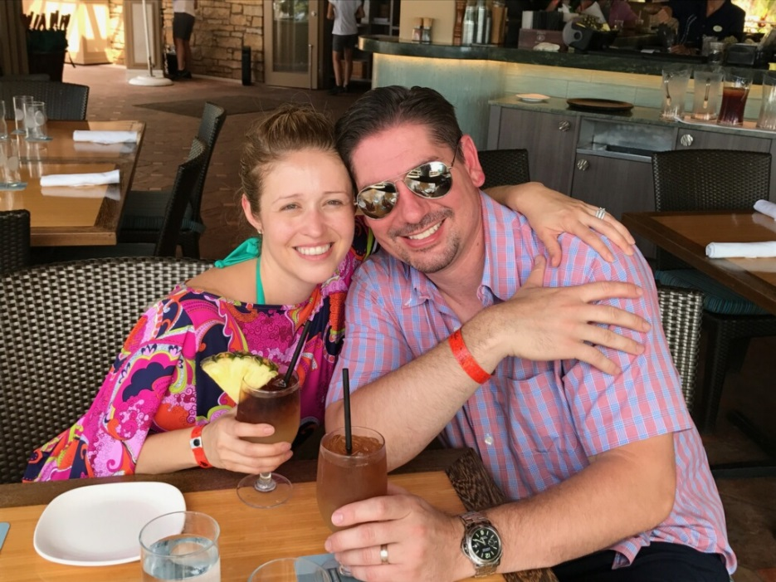
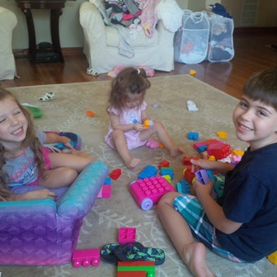
My Family
I was born in Long Beach, CA and grew up in Seal Beach, CA which is approximate 20 miles southeast of downtown L.A. I have a beautiful wife and three amazing children.

Slide 3
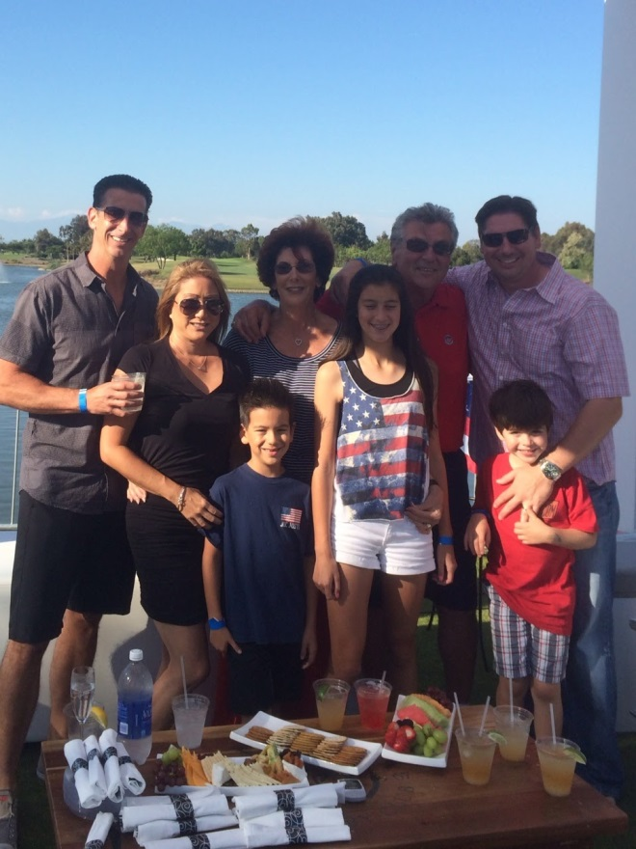
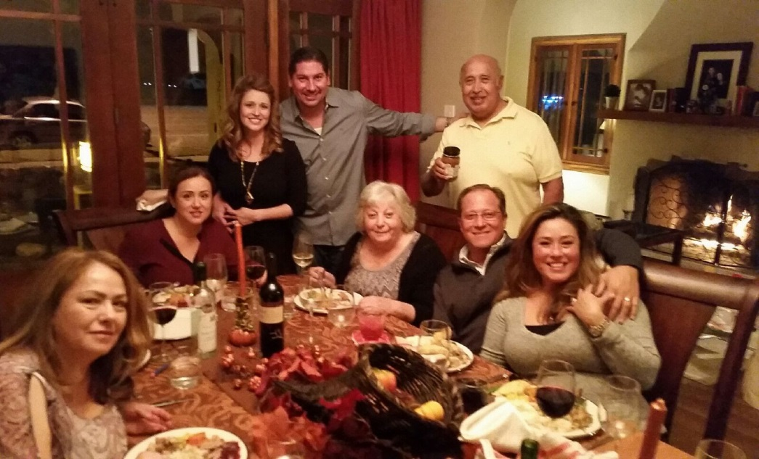
My family
A little about my family…
My parents and my siblings and I were born here in the U.S. My wife is 100% hispanic and was also born here. My wife’s mom was born in Aguas Calientes, Mexico and my wife’s dad was born in Zacatecas, Mexico.

Slide 4
MY HIGH SCHOOL
I attended Los Alamitos High School in Los Alamitos, CA.

Slide 5
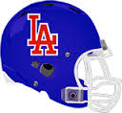
High School
As a high school student I was very social. I loved sports and I made the high school football, and track teams. Great way of meeting new friends. ……………………………………………………………….

Slide 6
High School
Things that I really liked in High School were:
Classes: Math, Science, Music;
Playing sports with new friends and competing;
I wasn’t involved in any clubs or other school activities which I now regret as I now love these types of activities as an adult.
Staying out of trouble. My parents made sure that I followed the rules, both at home and at school. Sports really kept me busy and out of trouble. I think when I did get in trouble it was because my friends and I really didn’t think things through at the time. My teachers and counselors always made sure to call my parents and had open lines of communication. I always got caught, was not good at it or lying.

Slide 7
High School
Things that were difficult or challenging for me while I was in High School were:
English, writing;
Making friends with the wrong crowds – I got into a fight or two but I mostly tried to avoid them. At times I felt like I was trying to be someone I was not;
Regret not making different kind of friends outside my circle of friends or activities;
Speaking in Public or having all the attention at the moment, like winning an award and having to walk up to some stage.

Slide 8
Getting in to College
The top few things I did to ensure I continue my education:
Applied to a few different colleges (U of A, San Diego State, Cal State Long Beach.
Was accepted and attended the University of Arizona in Tucson, AZ.
I made sure I kept my visits with my Counselors to stay on track.
Like many of you, I didn’t know what I wanted to do. So I kept going to school.

Slide 9
College
Things I enjoyed
in College
Things I didn’t enjoy in College
Making new friends
Playing Sports and working out at School gym
Exploring the campus and surrounding areas close to school
Free time
Studying for mid-term and final examinations
Staying up late to finish term papers or homework

Slide 10
College
Favorite classes
Least favorite classes
Math
Economics
Astronomy
Science
Accounting
Writing
English
History
Communications

Slide 11
Getting a job after College
The top few things I did to ensure I got a good job after college were:
Continue to improve my network and experiences.
Learn through my experiences and stay in touch with key influential people.
I utilized family and friends to help get me into better paying jobs.
I knew I enjoyed math and finance, and interacting with people. At this point I wanted to be either a stock broker or somehow get into investment banking.

Slide 12
This is My Company
Every day at my company:
Citizens Business Bank started in August 1974 with one branch in Chino, CA. Along the way, and after many years of success and progress, the Bank changed their name from Chino Valley Bank to Citizens Business Bank. Currently, the Bank employs over 800 individuals and is headquartered in Ontario, CA.
I work with many Business Owners and local community groups to ensure that we offer, educate and expand our Banking Services and relationships that we serve. In addition, my job is to provide new loans, deposits and services to Business Owners within our state of California and build new relationships for our bank.

Slide 13
My role within organization
CEO
SVP CM
EVP SDM
RM VP
SVP RM
Notes:
Use this graph to give more description of your role specifically (responsibilities, typical work week, direct reports, etc.)

Slide 14
Compensation at my company
President and Executive Vice Presidents
($500K - $1M)
Senior Vice Presidents
($250K - $400K)
Vice Presidents
($100K - $200K)
Entry Level to Non-Officer Positions
($40K - $75K)
Notes:
Use this graph to show general compensation ranges for people in various roles in your company

Slide 15
More than just work
When I am not at work I like to:
Spend time with my wife and kids.
Spend time with my parents.
Hang out with friends.
Play golf, work out.
Hiking.
Cooking.
HAVE FUN

Slide 16
Do it all over again?
If I could talk to my high school self, what would I say?
Realize that life is more than just the here and now. Take an eternal perspective of yourself and the people you meet.
Make new friends, outside my circle.
Be more involved in activities like clubs and sports.
Expand your horizons by trying different activities will lead to personal growth, meeting new people and travel.
Learn to enjoy each moment no matter where you are at.
Continue to make goals and take steps to achieve them. However, also take time to enjoy the path to each goal and reward yourself no matter how small the accomplishment.
Staying away from drugs, tobacco and alcohol.

Slide 17
QUESTION AND ANSWER

