Slide 1
INTRODUCTION
My name is David Fierro and I am 46 years old.
I work for Citizens Business Bank (CBB).
CBB is the largest financial institution headquartered in the Inland Empire region of California. The Bank has $8 billion in assets and 52 branches throughout the state.
My role at Citizens Business Bank is the RM Officer and
Vice President
Some of the key areas of activity in my position consist of; Making calls, schedule visits with Prospects, mailing or emailing info to existing Business owners, develop new Opportunities through my network which includes CPA’s and Brokers and Network events through Communities my Bank serves. We provide services that businesses may need to grow or improve.

Slide 2
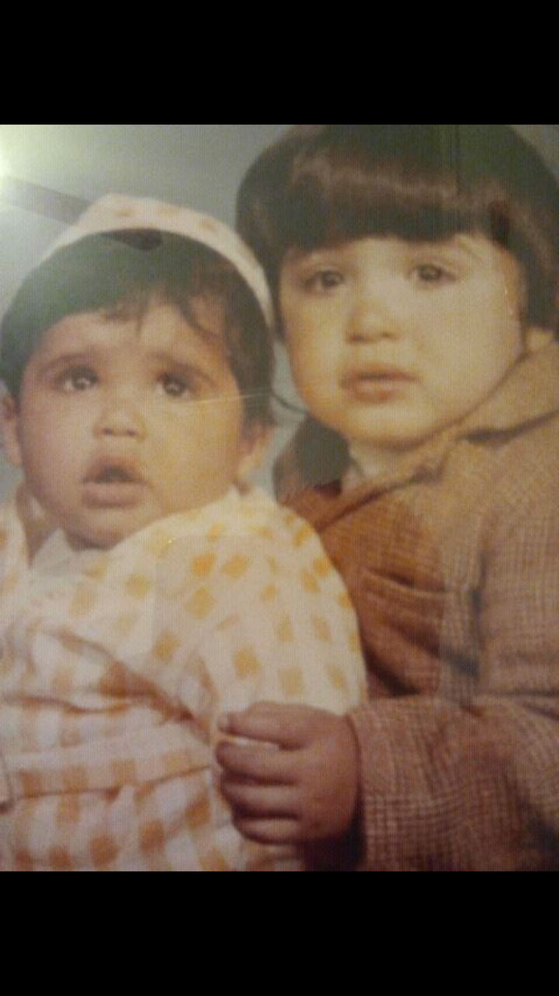
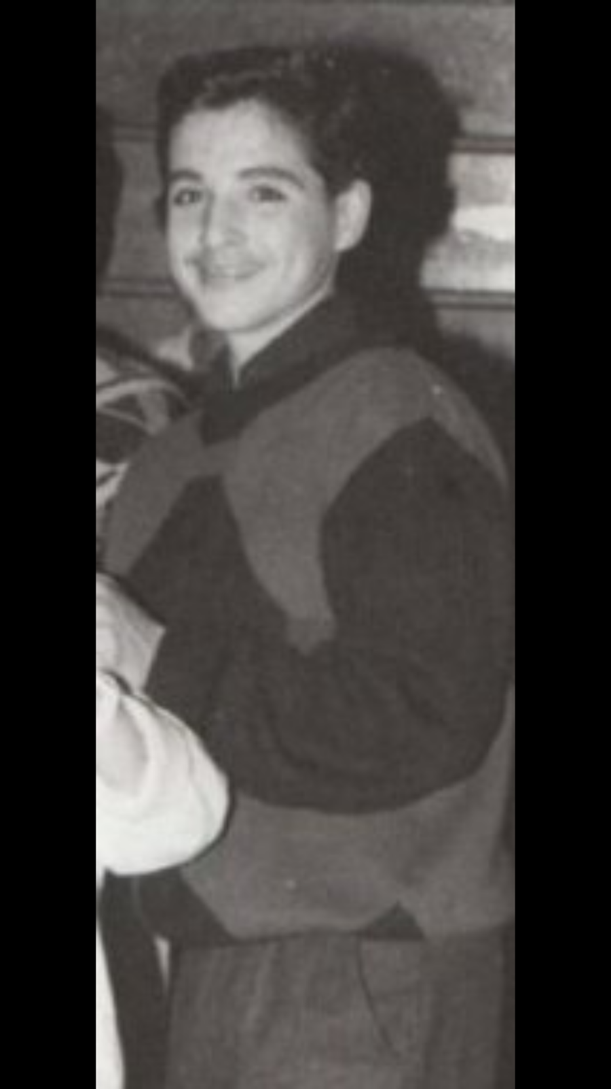
My childhood
I was born in Los Angeles and grew up in South Gate, CA which is approximate 7 miles southeast of downtown L. A. I have 2 brothers Peter 44 and Michael 31
The Picture on the left is with Peter and the picture on the right I must be in middle school at a dance.

Slide 3
My family
A little about my family…
My brothers and I were born here in the U.S. My mom was born in Colombia and my dad was born in Mexico. I grew up speaking Spanish at home and English at school. I have two beautiful children.
The picture on the left is me and my two kids celebrating my b-day. Alyssa and Izaiah. Picture on the right are my parents Peter and Gloria, trip to Colombia.

Slide 4
MY HIGH SCHOOL
I attended Downey High School in Downey, CA

Slide 5
High School
As a HS student I was very social. I loved sports and I made the High School Football, Baseball and Basketball Teams. Great way of meeting new friends. ……………………………………………………………….

Slide 6
High School
Things that I really liked in High School were:
Classes: History, Spanish, Drama and Physical Education
Playing sports with new friends and competing
I wasn’t involved in any clubs or other school activities which I now regret as I now love these types of activities as an adult.
Staying out of trouble. My parents made sure that I followed the rules, both at home and at school. Sports really kept me busy and out of trouble. I think when I did get in trouble it was because my friends and I really didn’t think things through at the time. My teachers and counselors always made sure to call my parents and had open lines of communication. I always got caught, was not good at it or lying.

Slide 7
High School
Things that were difficult or challenging for me while I was in High School were:
Math
Making friends with the wrong crowds – I got into a fight or two but I mostly tried to avoid them. At times I felt like I was trying to be someone I was not.
Regret not making different kind of friends outside my circle of friends or activities.
Speaking in Public or having all the attention at the moment, like winning an award and having to walk up to some stage.

Slide 8
High School
Jobs I worked while I was in High School were:
Construction with my Uncle in the Summers between sports.
K Mart in the footwear department close to my parents house.
Downey Pizza Company close to my High School.

Slide 9
Getting in to College
The top few things I did to ensure I continue my education:
Enrolled myself into Cerritos College close to my parents house.
My grades needed improvement if I wanted to continue my education and pick a Career.
I made sure I kept my visits with my Counselors to stay on track.
Like many of you, I didn’t know what I wanted to do. So I kept going to school.

Slide 10
College
I attended Cerritos College in Norwalk, CA

Slide 11
College
Things I enjoyed
in College
Things I didn’t enjoy in College
Making new friends
Playing Sports and working out at School gym
Exploring the campus and surrounding areas of close to school
Free time
Studying for mid-term and final examinations
Paying for college
Staying up late to finish term papers or homeowork
Night Classes while I worked

Slide 12
College
Favorite classes
Least favorite classes
History
World History
Economics
Art
Math
English

Slide 13
College
Jobs I worked while I was in College were:
I worked part-time at Bank of America as a Teller. Was very efficient at my work process and socializing with customers.
I worked Part-Time at La Opinion Spanish Newspaper in Accounting through my Uncle who helped me get into my first Professional job.

Slide 14
College
Things that felt difficult or challenging for me while I was in College were:
My Father lost his job and the company was closing down, financially it was very difficult for us at the time.
I started working more to help my parents and not burden them with my school expenses.

Slide 15
Getting a job after College
The top few things I did to ensure I got a good job after college were:
Continue to improve my network and experiences.
Learn through my experiences and stay in touch with key influential people.
I utilized family and friends to help get me into better paying jobs.
* I knew I enjoyed helping people, interacting but still during this time I didn’t know what I wanted to do. I think even at this time I wanted to be a fireman as well.

Slide 16
This is My Company
Every day at my company:
Citizens Business Bank started in August 1974 with one branch in Chino, CA. Along the way, and after many years of success and progress, the Bank changed their name from Chino Valley Bank to Citizens Business Bank. Currently, the Bank employs over 800 individuals and is headquartered in Ontario, CA.
I work with many Business Owners and local community groups to ensure that we offer, educate and expand our Banking Services and relationships that we serve. In addition, my job is to provide new loans, deposits and services to Business Owners within our state of California and build new relationships for our bank.

Slide 17
My Career Path
I was hired as a New Account Rep for First Interstate Bank
I started out as teller at Bank of America
Became a Officer of Union Bank of California, in charge of New Accounts and Loans
Notes:
You may use this chart to describe your journey to the current career

Slide 18
My Career
The first Banking Job as an Officer:
Union Bank of California where I became the top 10 Producer of the Company. I was in charge of 3 employees at that time.
The worst job I have ever had was:
When I left Banking to join Fox Channel 11/GDLA new department, new TV station. After 6 Months station moved and was bought by another company, very ugly times how I felt not being able to continue to learn something new. That industry is very volatile and taught me a big lesson about loyalty at that time.

Slide 19
My Career
Challenges I have had to overcome throughout my career are:
After my first few jobs , I realized I wanted to move up in the corporate world which meant I needed more education and experiences.
When my daughter were born, I was very young and now had to provide for her and put my stuff behind. My daughter became my priority. It helped shape the responsible person I am today.

Slide 20
My role within organization
CEO
SVP CM
EVP SDM
RM VP
SVP RM
Notes:
Use this graph to give more description of your role specifically (responsibilities, typical work week, direct reports, etc.)

Slide 21
Compensation at my company
President and Executive Vice Presidents
($500K - $1M)
Senior Vice Presidents
($250K - $400K)
Vice Presidents
($100K - $200K)
Entry Level to Non-Officer Positions
($40K - $75K)
Notes:
Use this graph to show general compensation ranges for people in various roles in your company

Slide 22
More than just work
When I am not at work I like to:
Spend time with my family.
Spend time at my parents as well.
Volunteering with basketball and I am certified as a referee for basketball.
Play basketball, work out
Hiking
Road Trips
Cooking

Slide 23
Do it all over again?
If I could talk to my high school self, what would I say?
Realize that life is more than just the here and now. Take an eternal perspective of yourself and the people you meet.
Make new friends, outside my circle.
Be more involved in activities like clubs and sports.
Expand your horizons by trying different activities will lead to personal growth, meeting new people and travel.
Learn to enjoy each moment no matter where you are at.
Continue to make goals and take steps to achieve them. However, also take time to enjoy the path to each goal and reward yourself no matter how small the accomplishment.
Thank you for staying away from drugs, tobacco and alcohol.

Slide 24
QUESTION AND ANSWER

