Slide 1
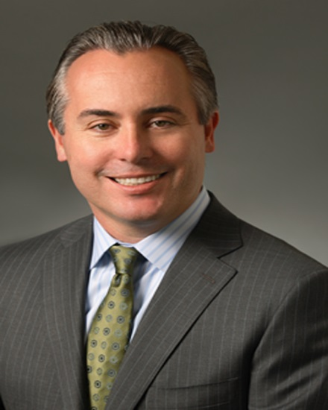
Youth Business Alliance Talk Alliance William & Carol Ouchi High School Monday, November 24, 2014 4:30 p.m. - 5:30 p.m. Presented by:
Dan Berman
Managing Partner

Slide 2
INTRODUCTION
My name is Dan Berman and I am 47 years old.
I am the co-founder of Wood, Smith, Henning & Berman LLP (WSHB).
WSHB is a full service law firm.
I am the Managing Partner of the firm.
What does a Managing Partner do?

Slide 3
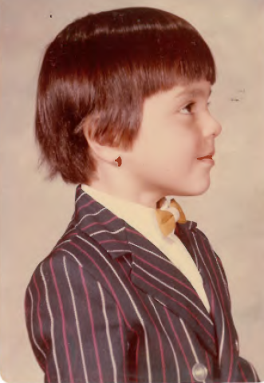
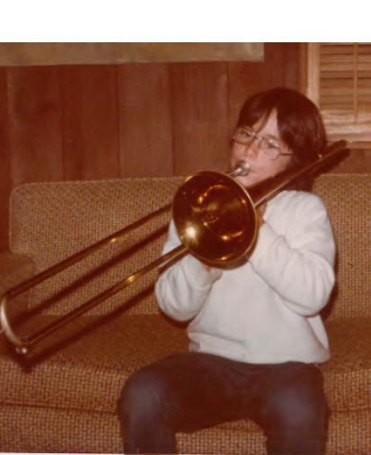
The Early Years…
I was born and raised in Santa Monica, CA.
This is a picture of me as a young boy.
Here I am again, playing the trombone.

Slide 4
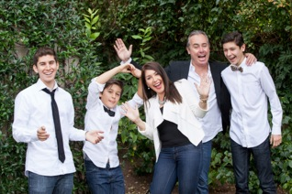
More Early Years…
A little about my family…
From left to right, Timothy (son, 26), Thomas (son, 12), Melinda (wife), Me, Christopher (17).

Slide 5
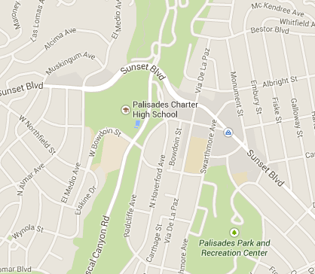
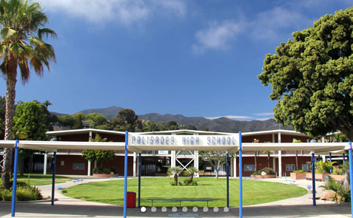
HIGH SCHOOL
I attended Palisades High School in Pacific Palisades, CA.
\

Slide 6
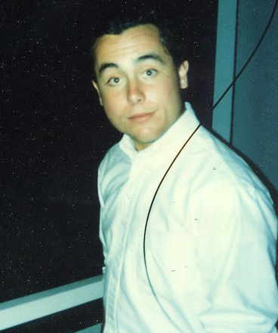
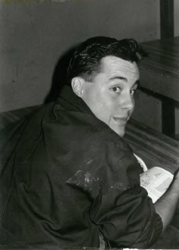
HIGH SCHOOL
As a high school student ,
I was involved in sports and music;
I enjoyed most of my classes, especially history.
\
Mugging for the camera, it’s me!
Me again – Before the Invention of Color Photos

Slide 7
HIGH SCHOOL
Things I enjoyed in HS:
Things I did not enjoy in HS:
History, English/Writing classes;
Playing baseball;
Participating in the school jazz band;
Music/Djing;
Working part-time to earn extra cash;
Hanging out with friends.
Social cliques;
Math;
Sometimes working a little too much = stress.

Slide 8
HIGH SCHOOL
Activities/Athletics in HS:
Jobs worked while in HS:
Karate;
Baseball;
Student government;
Jazz band.
Paper delivery boy;
Camp counselor;
After school playground counselor;
Pizza delivery boy;
Pizza restaurant assistant night manager.

Slide 9
HIGH SCHOOL
Fondest memories from HS
Obstacles Overcome from HS
Playing baseball in Dodger Stadium;
Playing with the jazz band;
Learning to DJ at parties;
Making friends to last a lifetime;
Earning good grades in hard classes;
Getting accepted into college.
Math;
Trying to fit in with a lot of different groups (sports, jazz, Honors students);
Balancing work and school;
Trying to make the right life choices.

Slide 10
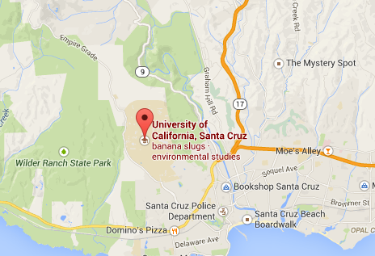
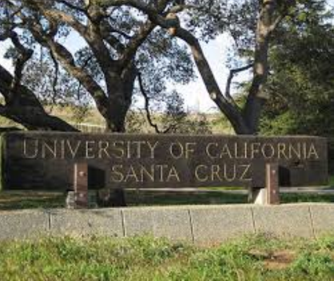
College
I attended college at UC Santa Cruz.
\

Slide 11
College
Favorite classes:
Least favorite classes:
Political Science;
World History;
World Religions;
Literature.
Computer Science/ “Programming”;
Japanese.

Slide 12
College
Fondest memories:
Obstacles I overcame:
DJing parties;
Playing intramural sports with my buddies;
Late night study sessions with lots of junk food;
Parties;
Meeting people from all over the world;
Finding my passion in my studies.
Staying focused!;
Figuring out what I was really passionate about in regards to my future.

Slide 13
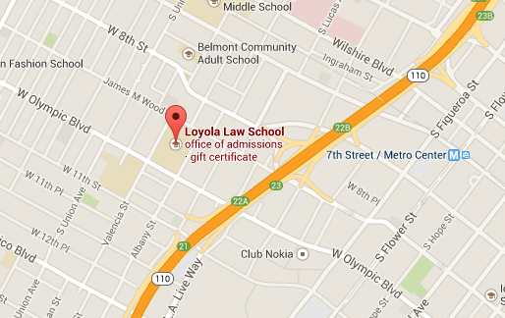
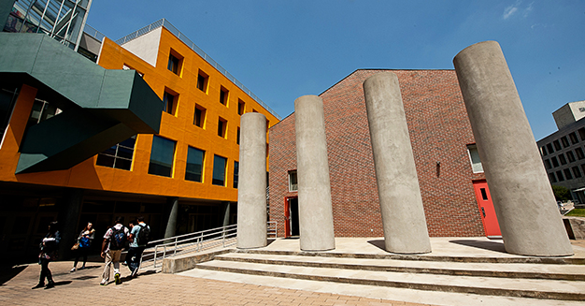
Law School
I attended Loyola Law School in Los Angeles.
\

Slide 14
Career Path
1990: Worked at the District Attorney’s office (during law school);
1991: Worked for a large law firm during law school;
1992: Started with this law firm after law school;
1997: Formed WSHB;
2007: Assumed role of Managing Partner.
Notes:
You may use this chart to describe your journey to the current career

Slide 15
Career
Company pic
Company pic #2

Slide 16
Career
My First Job
My Worst Job
Delivering newspapers.
Cleaning a biology lab room filled with mice, rats, and snakes.

Slide 17
Career
Challenges I Overcame in My Career
Started firm at a young age;
Financial challenges with a start-up firm;
Taking risks;
Learning how to run a business without any training
Balancing work and a family.

Slide 18
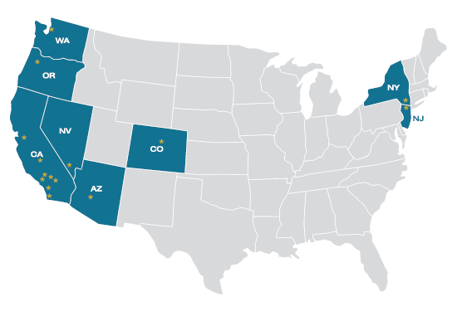
Current Role
Map of our current office locations. We just added a new location – Florida (not seen on this map)

Slide 19
Current Role
160 lawyers
170 staff
16 offices in states
Annual Gross Profits: $55,000,000 (est.)
Annual growth of 10-15% every year
Clients Include:
Real estate developers
Casinos and hotels
Restaurants
Schools and cities
Business owners
Doctors, lawyers, and other professionals

Slide 20
Current Role
Management Committee
Dan Berman
David Wood
Kevin Smith
Steve Henning
Stewart Reid
Managing Partner
Dan Berman
Director of
Administration
Cindy Hammond
Director of
Finance
Kameron Stout
Director of
Information Technology
Kelli Morehead
Partners
Attorneys
Facilities
Manager
Lou Turner
Marketing/Administrative
Administrator
Melissa Faust
Library
Elliott Lefko
Conflicts
Analyst
Danielle Combes

Slide 21
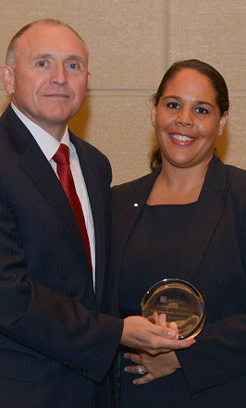
Current Role
Internationally recognized law firm
Award winning for our legal work
Award winning for our diversity
Not me! But my firm winning a prestigious diversity award

Slide 22
Current Role
CURRENT ROLE AS MP
Strategy
Staff Management
Financial Management
Client Marketing and Expansion

Slide 23
Career Compensation
Partners
$200,000
Attorneys
$125,000
Support Staff
$50,000
Mailroom
$25,000
Notes:
Use

Slide 24
Lawyer or Entrepreneur?
Lawyer by training;
Full-time business owner and operator now;
The Value of a Law Degree;
Lots of options for lawyers even if not practicing law.

Slide 25
Keys to Success
What I have learned from my firm’s growth and success:
Customer service is key;
The Golden Rule applies: Treat everyone the way you would like to be treated;
Everyone in an organization is important to its success.
Do something that you like doing
Be proactive and creative; don’t always do things the way everyone else does them;
Be transparent with your team;
Read as much as possible!
Do not stress too much; and
Have some fun!

Slide 26
QUESTIONS AND ANSWERS

