Slide 1


Slide 2
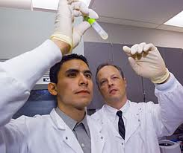
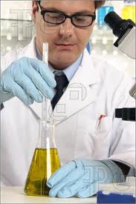
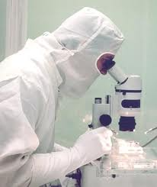


Slide 4
What do Scientists do?
Work in industry (pharmaceuticals, start-ups, environmental consulting)
Teach (all levels)
Policy work: talk to politicians and lawmakers
Work for the government (EPA, fisheries)
LOTS of other things (e.g. work at the aquarium)

Slide 5
What does my day look like?
I learn!

Slide 6
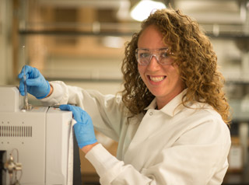
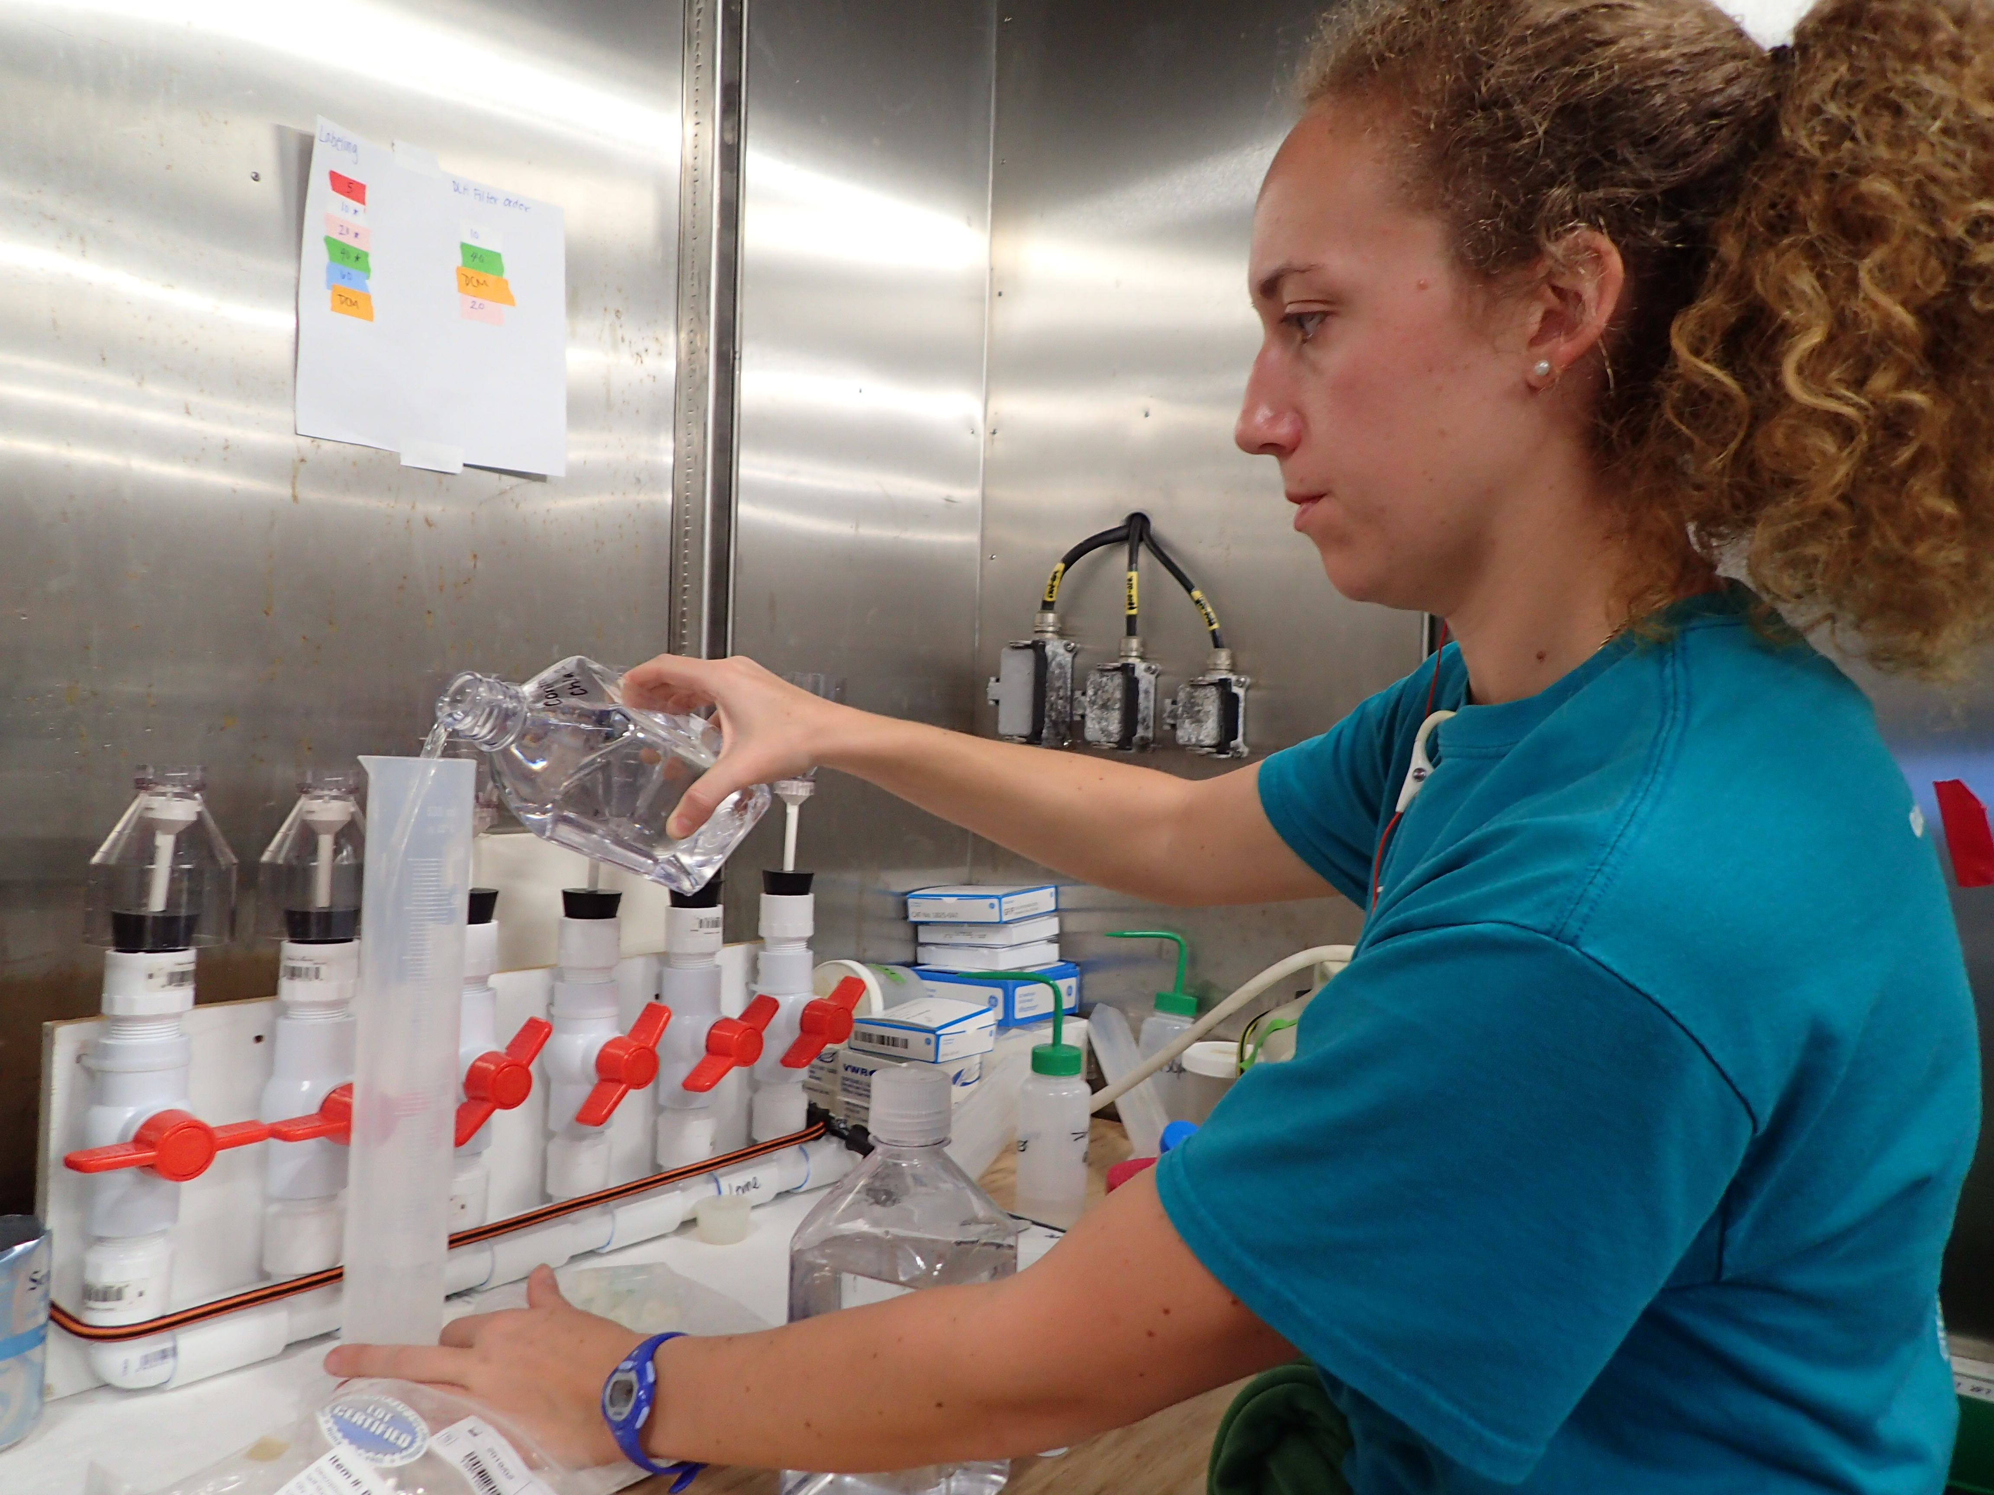
What does my day look like?
Work in the lab or at a computer

Slide 7

What does my day look like?
I teach and mentor

Slide 8
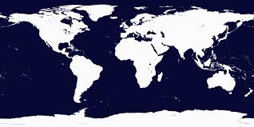
What does my day look like?
I travel a lot!

Slide 9
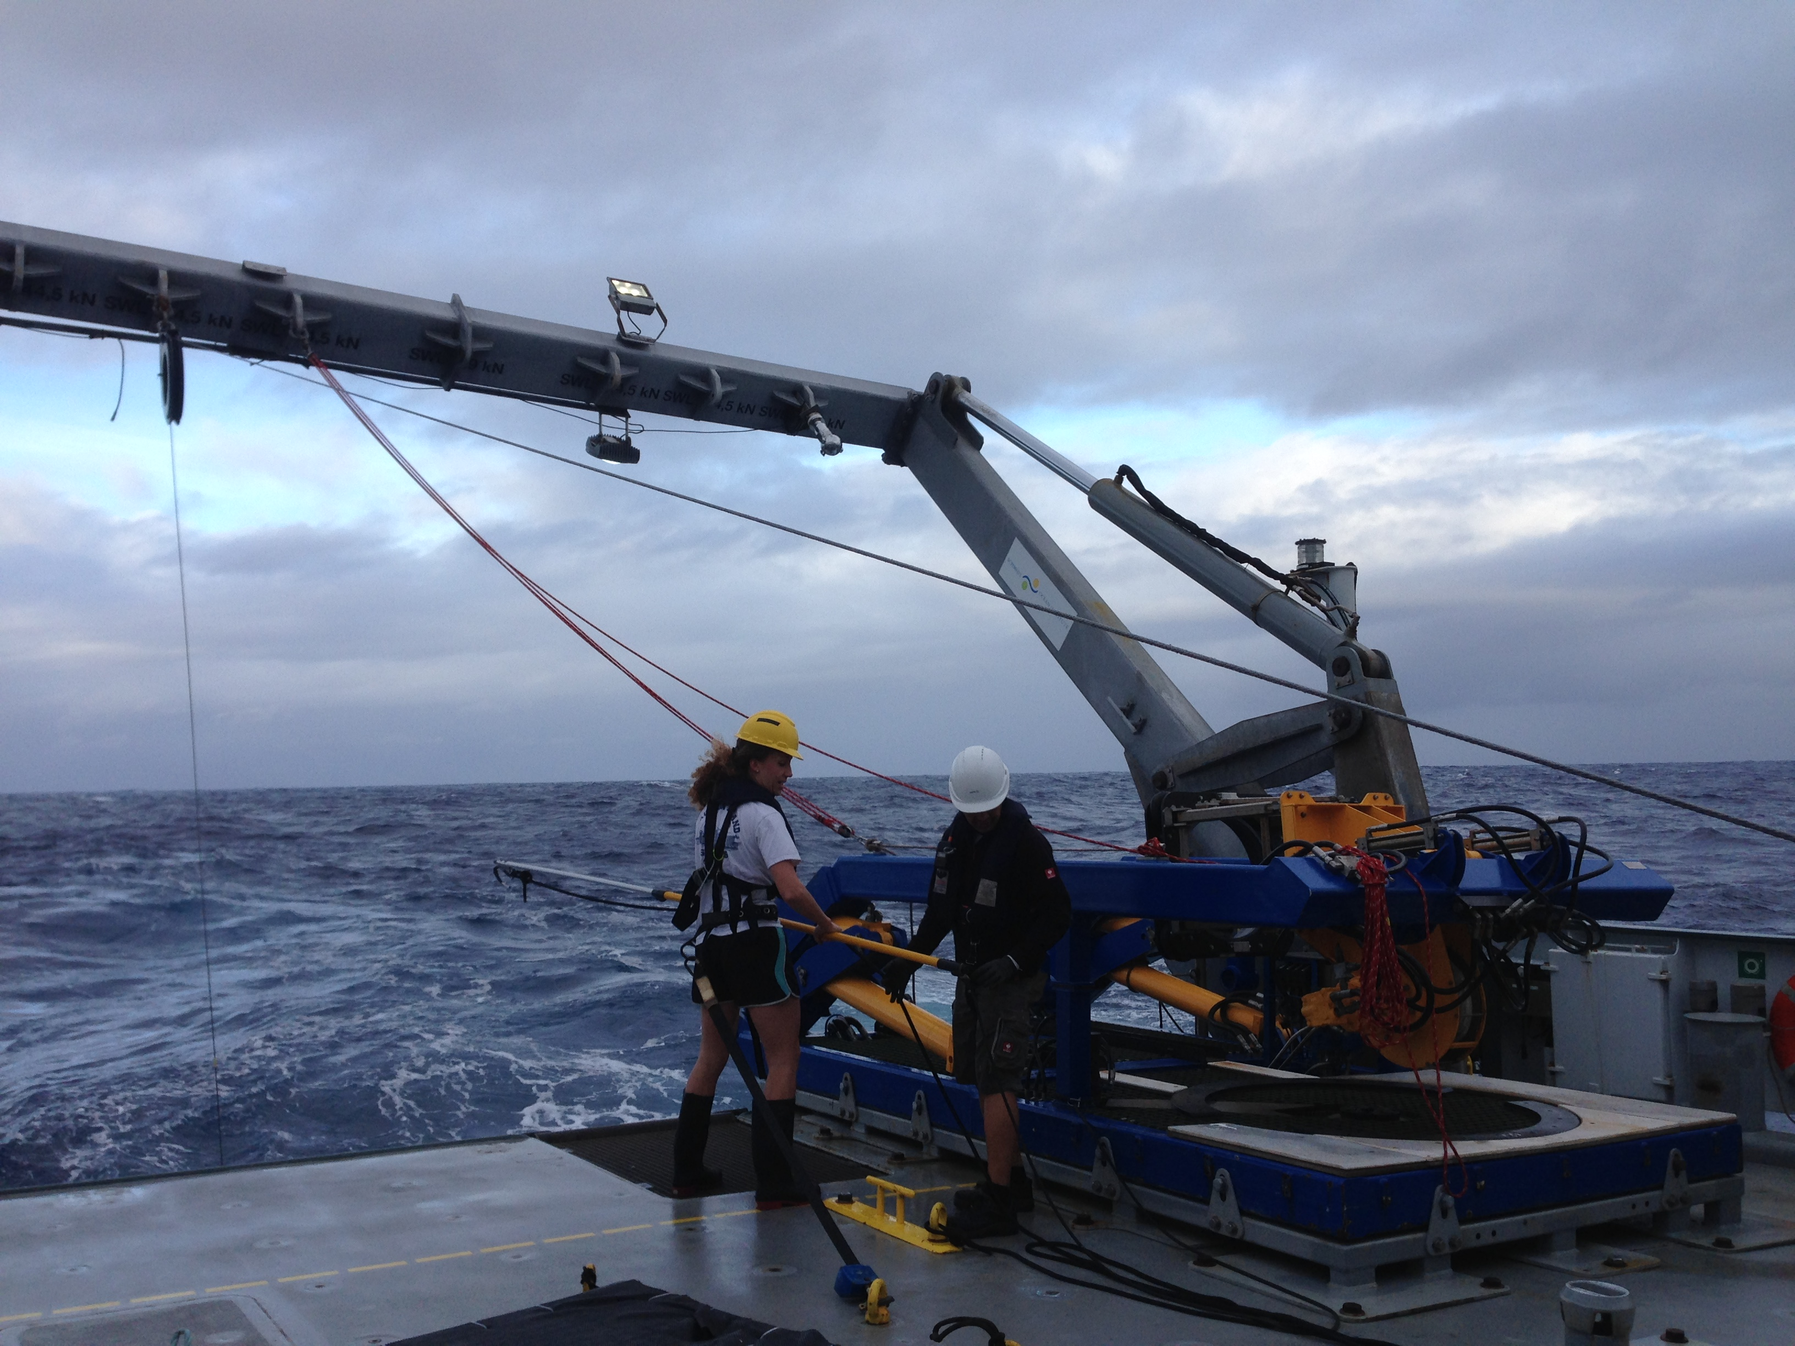
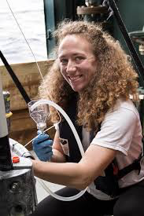
What does my day look like?
I make measurements of the oceans

Slide 10
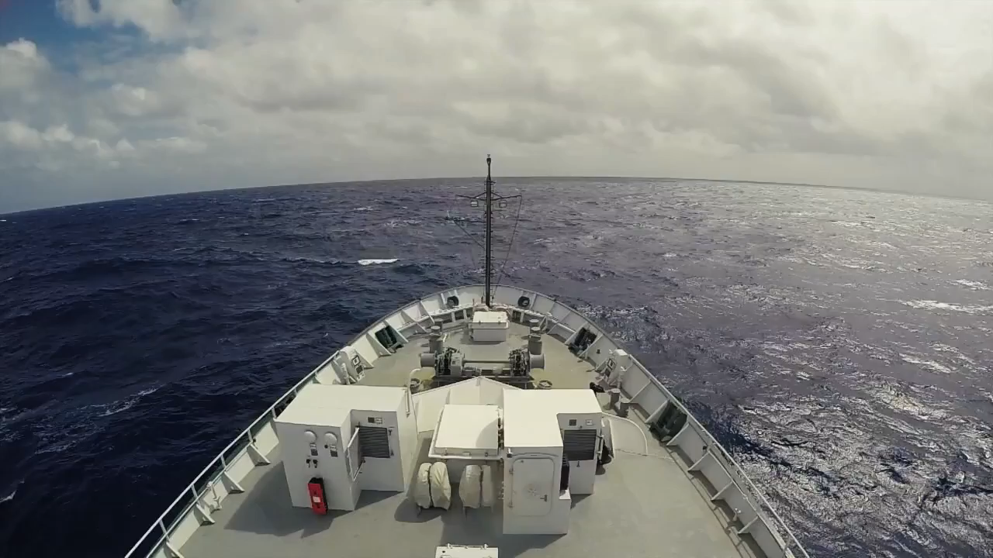
Notes:
Stop 1:22

Slide 11
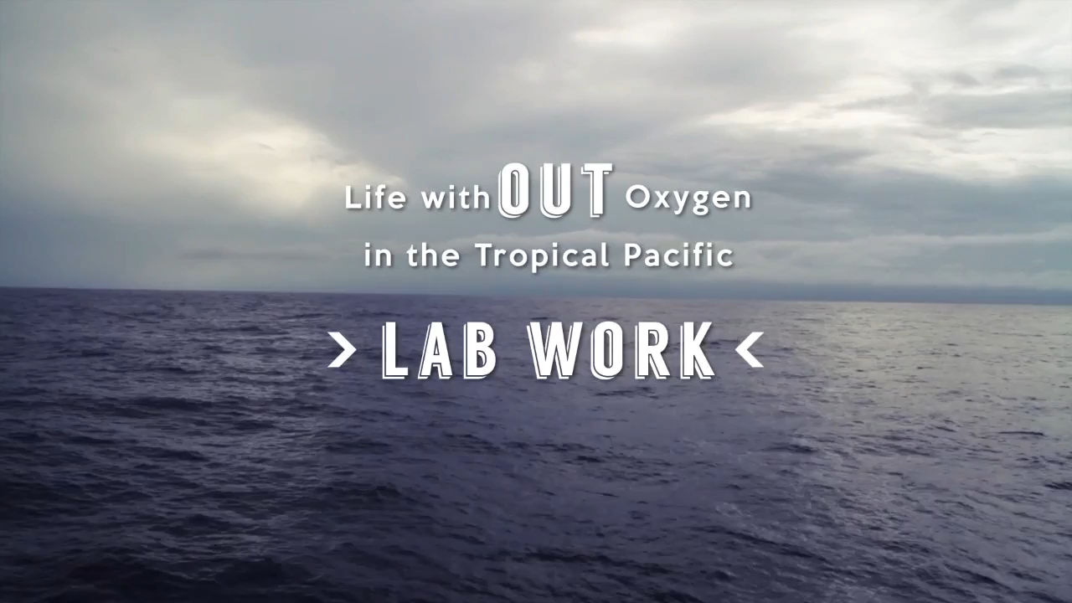
Notes:
Start 2:27

Slide 14
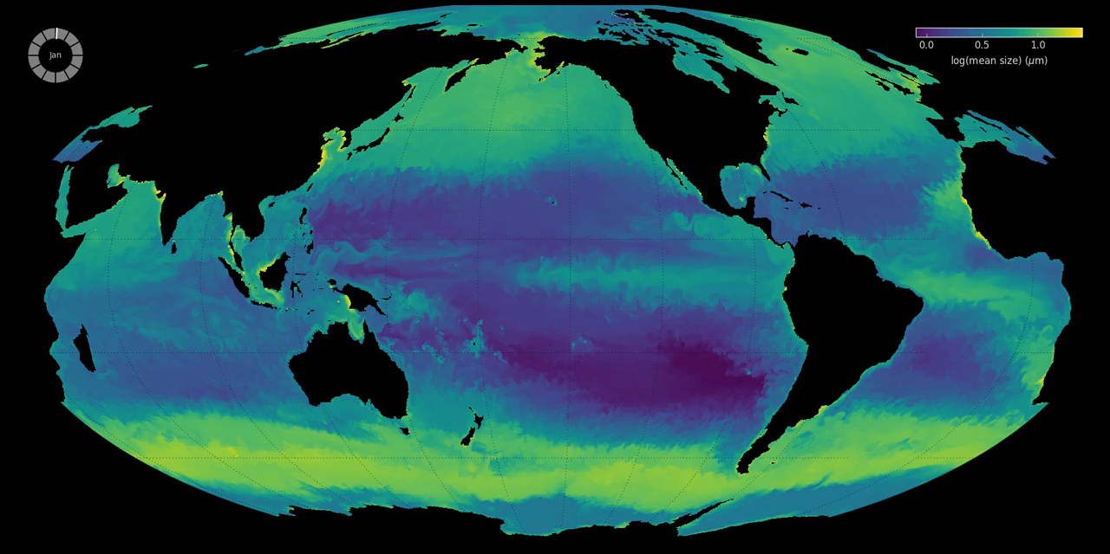

Slide 16
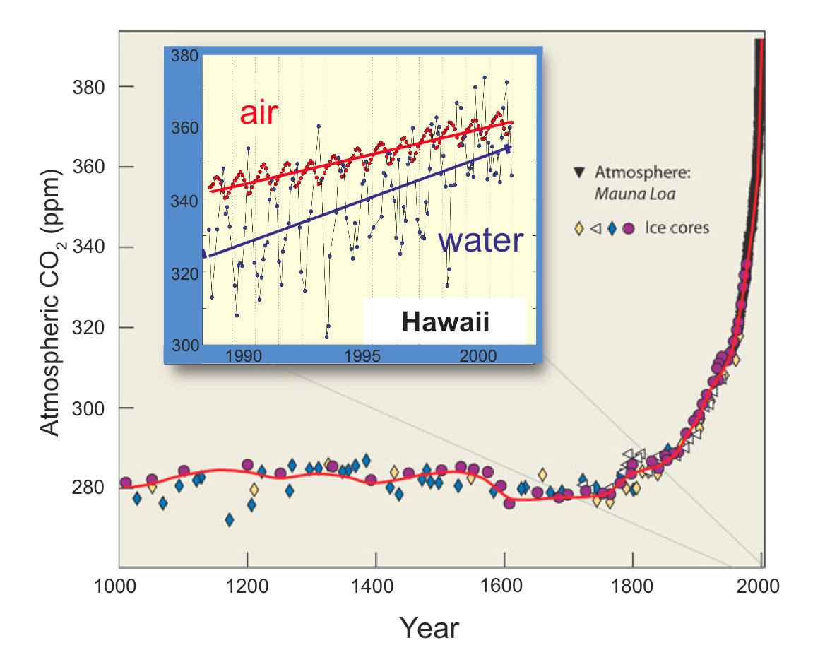
Sarmiento and Gruber, 2002; Dore et al. 2002
Notes:
Over past century and half drastic increase in atm CO2. This increase is also seen in the oceans which take up large portion (30-50%) of CO2 emissions. Globally the oceans have taken up ~118 PgC of 244 PgC emitted. Uptake and storage rates vary globally. Primarily due to water properties (temperature salinity) and circulation (deep and intermediate water formation). The result is certain regions of the ocean are particularly important players when considering the ocean as a sink for anthropogenic CO2 (e.g. north atlantic).

Slide 17
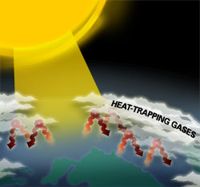

Slide 18
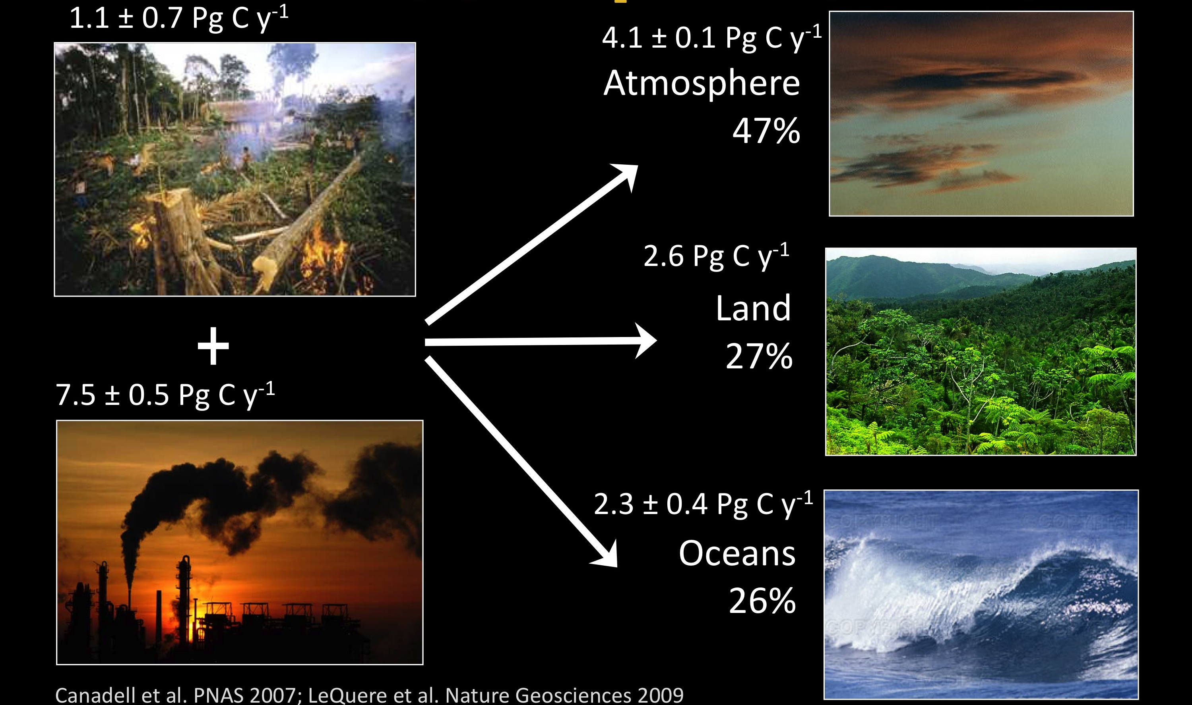
Fate of Anthropogenic CO₂
Feely & Doney ASLO © 2011
Notes:
SLIDE 4. Sources and sinks of anthropogenic CO₂ emissions for current conditions estimated from observations and models (2000-2009). At present, the dominant anthropogenic source of CO2 to the atmosphere is from fossil fuel combustion, with a smaller but important input from deforestation mostly in the tropics. A little less than half of the anthropogenic input stays in the atmosphere (the so-called air-borne fraction) with the rest removed in about equal portions into the ocean and land biosphere. The uptake into the ocean is well-understood and is controlled by physical-chemical processes: thermodynamics of seawater carbonate chemistry and ocean circulation. Land biosphere uptake comes from a range of processes including CO2 fertilization of plants, anthropogenic nitrogen fertilization, historical land-use changes, and climate change. Detailed budgets are presented in Canadell et al. PNAS 2007; LeQuere et al. Nature Geosciences 2009).

Slide 19
A Drop of Ocean (credit: Glynn Gorick, Justin Seymour and Roman Stocker; Stocker lab)

Slide 20
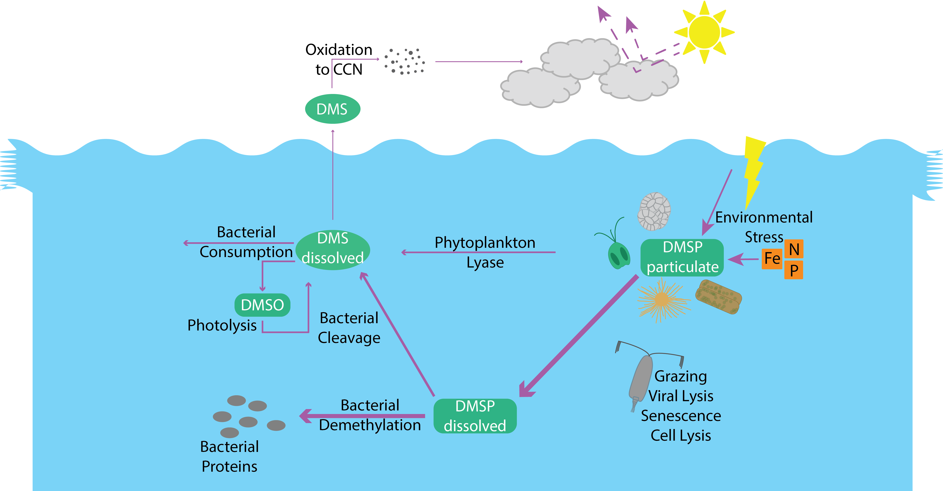

Slide 21
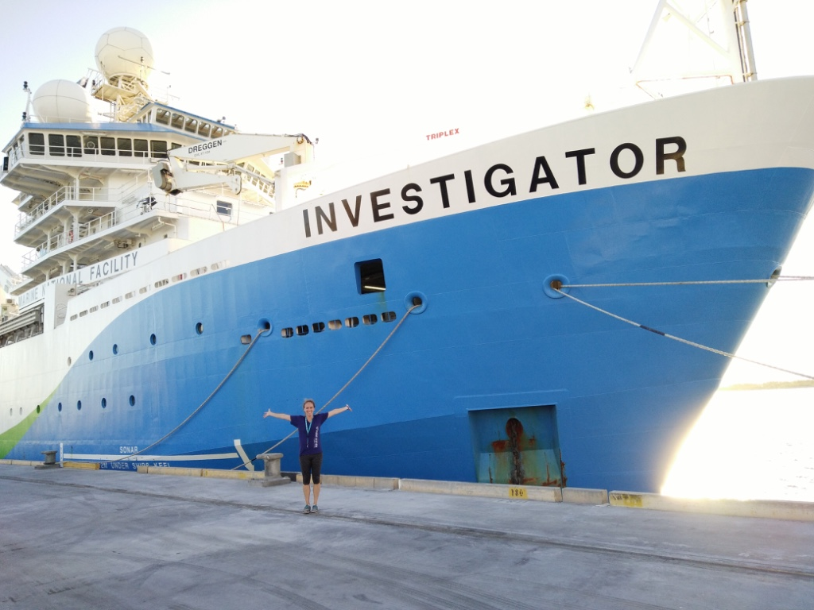
Questions?

Slide 22
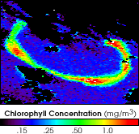
Iron fertilization and geoengineering

Slide 23
Fate of Anthropogenic CO₂
Feely & Doney ASLO © 2011
Notes:
SLIDE 4. Sources and sinks of anthropogenic CO₂ emissions for current conditions estimated from observations and models (2000-2009). At present, the dominant anthropogenic source of CO2 to the atmosphere is from fossil fuel combustion, with a smaller but important input from deforestation mostly in the tropics. A little less than half of the anthropogenic input stays in the atmosphere (the so-called air-borne fraction) with the rest removed in about equal portions into the ocean and land biosphere. The uptake into the ocean is well-understood and is controlled by physical-chemical processes: thermodynamics of seawater carbonate chemistry and ocean circulation. Land biosphere uptake comes from a range of processes including CO2 fertilization of plants, anthropogenic nitrogen fertilization, historical land-use changes, and climate change. Detailed budgets are presented in Canadell et al. PNAS 2007; LeQuere et al. Nature Geosciences 2009).

Slide 27
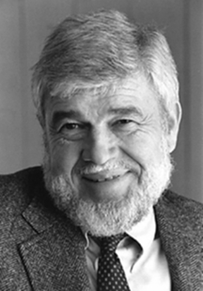
John Martin’s iron hypothesis:
The lack of iron prevents phytoplankton from growing and using up the nutrients in HNLC areas, and so reduces the amount of CO₂ fixed and carbon exported to the deep sea.

Slide 28
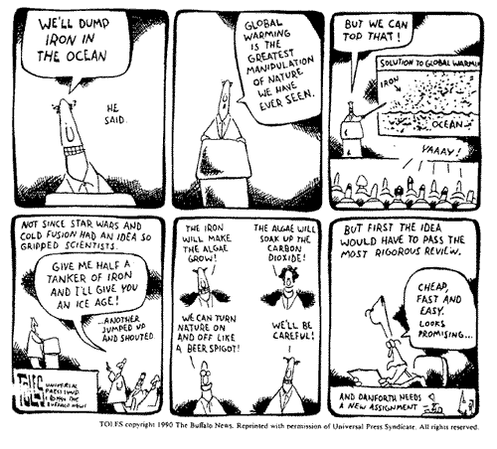
A political cartoonist’s view of the iron hypothesis

Slide 29
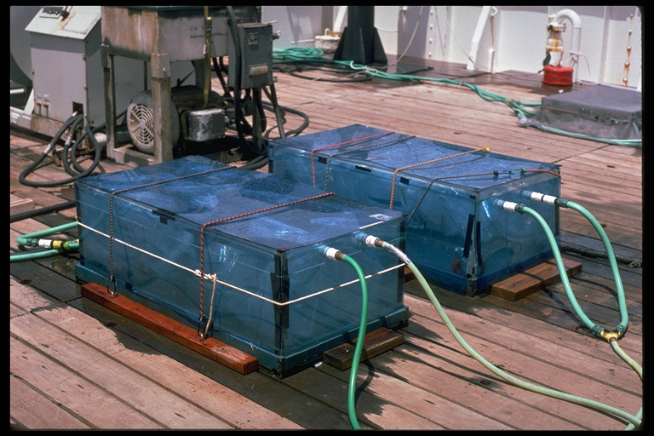
Shipboard growout incubation experiment

Slide 30
Iron limitation- Growout
Shipboard growout incubation experiment

Slide 31
Carbon sequestration through Fe fertilization
Can we- and should we- consider large-scale commercial fertilization of the ocean to draw down anthropogenic CO₂?

Slide 32
Proponents
  We are already changing the biogeochemistry of the Earth, deliberate intervention to fix it is justified
  Iron fertilization mimics natural iron inputs and is therefore safe
  Cheaper and safer than other options to reduce CO₂

Slide 33
Opponents
It won’t work- calculations suggest that you would have fertilize an area one million times the size of the SOFeX patch to draw down 30% of the CO₂ we produce (Ken Johnson)
Changing ecosystems recklessly could be disastrous

Slide 34
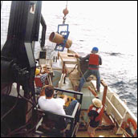
1960 singer Neil Young:
Adding iron to the ocean off his yacht

Slide 35
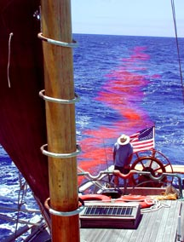
Planktos, Climos and GreenSea- Commercial iron fertilization

Slide 36
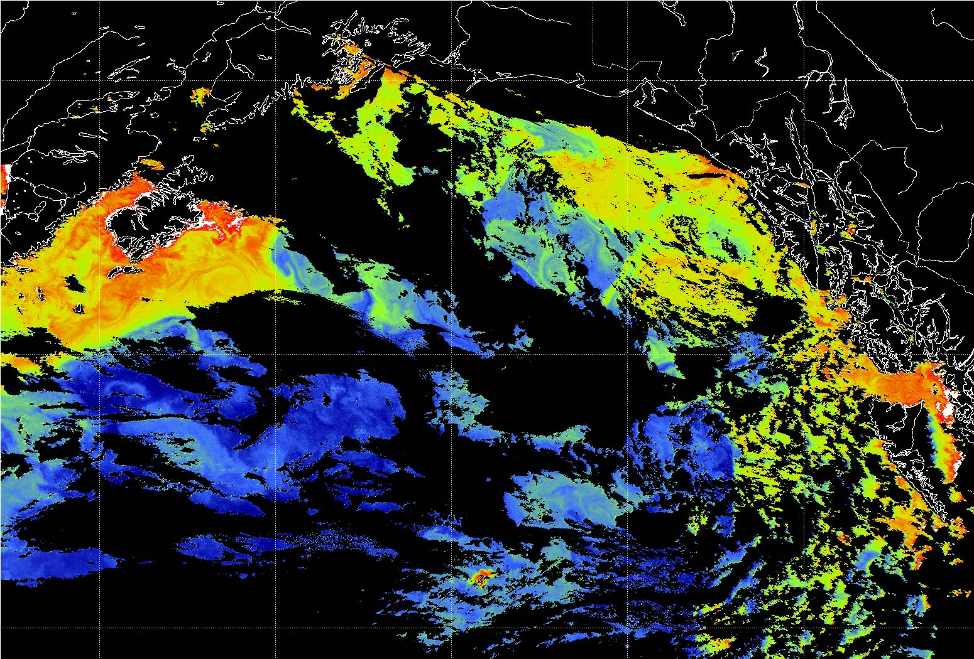

Slide 37
Ocean Fertilization:
Ethical and Practical Considerations
Is It Going to Be Worth the Effort?
Adverse Effects – Local and Far-Afield
Harmful Algal Blooms

Slide 38
The U.N. London Convention and London Protocol of 2008:
“
“knowledge about the effectiveness and potential environmental impacts of ocean iron fertilization currently was insufficient to justify large-scale operation…. noted with concern the potential for large-scale ocean iron fertilization to have negative impacts on the marine environment and human health.”

Slide 39
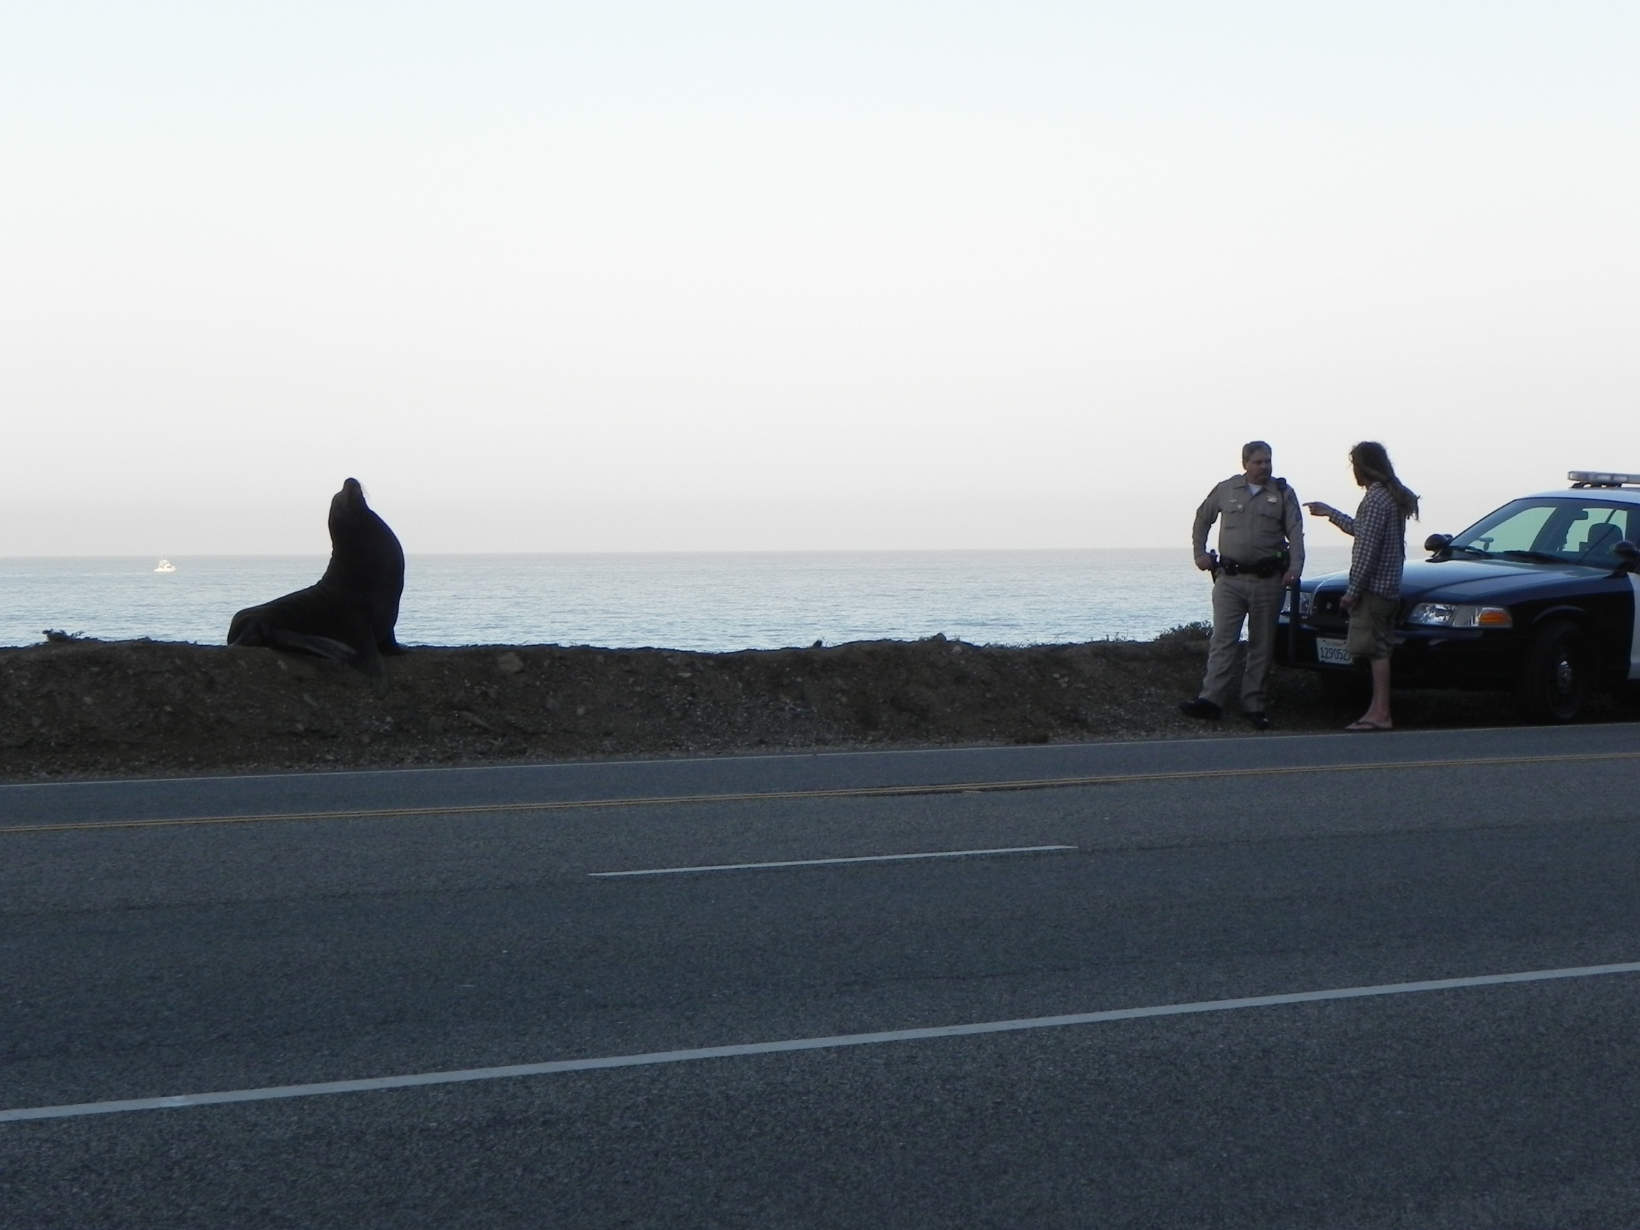
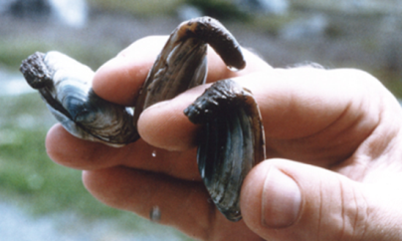
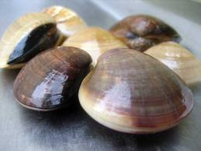
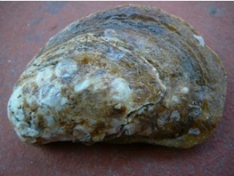
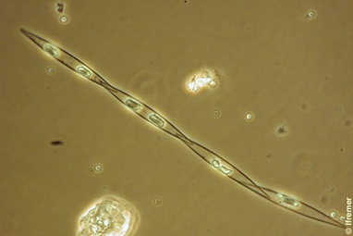

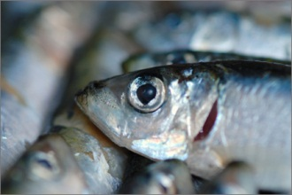
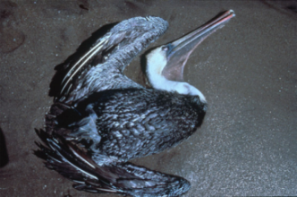
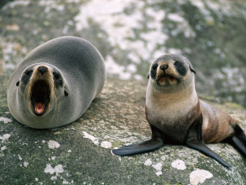
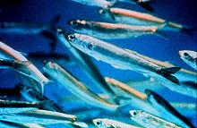
/
Pseudo-nitzschia and Domoic Acid

Slide 40
Pseudo-nitzschia in iron addition experiments
Silver et al. 2010

Slide 41
Ocean Fertilization:
Ethical and Practical Considerations
Is It Going to Be Worth the Effort?
Adverse Effects – Local and Far-Afield
Harmful Algal Blooms
  Changes to Structure of Food Webs
  Changes in Oxygen Distributions
  Changes in Cycling of Other Green House Gases

Slide 42
Commercial fertilization
Already, the several private fertilizations have been done by a company planning to do this for profit (carbon credits)
Planktos Foundation, Climos, GreenSea Ventures
Some oceanographers are working for these firms- others refuse to join in
Should we go ahead with this, or not?

Slide 43
And just when we thought the Fe fertilization
controversy was dying down:
October 2012: The Guardian reports a July 2012 iron fertilization experiment off west coast of Canada. Haida Salmon Restoration Corporation (HSRC)reportedly introduced 100 metric tons of iron sulfate into surface waters off west coast of Canada, near Haida Gwaii Islands

Slide 44
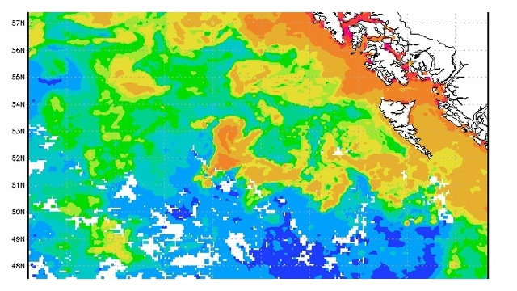
http://io9.com/5952101/a-massive-and-illegal-geoengineering-project-has-been-detected-off-canadas-west-coast

Slide 45
NOAA Statement:
“NOAA’s global ocean drifters provide data about the world ocean (such as ocean currents and temperature) that aids forecasters and researchers. Due to limited government resources, NOAA relies on volunteers and vessels of opportunity to deploy global ocean drifters into strategic locations.
In July, the Haida Salmon Restoration Corporation offered to deploy 20 NOAA global ocean drifters off the West Coast of Canada for a salmon research project. Haida Salmon Restoration Corporation did not disclose that it was going to discharge material into the ocean, nor did our drifters contribute to the discharge of any material.”

Slide 46
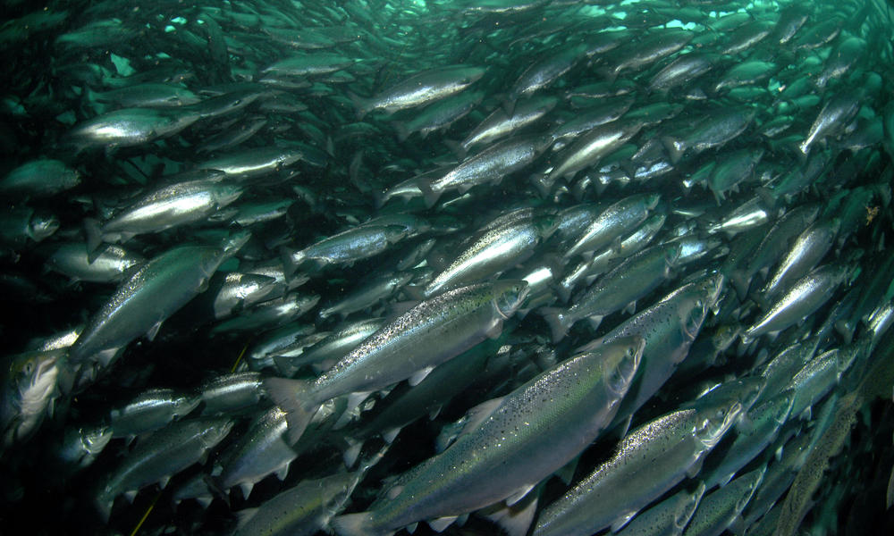
Whether by coincidence or not, the west coast of Canada experienced a record salmon run in 2013 !

Slide 47
What consequences have Planktos and Russ George faced for egregiously violating two UN laws banning large scale commercial iron fertilizations?
So far, nothing…

