Slide 1
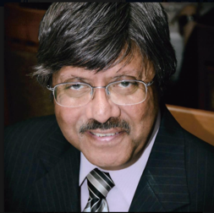
Valor Academy High School
Presentation by
Edwin Bernard, B.Eng, DTM, LRAM

Slide 2
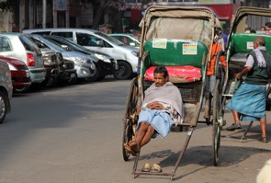
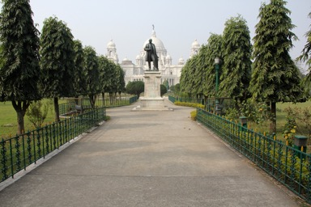
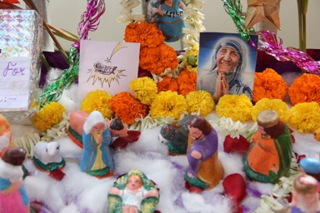
Calcutta, India

Slide 3
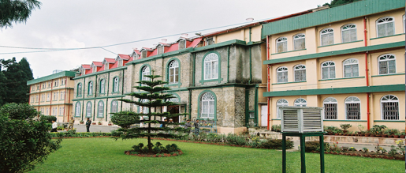
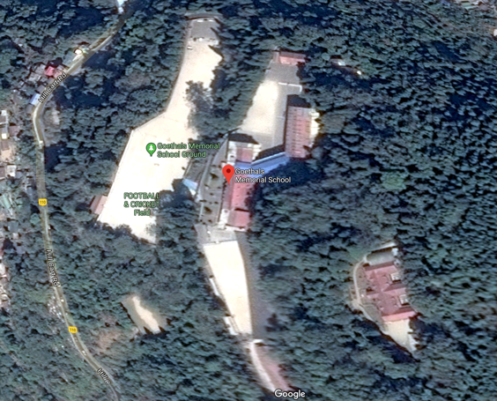
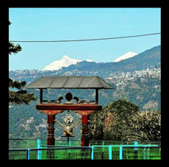
Goethals Memorial School – Kurseong (Himalayan Foothills)

Slide 4
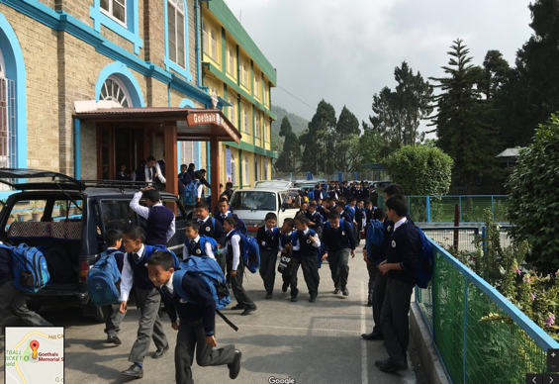
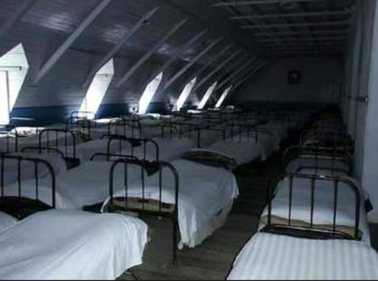
School Life

Slide 5
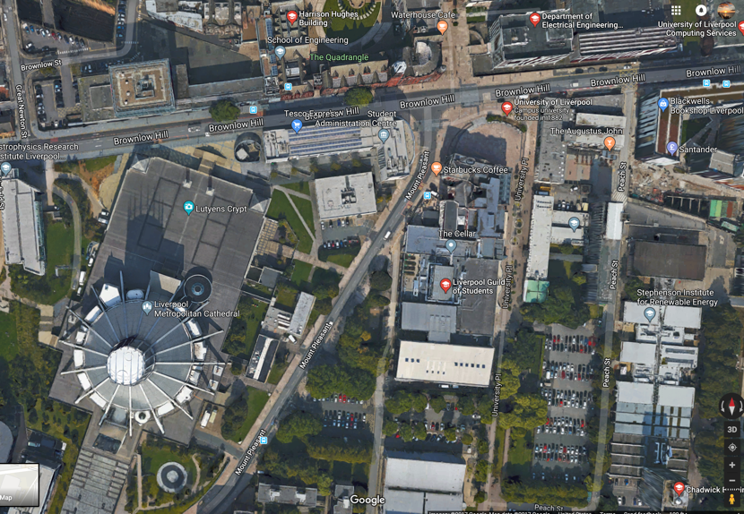
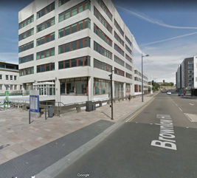
University of Liverpool England

Slide 6
My Career Path
LED
LCD Cockpits
Renewable Energy
Reconnaissance
Cockpit Displays
Signage
Lighting
Military
Fighters
Transport
Helicopters
Commercial
Information Displays
Solar
Providing Solutions
Communication
Sales
Entrepreneur

Slide 7
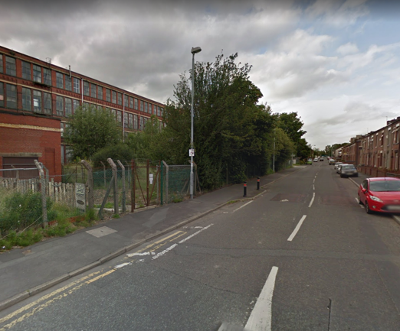
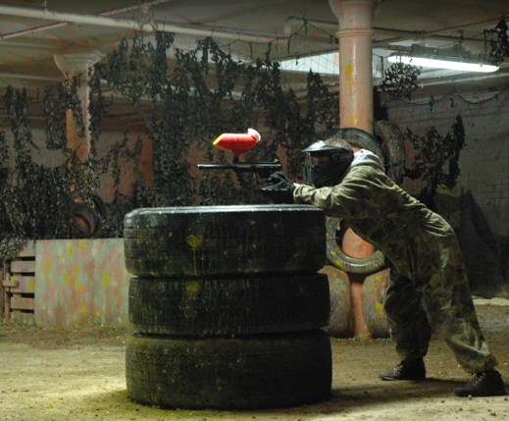
Manchester, England – My 1st Work Place

Slide 8
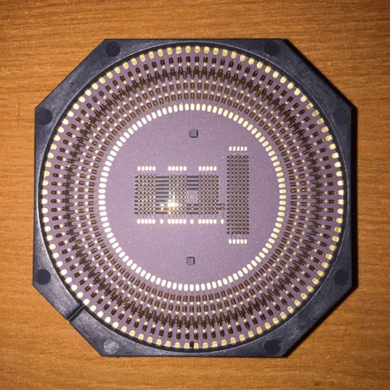
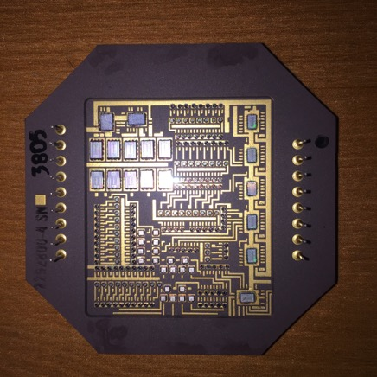
LED Displays – Pointer / Counter

Slide 9
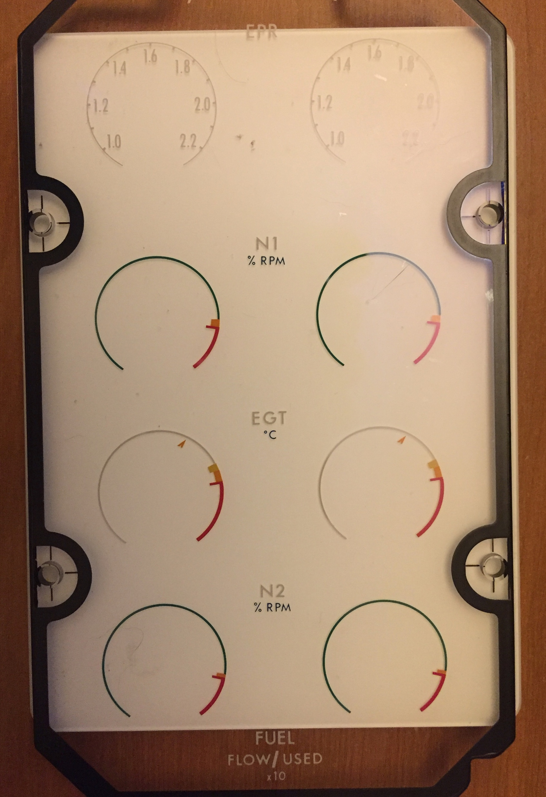
Glass Overlay with Dials

Slide 10
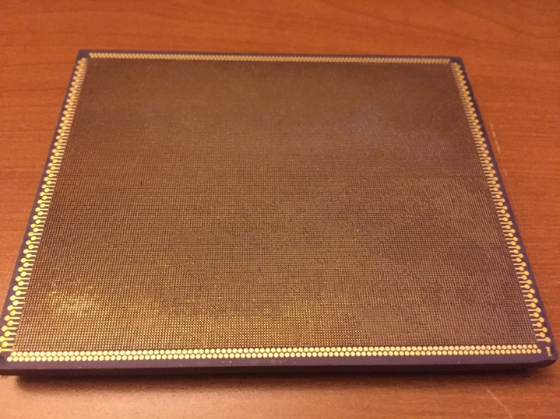
LED Matrix 4” x 4” 64 dots per inch

Slide 11
Typical LCD Layout
Optical Light Shaping Film
LCD
Diffuser
Flex Circuit
Light Pipe
Fluorescent Lamp
Connector
Aluminum Housing
Row Driver PCB
Column Driver PCB

Slide 12
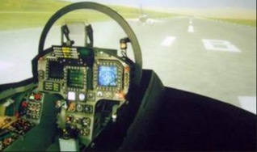
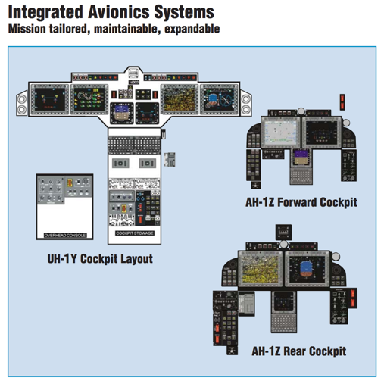
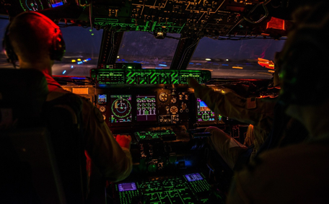
Cockpit Displays

Slide 13
Design Consideration and Tradeoffs
Display Luminance
Display Uniformity
Color
Contrast
Blemishes
Display Life and Reliability
Obsolescence

Slide 14
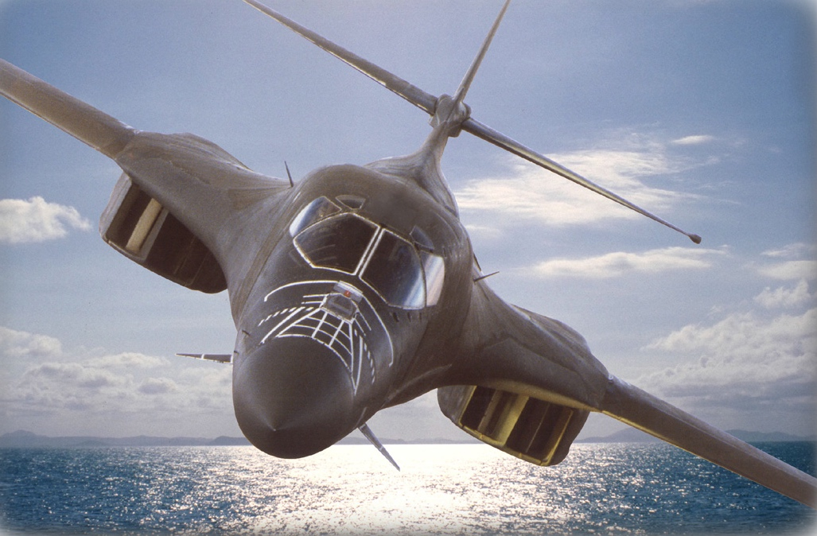
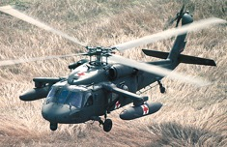
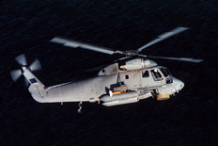
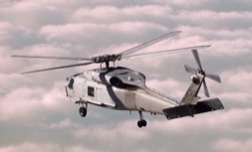
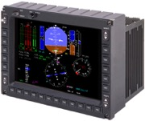
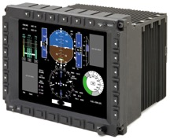
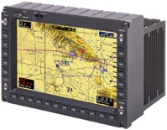
Typical Display Imagery

Slide 15
High Ambient Viewing Condition
When the sun is shining on the display
Reflections must be significantly minimized
High Contrast is critical
When the sun shines into the pilots eyes
High brightness is critical

Slide 16
Night Viewing Conditions
Dim enough to not overpower the cockpit and reflect from the glass window
Often must be designed to be used with Night Vision Goggles
Requires special light filtering

Slide 17
Knowledge Base
Display Design
Specifications
Optical
Electrical
Mechanical
Reliability
Testing and Verification
Customers
Military
Component

Slide 18
Subjects In School That Helped
Physics, including optics
Mathematics
Applied Mechanics
English
Speech and Debate

Slide 19
Skill Set
Technical Skills
Teamwork
Project and Time Management
Communication
Leadership

Slide 20
Why Go Solar?
Net reduction in electricity costs
Price protection for the future
Option to own your own power plant
No upfront costs
20-25 year warrantee
Great for the environment
Adds value to the home

Slide 21
Communication and Leadership
Toastmasters
International

Slide 22
Business Trips – Awesome travel perks
Jerusalem
Florence
Munich
Tokyo
Seoul
And many more

Slide 23
Post Script YouTube Space LA

Slide 24
Become the CEO of Your Life!

