Slide 1
YBA Guest Speaker
Eric Carlson
May 7, 2018
Downtown Magnets High School

Slide 2
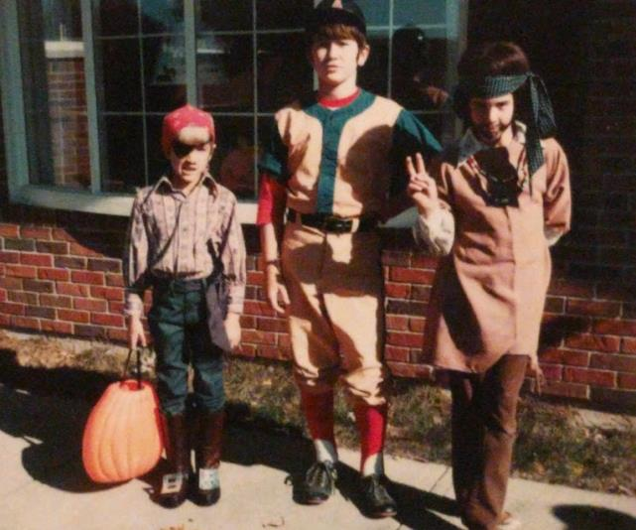
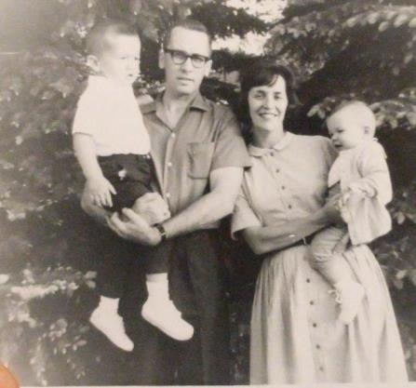
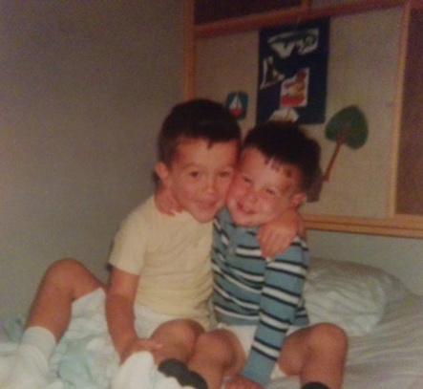
Growing Up
Small town - Xenia, Ohio
Oldest of 3 boys

Slide 3
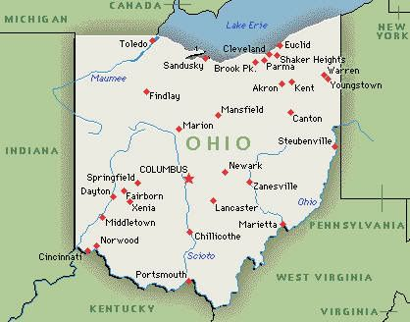
Growing Up
Sports
Good at math & science
Slow reader
Talked too much

Slide 4
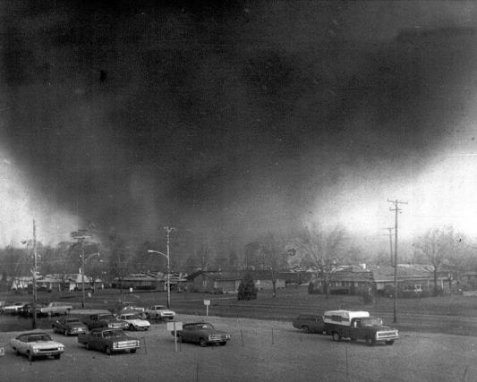
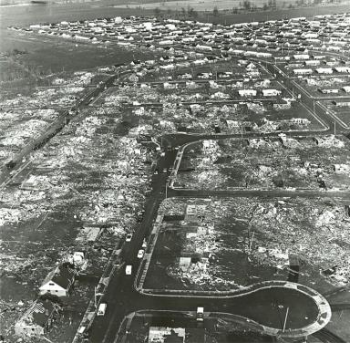
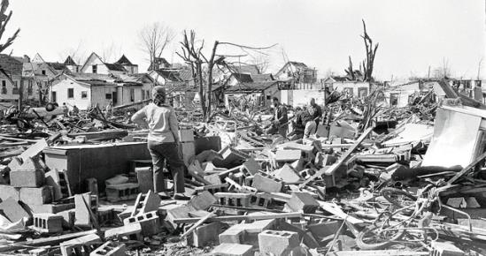
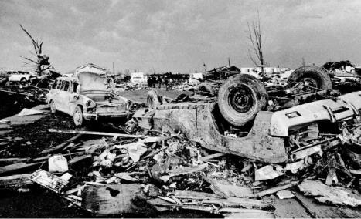
April 3, 1974 – Xenia Tornado
Big Tornado when I was 10
First job – paper route

Slide 5
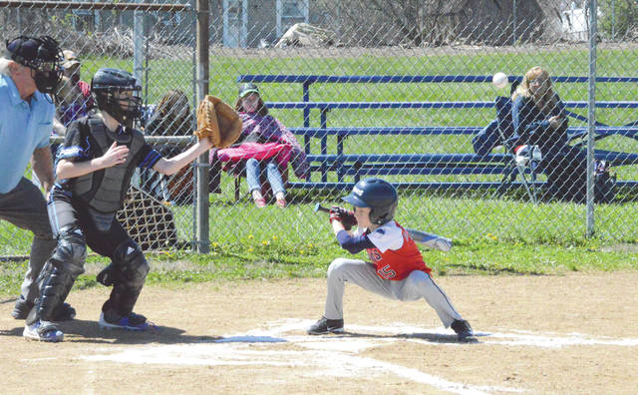
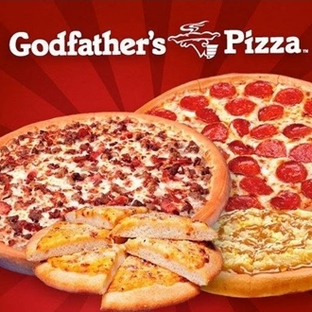
High School
Lacked confidence
Didn’t get too involved
Good grades but not a great student
Played baseball
Clueless about careers
Made Pizza after school
Time management
Assistant Manager

Slide 6
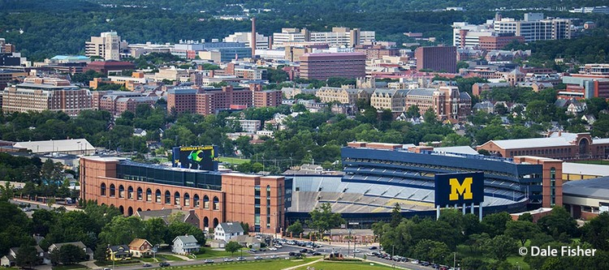
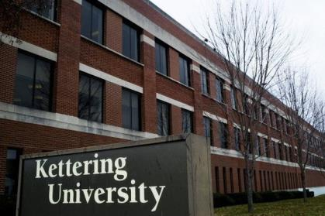
College
Goal: big university, 4+ hours from home, sports teams, good reputation, large campus, lots of majors
Limited $$ for college
Chose: small engineering college – no sports teams, small campus
Co-op Program = $$ + Experience
BS Electrical Engineering

Slide 7
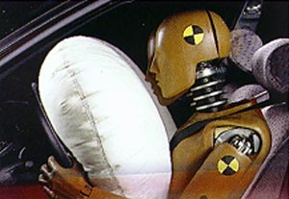
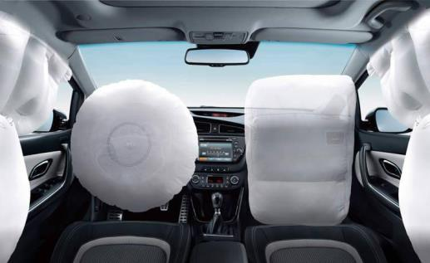
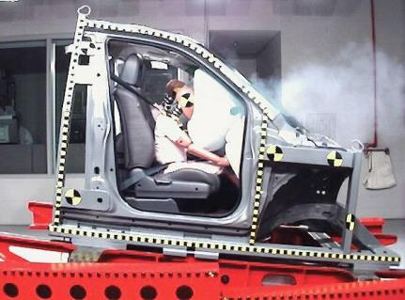
Careers - Ohio
GM – Airbags - Test Engineer, Design Engineer, Program Engineer

Slide 8
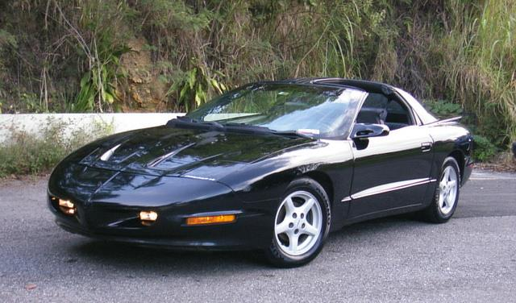
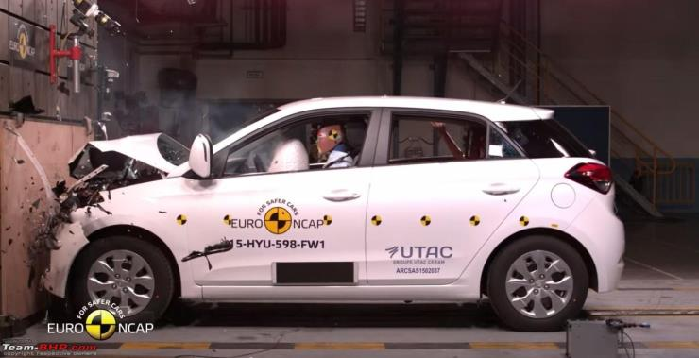
General Motors
Test Engineer - Test Facility, Teamwork, Technical
Design Engineer – Design, Test, Repeat
Program Engineer – Customers, Suppliers, Communication, Travel

Slide 9
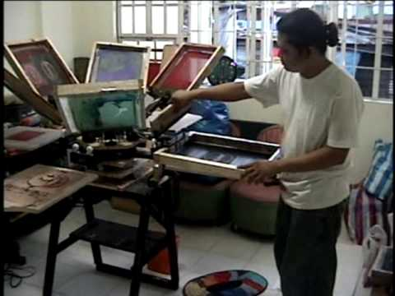
Careers - Colorado
KidsFirst Designs – Kids T-shirts – Founder/Owner
Creative, Sales, Isolated
(this is not me)

Slide 10
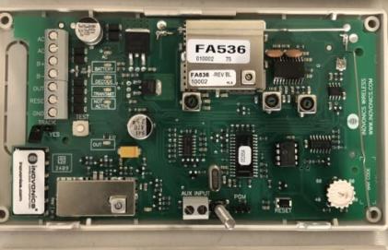
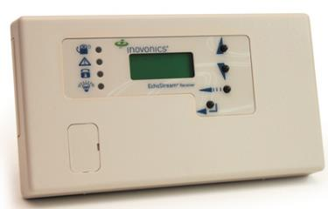
Careers - Colorado
Inovonics – Security Systems
Manufacturing Engineer
Problem-solving, Learning, Improving
Manufacturing Manager/Director
Coach, Help, Lead, Manage – Communicate!
Technical Services & Customer Service Manager
Internal & External Customers
Part-time Student – Masters, Nonprofit Management

Slide 11
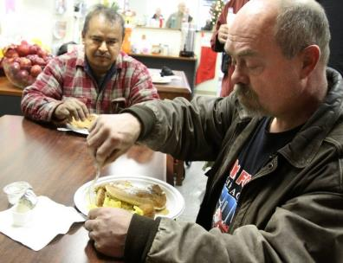
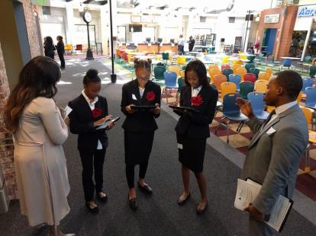
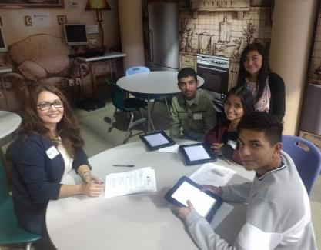
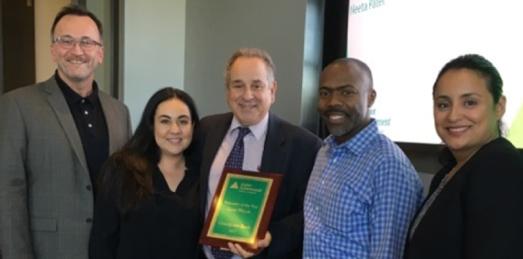
Careers - California
St. Francis Center – Breakfasts , Free Groceries
Development Associate/Manager – Learning, Writing
Junior Achievement of SoCal – Personal Finance, Entrepreneurship, Work
Director of Development – Listening, Coordinating, Communicating

Slide 12
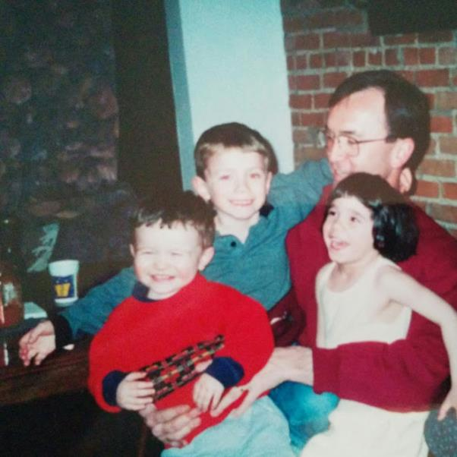
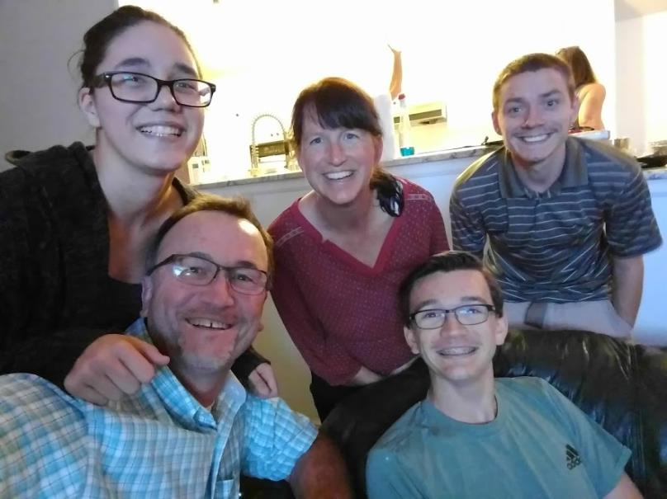
Family

Slide 13
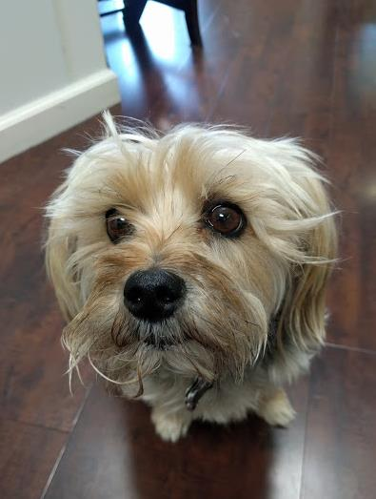
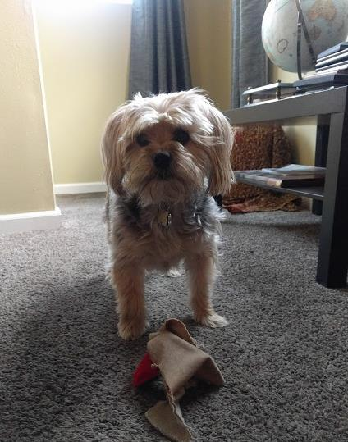
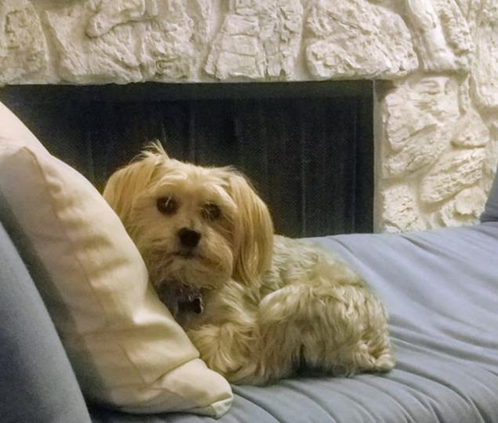
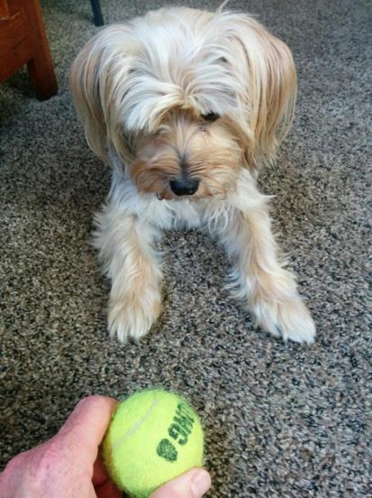
Dog

Slide 14
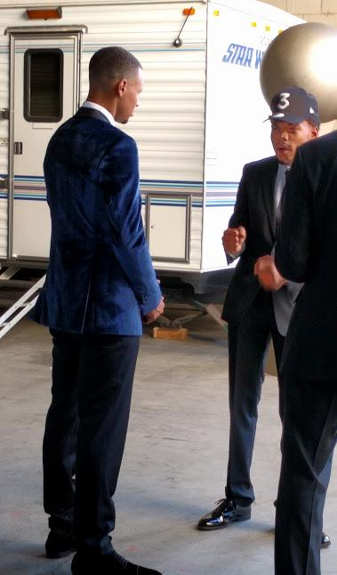
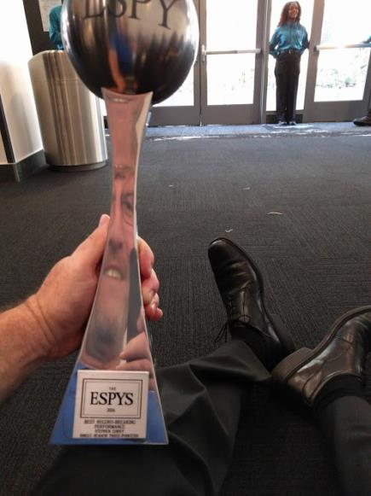
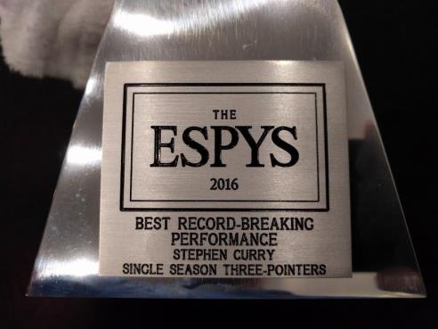
ESPYS

Slide 15
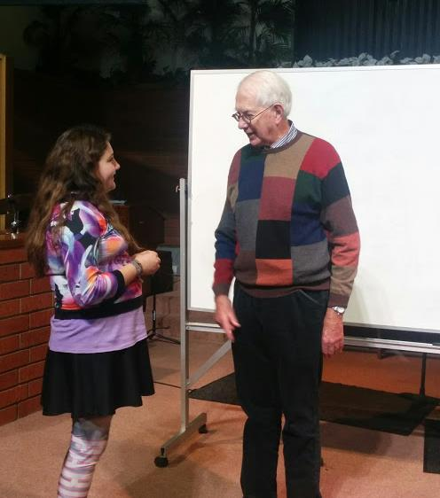
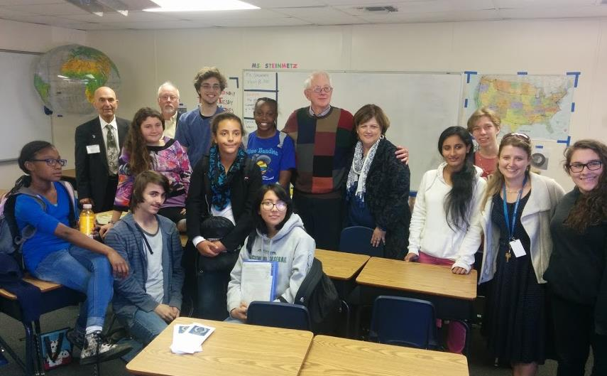
Nobel Laureate – Sheldon Glashow

Slide 16
Big Donation

Slide 17
Final Thought…

Slide 18
The End. Questions? Comments?
Eric Carlson – ecarlson@jasocal.org – (323) 785-3542

