Slide 1
Youth Business Alliance
Guest Speaker, Tarini Ramaprakash
Fall 2017

Slide 2


The Early Years…
I was born in London, Ontario, Canada and
raised in Fort Wayne, Indiana

Slide 3


More Early Years…

Slide 4
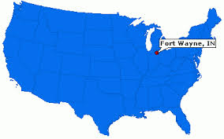



HIGH SCHOOL
I attended Canterbury High School in Fort Wayne, Indiana
\

Slide 5
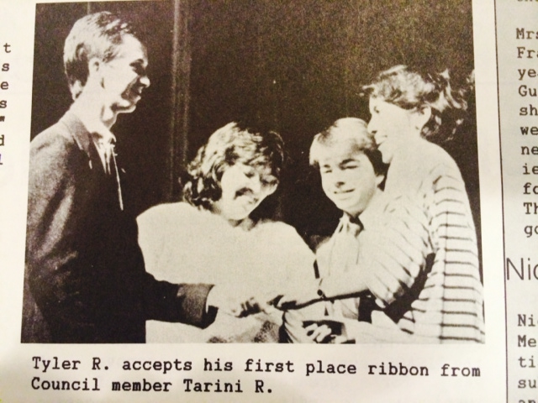
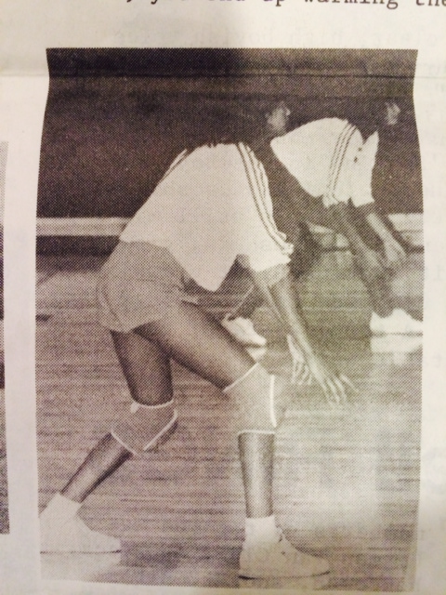
HIGH SCHOOL
As a high school student
  Sports : Volleyball Team & Tennis Team
  School Newspaper
  Was outgoing but not always confident
  Worked hard but not the smartest student
  Had many types of friends
\

Slide 6


College
I attended college at DePauw University
\

Slide 7


College
Activities
  International Club, Asia Club, Sorority, Tutoring local kids
Favorite Classes:
  English Literature (my major)
  Political Science and Asian Studies (my minors)
Fondest Memories
  Having fun, beautiful campus, late night studying, studying abroad in India for a semester, doing an internship on Capitol Hill in D.C.
Least Fond Memories
  DePauw was in the middle of nowhere so there wasn’t too much to do; not much diversity or open-mindedness

Slide 8

Law School
I attended law school at Indiana University School of Law
I worked full time for 1 ½ years of law school (half of the 3 year program) at the State Public Defender’s Office while going to school full-time. I learned a lot from real-life work experience.

Slide 9
Career Path
I started as a law clerk to a judge then worked as an associate attorney in law firms
Became Corporate Counsel then General Counsel of a publicly-traded company; from $250M to $2B in revenues.
Started
Full Circle Resources with another partner in 2014; sold company in 2017
Notes:
You may use this chart to describe your journey to the current career

Slide 10

Business Owner

Slide 11
Full Circle Resources
  Founder & Principal
  Staffing company which helps find jobs for individuals who work in finance and accounting roles
  Contract and Direct Hire
  Client focus

Slide 12
CSUN
Adjunct Professor at California State University Northridge (CSUN)
  Business Law I

Slide 13

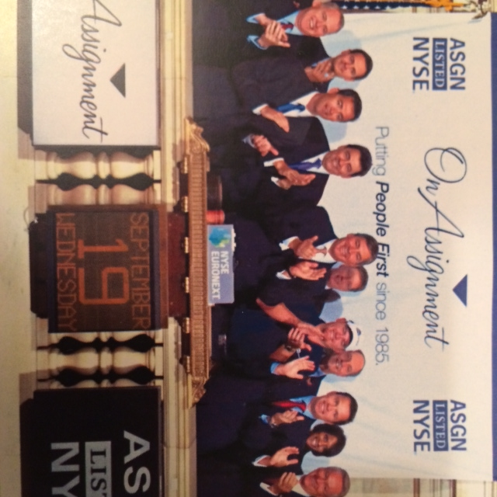


Career

Slide 14
Career
Some challenges
What (almost) always helps
Not being intimidated
  By others
  By my work responsibilities
Not being confident in my abilities
In the course of certain jobs, managing other people can be challenging
Teamwork and partnering with others
Being kind
Recognizing that I always have more to learn
Asking questions
Humility

Slide 15
Next Steps…
Transitioning Full Circle Resources to new owners
Career transition

Slide 16
ACADEMIC EXERCISE 1
Issue analysis

Slide 17
ACADEMIC EXERCISE 2
IRAC

Slide 18
ACADEMIC EXERCISE 2
Issue
Rule
Analysis/ Application
Conclusion

Slide 19
ACADEMIC EXERCISE 2
Civil Law & Criminal Law

Slide 20
Jonah v. Thomas
Jonah was depositing his paycheck at the bank when Thomas, an armed bank robber, came into the bank. He yelled at Jonah to get down on the floor. Thomas threatened to shoot Jonah if he tried to leave. Jonah sues Thomas for false imprisonment.

Slide 21
Jonah v. Thomas
Jonah was depositing his paycheck at the bank when Thomas, an armed bank robber, came into the bank. He yelled at Jonah to get down on the floor. Thomas threatened to shoot Jonah if he tried to leave. Jonah sues Thomas for false imprisonment.
Issue: Is Thomas liable for false imprisonment of Jonah when he threatened to shoot Jonah if he tried to leave the bank?

Slide 22
Jonah v. Thomas
Jonah was depositing his paycheck at the bank when Thomas, an armed bank robber, came into the bank. He yelled at Jonah to get down on the floor. Thomas threatened to shoot Jonah if he tried to leave. Jonah sues Thomas for false imprisonment.
Issue: Is Thomas liable for false imprisonment of Jonah when he threatened to shoot Jonah if he tried to leave the bank?
Rule: In order for Thomas to be liable for false imprisonment, Jonah must prove that there was (1.) an intentional confinement of another person (2.) for a reasonable amount of time (3.) without that person’s consent and (4.) with that person’s knowledge.

Slide 23
Jonah v. Thomas
Jonah was depositing his paycheck at the bank when Thomas, an armed bank robber, came into the bank. He yelled at Jonah to get down on the floor. Thomas threatened to shoot Jonah if he tried to leave. Jonah sues Thomas for false imprisonment.
Issue: Is Thomas liable for false imprisonment of Jonah when he threatened to shoot Jonah if he tried to leave the bank?
Rule: In order for Thomas to be liable for false imprisonment, Jonah must prove that there was (1.) an intentional confinement of another person (2.) for a reasonable amount of time (3.) without that person’s consent and (4.) with that person’s knowledge.
Application:

Slide 24
Jonah v. Thomas
Jonah was depositing his paycheck at the bank when Thomas, an armed bank robber, came into the bank. He yelled at Jonah to get down on the floor. Thomas threatened to shoot Jonah if he tried to leave. Jonah sues Thomas for false imprisonment.
Issue: Is Thomas liable for false imprisonment of Jonah when he threatened to shoot Jonah if he tried to leave the bank?
Rule: In order for Thomas to be liable for false imprisonment, Jonah must prove that there was (1.) an intentional confinement of another person (2.) for a reasonable amount of time (3.) without that person’s consent and (4.) with that person’s knowledge.
Application:
Conclusion:

Slide 25
England v. Garley
Betty England worked at a Dairy Queen in Tallulah, Louisiana. One day, her manager, Larry Garley, became upset about burned hamburgers. In anger, Garley threw a hamburger which hit England on the leg. England was not harmed by the hamburger. England sued Garley for battery.
Issue: Is England liable for battery against her boss Garley when she was hit by a hamburger that Garley threw in anger?
Rule: In order to win a case for battery against Garley, England must prove that there was an (1.) intentional and (2.) harmful or offensive touching of another (3.) without her consent. No direct contact is needed for the touching requirement.
Application:
Conclusion:

Slide 26
Wilson v. Huey
Martin Wilson worked as a paralegal for an attorney. While the attorney was talking to David Huey, Martin tried to enter into the attorney’s office. Huey slammed the door closed in Wilson’s face, saying “you get out!,” pushing him into the hall. Wilson suffered no physical injury. Wilson sued Huey for battery.
Issue: Is Huey liable for battery against Wilson when he pushed a door closed in Wilson’s face forcing him into the hall?
Rule: In order to win in an action for battery against Huey, Wilson must prove that there was an (1.) intentional (2.) harmful or offensive touching of another (3.) without his consent.
Application:
Conclusion:

Slide 27
Carly v. Vince
When the sun is setting one night, Carly sees that the door to Vince's house is unlocked. Carly knows that Vince has a home office with expensive computer equipment. Carly pushes the unlocked door open, walks into the house and steals Vince's computer equipment that is worth more than $5,000. Carly is charged with burglary.
Issue: Did Carly commit burglary when she opened the unlocked door to Vince’s house at sunset in order to steal Vince’s computer equipment?
Rule: In order for Carly to be guilty of burglary, the prosecution must prove:
(1) a breaking
(2) and entry
(3) of a dwelling
(4) of another
(5) at night
(6) with the intent of committing a felony inside
Application:
Conclusion:

Slide 28

Questions and Answers

