Slide 1
Dana Coffman
Nonprofit development and communications

Slide 2
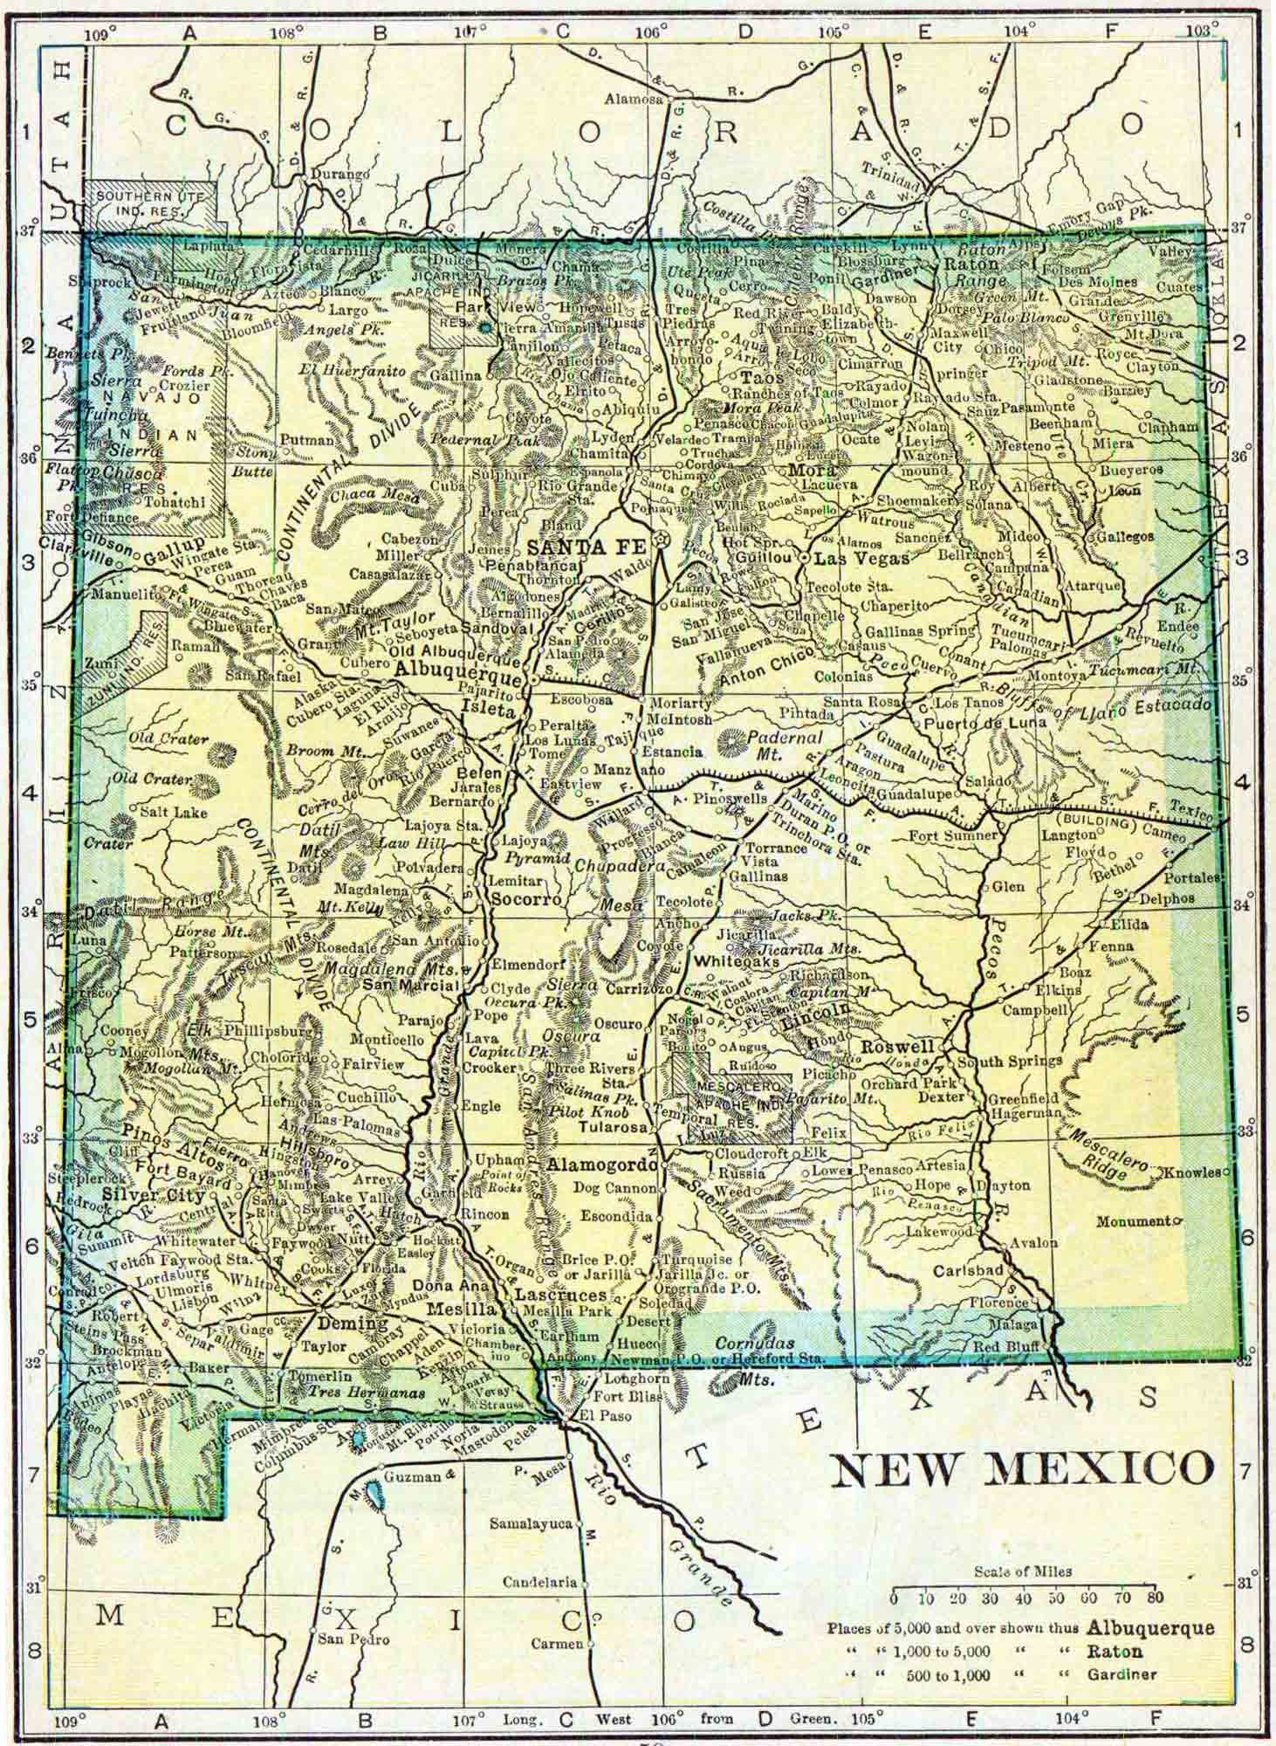
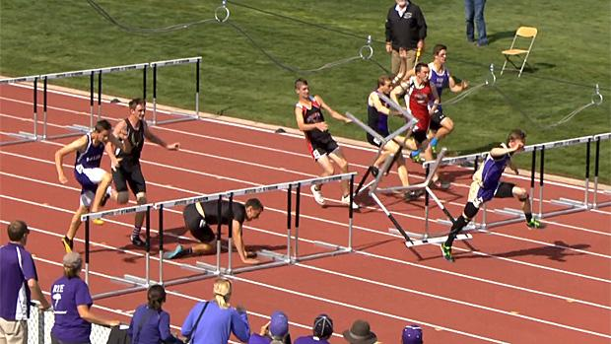
A little about me...
From Santa Fe, NM
Grew up in the outdoors and riding horses
Played soccer and ran track
Huge Lord of the Rings and Harry Potter fan

Slide 3
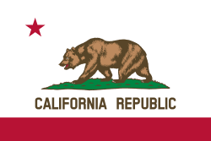
On to the big city...
Moved to Los Angeles to attend Occidental College
Studied sociology: how institutions can impose inequality and prohibit equal rights
Focused me towards a career making a difference

Slide 4
#Adulting
Started at GLEH senior year (first nonprofit job)
Also worked for a catering company
Left for Australia
Came back into politics...
Then furniture….

Slide 5
Back to School

Slide 6
The Climate Registry
After my Masters I went back to my first role with more knowledge.
Running communication, fundraising, and events.
- - - - - - - - - - - - - - - - - - - - - - - - - - -
Greenhouse gas accounting.
Helping governments and corporations understand their emissions.
Providing the tools, resources, expertise needed to identify reduction opportunities.

Slide 7
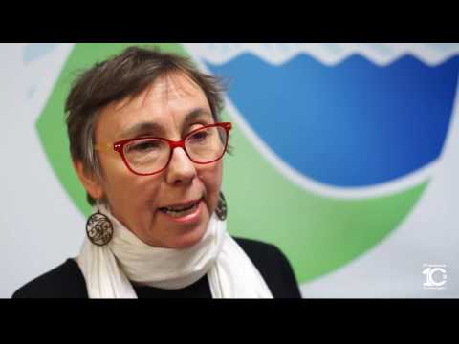
Coalition of Climate Leaders
It is really all about interaction, partnerships, and support.
I am not as interested in the technical work, but I care deeply about climate change.

Slide 8
The Takeaway
Any skill can be transferred into almost any industry.
Do what you like for something you care about.
Example: environmental lawyer, sports reporter

Slide 9
Entrepreneurship get creative with it
Favorite subject and/or activity in school
Example: biology, reading, algebra
Careers you know of that use that subject/skill
Example: doctor, author, data scientist

Slide 10
It’s about you!
What do you LIKE to do? What are you passionate about?
Example: bike riding, playing video games, eating
Connect the dots!
Example: I like creating memes and my favorite subject is chemistry - social media manager for a prescription drug company OR hardware engineer at google

