Slide 1
Youth Business Alliance
Jacob Hallman – StudyGate

Slide 2
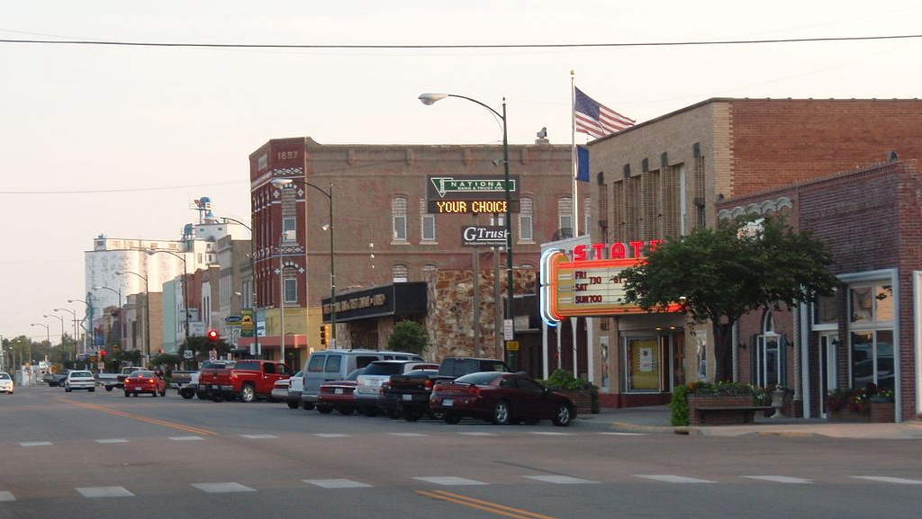
My Backstory
Moved around 4 times as a boy, went to high school in rural Kansas.
Parents divorced in high school and I am the oldest of 4.
My classmates stayed in Kansas, joined the military, started families

Slide 3
My Business

Slide 4
Why I started this company
There always will be smart people.
Who helps the others?
Professor
Lecturer
Teacher Assistant
Tutor center
Traditional tutoring

Slide 5
My Job: Study Different ways to learn after school
How to balance a chemical equation?
H2 + N2 → ?
Watch a video

Slide 6
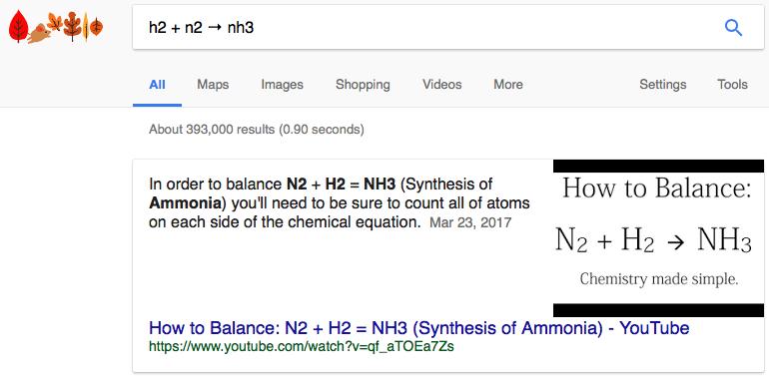
My Job: Different ways to learn after school
How to balance a chemical equation?
H2 + N2 → ?
Watch a video
Ask Google

Slide 7
My Job: Different ways to learn after school
How to balance a chemical equation?
H2 + N2 → ?
Watch a video
Ask Google
Make some guesses

Slide 8
My Job: Different ways to learn after school
How to balance a chemical equation?
H2 + N2 → ?
Watch a video
Ask Google
Make some guesses
Studygate
StudyGate is On-Demand Learning Solutions.

Slide 9
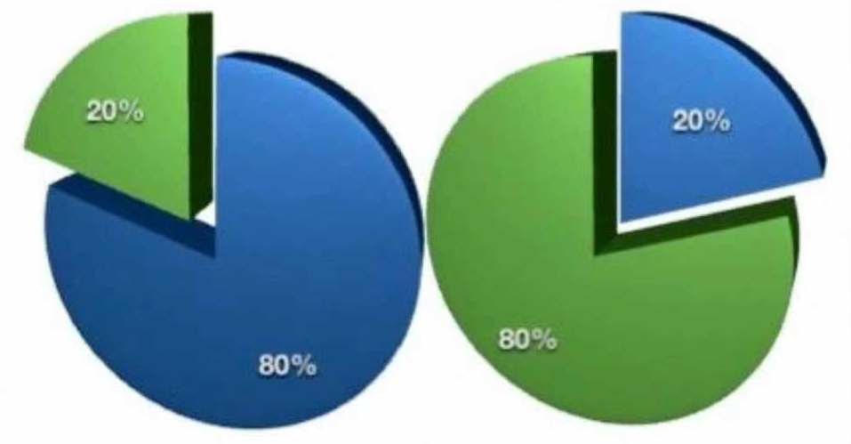
80/20 – The Pareto principle
80% of the population traditionally possesses 20% of the world’s financial wealth
80% of the peas in a garden are produced by 20% of the pea plants
80% of an entrepreneur’s time is spent figuring out how to best use their time!
20% of the input (time, resources, effort)
Accounts for 80% of the output (results, rewards)

Slide 10
Day in the life
A Typical Day as an Entrepreneur
Talk to students
Help a tutor
Find ways to improve the website
Meet people I can help
Skills that Have Helped Me Excel
Positive attitude
Hard work and tenacity
Desire to always learn
Focus on core strengths

Slide 11
Because life only gets as big as you can imagine it

