Slide 1
Youth Business Alliance
Guest Speaker
Michelle Kane
February 9, 2015

Slide 2
INTRODUCTION
My name is Michelle Kane and I am 45 years old.
My company is Kane Public Relations
Kane Public Relations is a public relations firm that works with high powered CEOs and high growth companies to increase their media exposure
I am Founder & President of Kane Public Relations
I worked at several companies before Kane PR (technology, entertainment, healthcare and retail

Slide 3
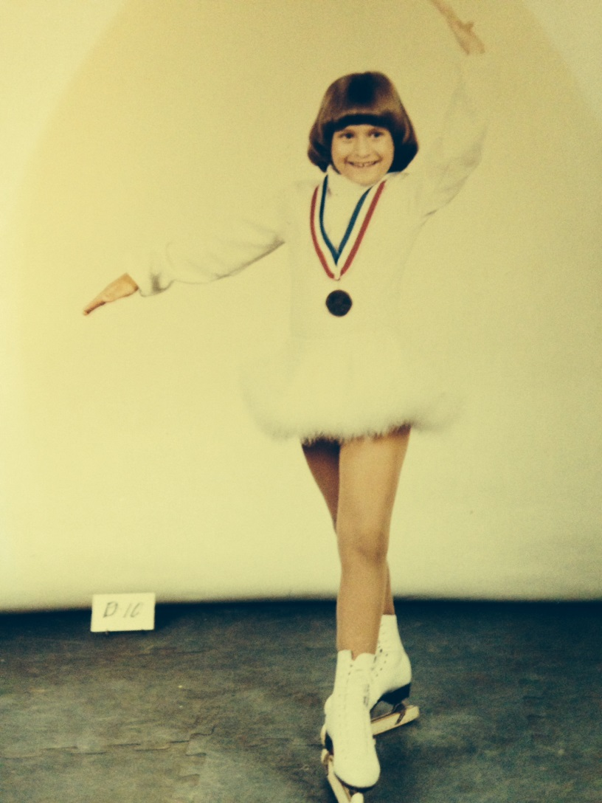
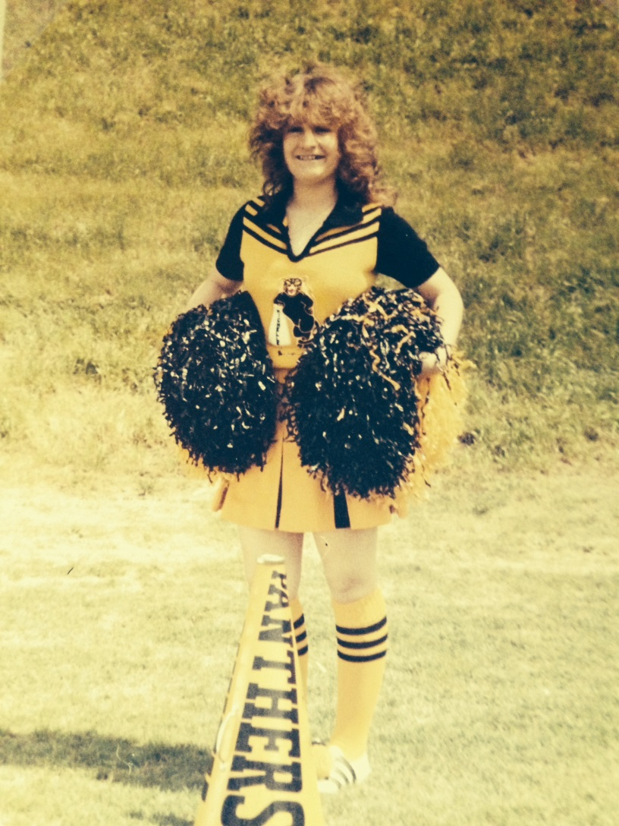
The Early Years
I was born in Los Angeles, CA and raised in Grand Prairie, TX
This is me when I was 6 years old
I was a cheerleader in 6th grade

Slide 4
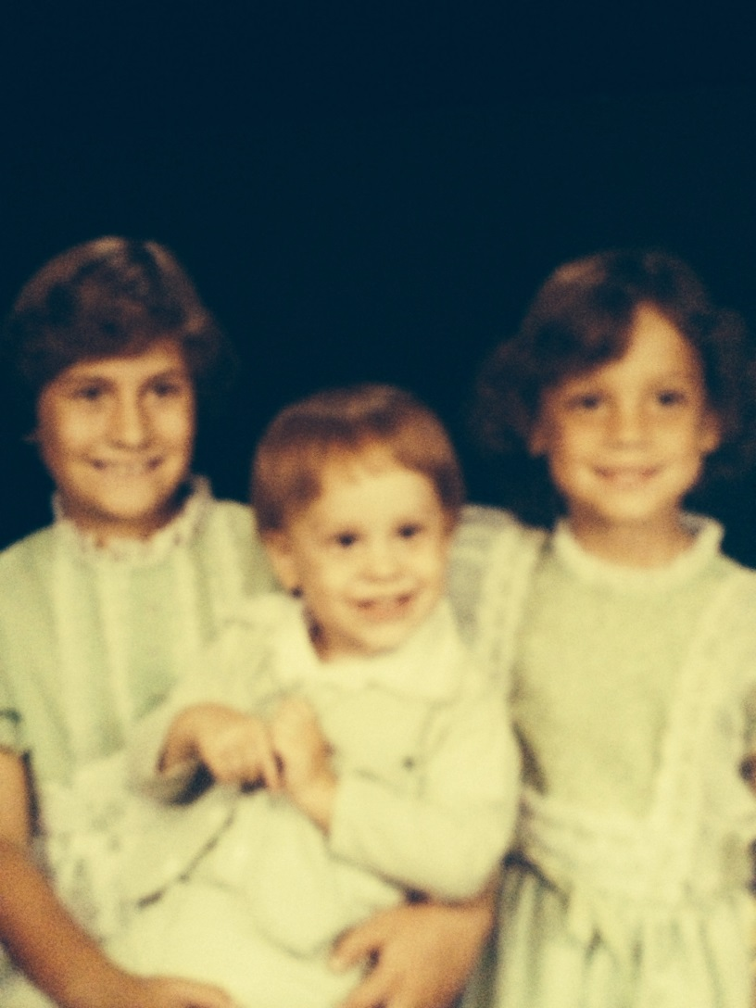
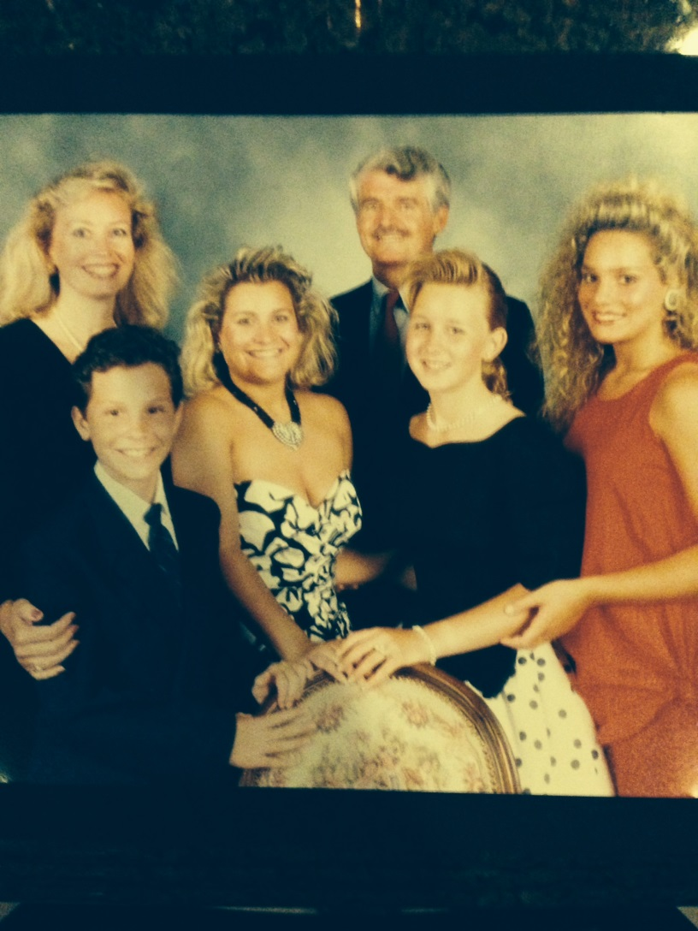
More Early Years….
A Little About My Family
This is my Dad, Step Mother, sister s and brother (Christine, Sean and Mandy ).
This is a picture of me and my brother and sister (Sean and Christine).

Slide 5
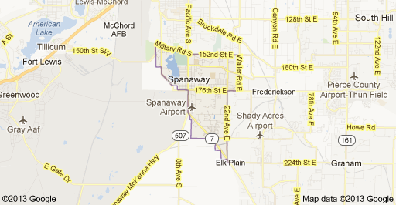
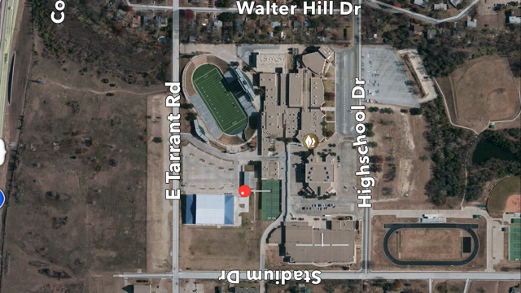
HIGH SCHOOL
I attended Grand Prairie High School in Grand Prairie, TX
Insert map shot here
\

Slide 6
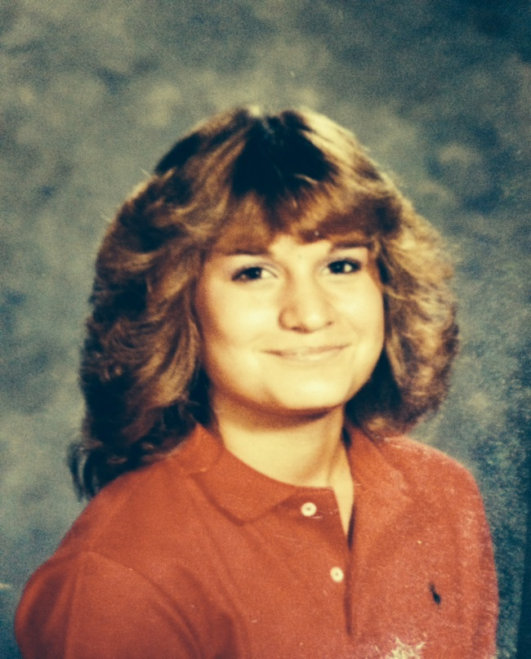
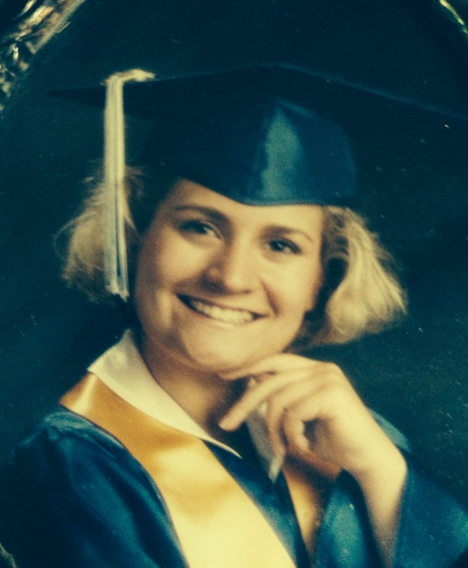
HIGH SCHOOL
As a HS student I was President of my class for 3 years, played volleyball, and was a member of the Academic Decathlon
As a HS student I was pretty popular, had lots of friends, and was very busy with academics, sports and activities.
\
Me in the 9th Grade in HS
Me when I graduated HS

Slide 7
HIGH SCHOOL
Things I enjoyed in HS
Things I did not enjoy in HS
Classes:
English
Latin
History
Sports:
Volleyball
Soccer
In-School Activities:
Student Council
Some classes and teachers
Hated Math – All of it
Chemistry
Favorite teacher
English Teacher, Dana Ivy
Detention
I was in trouble several times for doing stupid things.
In Texas, we got a “swat” on the backside every time we were sent to the principals office.
School “cliques”
I was one of the popular kids and enjoyed the “clique” I was in.

Slide 8
HIGH SCHOOL
Activities/Athletics in HS
Jobs I worked while in HS
I was very busy in HS. I would get home after volleyball practice at about 7pm every night. I would eat dinner and do my homework every night . No phone or TV (no Internet back then) until I was finished.
I’ve been working since I was 14. I worked in the concession stands for the Texas Rangers Baseball team for 4 years. Every summer I would work at a waterpark during the day and work at Ranger stadium at night.

Slide 9
HIGH SCHOOL
Fondest memories from HS
Obstacles/Adversity you had to overcome in HS
Hanging out with my friends
Getting good grades to get into a good college
Playing sports, participating in Student Council and being elected President of my class for 4 years
Working at Ranger Stadium with my best friends from HS
Even though I was in the popular crowd, I did try out to be a cheerleader in 11th grade and did not ’ t make it.
Sometimes I was more interested in going out with my friends than doing my homework and focusing on what was important.

Slide 10
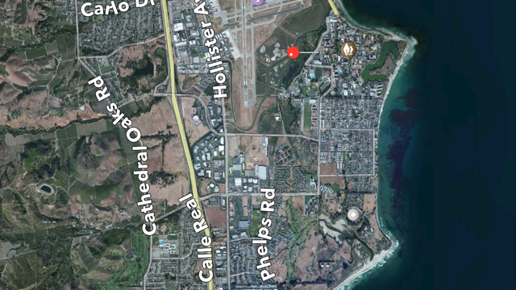
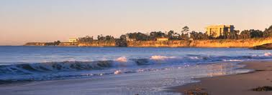
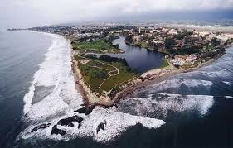
College or
Graduate School
I attended college at the University of Santa Barbara, CA
UCSB Campus
\

Slide 11
College or
Graduate School
Activities/Athletics in College
Jobs I worked while in College
Sorority
Traveling
Surfing
My freshman year I worked at Carrow’s Restaurants from 9pm – 5am (50 cent tips were average during that shift)!
My last 3 years of college, I worked at Red Robin as a waitress 4 nights a week to help pay for school

Slide 12
College or
Graduate School
Favorite classes
Least favorite classes
Sociology
Phycology
Greek and Roman Mythology
History
Russian History
Vietnam War – Wash DC
Math
Sex Education

Slide 13
College or
Graduate School
Fondest memories
Obstacles or adversity that you had to overcome
Making new friends who are my very best friends today
Learning to be independent by living far away from home (Texas)
Traveling to new cities, NYC, San Diego, Washington DC
Playing Tennis
I worked full time in college to help with my expenses and my sorority
I had to graduate in 3 ½ years because my younger sister was going to start college then
Studying – I was never a big fan which made things MUCH harder!

Slide 14
Career Path
I worked at Nordstrom and then became an assistant to an agent in the Entertainment Industry
After 6 years, I became a Creative Executive at a production company and oversaw public relations for our TV shows and Films
I am now the Founder and President of this organization ….
I went to a technology company and ran International PR for PriceGrabber.com
I started my own Public Relations Firm in 2006
Notes:
You may use this chart to describe your journey to the current career

Slide 15
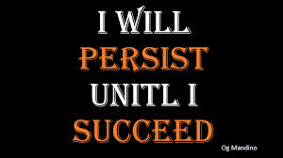
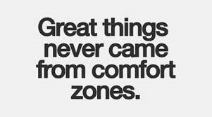

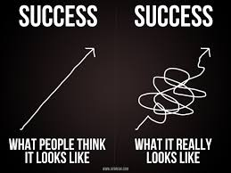
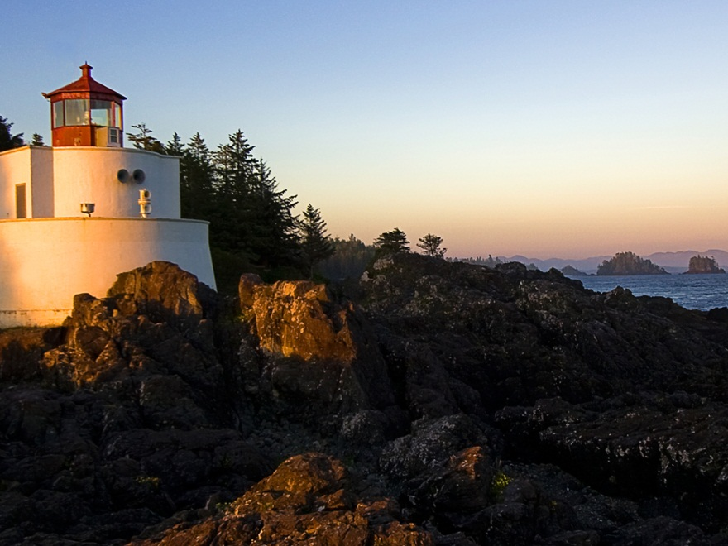
Career

Slide 16
Career
My first Job
My worst Job
My first job was working in the ice cream concession stand for the Texas Rangers Baseball Team. After eating too much of it, I asked to move. Then, I made nachos, popcorn and fried chicken fingers for the crowds at the baseball game.
My worst job was my first job in college at Carrow’s Restaurant. I did not have any waitressing experience so I had to work the graveyard shift. Everyone was drunk by the time they came in at midnight and I would leave an 8 hour shift with coins only – maybe making $20.00.

Slide 17
Career
Some challenges I had to overcome in my career
Leaving the Entertainment Industry to go work in Public Relations at a Technology company was the hardest decision I ever made. Eventually, I oversaw Global PR for the company and opened offices in London, Paris, Germany and Canada. This job gave me the confidence I needed to start my own company. Believing in myself and never giving up have been the secrets to my success in my own company and my past careers.

Slide 18
CURRENT ROLE
History
Kane Public Relations was formed in 2006.
We provide communications and marketing strategies to high end companies
Size
Kane PR has approximately 15 employees
We have people who work remotely across the US
Location
Kane PR has offices in Los Angles, CA and NYC
Products
Services
N/A
We provide public relations and marketing strategies to high powered CEO’s and high growth companies.
Notes:
Use this graph to give more description of your current company (history, size, location, products and services, etc.)

Slide 19
Current Role
President
Public Relations
Operations
Brand Strategist
Recruiting
Notes:
Use this graph to give more description of your role specifically (responsibilities, typical work week, direct reports, etc.)

Slide 20
Career Compensation
Management
($90k - $150k)
Global Public Relations
$100k
Creative Director
$75k
Executive Assistant
$50k
Notes:
Use this graph to show general compensation ranges for people in various roles in your company

Slide 21
ACADEMIC EXERCISE
We will now spend several minutes discussing the day’s academic module and how it is relevant in the ‘real world’

Slide 22

QUESTION AND ANSWER

