Slide 1

THE REAL HEALTH SCARE

Slide 2
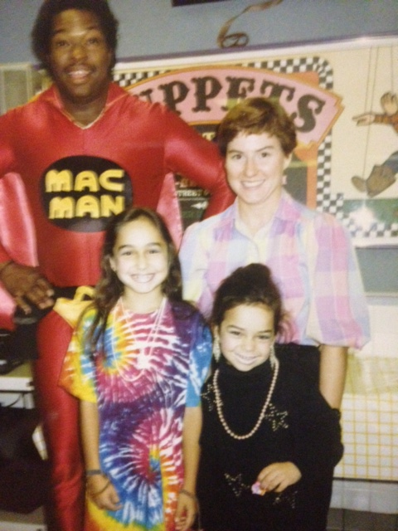
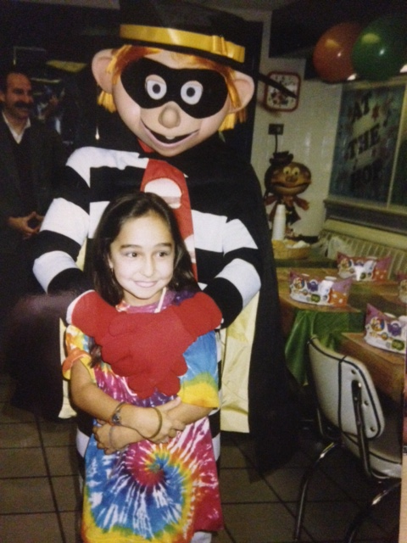
FORMER FAST FOOD ADDICT...
CELEBRATED SEVERAL BIRTHDAYS AT MY FAVORITE PLACE...McDONALD’S

Slide 3
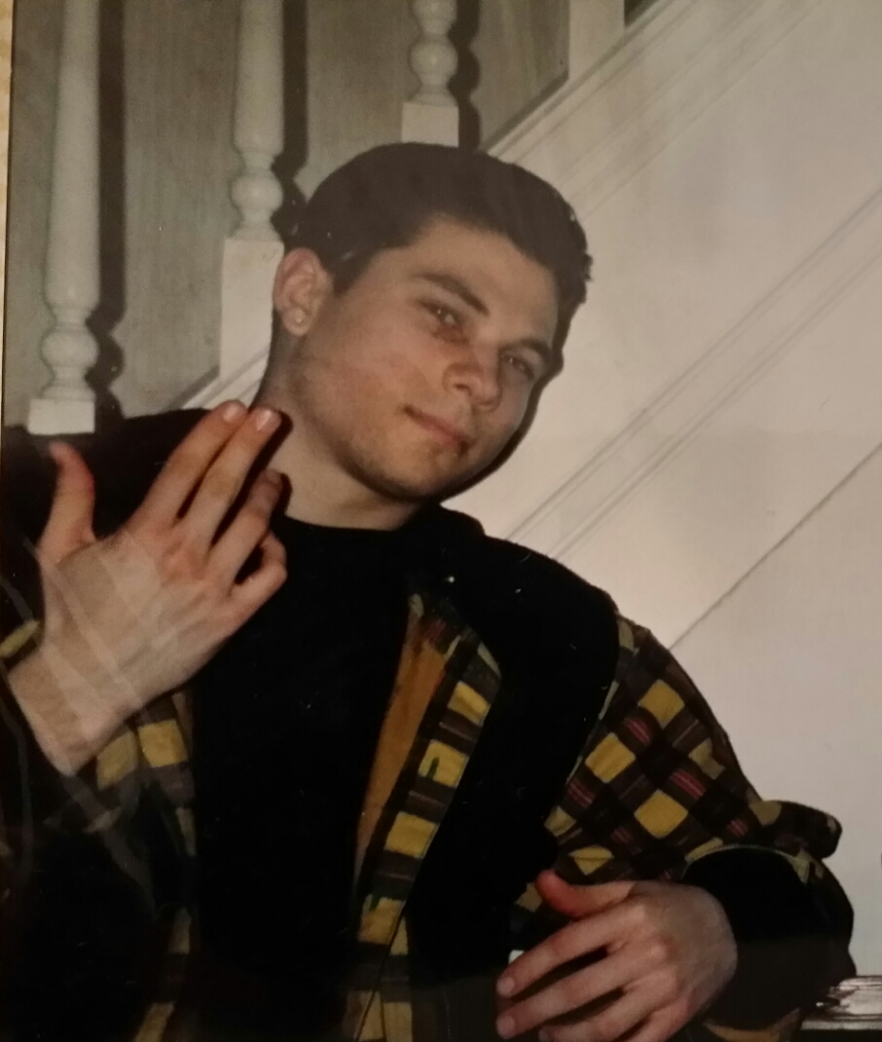
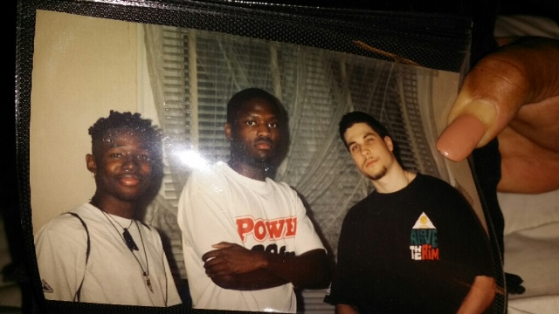
Always serious
...especially about health, nutrition and working out.

Slide 4

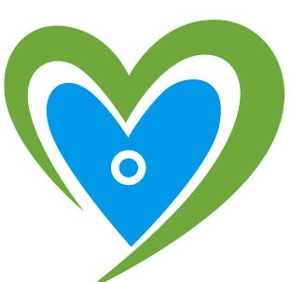
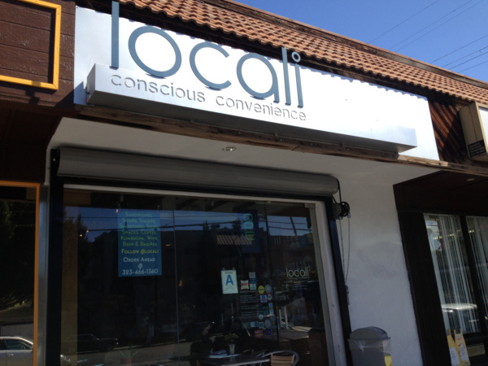
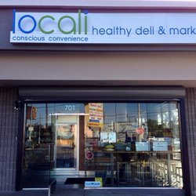

5825 Franklin Ave.
Hollywood, CA 90028
701 Lincoln Blvd.
Venice, CA 90291
817 S. Los Angeles St.
Downtown LA, CA 90014
INNOVATION • SUSTAINABILITY • COMMUNITY

Slide 5



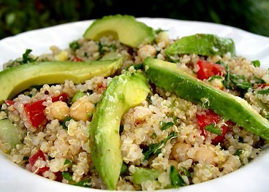
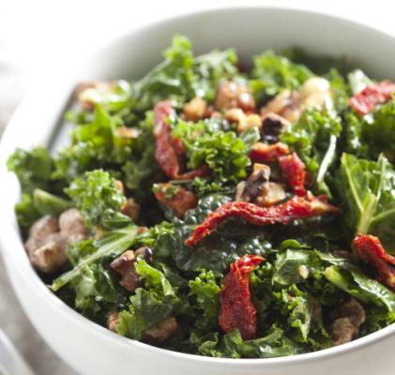
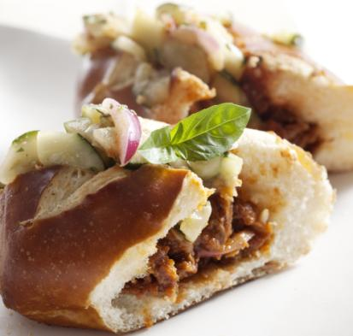
“A sustainable version of 7-11, stocking healthful, gourmet prepared foods…”
Gayot, 2014
“…huge selection of good-for-you drinks, sandwiches and salads…”
Aram B.
Venice Customer
“…amazing vegan treats…”
Tara
Hollywood Customer
“…breakfast, lunch and dinner…can’t get enough of this place”
Jasmine W.
Hollywood Customer
“…awesome shakes & salads”
Alexis A.
Venice Customer

Slide 6
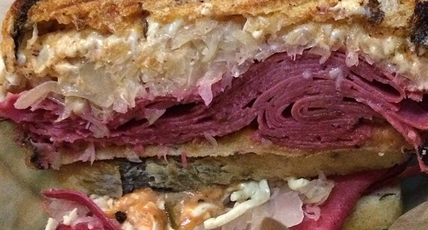

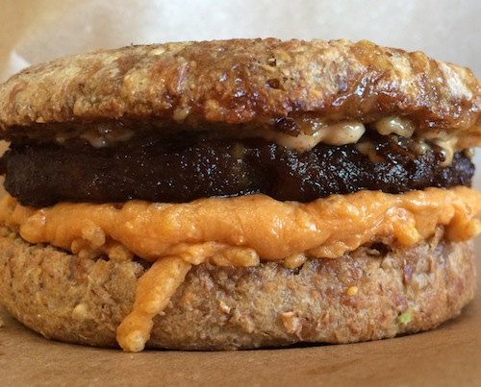
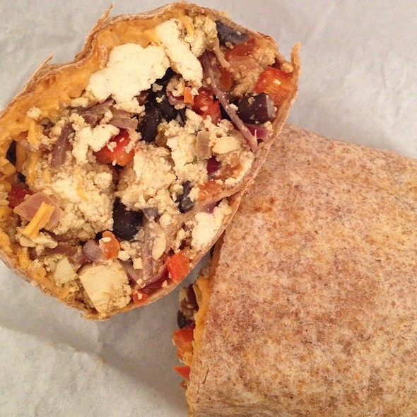
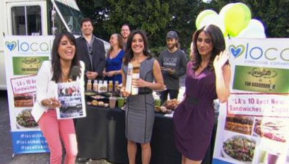
“LA’s first conscious convenience store” LA WEEKLY, 2009
“1st Place Professional Category”
Grilled Cheese Invitational, 2010
“LA’s 10 Best New Sandwiches”
Zagat, 2014
“…creatively-engineered meat-free sandwiches”
LA TIMES, 2012
“…an eco-friendly 7-11…”
Good Day LA
FOX TV
2014
“One of LA’s Best Breakfast Burritos”
CBS News
2014

Slide 7
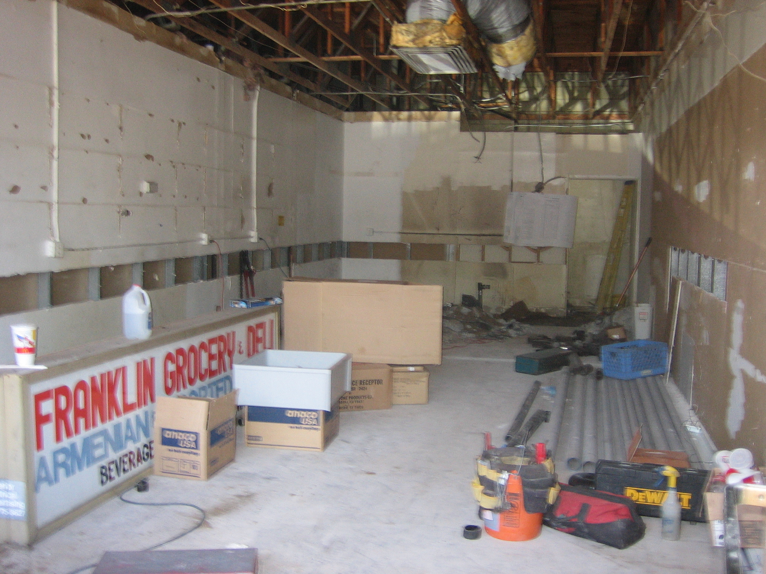
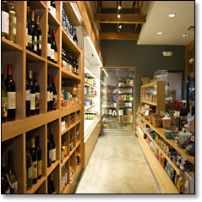
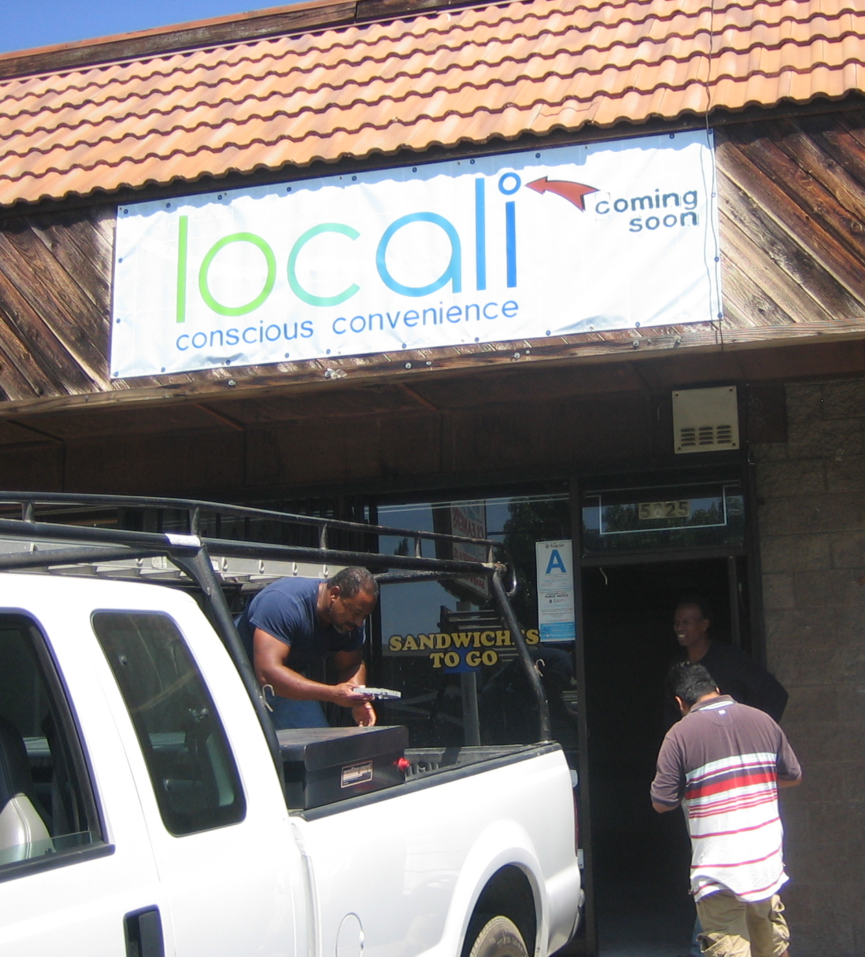
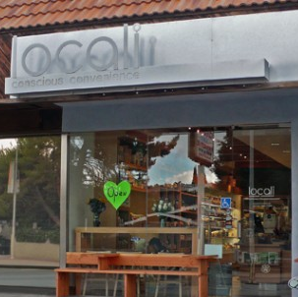
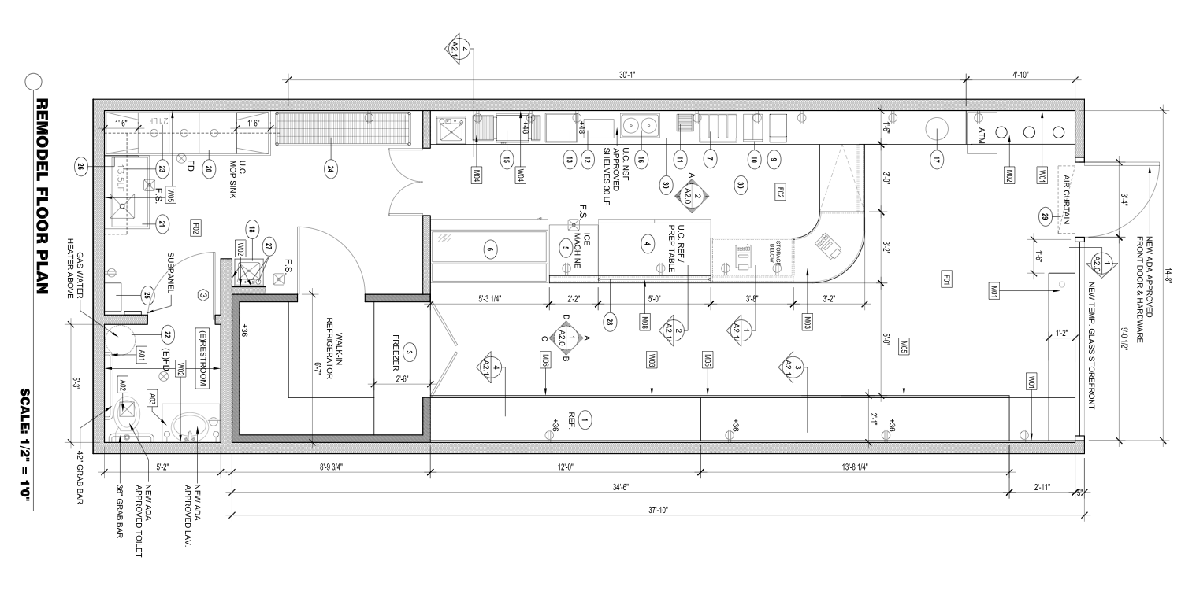
“…taking grab-n-go to a whole new level…”
Tree Hugger, 2009
LOCALI HOLLYWOOD
675sqft space
Reclaimed wood fixtures
Recycling waste program
Energy Efficient lighting

Slide 8
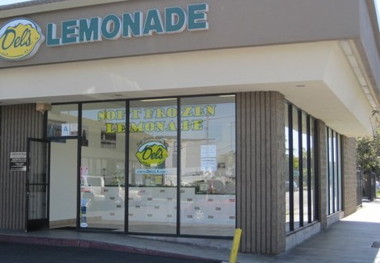
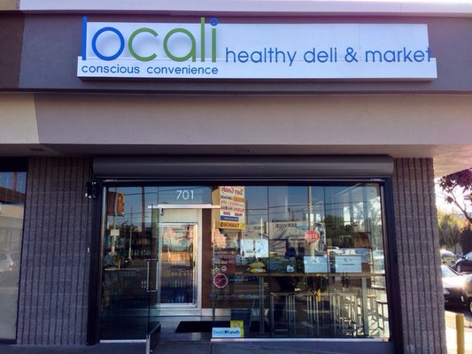
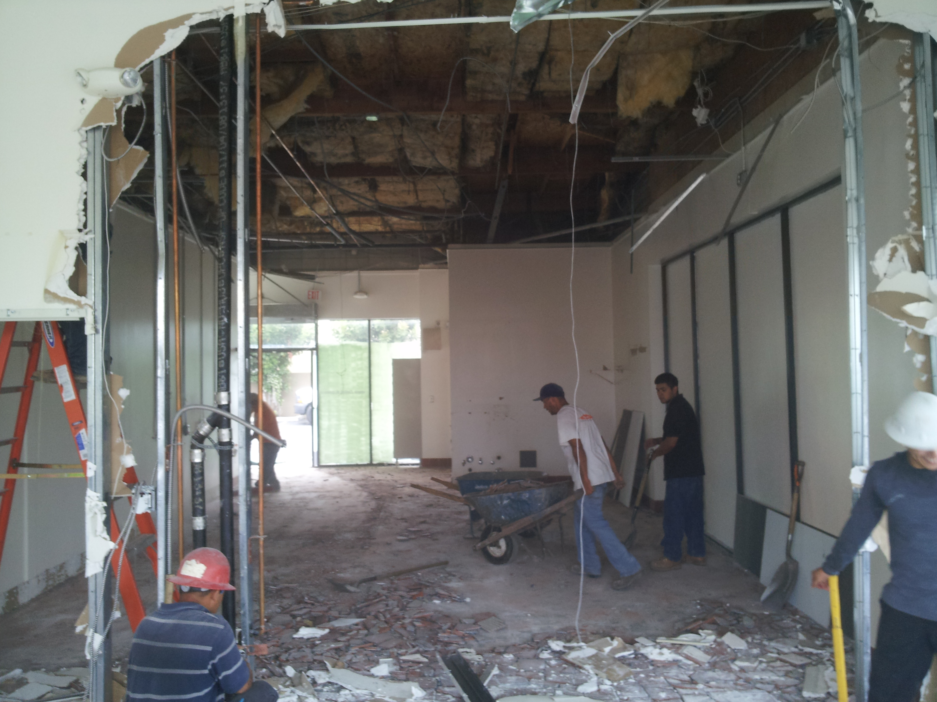
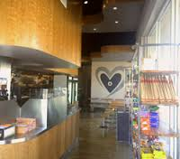
“Locali Conscious Convenience Lands on Lincoln in Venice” - Eater LA, 2013
LOCALI VENICE •1,200sqft •100% hand-crafted reclaimed wood/metal furniture •Energy efficient lighting, fixtures and appliances •Gentrification of a center in a Coastal area undergoing growth

Slide 9
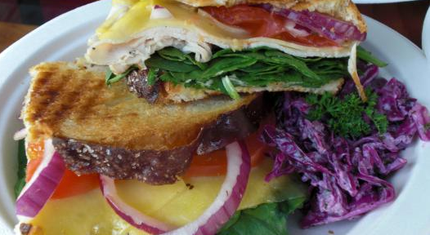
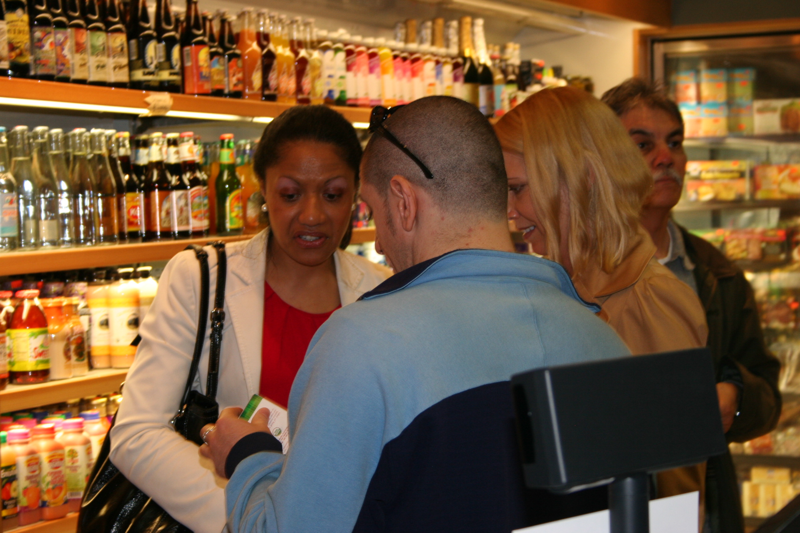
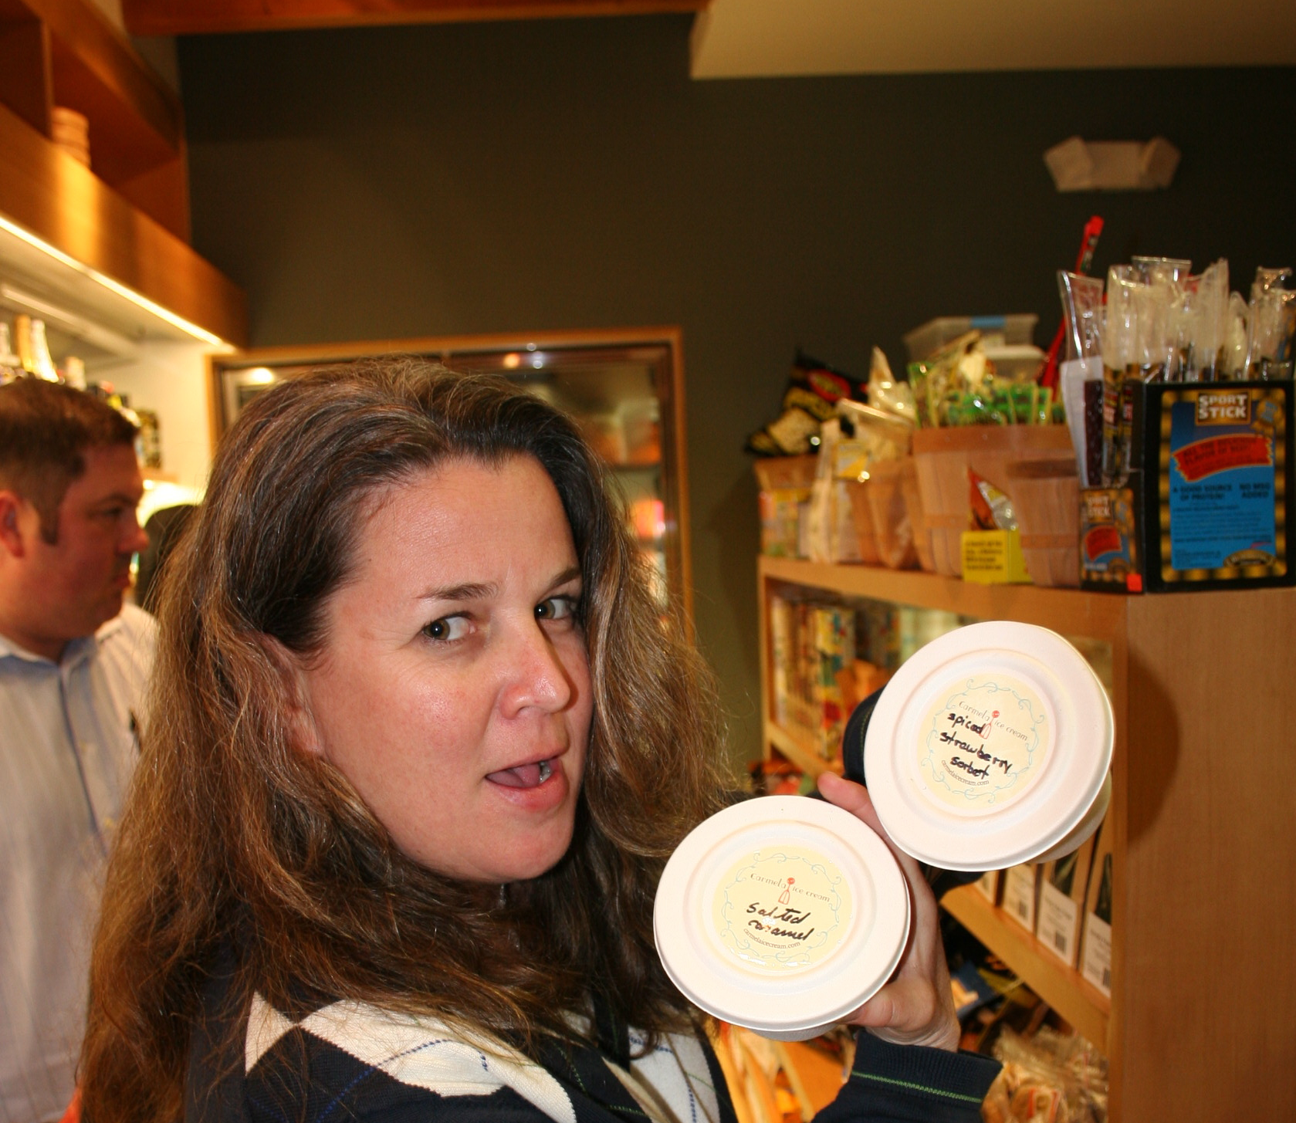
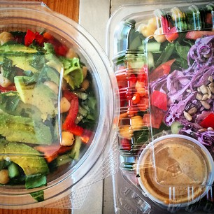
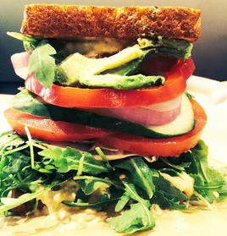
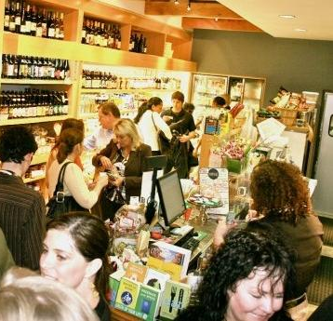
“Locali offers natural and organic alternatives to conventional convenience store fare…”
- Farm Lab, 2010
“Locali Conscious Convenience - the deli and convenience store known for great sandwiches, Elvis smoothies…and vegan condoms.”
- Urban Daddy, 2014

Slide 10
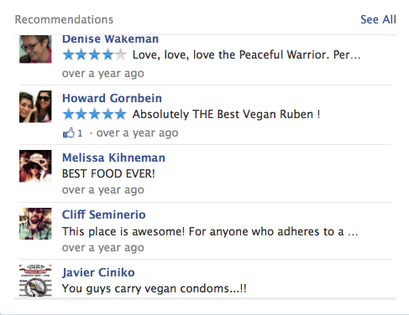



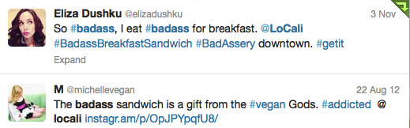

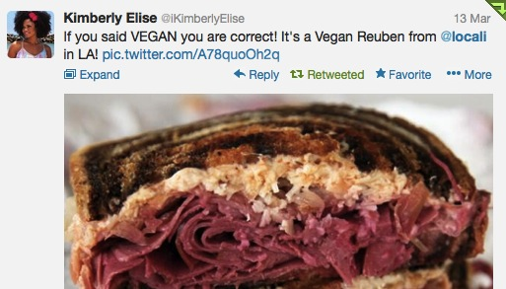


Tweets, Facebook Likes & 5 Star Yelp Reviews Confirm the Truth...
Locali has something for everyone!

Slide 11
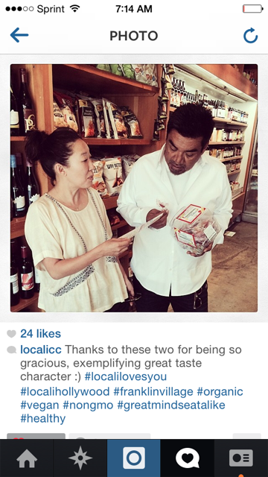
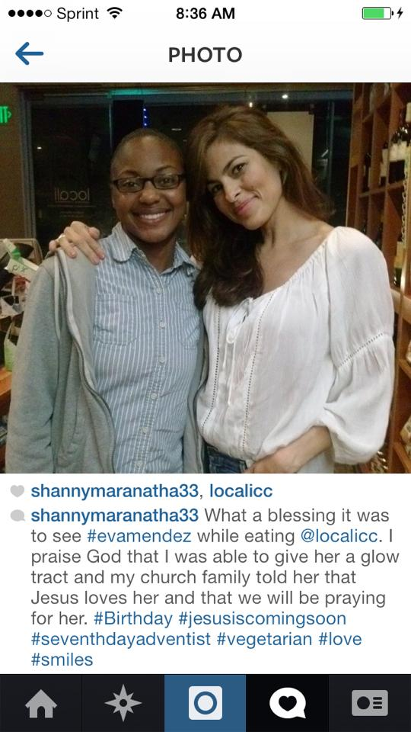
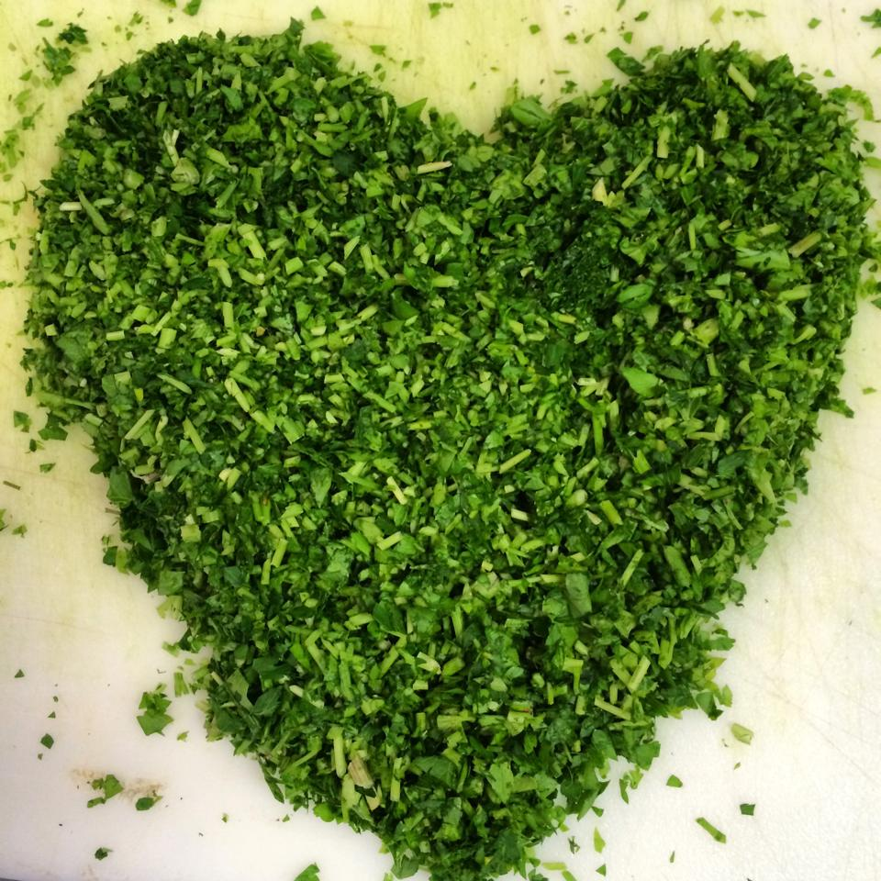

Slide 12









“Tell me and I forget. Teach me and I remember. Involve me and I learn”
- Benjamin Franklin

Slide 13
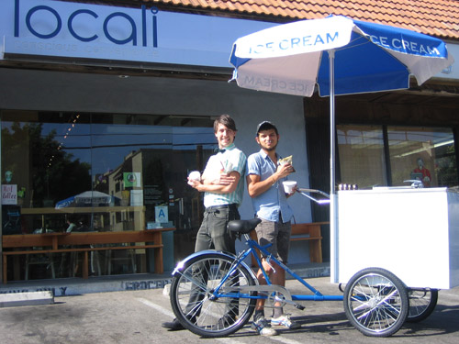






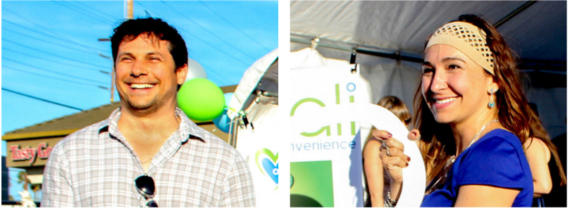
Management Team
Combined 25 years in food service, physical fitness & health care.
Certified Woman Owned Business (WBE) & B-Corp by 2014.
Established Partnerships with:
_________________________________________________________________________
Greg Horos, COO –
Temple University, Clear Channel, Personal Training, B2B Sales
Expertise: Restaurant Management, Construction; Real Estate; Accounting
Melissa Adele Rosen, CEO –
BA, Northwestern; MPW, USC;
Health Counseling, IIN/Columbia
Expertise: Menu Creation; Branding; Design; Business Development; HR

Slide 14
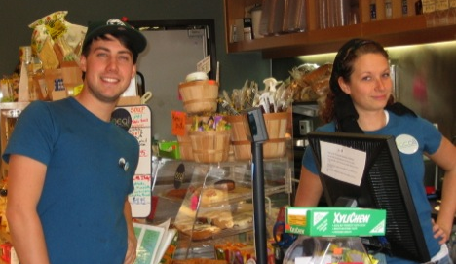
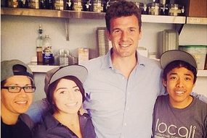
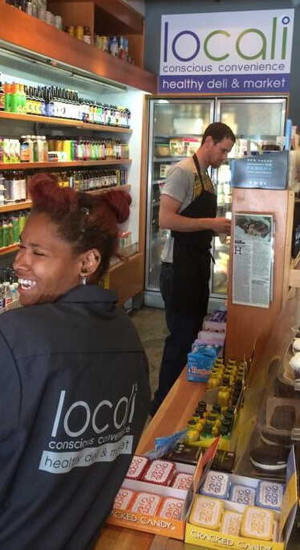
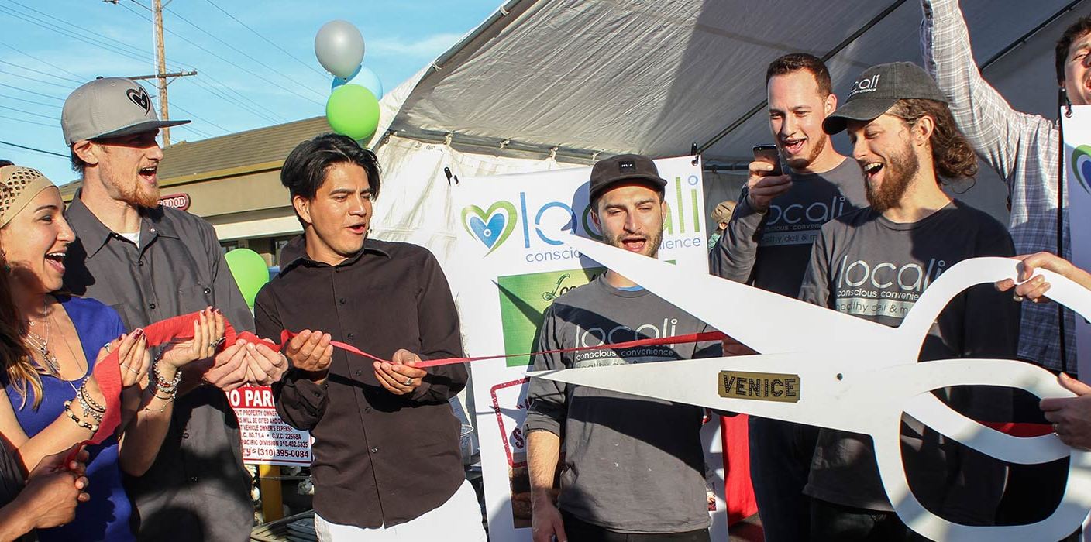
“Design is not just what it looks like and feels like. Design is how it works.”
- Steve Jobs

