Slide 1
“To me, job titles don’t matter. Everyone is in sales. It’s the only way we stay in business”
-Harvey Mackay
Taylor Dance
Account Executive, Salesforce

Slide 2
Background:
-Born in Northridge
-Grew up in DC
-First Job: Dishwasher
-College: University of Washington

Slide 3
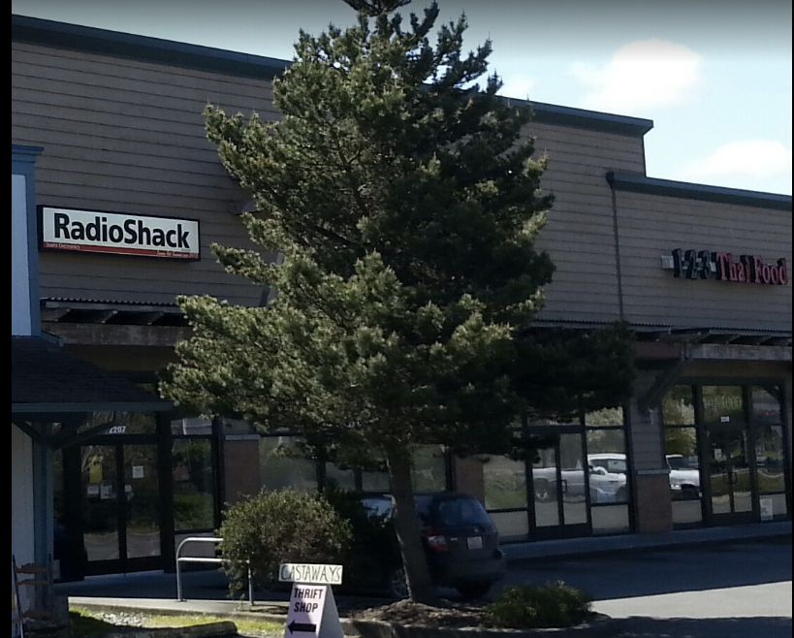
Gap Year… or two
Definition: a period, typically an academic year, taken by a student as a break between secondary school and higher education.
What I learned:
Value of $ and doing without
The power of networking
My passion for helping people solve a problem

Slide 4
College
It’s challenging, but so worth it
Follow your interests You’ll be studying for four years… make sure it’s something that you care about
Get involved Don’t be afraid to join, or start an interest group. Plug-in to the university… many professors are also business professionals or entrepreneurs.
Stay focused There are a lot of distractions… remember why you’re there!

Slide 5
First Job: Role: Sales and Marketing, software startup
Source: Craigslist
What I learned:
The meaning of hustle
You’re going to make mistakes
“Comfort can be dangerous. Comfort provides a floor, but also a ceiling” -Trevor Noah
Tip
Entering the workforce can be SUPER scary… don’t be afraid to take that entry-level job or work multiple jobs in a field you want to be in.

Slide 6
Acorns
Role: Business Development/Sales
Source: Networking
What I learned:
Follow your passions
Don’t be afraid to ask
Keep in touch with your colleagues
Tip
Your job won’t always be crystal clear... don’t be afraid to lead the way and take ownership!

Slide 7
Salesforce
Role: Account Executive
Source: Networking
What I learned:
Surround yourself with greatness
Build your empathy muscles
Focus on YOUR brand!
Tip
Remember. If something sounds like common sense, people will ignore it.
Highlight what is unexpected about your topic.

Slide 8
What is a day in the life of an AE?
Morning - Plan your day (calls, customer visits, tasks)
Afternoon - Customer calls, product demos, prospecting and customer check-ins
Evening - follow-ups, product education, examining data

Slide 9
OK… but what if I want to be more than a salesperson?

Slide 10
Sales jobs teach you:
How to ACTIVELY listen
How businesses work and make $
How to leverage your network and work as a team
How to “read people” and their motivations
Resiliency and how to learn from failure
Empathy and solving customer problems

Slide 11
2. Practice!
Find a partner
Pick who will be the buyer and who will be the consultative salesperson
Sellers: remember, no one wants to be sold! Make sure you’re asking questions and find out what’s important to the customer.
Sellers, take 3-4 mins to come up with some great questions (focus on the what, how and why?)

Slide 12
All‑new 5.8‑inch Super Retina screen
Face ID recognition
Most durable glass ever in a smartphone, front and back
Larger and faster 12MP camera
A11 Bionic chip - the most powerful and smartest chip in a smartphone
Battery lasts two hours longer between charges than iPhone 7
Wireless charging
Augmented Reality

Slide 13
Thank You,
David Starr Jordan High School!

