Slide 1
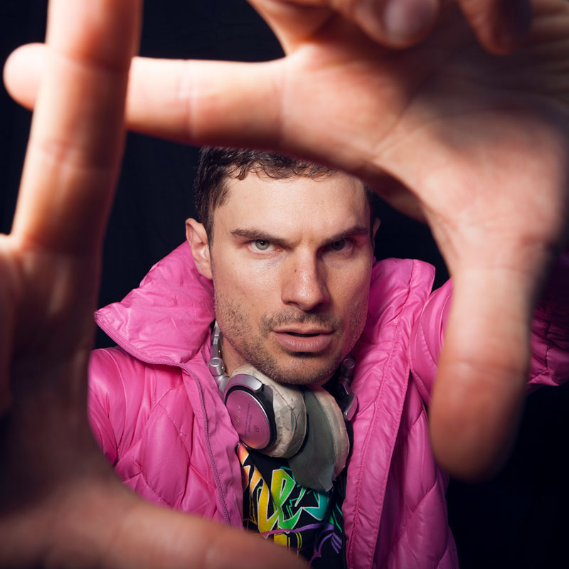
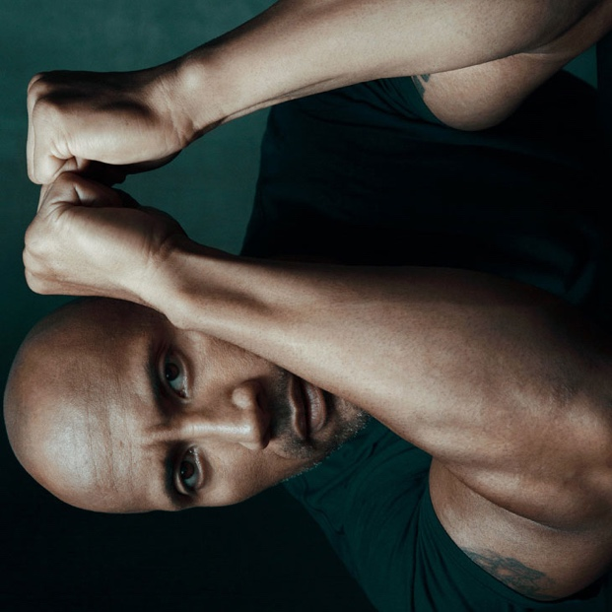
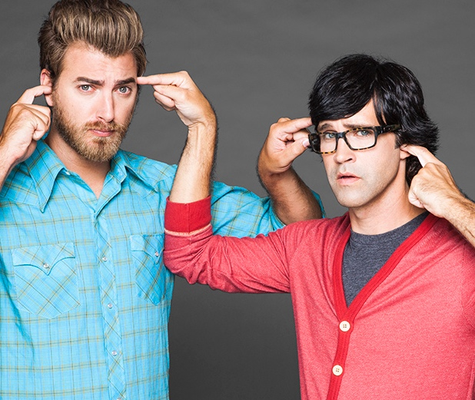
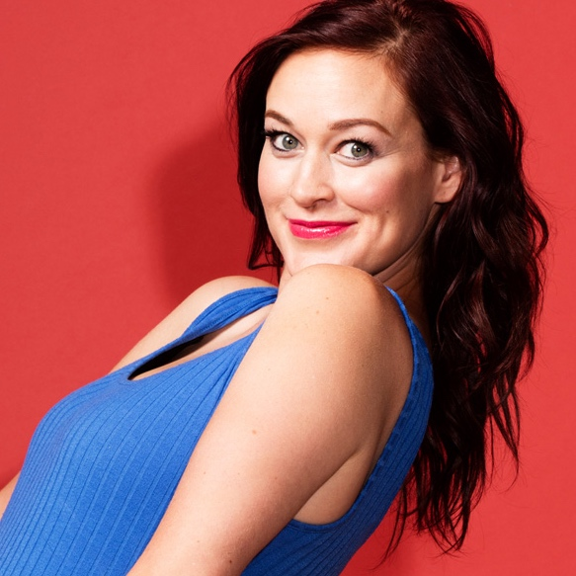
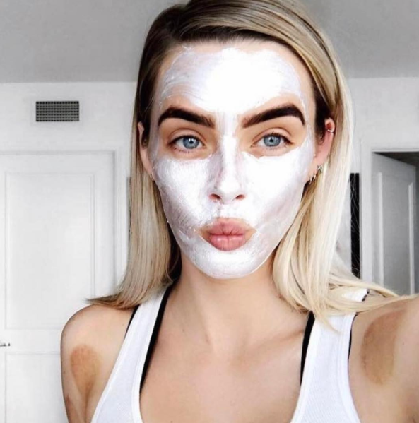
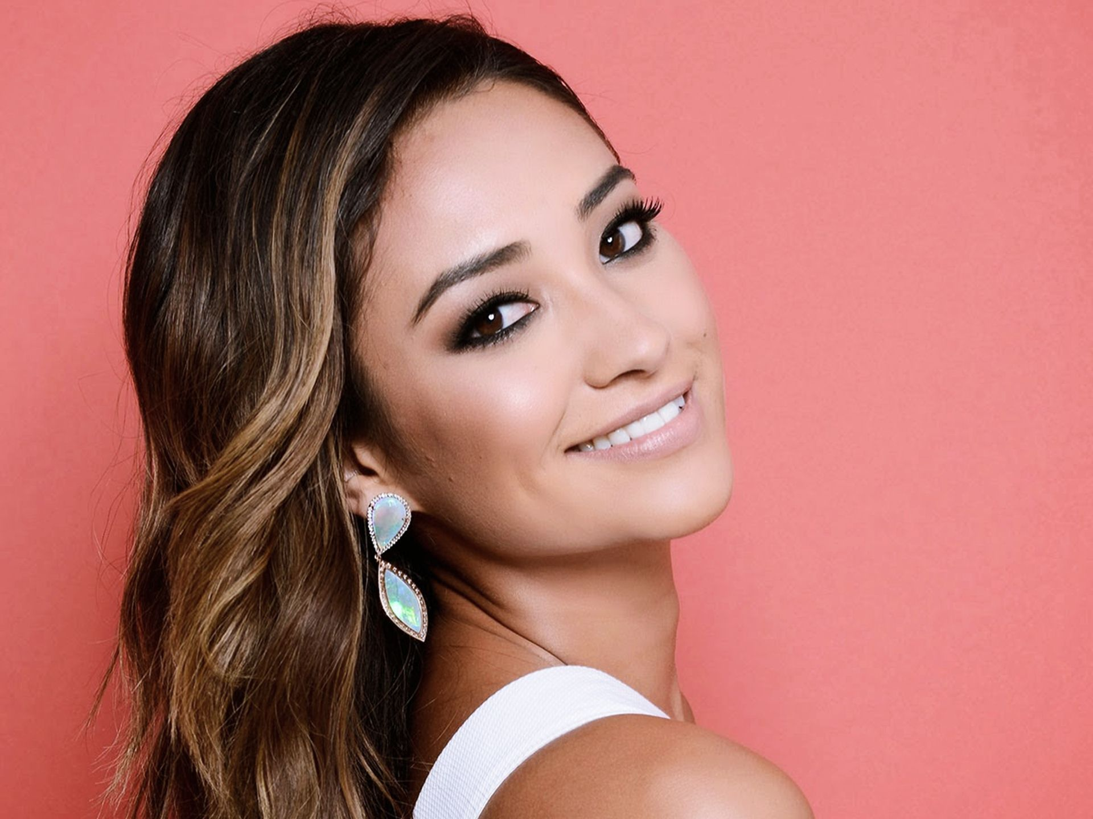
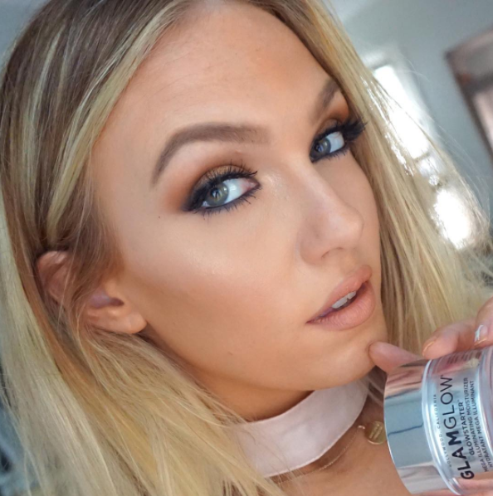

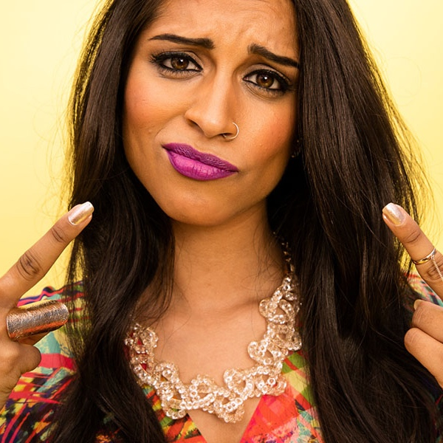
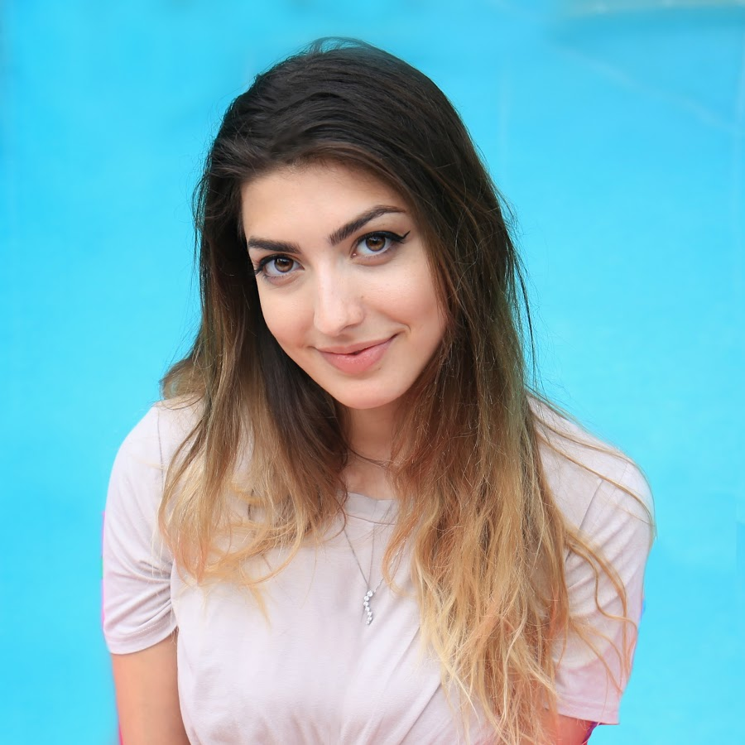

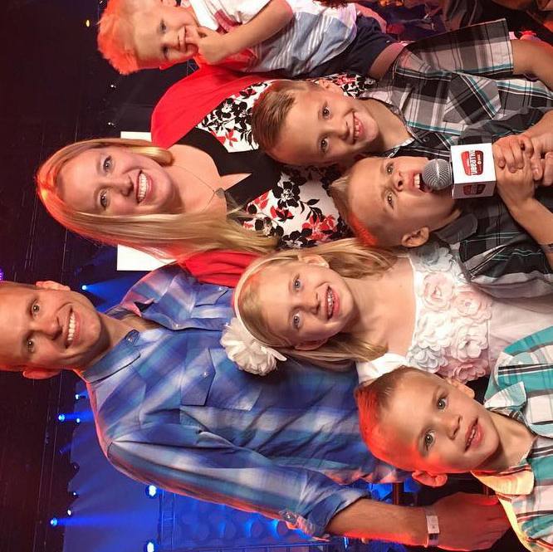
PHIL RANTA
Chief operating officer
studio71

Slide 2
My HISTORY
Born and raised in grand rapids, michigan
GRADUATED WITH A B.A. IN FILM AND VIDEO STUdies from university of michigan
Moved to Los Angeles in 2005
Worked with digital video content for 12 years
Married y.a. author lindsey klingele on april 1, 2017
Live with a pit bull named bighead
Love performing live comedy, watching tv / movies, and playing video games
Also a member of the television academy and mensa

Slide 3
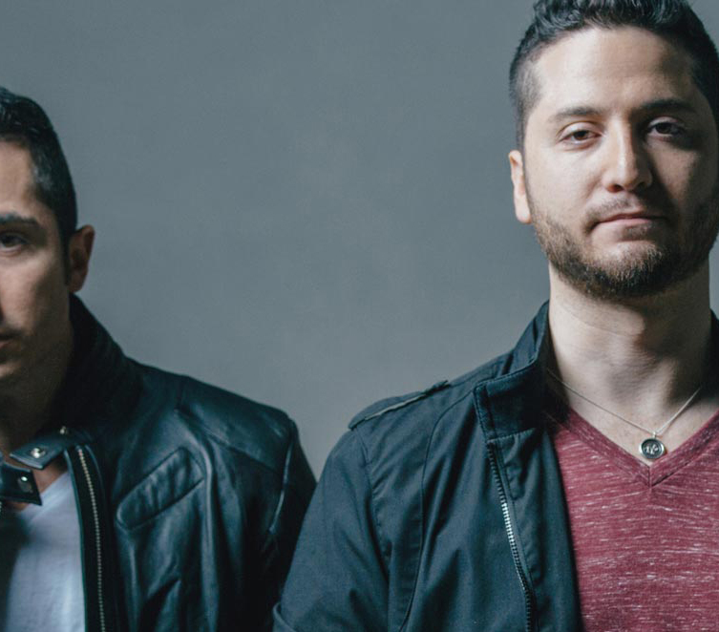
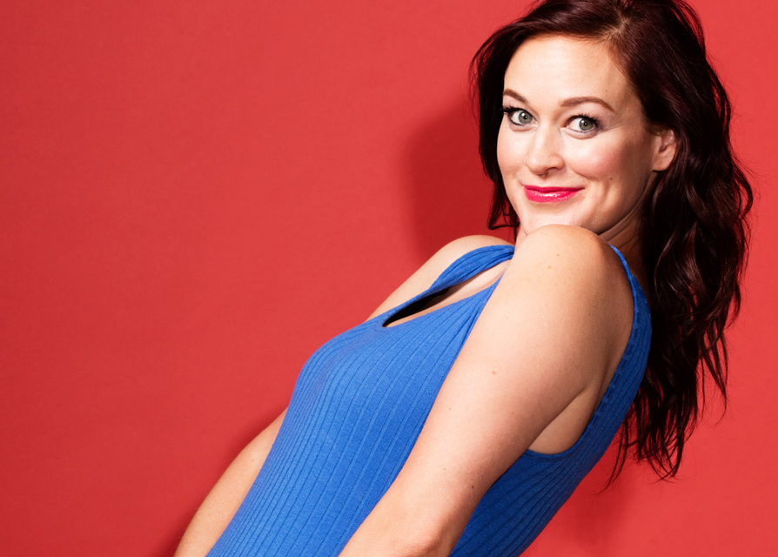
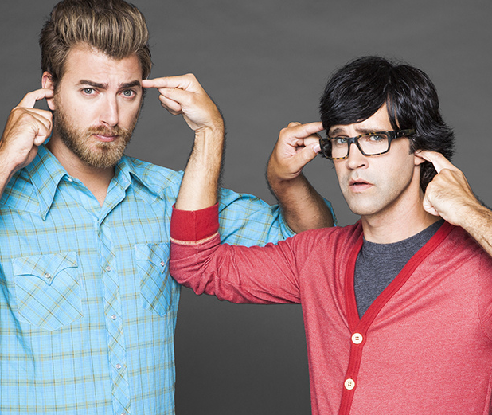
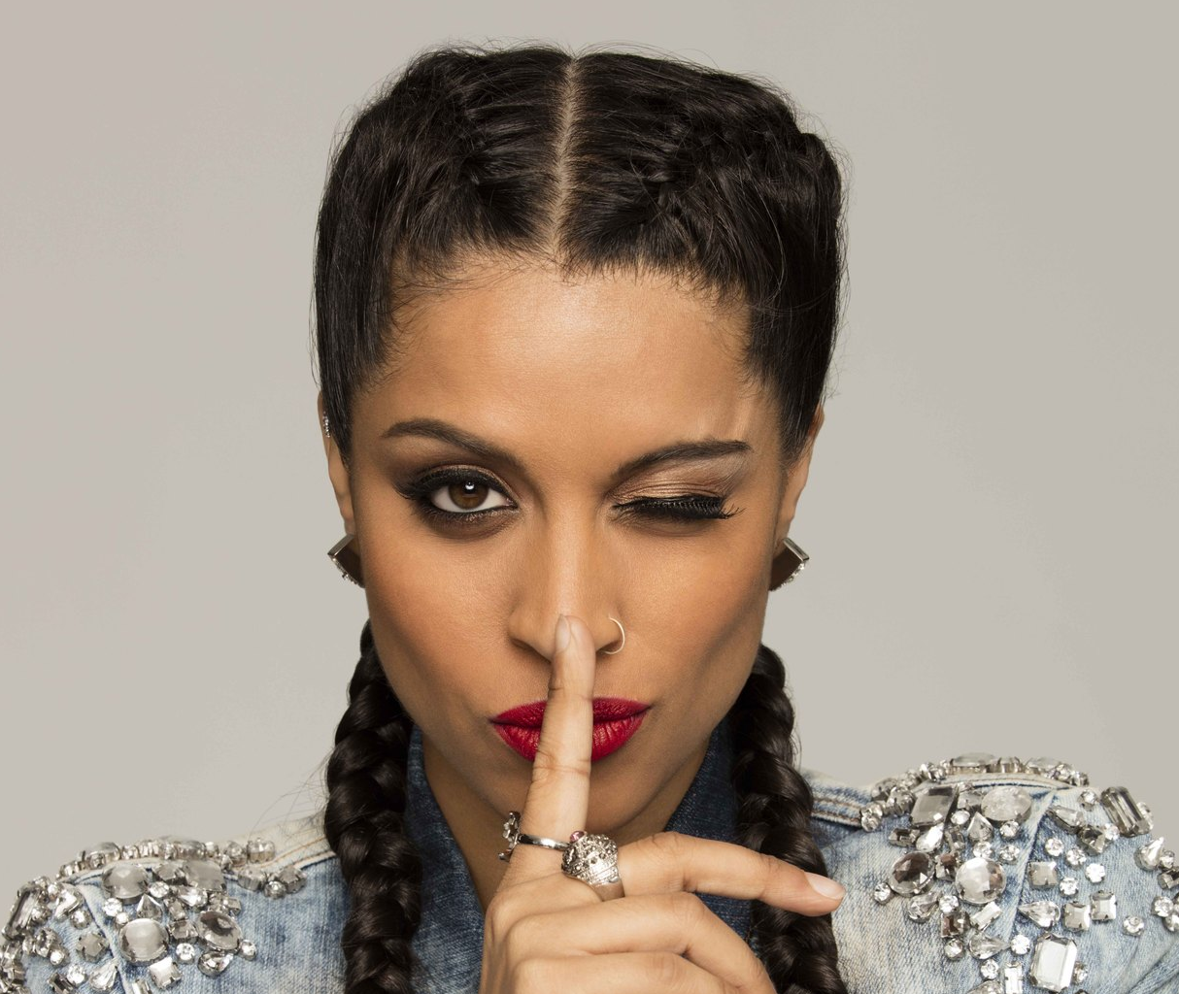
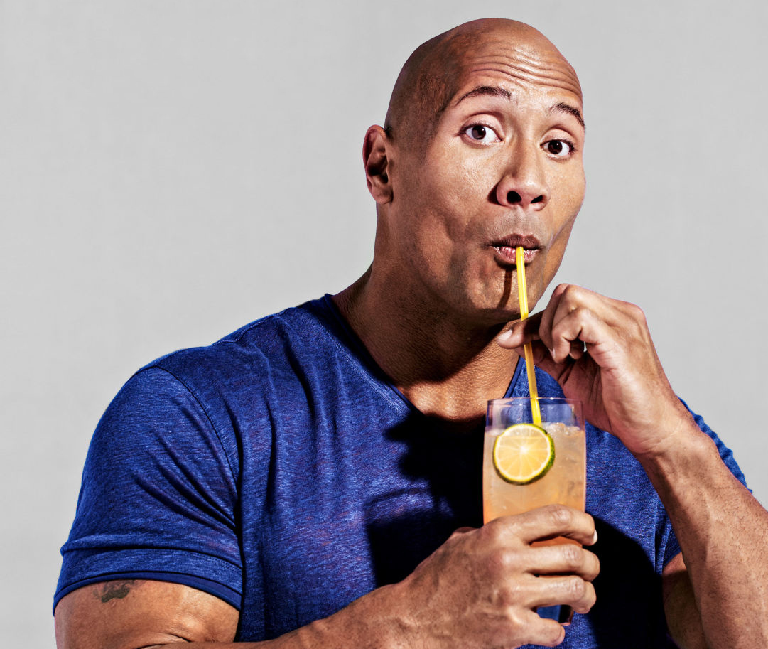
We are prime time for people who don’t watch TV
1,300
7B
94%
99%
Global
Channels
Views
per Month
Year Over Year Growth
Exclusive
Partnerships

Slide 4




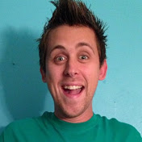

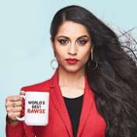

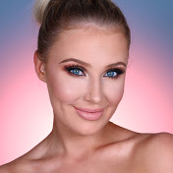




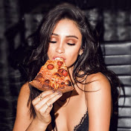
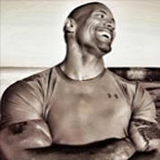
programming verticals that matter
GAMERS
ENTERTAINMENT
MUSIC
STYLE
FAMILY-FRIENDLY
The Game Theorist
7.9 M+
Subscribers
Good Mythical
Morning
11.9 M+
Subscribers
Boyce
Avenue
9.4 MM+
Subscribers
RCL Beauty
11.4 MM+
Subscribers
Roman Atwood
11.8 MM+
Subscribers
RocketJump
7.7 M+
Subscribers
Superwoman
11.2 MM+
Subscribers
Vidya
Vox
2.5 MM+
Subscribers
Lauren
Curtis
3.6 MM+
Subscribers
Family Fun
Pack
4.9 MM+
Subscribers
Corridor
Digital
4.2 M+
Subscribers
Matthew
Santoro
5.8 MM+
Subscribers
Tiffany
Alvord
3 MM+
Subscribers
Shay
Mitchell
1.8 MM+
Subscribers
The Rock
2 MM+
Subscribers

Slide 5
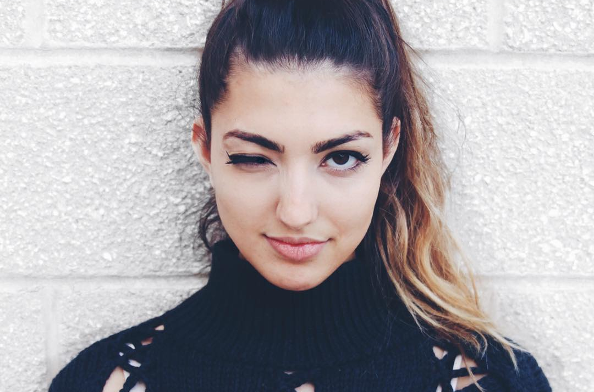

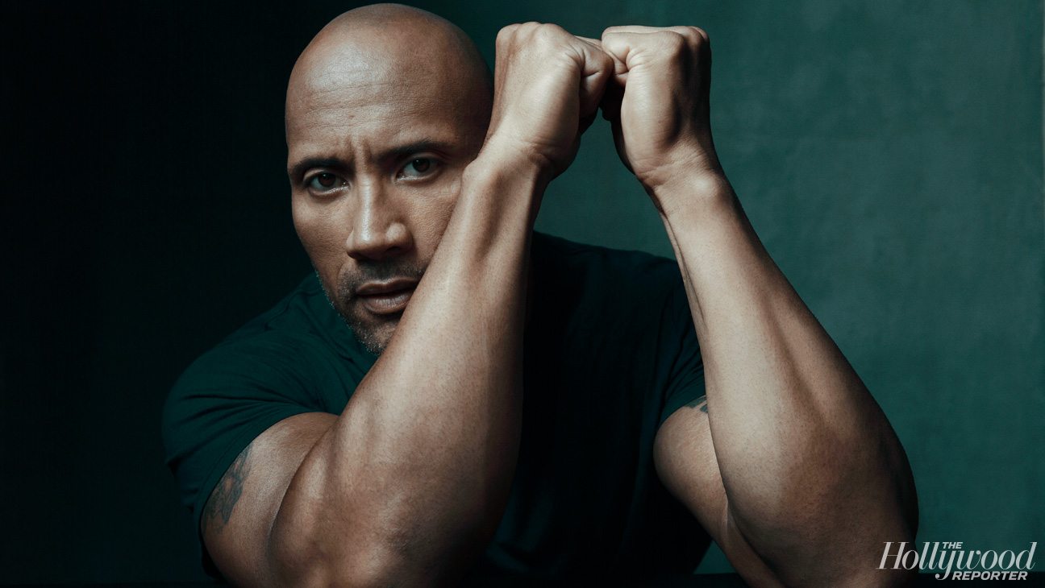

Creators
Won the most awards
thrive
at 2016 Streamys
with us
Rachel Levin,
YouTube’s #1 beauty creator
joins the network
YouTube RED just partnered
Logan Paul achieves
with Dwayne Johnson,
120M views in
on their new slate
just under 33 hours
Notes:
IS THERE ANY HISPANIC NEWS

Slide 6
Our services
Branded Content
Media Inventory
Channel Management
Social Promotion
True creator collaborations and productions that elevate brand objectives beyond expectations
Premium inventory with scale, efficiency and total contextual control
Engineering, optimizing and developing channels to their maximum potential
Fostering real engagement and conversations across channels
Production
Custom Research
Activation
Merchandise
In-house, world-class production for premium content on any platform
Delivering live events and experiences
Custom merchandise for creators and brands
First party data, insights and behavioral modeling

Slide 7
What does a c.o.o.* do?
*Chief Operating officer
Company Building
Digital Strategy
Rights Protection
Brand Strategy
International
Work with the C.E.O. and President to define company vision
Translate the company vision into action
Work across departments and international offices to be sure goals are being met effectively
Work with social platforms to promote our clients
Define programming strategy for clients
Encourage clients to build audience on different platforms
Manage team that makes sure videos aren’t being stolen and re-uploaded
Help major brands build video strategies online
Clients have included:
  The Tonight Show
  Lip Sync Battle
  Taco Bell
  Anheiser-Busch
Build International Offices
Current Studio71 offices include:
  U.K.
  Canada
  Latin America
  L.A. / NYC
  Germany
  France
  Italy

Slide 8

Leading the next era of entertainment
What I love about
My job
I get to work with creative celebrities every day
Figuring out how to create the best content on new platforms
Working in a growing industry = unlimited upward mobility
Having the chance to fix what we perceive as issues with how Hollywood operates (and has always operated)
Helping creators make online video their full-time job

Slide 9

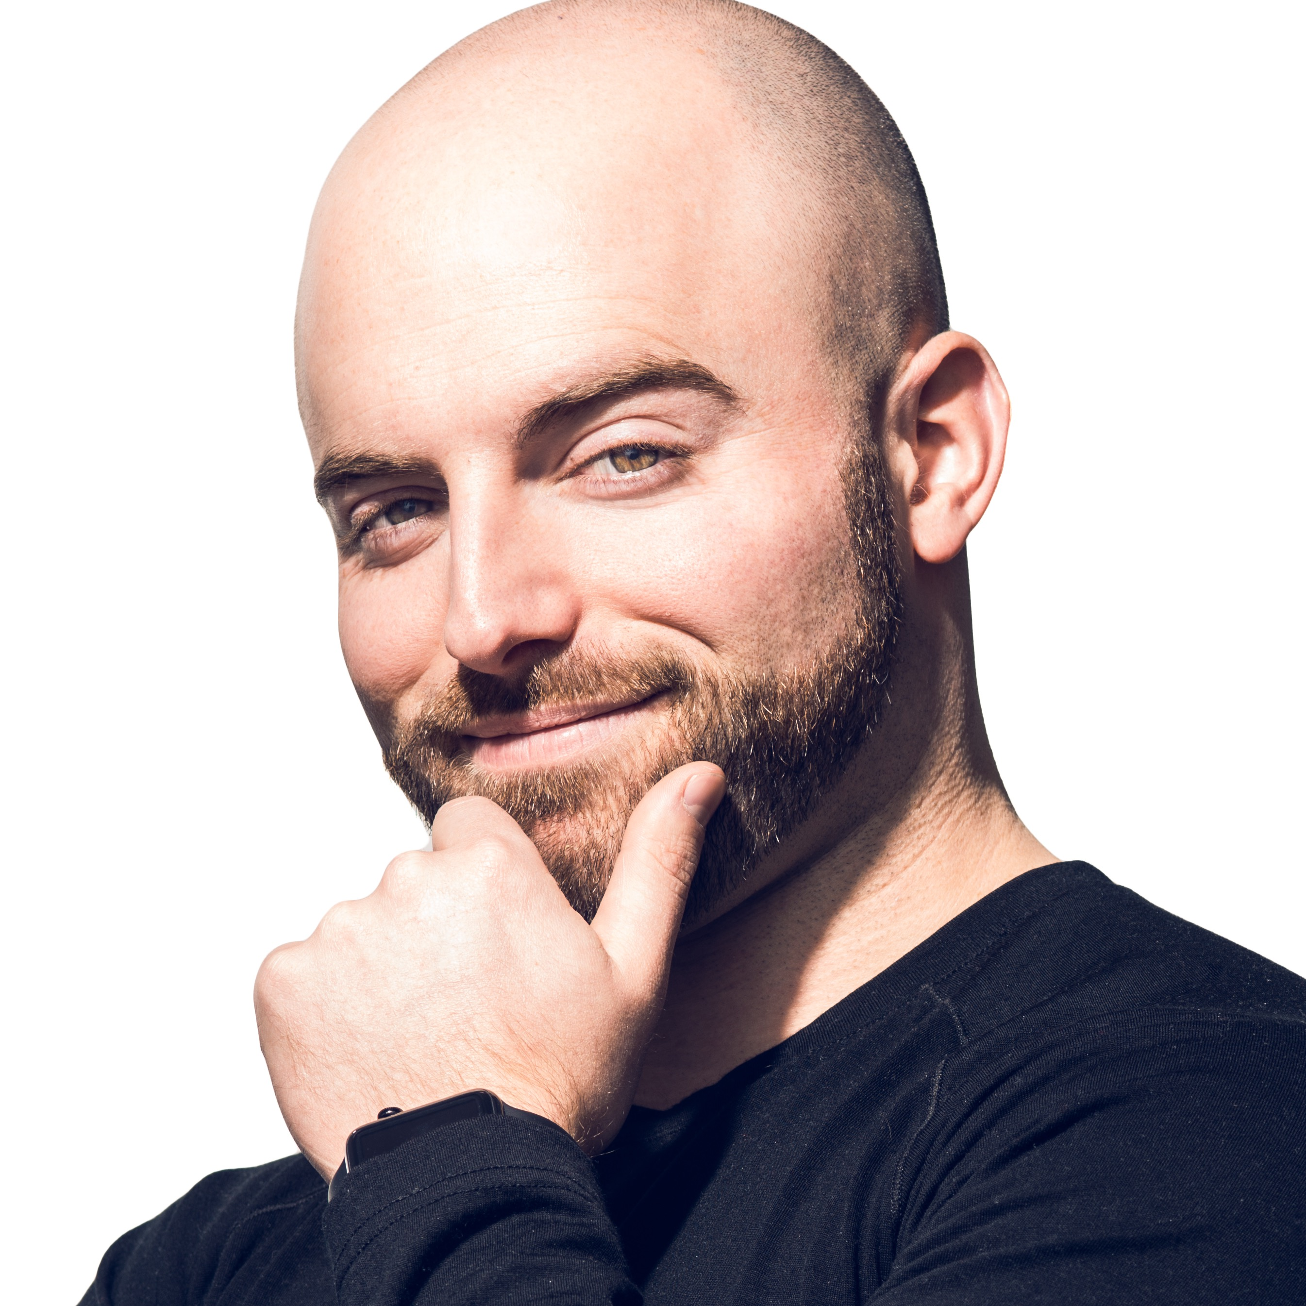

ACTIVITY
Pick a digital star, look at all of their social media, and give them notes about what you like and what they could do to improve

Slide 10
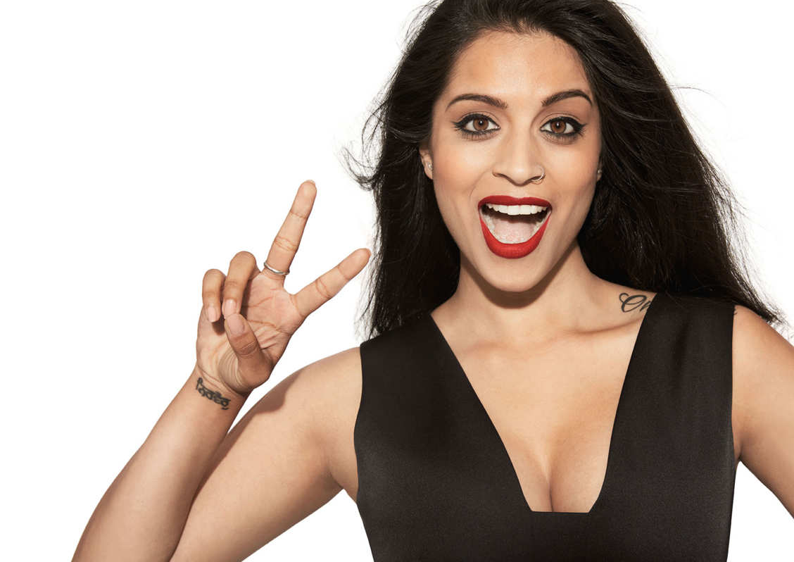
We are
the media company for creators
Q&A

Slide 11



THANK YOU
Create
@studio71us

