Slide 1
Russell Belinsky
Ingredients for success in life

Slide 2
INTRODUCTION
My name is Russell Belinsky and I am 57 years old.
I work for LB Advisors, LLC.
My company does:
We invest in companies that are troubled
Financially
Oeprationtionly
Founder and CEO
Try to find investments, analyze investments and monitor companies

Slide 3
My childhood
Detroit Michigan and raised in Detroit Michigan
This is a picture of me at age 13

Slide 4
My family
A little about my family
I have one older brother who is also an entrepreneur
This is a picture of my brother and parents

Slide 5
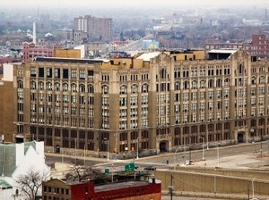
MY HIGH SCHOOL
I attended Henry Ford High School, Detroit, Michigan
(Insert map or image of high school or mascot etc. here)

Slide 6
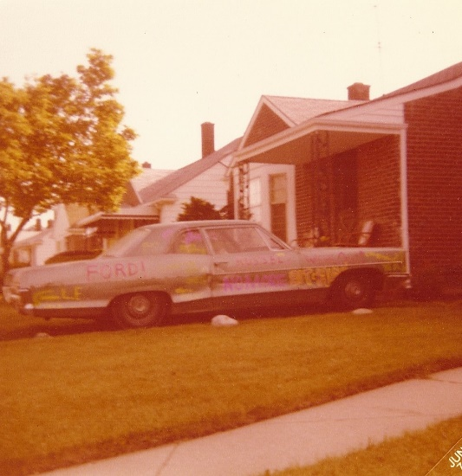
High School
As a HS student I was on the yearbook staff, played tennis, and enjoyed driving my 1966 Pontiac Catalina and hanging with my friends
my car parked at my childhood home in Detroit

Slide 7
High School
Things that I really liked in High School were:
Economics
Sciences
Yearbook
Sci Fi Literature
Varsity Tennis
Photography
Hockey

Slide 8
High School
Things that felt difficult or challenging for me while I was in High School were:
Our school became violent because of white fight to the suburbs
The School was divided on race and college bound vs. non college bound students

Slide 9
High School
Jobs I worked while I was in High School were:
Shoe Store Stock boy
Shoe Salesman
Investing in real estate and the stock market

Slide 10
Getting in to College
The top few things I did to ensure I got into college were:
Grades
Extracurriculars
Studying for tests

Slide 11
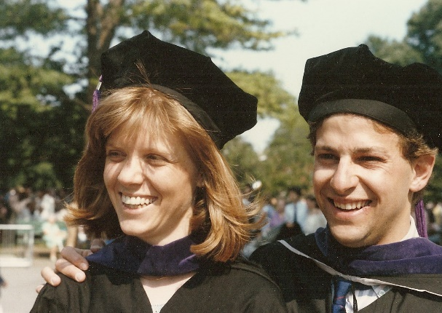
College
I attended college in Detroit Michigan at Wayne State University and Law School at Georgetown University in D.C.
Insert map shot here

Slide 12
College
Things I enjoyed in College
Things I didn’t enjoy in College
Finance
Marketing
Chemistry
Literature
Philosophy
Calculus
Accounting

Slide 13
College
Favorite classes
Least favorite classes
Business Stats
Business Planning
Finance
Political Science
Logic

Slide 14
College
Jobs I worked while I was in College were:
Para legal
Shoe Salesman
I learned to be professional, punctual and to deal with people

Slide 15
College
Things that felt difficult or challenging for me while I was in College were:
Learning how to get good grades
Balancing work, play, and school

Slide 16
Getting a job after College
The top few things I did to ensure I got a good job after college were:
Grades
Relationship building
Persistence

Slide 17
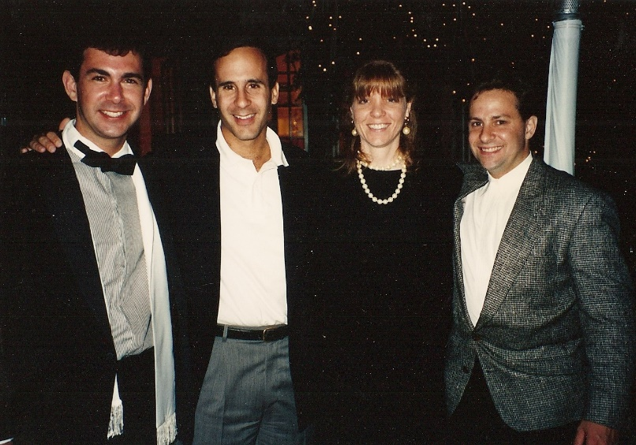
This is My Company
Every day at my company:
Every day is unique; in general I am looking to invest in companies with some trouble—financial, operational or market related
We are small (4 employees) and based in LA
Insert company picture

Slide 18
My Career Path
My partner and I bought out the third partner after 5 years and we were equal partners (50-50)
I was the Jr. Partner at Chanin Capital
I became the CEO two years later
I sold the company in 2006
I started a new venture (LBA) in 2006
Notes:
You may use this chart to describe your journey to the current career

Slide 19
My Career
The first job I had after college was:
Working as an aide to a State Senator in Lansing Michigan
I moved to Lansing Michigan
The job lasted 6 months, then I attended law school
The worst job I have ever had was:
My gardening business, the customers would often not pay me because I was a kid (age 12). This made me very angry, but determined to succeed.

Slide 20
My Career
Challenges I have had to overcome throughout my career are:
Coming from a “no-name” college
Joining a start up with little name recognition
Working with a partner who was not loyal to the business or me
Travelling and balancing work-life demands

Slide 21
My role within organization
Russ
MANAGEMENT
ENTRY LEVEL
ENTRY LEVEL
Notes:
Use this graph to give more description of your role specifically (responsibilities, typical work week, direct reports, etc.)

Slide 22
Compensation at my company
C-Suite
($500+)
Management
($300)
Middle Manager
(200)
Entry Level
($65)
Notes:
Use this graph to show general compensation ranges for people in various roles in your company

Slide 23
More than just work
When I am not at work I like to:
Play Ice Hockey
Ski
Bike Riding
Tennis
Travel
Reading
Investing

Slide 24
Do it all over again?
If I could talk to my high school self, what would I say?
Take things more seriously
Don’t worry about cliques, do things that interest you
Take more risks
Enjoy each day, each experience
Slow down, don’t rush, the world will be there when you arrive

Slide 25
QUESTION AND ANSWER

