Slide 1
Hip Hop Leaders
Turning Dreams of Working in STEM into Reality

Slide 2
About Me
Jacqueline Catala
I work as in Telecommunications Engineering
I help businesses design the fastest and most secure ways to communicate and store data between locations
College Degree in Science (Physics)
Hollywood, CA

Slide 4
When it doesn’t work…
This is why I have a job ☺

Slide 6
Your Big Dream

Slide 7
Your Dream vs. Your Doubts

Slide 8
Nagging Doubts and Questions… Yours… Your Family’s… Your Friend’s…
Is technology and science a good career for me?
Are there jobs I can do?
I’m worried that tech and science will be boring…
What if I like doing other things?
I don’t want to be limited.
I don’t want to lose the ability to pursue my other interests…
Will I be able to learn this stuff?
How do I get through ‘hard’ classes?
(I’m not good at math…)

Slide 9
Is technology and science a good career for me?
Are there jobs I can do?

Slide 10
1.5 million Uber/Lyft drivers in the US
Driver
Difficulty
How much $/hour
Important Question….

Slide 11
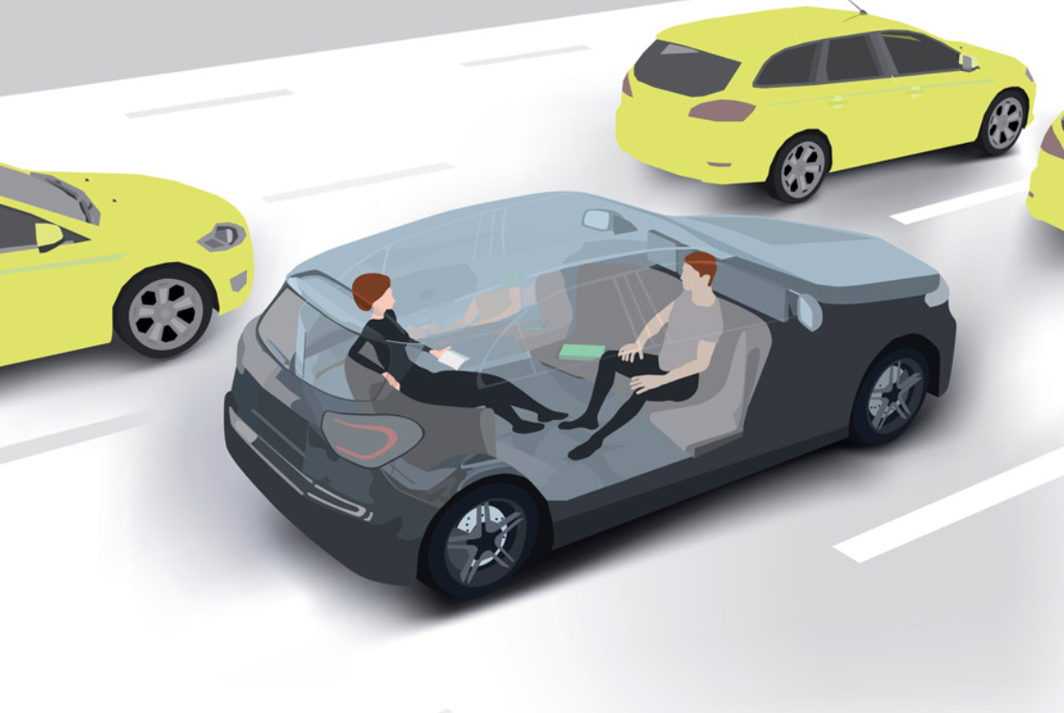

Slide 12
What Other Jobs Will Be Replaced By Technology?
Bank Teller
Accountant
Retail Sales Associate
Grocery Store Clerk
Starbucks Coffee Employee
Truck Driver
Fitness Coach
????

Slide 13
Then where will the jobs be?
Which jobs are safe?
(for now)

Slide 14
Supply vs. Demand in Technology and Coding Some Statistics…
There will be an estimated 1 million more computing jobs than applicants who can fill them by 2020, projects Code.org, based on estimates from the U.S. Bureau of Labor Statistics on job creation and separately, estimates of college graduation rates by the National Science Foundation.
There are more than 500,000 open computing jobs nationwide, but less than 43,000 computer science students graduated into the workforce last year, according to Code.org, a non-profit backed by the tech industry that's dedicated to expanding access to computer science.
More than 500,000 computing jobs remain unfulfilled in the U.S., the App Association report said, and that’s despite the fact that the average developer salary is more than $102,000. That’s almost double the country’s median household income in 2015 — $56,516, according to the most recent census data. So, if you like money and job security, computer science is one logical path.
In the United States, there are 5 job openings for software developers for every American software developers (4 unfilled jobs)
1.8 open million IT jobs in the US. Companies can’t find the people they need to run their businesses.

Slide 15
Who gets paid more?
Uber Driver
no special skills
lots of people to do it
Developer who wrote the Uber Code
special skills
(by far) not enough people to do it

Slide 16
Supply vs. Demand
Not enough Americans to do the work
Companies prefer to hire Americans
Do you have to be the best to get the job?
Will there be scholarship money to get schooling?

Slide 17
Who will have a job in the future?

Slide 18
Is technology and science a good career?
Are there jobs I can do?
YES

Slide 19
Boring…
I’m worried that tech and science will be boring…
I don’t want to be bored!

Slide 20
Which is more boring?
Receptionist
Building Flying Drones

Slide 21
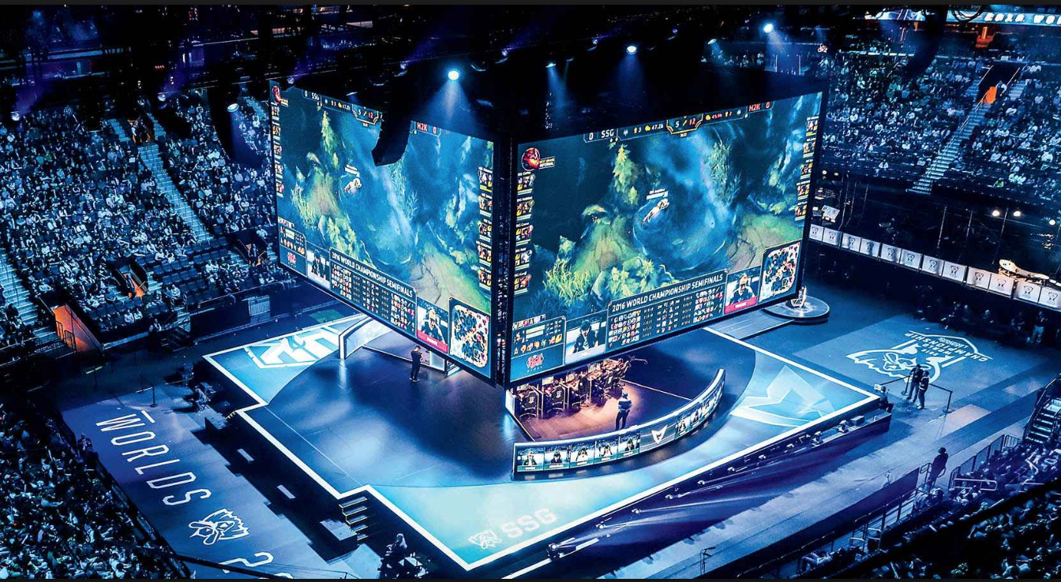
Which is more boring?
Video Game Convention
Human Resources Meeting

Slide 22
Which is more boring?
Customer Service Representative
Instagram Programmer

Slide 23
Technology Company Workspaces

Slide 24
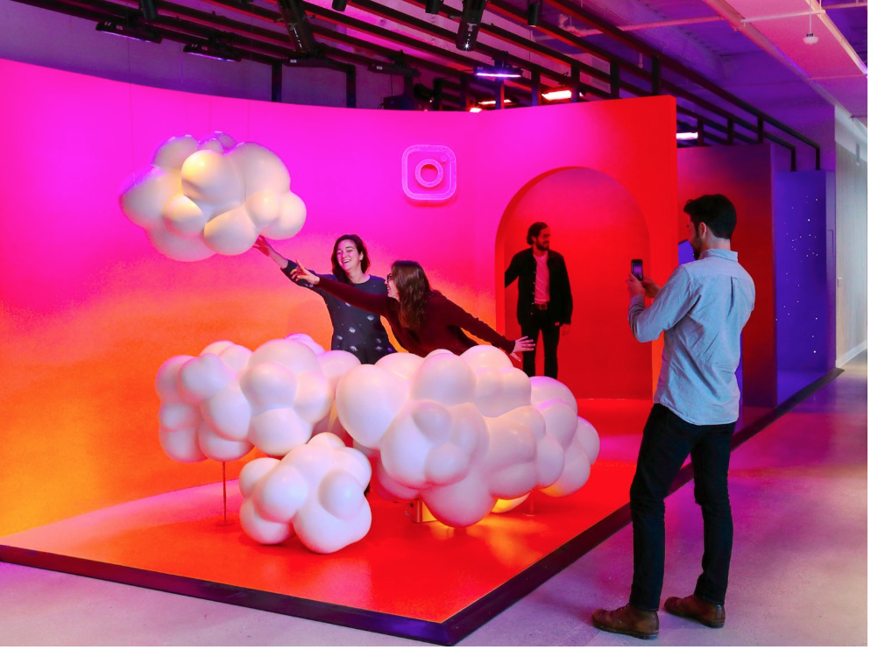

Slide 25
I’m worried it will be boring…
I don’t want it to be boring!

Slide 26
What if I like doing other things that are not technology related?
I don’t want to be limited by selecting a tech career…
I don’t want to lose my other interests…

Slide 27
The other ‘interests” we are worried about losing are often artistic, sports, or business passions…
Actor
Dancer
Writer
Painter
Model
Singer
Musician
Athlete
Real Estate Agent
Store Owner

Slide 28
Artistic / Sport / Business Passions
We all have side interests.
We don’t want to give them up.
People often believe that one has to give the up other interests to have “a job”.
Let’s take a look at this idea….

Slide 29
The Age of the Parallel Career
It is not going to take away your toys…
It might even buy you some bigger toys ;)

Slide 30
Sports Example: She has an tech job during the week and she likes to ski on the weekend…

Slide 31
Art Example: She has an tech job during the week and she loves acting in her free time…

Slide 32
Social Media Example: She has an tech job and she creates YouTube makeup videos…

Slide 34
But I’m really good at it!!!

Slide 35
What if I like doing other things that are not technology related?
I don’t want to be limited by selecting a tech career…
I don’t want to lose my other interests…

Slide 36
Will I be able to learn it?
How will I get through such ‘hard’ classes?

Slide 37
Best Kept Secret for Learning ANYTHING

Slide 38
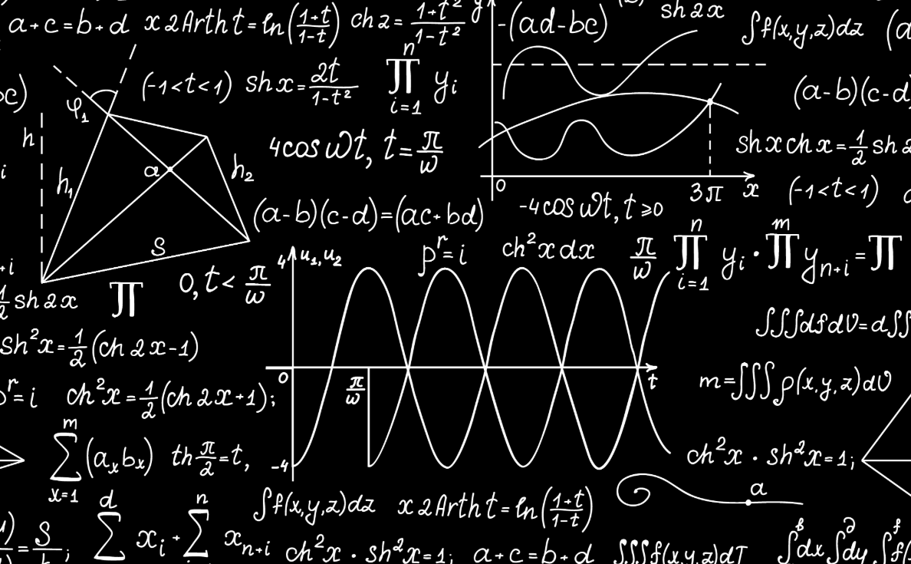
All information is taught using either: words OR symbols to communicate the concepts

Slide 39
The Key To Learning and Understanding
Understand the meanings of any and all words
Understand the meaning of any and all symbols

Slide 40
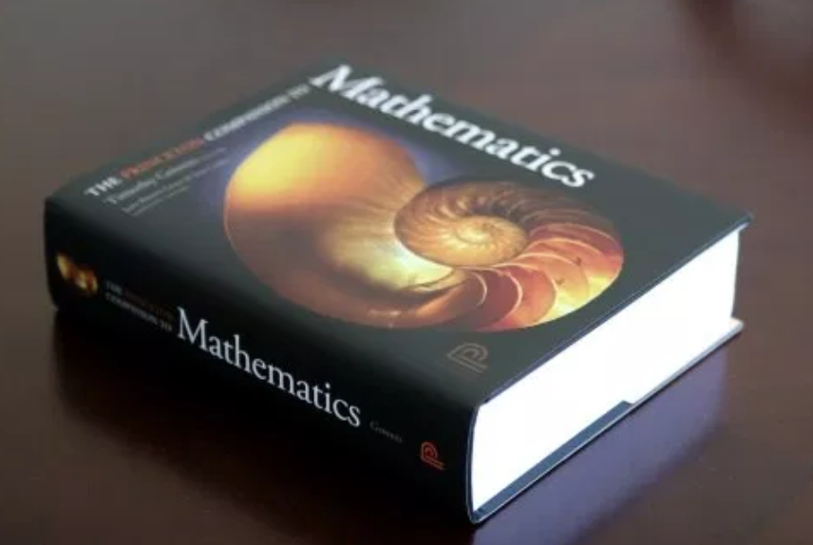
How do I do that?
Easy!
Look up ANY word or symbol you don’t understand in a dictionary or science/math/engineering definition book.

Slide 41
@^$&*%!!!!

Slide 42
Word Examples
Phil and Dave were raring to get off to the mountains; they packed up their ski gear and climbed into the van with alacrity.
The tribe could not satisfy the cupidity of the conquerors, who demanded excessive tribute.

Slide 43
Phil and Dave were raring to get off to the mountains; they packed up their ski gear and climbed into the van with alacrity. The tribe could not satisfy the cupidity of the conquerors, who demanded excessive tribute.
Alacrity
cheerful promptness or willingness; eagerness; speed or quickness
Cupidity:
greed; excessive desire, especially for wealth

Slide 44
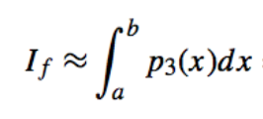
Math/Symbol Example

Slide 45
Let’s pretend we have these definitions…
I 2nd grader
f girl
≈ went down
∫ playground slide
b top
a bottom
p climbed
3 three times
(x) on
dx tallest slide

Slide 46
Good Grades and Success in School and Life
Yes, it is that EASY!
Look up definitions… ALWAYS
Everyone will want to know the secret to how you learn everything so easily
Everyone will wonder how you got so smart

Slide 47
Will I be able to learn it?
How will I get through such ‘hard’ classes?
YOU KNOW HOW…

Slide 48
In Conclusion…

Slide 49
What We Accomplished Today…

Slide 50
We Eliminated Doubts…
Is technology/science a good career to get in to?
Is there going to be a job for me?
I’m worried a tech career
will be boring…
What if I like doing other things that are not technology related?
I don’t want to be limited by selecting a tech career.
I don’t want to lose my other interests…
Will I be able to learn it?
How do I get through such ‘hard’ classes?
I’m not good at math…

Slide 51
Now its time for you to go make it happen!!!

