Slide 1
INTRODUCTION
My name is Tanya Nelson and I am an accountant.
I work for Moss Adams LLP
My company provides accounting services including tax planning and tax return preparation, audit of financial reporting, accounting consultation, etc.
My role at Moss Adams is Audit Senior Manager

Slide 2
My family
A little about my family: married Mark in 2013

Slide 3
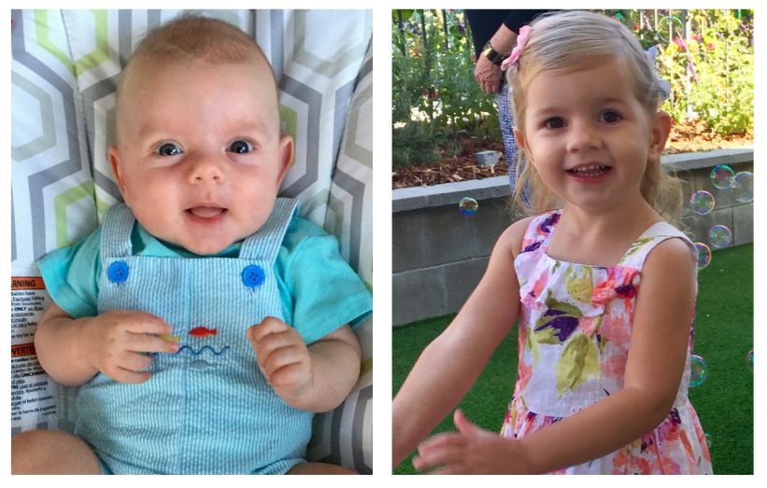
My family
A little about my family: Sabrina – 3 years, Troy – 4 months

Slide 4
My childhood
I was born and raised in Ukraine

Slide 5
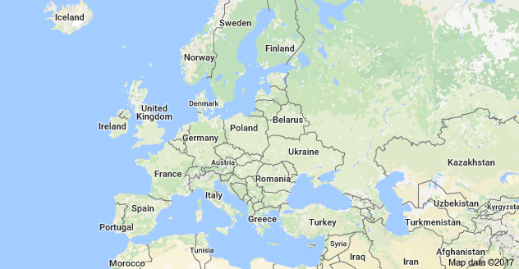
My childhood
Where is Ukraine?

Slide 6
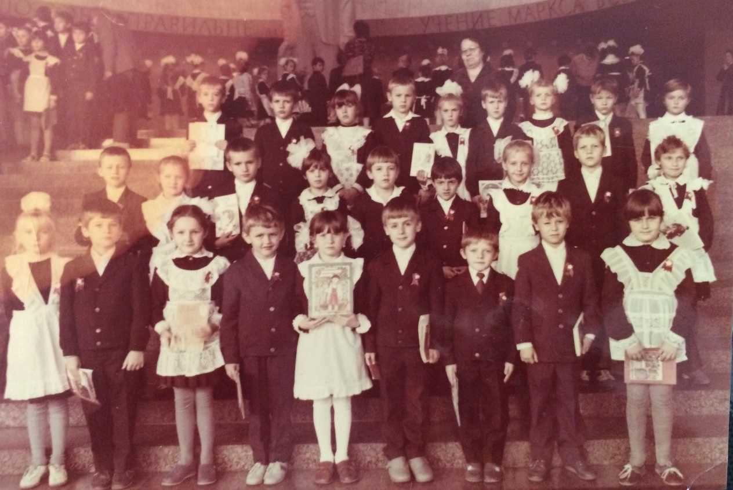
MY SCHOOL
I attended school in Kiev, capital of Ukraine

Slide 7
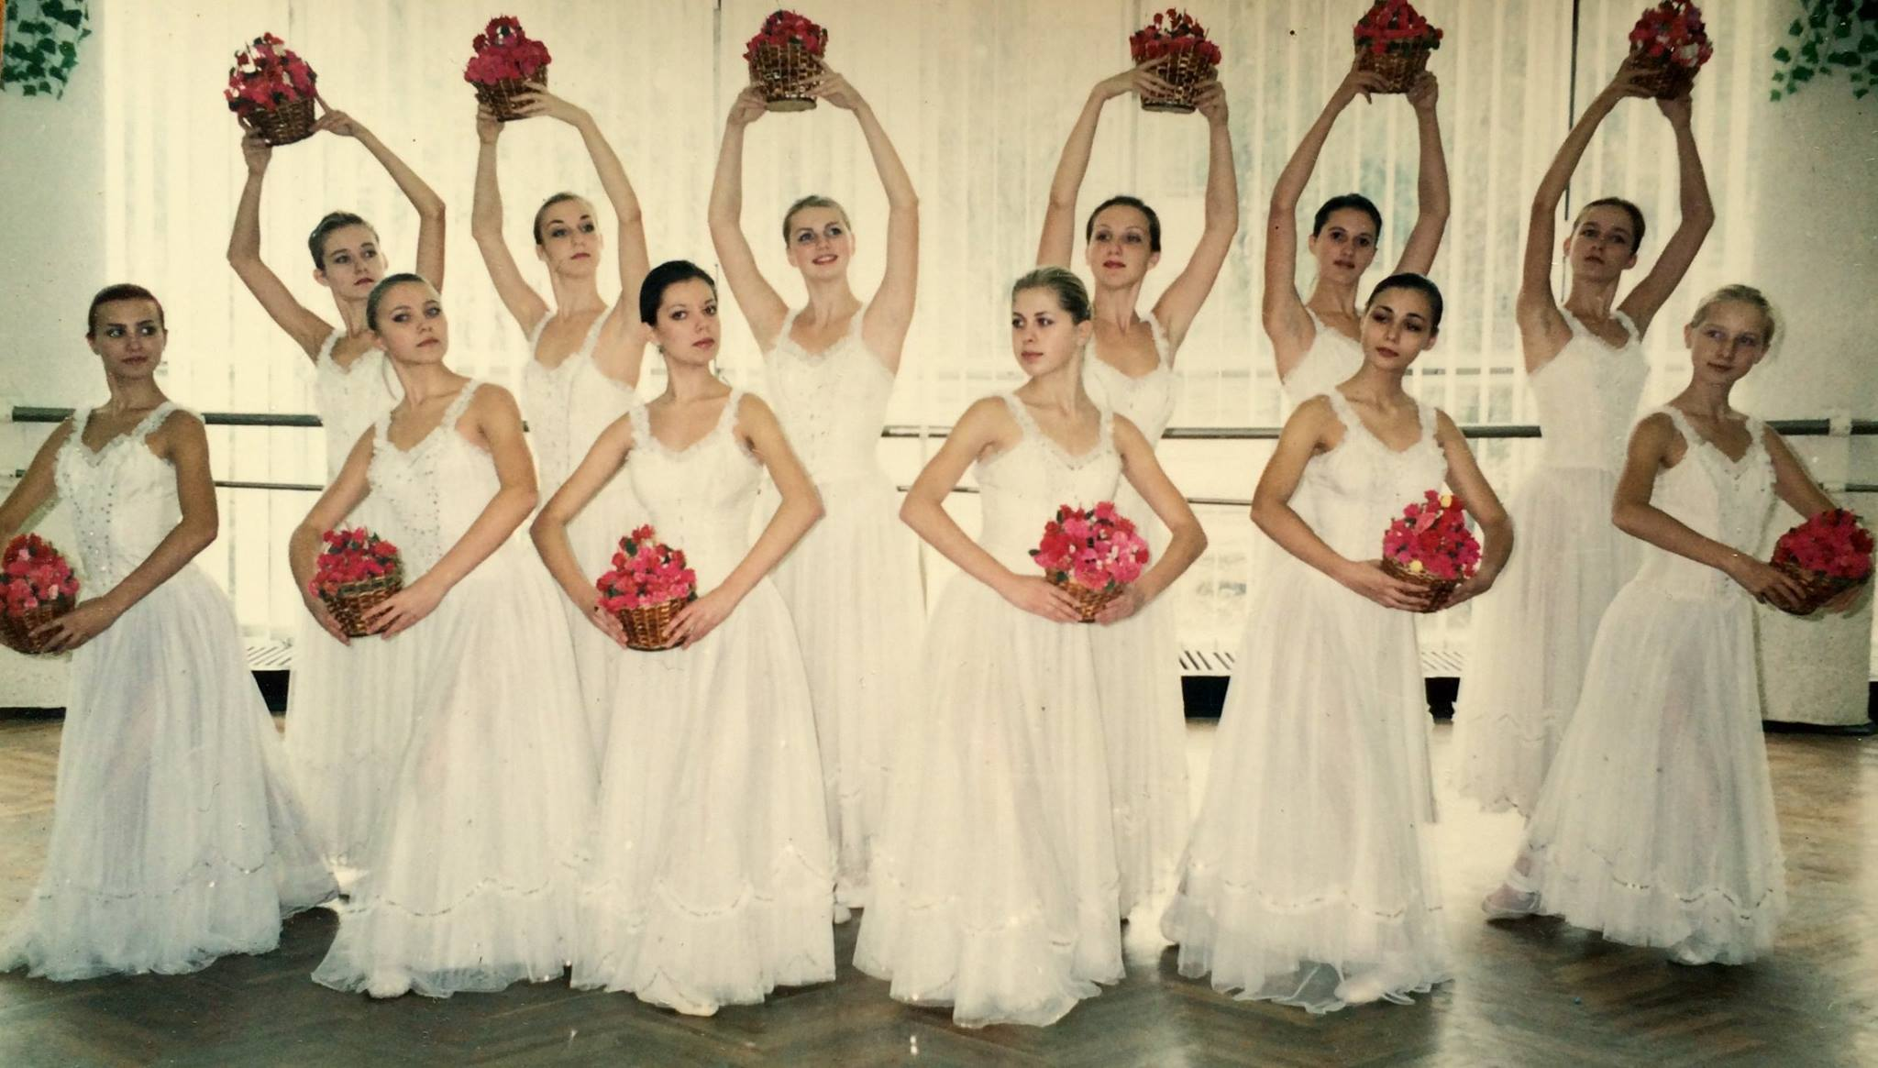
High School
As a HS student I was very active: academics, ballet.
Here is a picture of me in HS

Slide 8
College
I attended University of Engineering and Architecture in Kiev, Ukraine
Insert map shot here

Slide 9
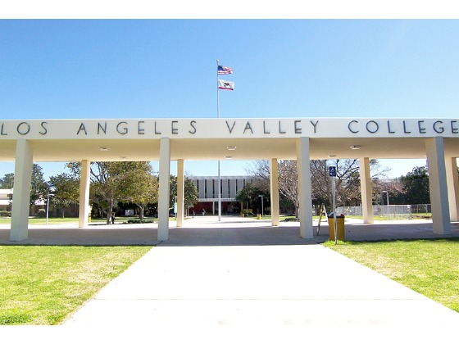
College
And then Los Angeles Valley College

Slide 10
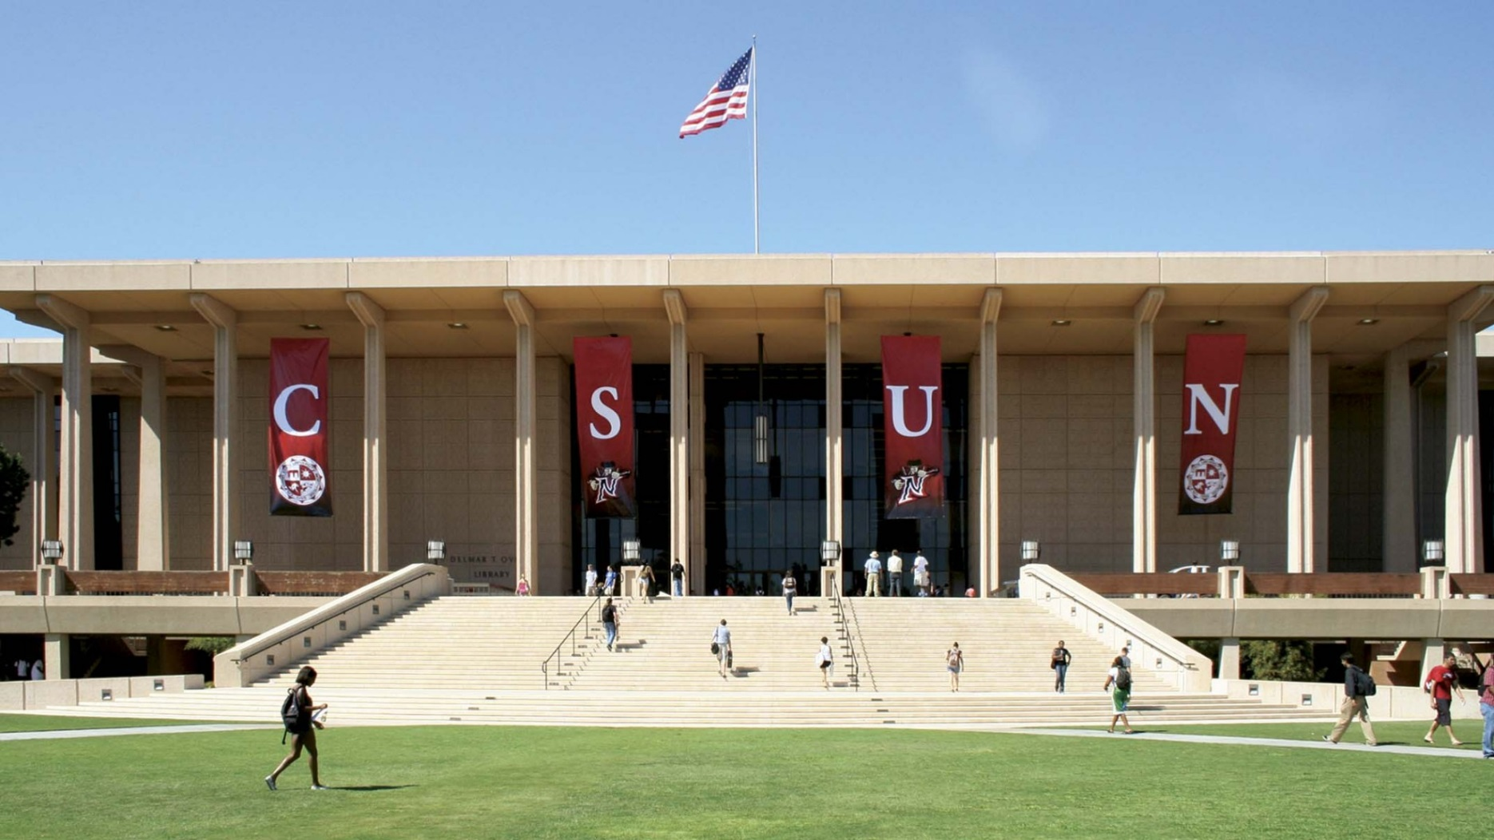
College
Transferred to CSUN

Slide 11
College
Things I enjoyed in College
Things I didn’t enjoy in College
Being a member of student organizations – accounting association Beta Alpha Psi.
Academics: accounting, economics, math, Spanish, communication, English, yoga, tennis.
Stress of making enough money to pay for school and living expenses.

Slide 12
College
Jobs I worked while I was in College were:
LAVC Cafeteria worker – making burgers and sandwiches
LAVC tutoring center – tutor of accounting courses
Bookkeeper and office administrator for various companies
Internship with Ernst&Young (Big 4)

Slide 13
Getting a job after College
The top few things I did to ensure I got a good job after college were:
Good grades, Dean’s list, honors, etc.
Actively involved with professional associations (BAY, AA)
Work experience
Interviewing skills

Slide 14
This is My Company
Moss Adams is a CPA firm that provides accounting services including tax planning and tax return preparation, audit of financial reporting, accounting consultation, bookkeeping, etc.

Slide 15
My Career Path
After 2 years I became a supervising senior, and after another 3 years became a manager
I started as an intern and then a entry level staff
I am now a senior manager with over 10 years of experience and I plan on becoming a partner
Notes:
You may use this chart to describe your journey to the current career

Slide 16
Compensation at my company
Partners
($500K - average)
Senior Manager
($120-200K)
Manager
($80-120K)
Entry Level - Staff
($55K)
Notes:
Use this graph to show general compensation ranges for people in various roles in your company

Slide 17
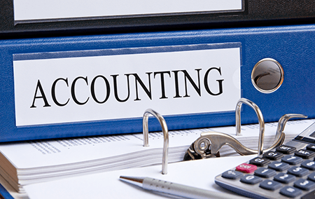
My Profession
What is Accounting?
What is Financial Audit?

Slide 18
My Career
Being a CPA/Auditor involves:
Reviewing clients’ books and records, perform testing via agreement to supporting documents, analyze trends and results when assessing potential misstatements
Issue audit opinion
Advise about best practices and suggest improvements
Act as a trusted advisor to clients
Business development and marketing
Mentoring, training and coaching
Continuous professional growth and learning
Giving back to community

Slide 19
Do it all over again?
If I could talk to my high school self, what would I say:
Keep up the hard work (academics first!)
Step out of your comfort zone
Don’t worry about boys
Find time to enjoy yourself
Don’t worry about money

Slide 20
QUESTION AND ANSWER

