Slide 1
Mike Flannery theatre technician & designer
“Village Idiot . . . currently seeking village”

Slide 2
INTRODUCTION
I’m a freelance Theatrical . . .
Rigger
Carpenter
Electrician
Scenic Designer
Lighting Designer
Technical Director

Slide 3
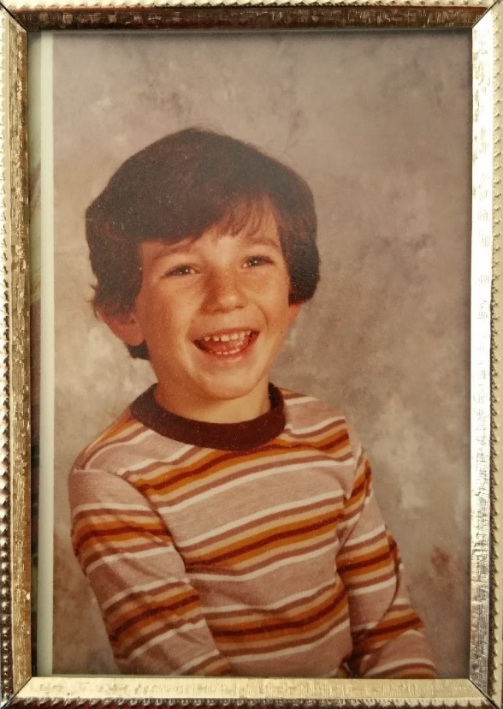
My childhood
I was born in Burbank and raised in Chatsworth.
8 years old
6 years old

Slide 4
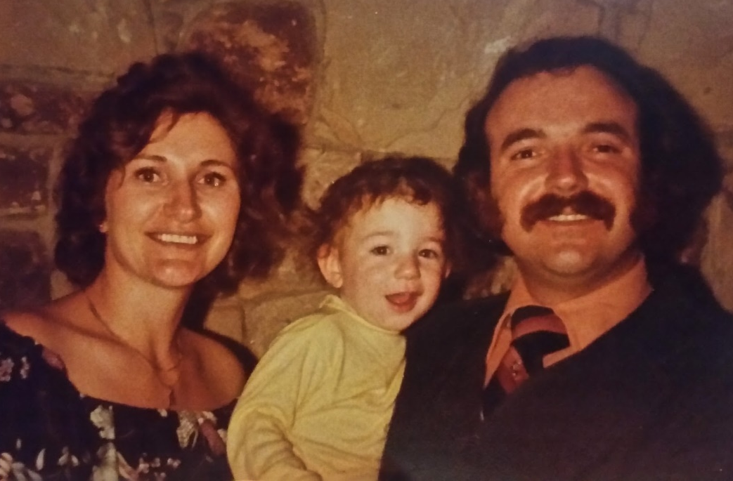
My family
I’m the eldest of 4 kids. My parents own a medical imaging service company. I’m the black sheep of the family considering I chose theatre and my siblings are (from left to right) a paralegal, a paramedic and a PhD botanist.
Mom, Mike & Dad
Ally, Chris, Robby & Mike

Slide 5
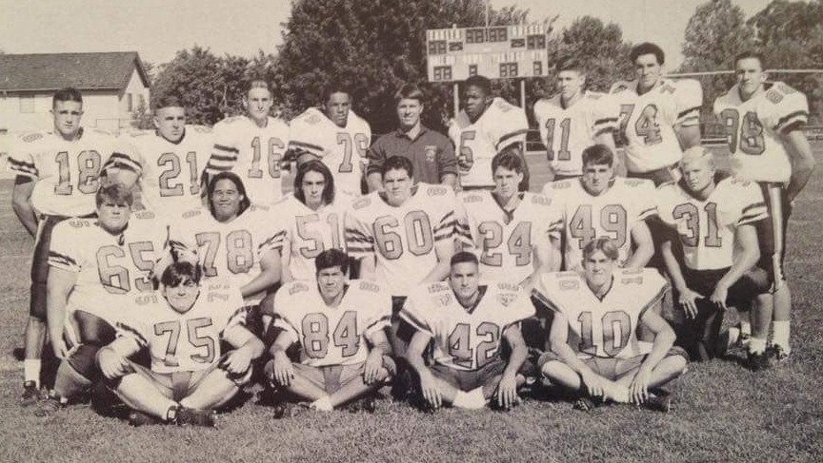
MY HIGH SCHOOL
I attended Chaminade College Preparatory
High School in West Hills, CA.

Slide 6
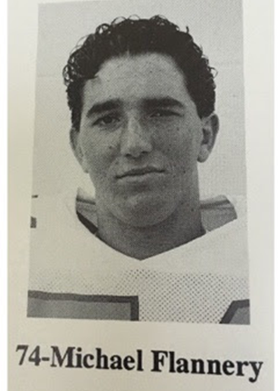
High School Life
As a student I was a bit shy but also a jock. I played several sports and was a bit of a social butterfly.

Slide 7
High School Likes
Things that I really liked in High School were:
All my science classes (total geek)
Sports (Football, Wrestling, Shot Put)
Playing football in Hawaii against a sister school
My close friends
My first car, a very used 1987 Bronco II

Slide 8
High School Dislikes
Things that felt difficult or challenging for me while I was in High School were:
All my math classes, except geometry
Authority
Social pressures to fit in (ask me later what I did to face this)

Slide 9
High School Job
The first job I ever had was in High School.
I worked for my parents company in the shop.
I cleaned and dismantled equipment, sorted parts, and kept the shop organized.
This is where I learned about tools, electricity and respect for heavy things. (X-ray machines are very heavy)
I made $6/hour
My dad told the other guys in the shop not to take it easy on me because I’m his son which they took as permission to give me the worst jobs.

Slide 10
Getting in to College
I had no clue what I wanted to do or which classes to take in college.
Until a high school friend told me about working as a background extra in movies and television.
So I took a beginning acting class at my local community college and it changed my life.

Slide 11
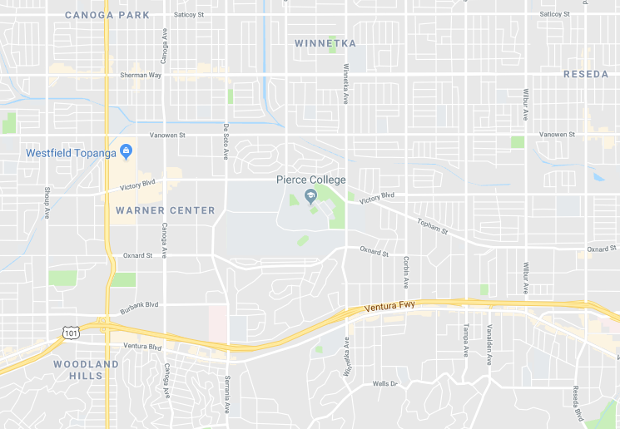
College
I attended Los Angeles Pierce College in Woodland Hills, CA

Slide 12
College Theatre Department
Arena theatre
Main stage

Slide 13
Acting classes
I thought I wanted to be an actor and figured I should take a beginning acting class.
It was here that my life long shyness had to be dealt with.
I learned more in that class about MYSELF than anything else.
The ONE THING I want you to remember from this talk is that everyone should enroll in an acting class at your nearest community college.
Here’s why…

Slide 14
Actor to tech
In the acting class we learned how to:
Listen
Move
Deliver a speech in front of an audience
Breathe (crucial to good acting)
Get over our fears
Put yourself in someone else’s shoes
Respect the cast, crew and production team

Slide 15
Tech Class
We were low on technicians the year I attended and they made it a requirement for all actors to also take the tech class.
I fell in love with it; especially rigging and carpentry. *INSERT BAD PUN HERE*
Eventually I was acting in shows and working on shows. I tried it all. I took every class I could.
Doing it all meant I knew how hard my friends were working on other parts of the show. Everything fell into perspective.

Slide 16
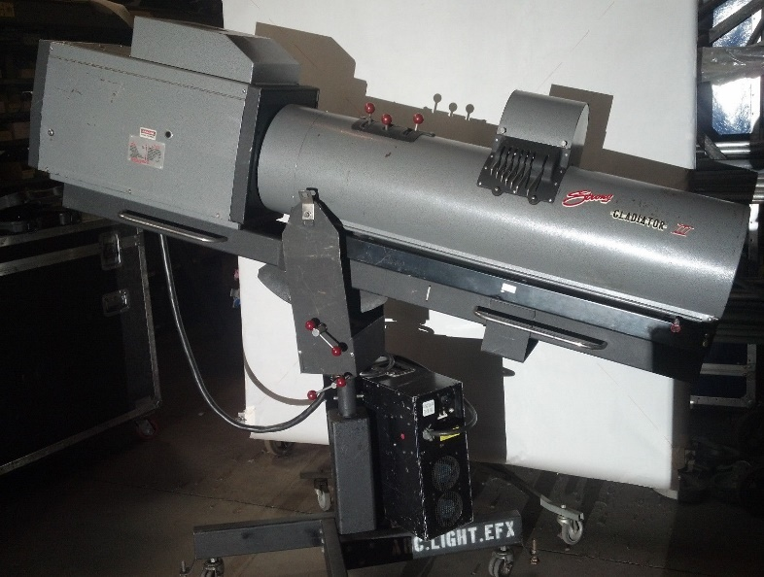
Getting a job after College
My first paying job in theatre was as a followspot operator for a dance concert at my college. However, no one trained me on the equipment. I had to figure out on my own that they are easier to operate when you loosen the knobs.

Slide 17
Paying my dues
I took a lot of low or no pay gigs in small community theatres throughout the city.
This is where I sharpened my skills.
Making mistakes are absolutely crucial to success.
Eventually my resume looked good enough to get real work.
But my focus was always to learn new skills along the way and challenge myself regardless of the job.

Slide 18
My Career Path
I became the youngest Technical Director in LA at the age of 21
Studio Guide & Character at Universal Studios Hollywood
Rigger & Electrician on tour with My Chemical Romance
Notes:
You may use this chart to describe your journey to the current career

Slide 19
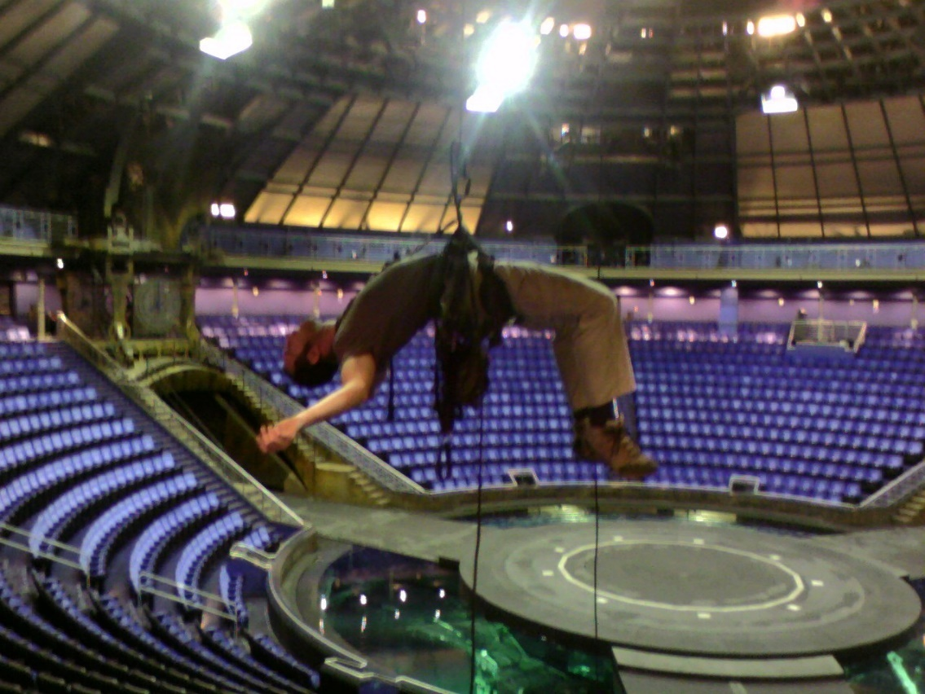
Vegas, baby!
I moved to Las Vegas in 2006 to work as a rigger on Le Reve at Wynn Las Vegas. BEST JOB EVER!!!

Slide 20
Home sweet home
I moved back to LA when the recession kicked me in the wallet and eventually went back to school to focus on scenic design.
I never finished my degree because you can make good money based on your attitude and reputation. It’s a very equitable industry. Work hard and you’ll do well.
It turned out that I was only 1 class from a degree for almost 20 years.

Slide 21
Better living through Theatre
Some important lessons I learned in the industry:
In theatre, everyone has the same job description: Make your boss look good.
Early is on-time, on-time is late and late is unacceptable.
Don’t let anyone see you running. It makes your department look bad.
Load-in the show with the load-out in mind.
Be nice to everyone. There’s no telling who may be working with or for on the next gig.
Proficiency at several disciplines will ensure you’ll always have work.
Love what you do or stop doing it.

Slide 22
Do it all over again?
If I could talk to my high school self, what would I say?
Don’t be afraid. It’s almost never as bad as you think.
Hold out just a little bit longer. You’re probably not done learning that lesson yet.
Open communication is the best remedy.
Always pair up with the strongest, smartest, most talented people in class. They will push you up more than you will pull them down.
Stretch every day. Trust me on this one.
It’s OK to not know where you’re going or who you want to be. As long as you don’t forget who you are you’ll never get lost.

Slide 23
QUESTION AND ANSWER

