Slide 1
YBA GUEST RESOURCE TEMPLATE
DRAFT

Slide 2
INTRODUCTION
My name is Erik Oberholtzer and I am 46 years old.
I am the founder of Tender Greens
Tender Greens is a collection of 17 restaurants here in CA serving chef-driven, organic food at an affordable price.
My role at Tender Greens is Chairman and CEO
As the founder and CEO my primary responsibility is to promote the culture and brand to everyone who touches it.

Slide 3
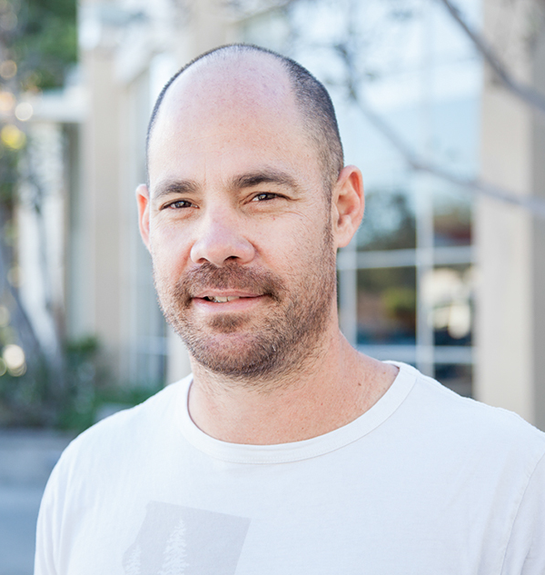
The Early Years…
I was born and raised in Pennsylvania
This is a picture of me at 46.
This is a picture of me at 21 in Paris at culinary school.

Slide 4
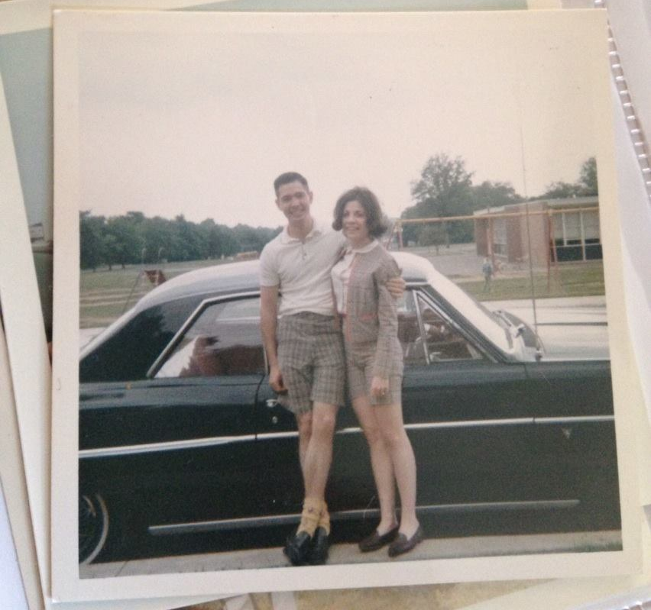
More Early Years…
I am the oldest of four boys. My dad was a teacher, mom stayed home to raise us. We were lucky.
This is a picture of me and INSERT FAMILY NAMES.

Slide 5
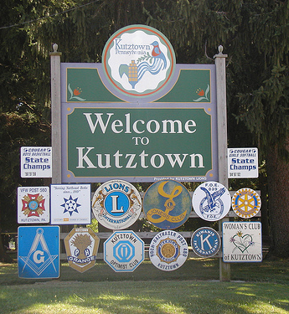
HIGH SCHOOL
I attended Kutztown HS in Kutztown, PA
\

Slide 6
HIGH SCHOOL
Things I enjoyed in HS
Things I did not enjoy in HS
Sports
Girls
English
Art
History
Political science
Chemistry
Biology
Calculus
Trigonometry
Physics
The food
Most lectures

Slide 7
HIGH SCHOOL
Activities/Athletics in HS
Jobs I worked while in HS
Soccer
Tennis
Running
Skiing
Morning paper route
Acme markets
Feed & Read Booksellers
Berkeley Country Club as a busboy.

Slide 8
HIGH SCHOOL
Fondest memories from HS
Obstacles/Adversity you had to overcome in HS
Friendships
Punk rock
Soccer
Tennis
Entrepreneurial efforts
Small town
Lack of inspiration in class
Learning out of context. No “WHY”
Name in the community. High expectations.
conservative values in the town
I was a “free-thinker”.

Slide 9
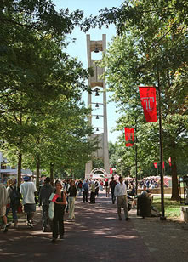
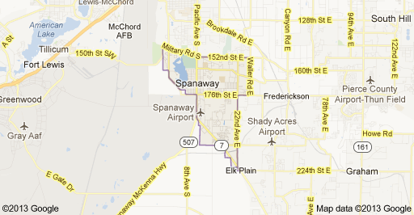
College or Graduate School
I attended college at Temple University in Philadelphia.
\

Slide 10
College or Graduate School
Activities/Athletics in College
Jobs I worked while in College
Soccer
Transcendental meditation
Judo
Independent research in psychology labs
Zen Buddhism
cooking
Four Seasons Hotel in various positions
Valet
Concierge
Doorman
Banquet waiter
Limo driver
Research assistant

Slide 11
College or Graduate School
Favorite classes
Least favorite classes
Psychology
Philosophy
Critical writing
Economics
Political science
Art history
Biochemistry
Calculus

Slide 12
College or Graduate School
Fondest memories
Obstacles or adversity that you had to overcome
Relationships and mentors
Four Seasons
Philadelphia
Independent research
Free thinking environment
Urban experience
independence
Money
Mediocre high school experience
World exposure
Working and studying full time

Slide 13
Career Path
I started as a cook and worked my way up.
I became a chef for a number of luxury hotels and restaurants until meeting my partners at Shutters on the Beach
I founded Tender Greens with my partners and am the CEO with 17 restaurants and $60m in revenues. ….
Notes:
You may use this chart to describe your journey to the current career

Slide 14
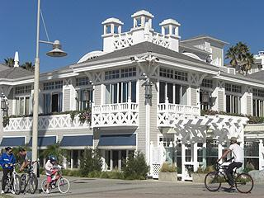
Career
Four Seasons Hotel
Shutters on The Beach
Tender Greens

Slide 15
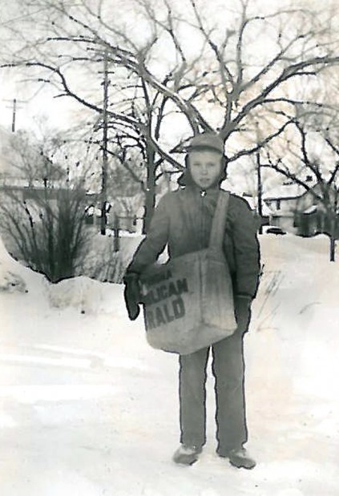
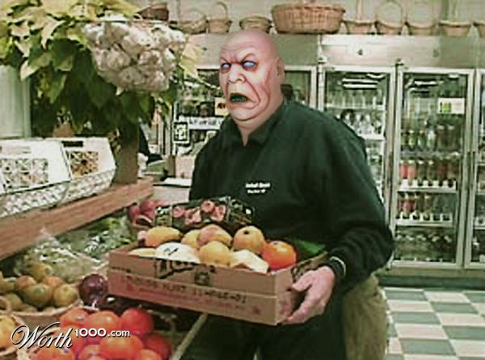
Career
My First Job
My worst job
Paper boy for the morning call
Stock boy for Acme Markets in Pennsylvania

Slide 16
Career
Some challenges I had to overcome in my career
Low pay
Cultural resistance
Long hours
Physical work
Little balance
uncertainty

Slide 17
CURRENT ROLE
History
Opened 2006 in Culver City, CA
Size
17 restaurants in California
1000+ employees
Location
Based in Culver City
Locations throughout California
Products
Services
Chef driven, organic food at a reasonable price
$60m in annual revenue
Restaurant
catering
Notes:
Use this graph to give more description of your current company (history, size, location, products and services, etc.)

Slide 18
Current Role
Founder and CEO
Ops
Brand expression
finance
People development
Notes:
Use this graph to give more description of your role specifically (responsibilities, typical work week, direct reports, etc.)

Slide 19
Career Compensation
Chef
$80k-$125k
Line cook
$20k
Sous chef
$45k-$65k
Sr. Executive
$100k-$200k
Notes:
Use this graph to show general compensation ranges for people in various roles in your company

Slide 20
ACADEMIC EXERCISE
We will now spend several minutes discussing the day’s academic module and how it is relevant in the ‘real world’

Slide 21
QUESTION AND ANSWER

