Slide 1
GALINA SLAVOVA

Slide 2
INTRODUCTION
My name is Galina Slavova and I am 39 years old.
I am the Co-Founder of BONFIT LLC
Other projects includes
AppRising Inc
TravelbyGalina.com
Fitness Model
Personal Trainer
My company does:
BONFIT is an App to connect clients with personal trainers and fitness professionals.
My role at BONFIT is CEO/COO
My daily duties Involved in all aspects of the business including strategy development, risk management, client relations, corporate accounts, contract negotiations, marketing and public relations.

Slide 3
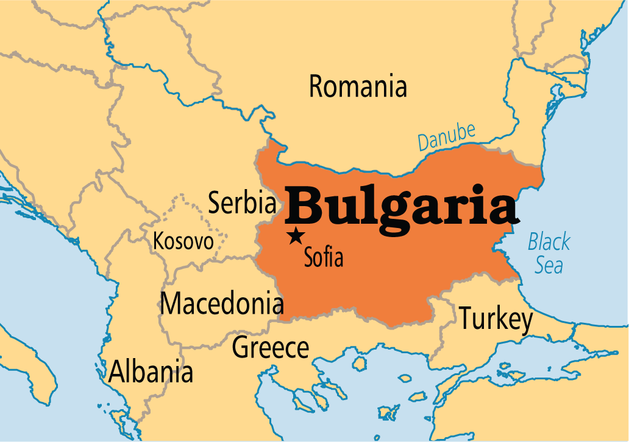
My childhood
I was born in Sofia, Bulgaria

Slide 4
My family
Very traditional Bulgarian family where we value honesty, respect, loyalty and appreciation.
This is a picture my parents, my sister and my adorable nephew

Slide 5
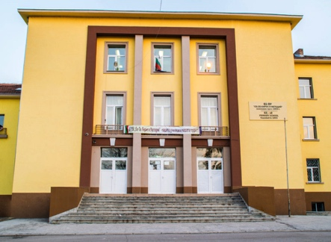
MY HIGH SCHOOL
I attended Sofia school in Bulgaria

Slide 6
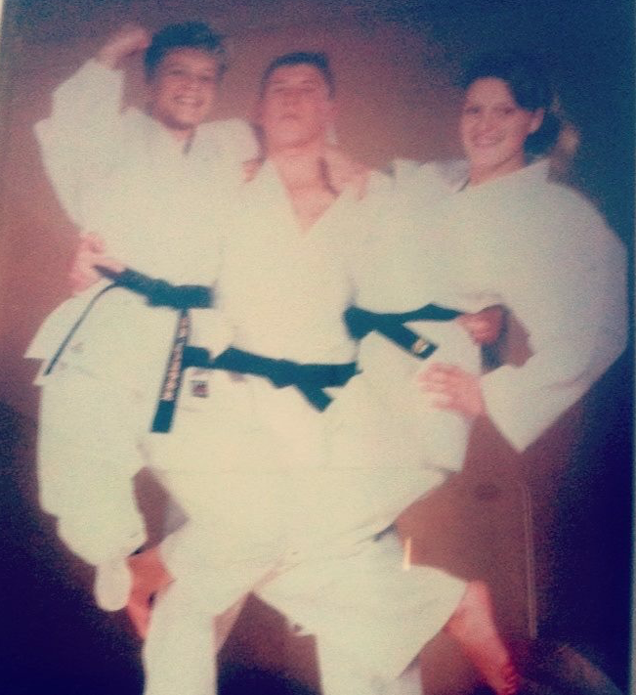
High School
As a HS student I was very athletic and somehow popular.
Here is a picture of me in HS

Slide 7
High School
Things that I really liked in High School were:
Sports, hanging with friends, activities,
Playing backgammon
I also enjoy traveling which I start doing it from a very early age. I was 11 years old when I went to Turkey for my first international Judo championship. Since then I visited total of 41 countries so far.

Slide 8
High School
Things that felt difficult or challenging for me while I was in High School were:
Math, algebra, chemistry, biology. Those were not my favorite in HS.I had no choice but to force myself to study and understand the concept if I wanted to graduate. It is amazing how much you can accomplished if you make efforts and believe in yourself.

Slide 9
High School
Jobs I worked while I was in High School were:
My full time job was to be the best female judo player so I had to train several hours a day for that reason; however I also worked at night at my parents grocery store after my school and my practice. My day usually started at 6am till after midnight.
I tried another job as executive assistant at a real estate company but was not something I enjoyed doing.

Slide 10
Getting in to College
The top few things I did to ensure I got into college were:
Considering I grew up in poverty the chances me going to college were very limited. After I graduated from HS I got a bartending job so I can pay for college. A year later I was excepted at Denmark college with business management

Slide 11
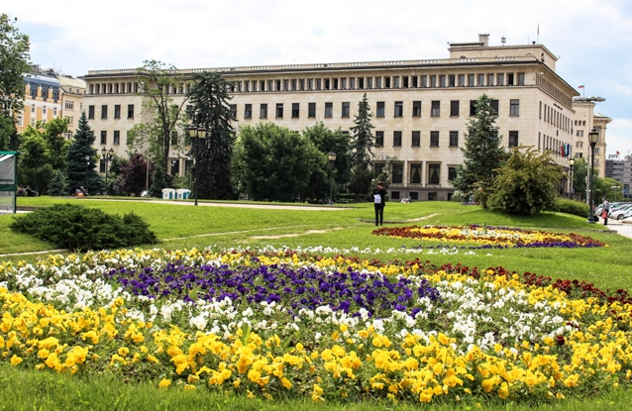
College
I attended Denmark college in Sofia, Bulgaria
Insert map shot here

Slide 12
College
Things I enjoyed in College
Things I didn’t enjoy in College
Meeting new creative people
Learning new things
Long hours study
Homework

Slide 13
College
Favorite classes
Least favorite classes
Marketing
Phycology
Sports activities
Business Classes
History
Languages
Geography
Math
Biology
Science
Chemistry

Slide 14
College
Jobs I worked while I was in College were:
Bartender

Slide 15
College
Things that felt difficult or challenging for me while I was in College were:
I didn’t really enjoy being in college because I always felt the urge to explore the world instead of reading books so I dropped of college 2 years later and start traveling around the world….and that was also the end of my professional athlete career.

Slide 16
Getting a job after College
The top few things I did to ensure I got a good job after college were:
Confidence
Believing in myself

Slide 17
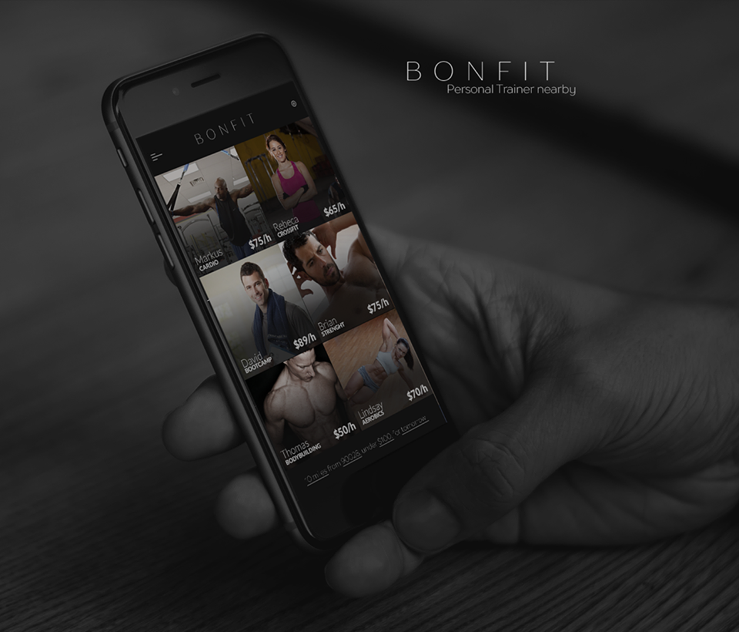
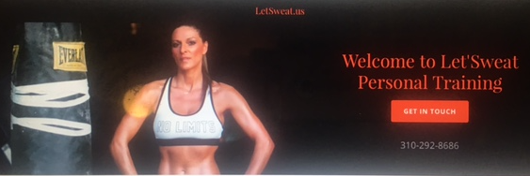
My Companies
BONFIT
App for Personal trainers and fitness professional on demand.
AppRising
Apprising is an IT software development company specializing in iPhone, Android , Windows phone and Cloud base application, most talented experienced app development company.
Let’Sweat
Private Client Personal Training

Slide 18
My Career Path
. Started as a maid on the small boat. Worked as server, bellman, valet, front office agent, concierge, room service etc..
I was in hospitality industry for over 15 years
I grew to Director of Guest Relations and hotel manager but I choose to change my career for what was forever passion Fitness.
Notes:
You may use this chart to describe your journey to the current career

Slide 19
My Career
The first job I had after college was:
I went to France to work on a little family own boat serving as a housekeeper and room services attendant
The worst job I have ever had was:
Cashier in a grocery store

Slide 20
My Career
Challenges I have had to overcome throughout my career are:
(list a few things that have made your career path difficult or that you have had to learn/change along the way)

Slide 21
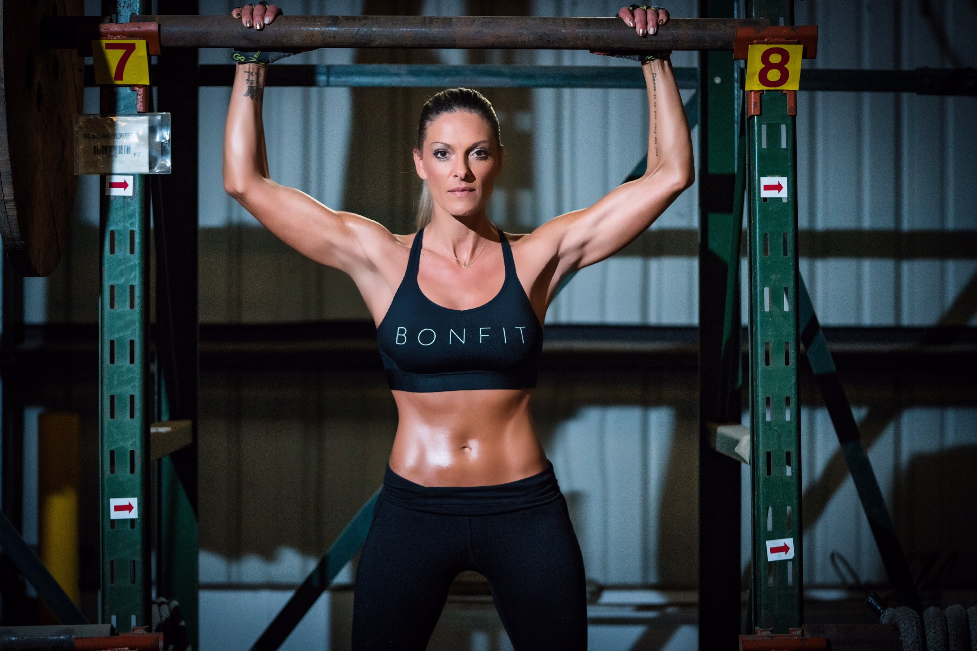
My role within organization
Co-Founder CEO
MANAGEMENT
ENTRY LEVEL
ME
ENTRY LEVEL
Notes:
Use this graph to give more description of your role specifically (responsibilities, typical work week, direct reports, etc.)

Slide 22
Compensation at my company
Compensation vary from each company
Notes:
Use this graph to show general compensation ranges for people in various roles in your company

Slide 23
More than just work
When I am not at work I like to:
I really try to enjoy my life to the fullest. I like adventure, traveling, extreme sports, exercising, watching sports, fast cars, love the beach and outdoor activities.

Slide 24
Do it all over again?
If I could talk to my high school self, what would I say?
The cost of not following your heart, is spending the rest of your life wishing you had. Making a big life change is pretty scary. But, know what’s even scarier? Regrets. Just because something ends doesn’t mean it never should’ve been. Remember, you lived, you learned, you grew and you move on.

Slide 25
QUESTION AND ANSWER

