Slide 1
Marriage and family Therapy
Presented by: Sandra Kushnir, LMFT
(Licensed Marriage and Family Therapist #99225)

Slide 2
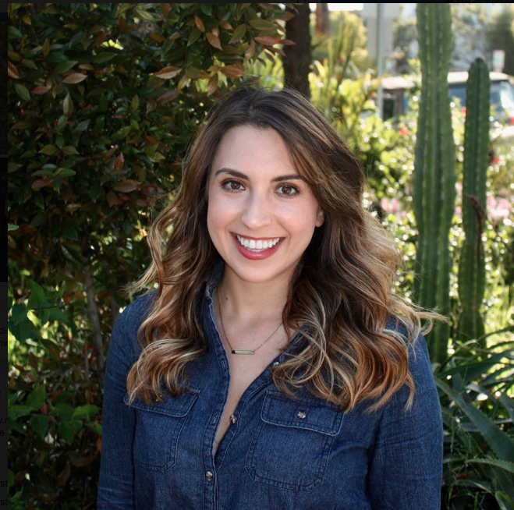
ABOUT ME
My name is Sandra Kushnir, 26-years old and I am a licensed marriage and family therapist
I grew up in Salt Lake City, Utah
My family is from Kiev, Ukraine (USSR)
Traveling is one of my biggest passions outside of my career
I graduated from the University of Utah with a bachelors degree in Psychology
My masters degree I got at California State University, Northridge in Marriage and Family Therapy
Photography, meditation, journaling, friends,
traveling, working out and self-care

Slide 3
Marriage and Family Therapy
Requires a masters degree (2-3 years) and 3,000 hours of experience, two licensing exams and ongoing consultation
You can specialize in different areas (substance abuse, trauma, family therapy, sex therapy, couples therapy, etc)
There are many different things you can do as a therapist!!!
Private Practice
Department of Mental Health DMH
For profit clinics
Hospitals
Schools
Coaching
Podcasts
Blogging
Consultation
Custody evaluations

Slide 4
What I love!
You get to help people change their lives, process their trauma, learn new ways of communicating and coping.
Your own personal growth never stops because you learn something new from your client’s every single day.
You get to witness the most vulnerable parts of life/others.
You offer people a new type of experience by not judging them, allowing them the space to be authentic and vulnerable with you.
Work is never boring and it’s not your standard 9-5 job.
Your colleagues are therapist so you always have someone that you can talk too about anything and not feel judged.
There are so many options on what you can do.

Slide 5
What I Don’t Love:
It takes a very long time too make good money- BUT it is possible!!!
The stigma around mental health and seeking therapy.
People negotiating the fee when they call you.
The lack of education and value that our culture places on mental health.
You are always on-call and have an obligation to be available for your clients who may be crisis.

Slide 6
What Makes A “Good” Therapist
Empathy
Openness to learn new things
Non-judgmental
Want’s to help others/Altruistic
Creative
Vulnerable
Willing to do work on oneself
Curious about others
Listening
Never assuming anything about anyone

Slide 7
ACTIVITY
Break up into groups of 5-6 people
Please be respectful!!!
“I-statements”
Confidentiality (keep it in the group/room)
Check-in: Everyone rate your mood on a scale from 1-10 in this moment.
(if you feel comfortable) share what is impacting your mood today with the group
The topic for the group today is “vulnerability”
What does being “vulnerable” mean too you?
Is it a positive thing or a negative thing?
What has been the most vulnerable thing that has happened too you?
Check-Out: What did you learn from each other during this group?
* How did it feel to talk to your classmates in this way?! What did you learn and what was your experience?

Slide 8
RESOURCES
https://www.ted.com/talks/brene_brown_on_vulnerability
BOOKS:
The Power of Vulnerability
Love Languages
The Defining Decade
My Website:
www.meridian-counseling.com
Meridian.Counseling
sandramytherapist@gmail.com

Slide 9
Q & A
15-20 minutes for questions!

