Slide 1
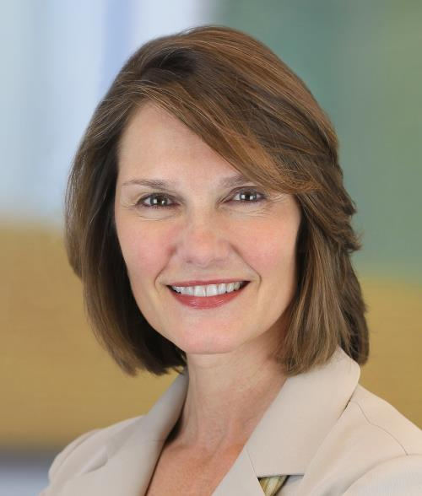
YBA GUEST Linda Whalen
March 16, 2016

Slide 2
INTRODUCTION
My name is Linda Whalen and I am as old as your parents.
I work for Ernst & Young LLP, also known as EY.
EY is an accounting and consulting firm. Our 200,000 people around the world help companies manage their accounting and tax needs, and help them operate more efficiently.
My role at EY is to build the firm’s brand among the people who buy our services.
I spend most of my time developing opportunities for our people to be quoted in the newspaper, helping them craft messages, working with them on social media and writing articles based on EY’s reports.

Slide 3
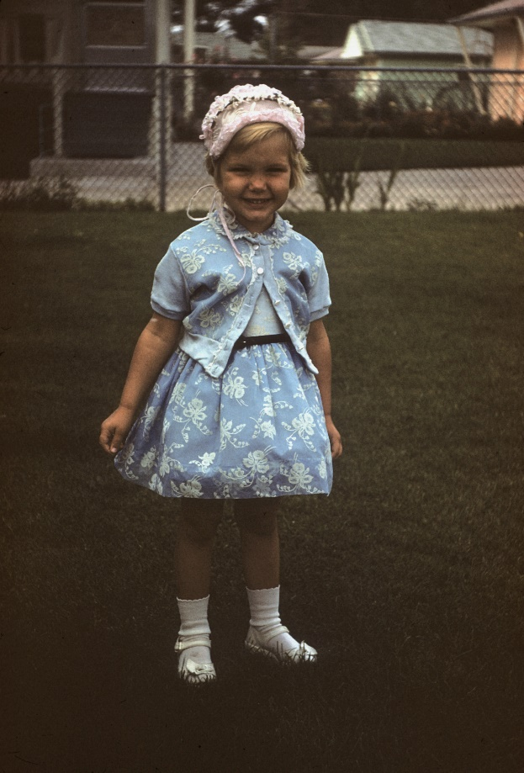
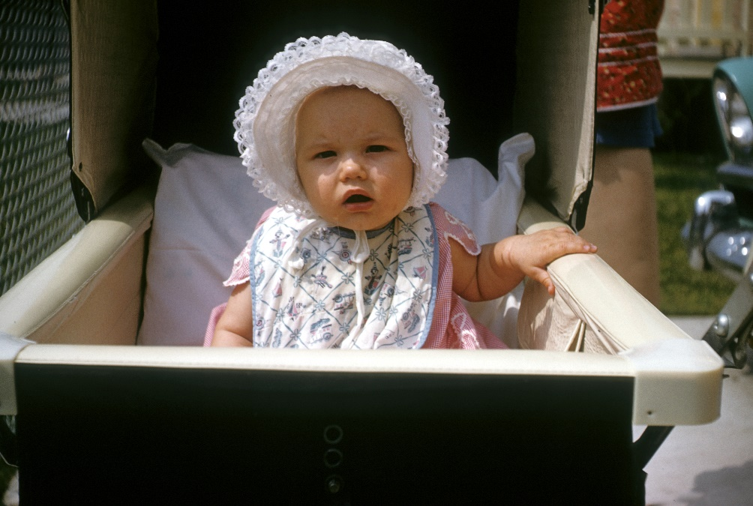
The Early Years…
I was born and raised in Chicago, Illinois.
This is a picture of me at six months old.
This is a picture of me at four years old.

Slide 4
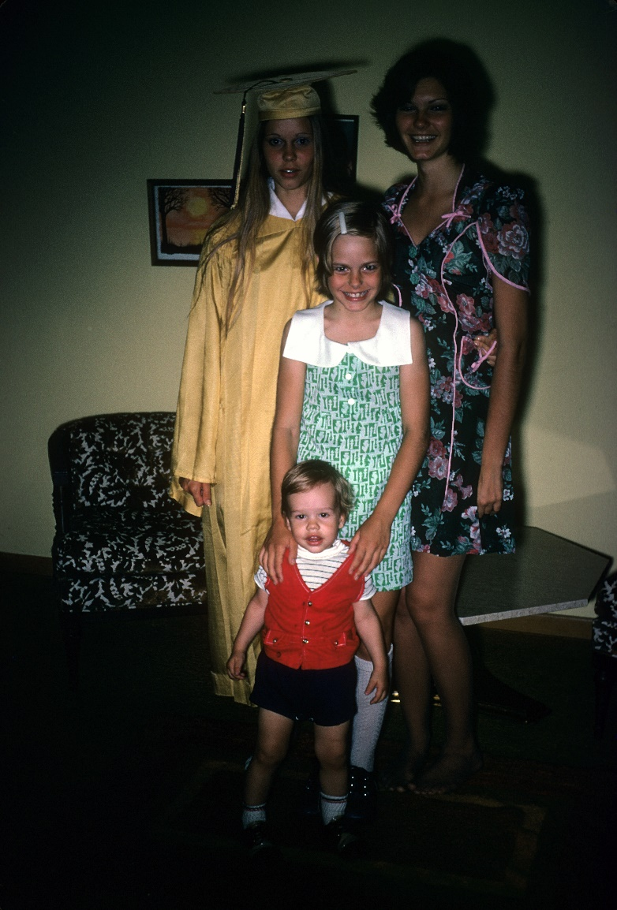
More Early Years…
A little about my family…
This is a picture of me and my three sisters: Nancy, Susan, and Karen. When I was 15, my brother, David, was born. We are best friends.

Slide 5
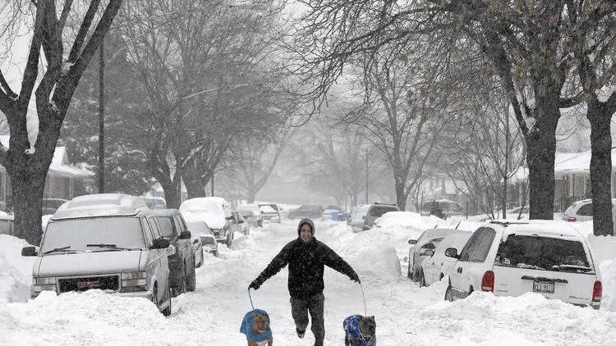
The Early Years…
Chicago looks like this. I prefer L.A.

Slide 6
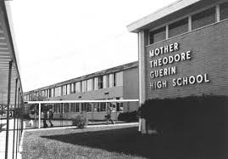
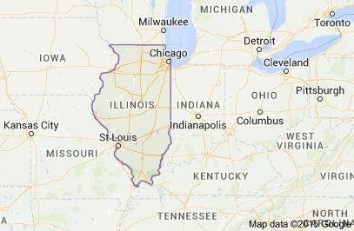
HIGH SCHOOL
I attended Mother Guerin High School for Girls in River Grove, Illinois. River Grove is a suburb of Chicago. It was girls only when I was there but now it is co-ed.
\

Slide 7
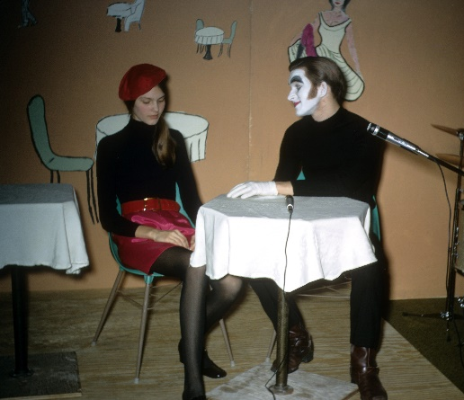
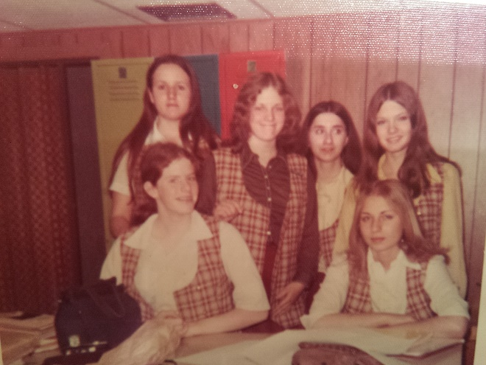
HIGH SCHOOL
As a HS student I was involved in art classes and theater.
I was shy and academic.
This is me in a play.
This is me in freshman art class.

Slide 8
HIGH SCHOOL
Things I enjoyed in HS
Things I did not enjoy in HS
Art and art museums
Music (lots of concerts!)
Being with friends
Reading
Making money
Dances (do you still have dances?)
Going to school, even though I got good grades
Studying
Taking the bus home from school (it was only two miles but seemed much farther when it snowed or rained)
Working

Slide 9
HIGH SCHOOL
Activities/Athletics in HS
Jobs I worked while in HS
Nope…didn’t play sports
Didn’t write for the school paper
Didn’t join any clubs
Babysitter
Telephone solicitor for carpet company
Telephone solicitor for Sears driving school
Mailroom at Motorola
Cashier at gift shop in the Hyatt Hotel
Babysitter at Hyatt Hotel

Slide 10
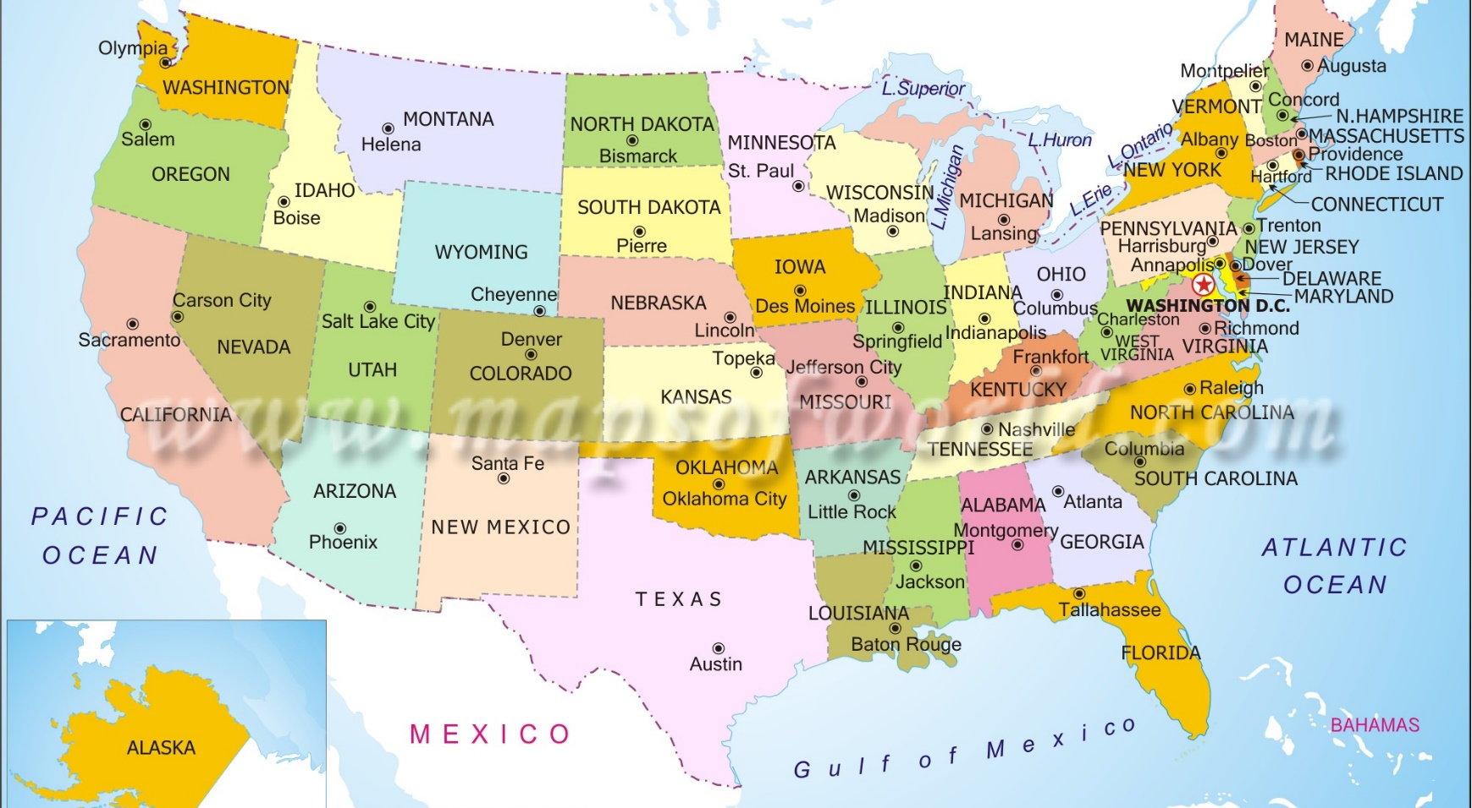
College & Grad school
I attended college/grad school in four cities: Chicago, Williamsburg, VA; San Francisco (undergrad) and Los Angeles (graduate school)
\

Slide 11
College or Graduate School
Jobs I worked while in College
Cashier in hotel gift shop
Library clerk
Waitress
Bakery clerk
Law office – collecting money!
Carpenter
Job I worked while in Grad School
EY West Region Brand and External Communications Leader

Slide 12
College or Graduate School
Favorite classes
Least favorite classes
English
Spanish
History
Every class in Grad School was my favorite!!
Calculus (but I did pass!)
Trigonometry (I dropped this class)
Astronomy
Accounting

Slide 13
College or Graduate School
Fondest memories
Obstacles or adversity that you had to overcome
Meeting interesting, kind, smart people from all over the world who are still my friends!
I ran out of tuition money and had to quit school for a while.
My family had moved from Chicago to Florida and into a smaller house, so I lived with friends in Chicago and worked in a bakery there.

Slide 14
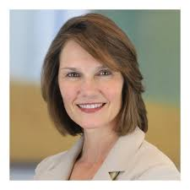
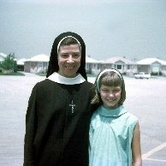
Career Path
I thought about being a nun when I was young…
I tried lots of different things along the way
I am now the Western US Brand and External Communications leader at EY
TV station
Presenter
Actress
Financial analyst
Notes:
You may use this chart to describe your journey to the current career

Slide 15
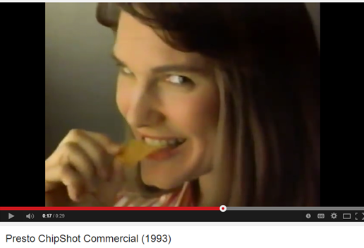
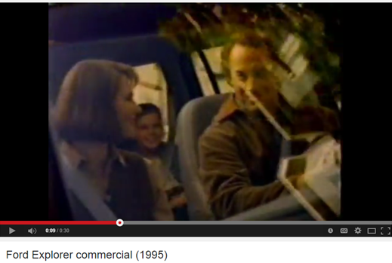
Fun job : TV commercials, videos, theater, Presentations

Slide 16
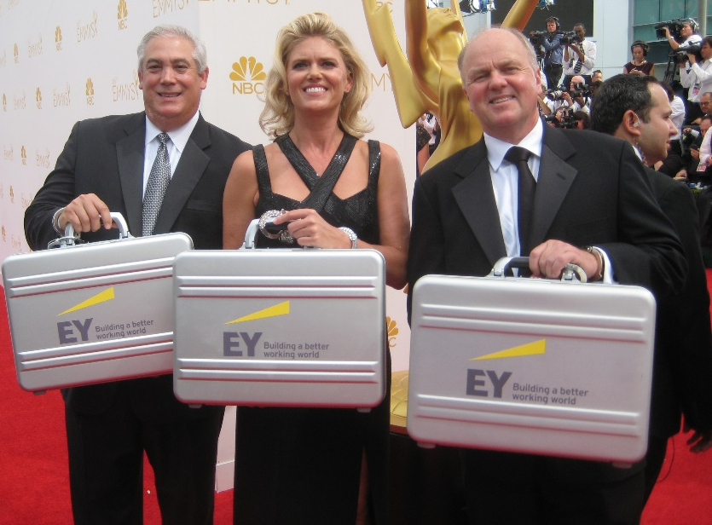
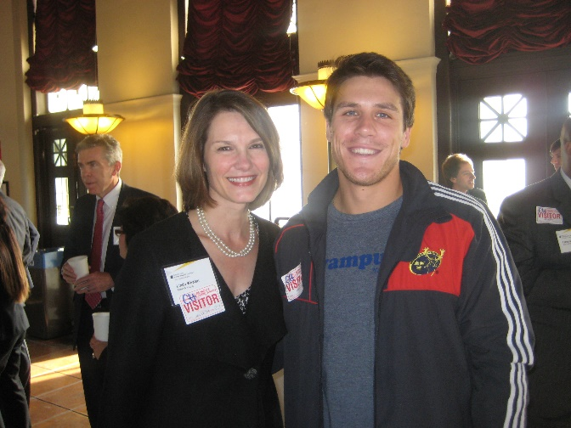
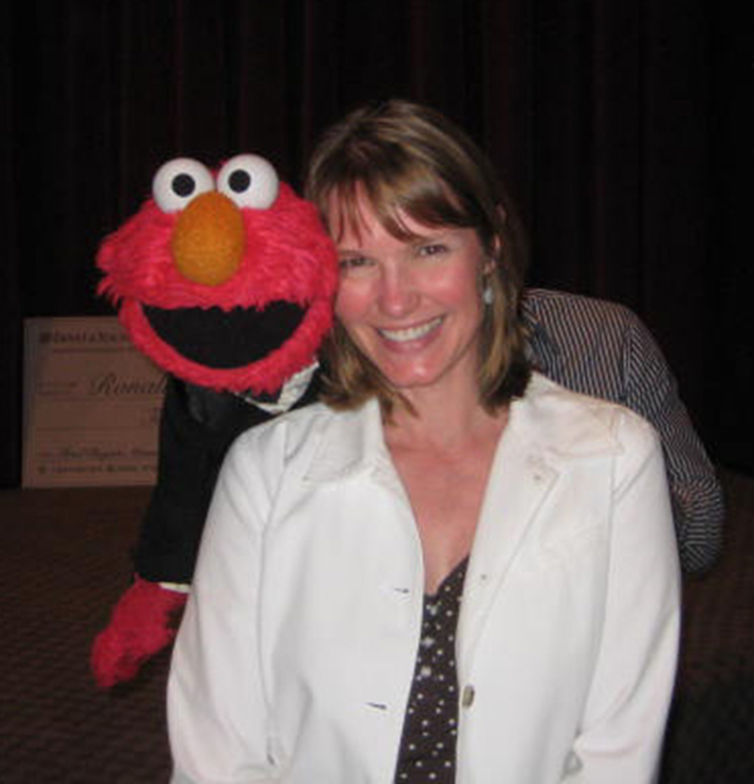
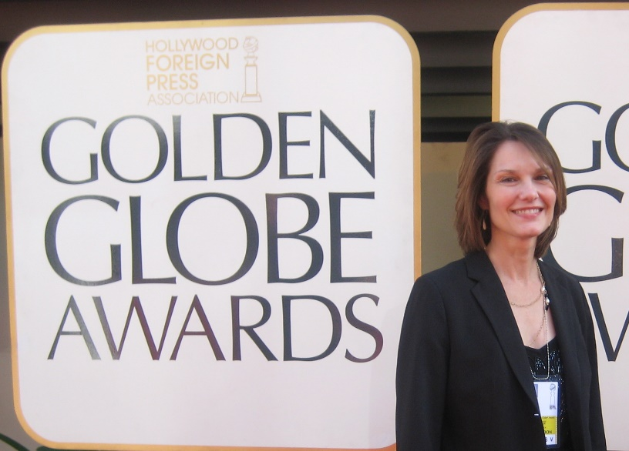
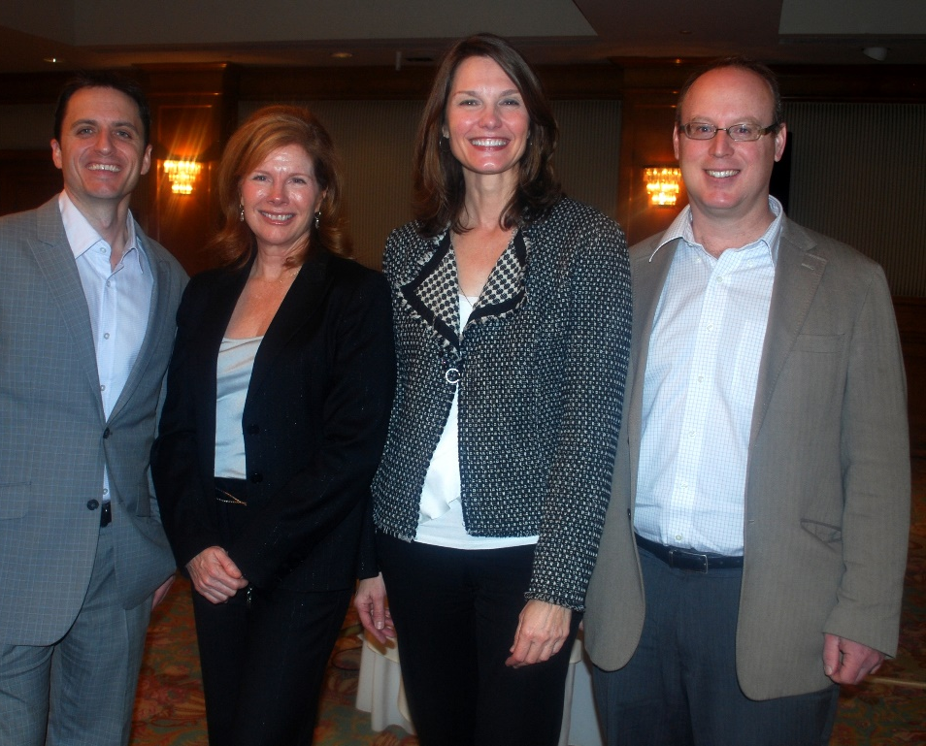
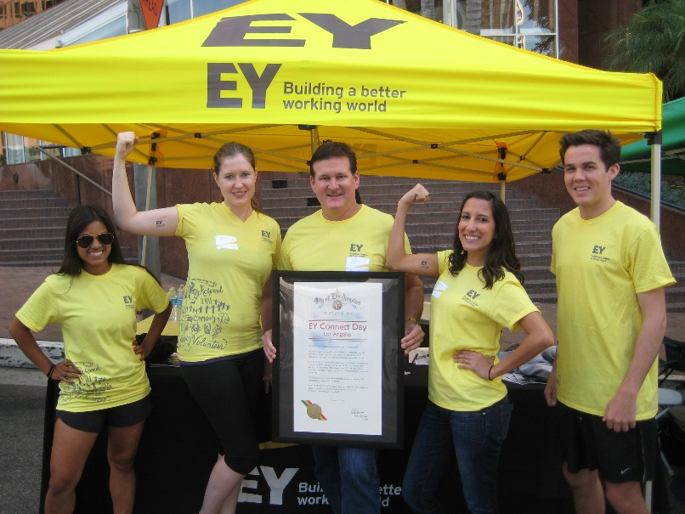
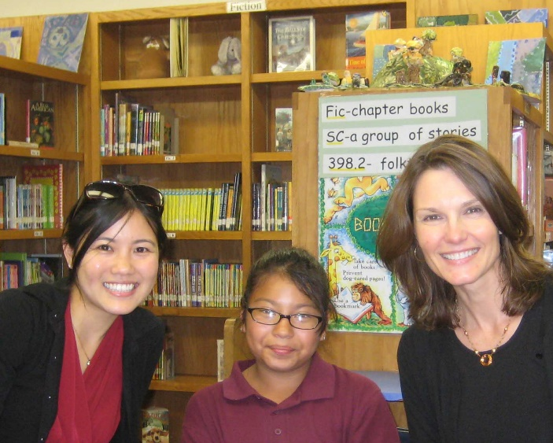

Slide 17
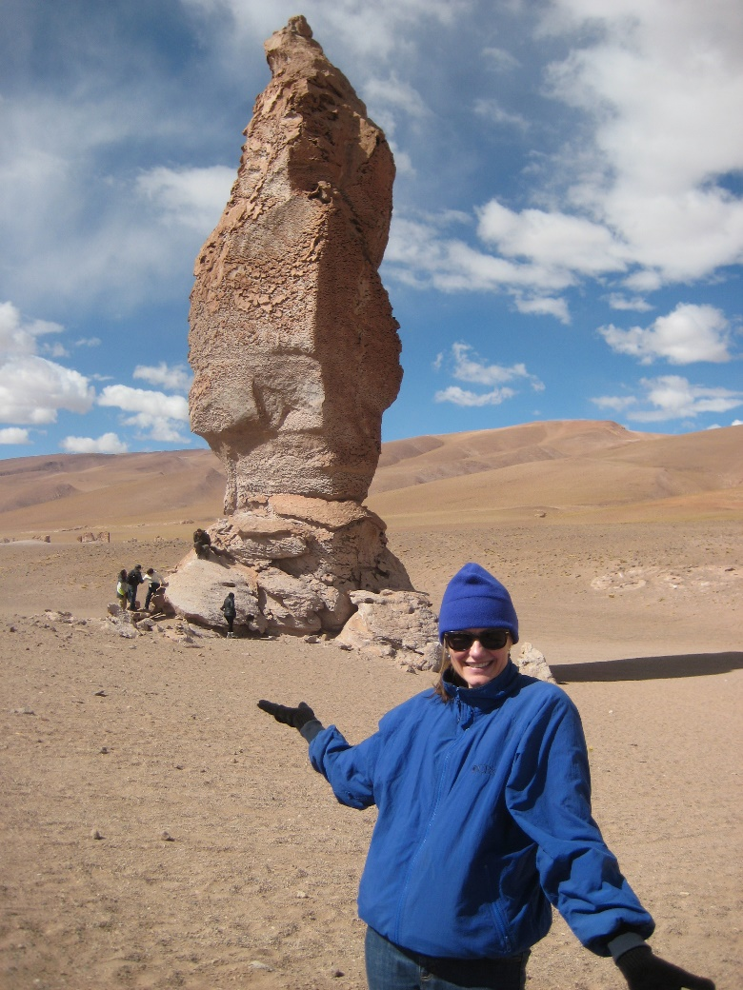
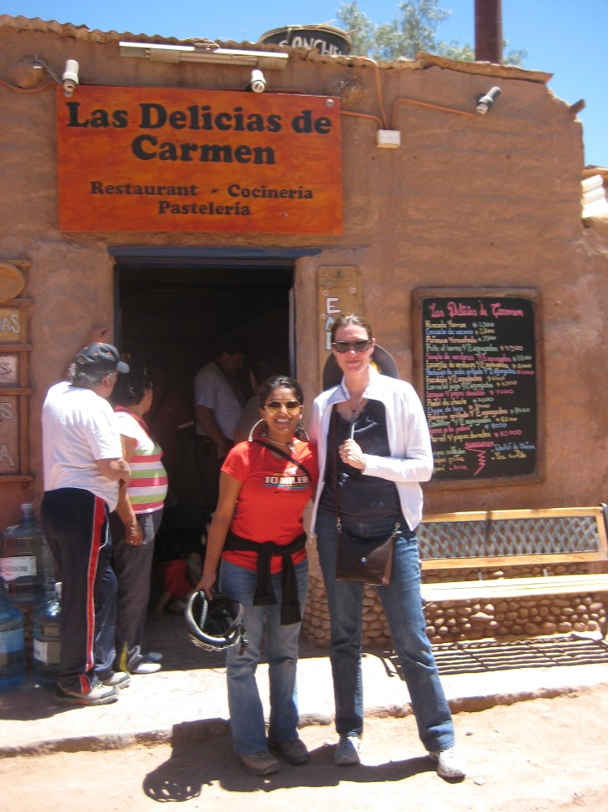
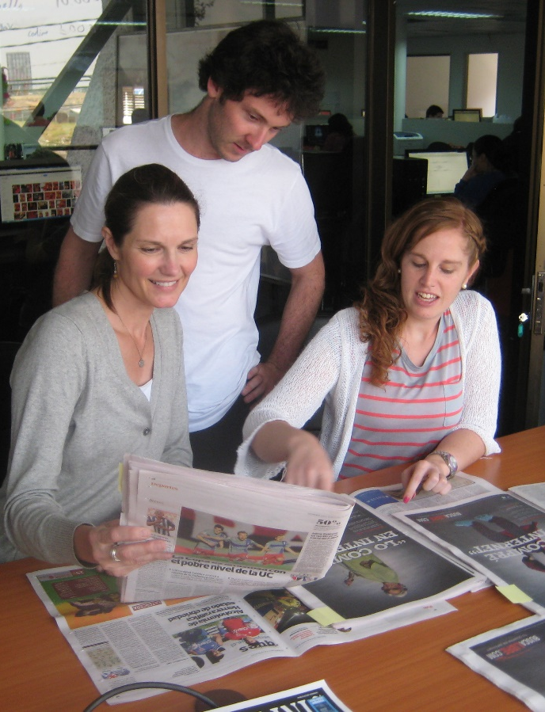
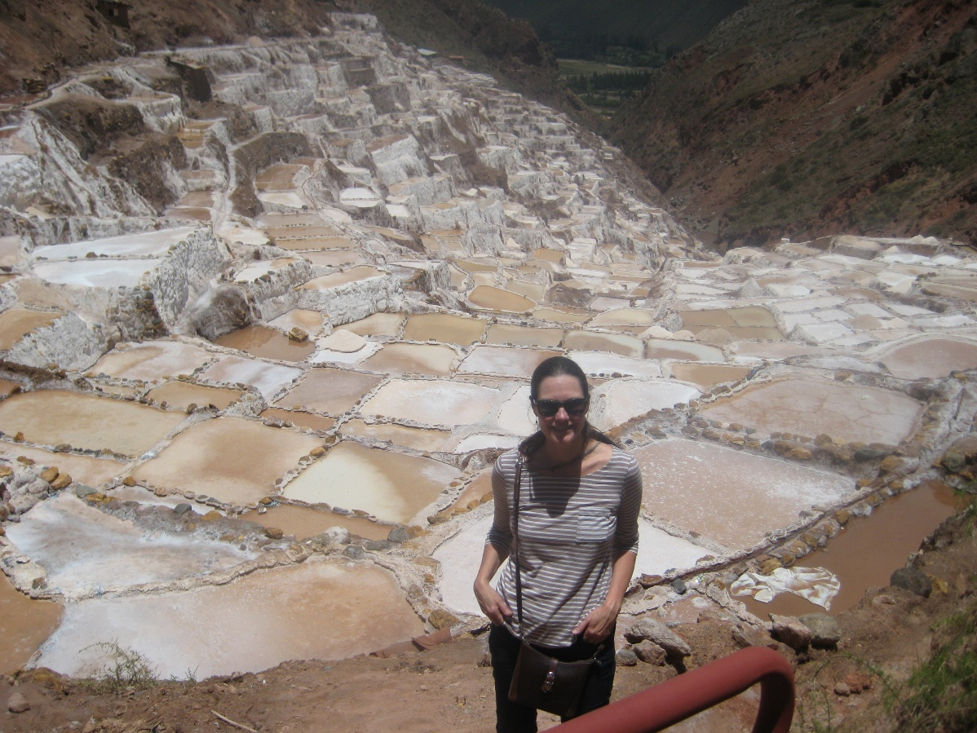
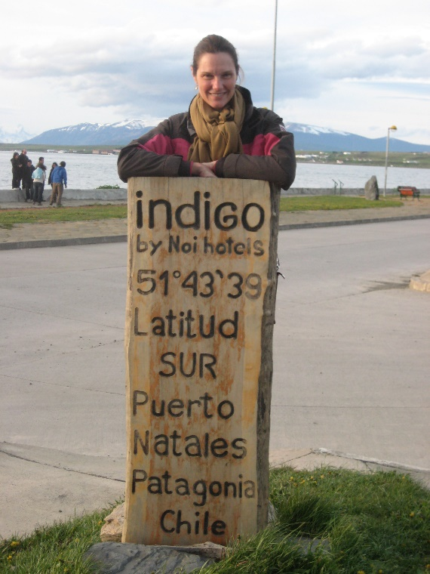
Career

Slide 18
Current Role
Brand and External Communications Leader
Public Relations
Social media
Message development
Writing
Notes:
Use this graph to give more description of your role specifically (responsibilities, typical work week, direct reports, etc.)

Slide 19
Career
Some challenges I overcame in my career
I moved a lot and switched careers a lot.
Started as a financial analyst
Then worked in public television (I started as a volunteer)
Then worked as an actress while I improved my writing
Then worked in corporate communications
Then learned public relations
Then learned social media
At each new direction in my career, I had to take risks and learn how to do new things
Learning doesn’t stop when you leave school!
I took classes and practiced new skills before taking the next career step
Lots of people helped me along the way!

Slide 20
CURRENT ROLE
History
Started as the Communications Leader for EY’s Pacific Southwest Region
Became the External Communications and Marketing Leader for the West
Size
EY has 200,000 people in 150 countries around the world.
Location
I work in EY’s Los Angeles office but travel all over the West Coast.
Products
Services
We provide services to large businesses.
Became the Brand and External Communications Leader for the West
There are over 6,000 people in EY’s West region.
The services we provide are accounting, tax, transaction and consulting.
Notes:
Use this graph to give more description of your current company (history, size, location, products and services, etc.)

Slide 21
Career compensation by level
Partner $200,000 +
Senior Manager $90,000 - $200,000
Manager
$65,000 - $90,000
Senior
$55,000 - $65,000
Staff & Administrative
$40,000 - $55,000
Notes:
Use this graph to show general compensation ranges for people in various roles in your company

Slide 22
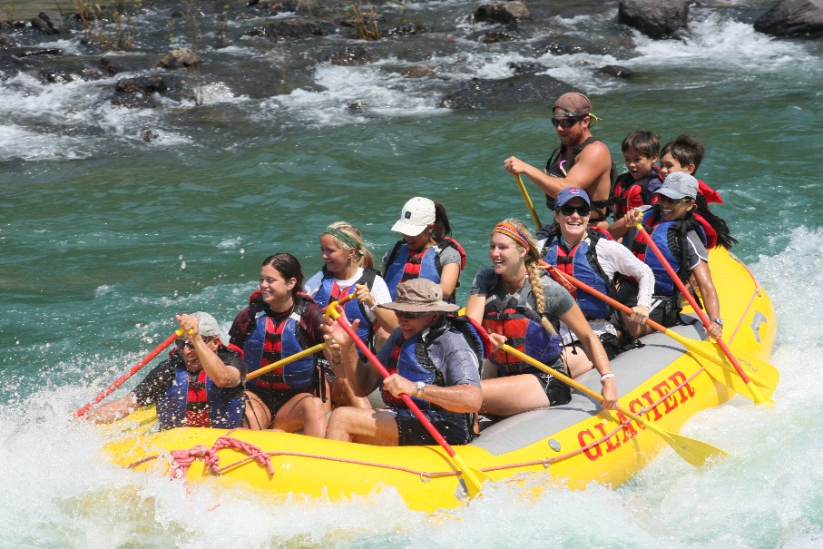
More than just work
When I am not at work I like to:
Practice yoga
Play Scrabble
Spend time with friends
Travel

Slide 23
QUESTION AND ANSWER

Slide 24
If I could talk to my high school self, what would I say?
The two most important questions in life are:
Where am I going?
Who is going with me?

