Slide 1
Journeys
Han Nguyen
YBA Speaker Representative
Aug 15, 2017

Slide 2
My backstory

Slide 3
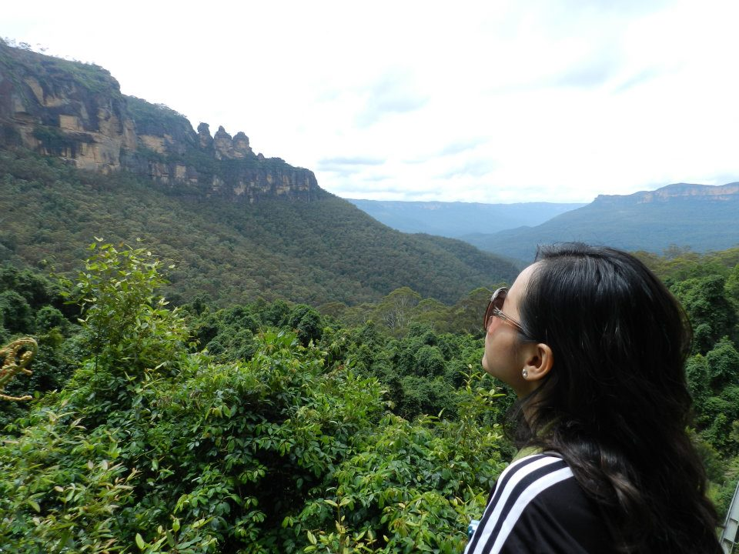
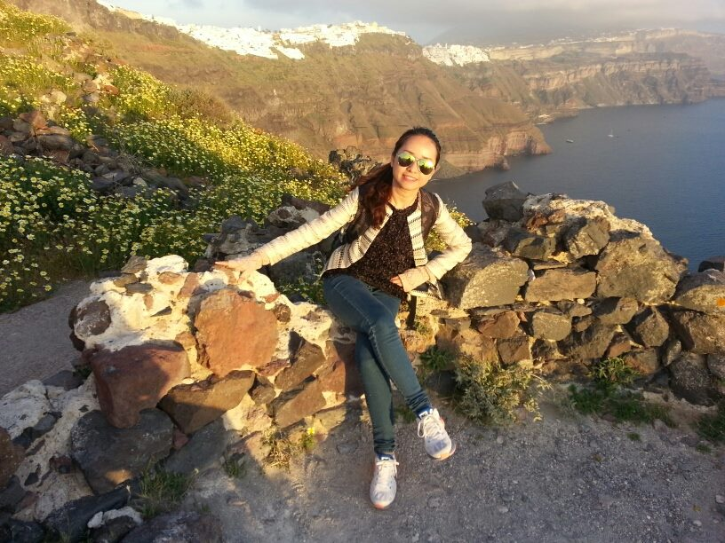
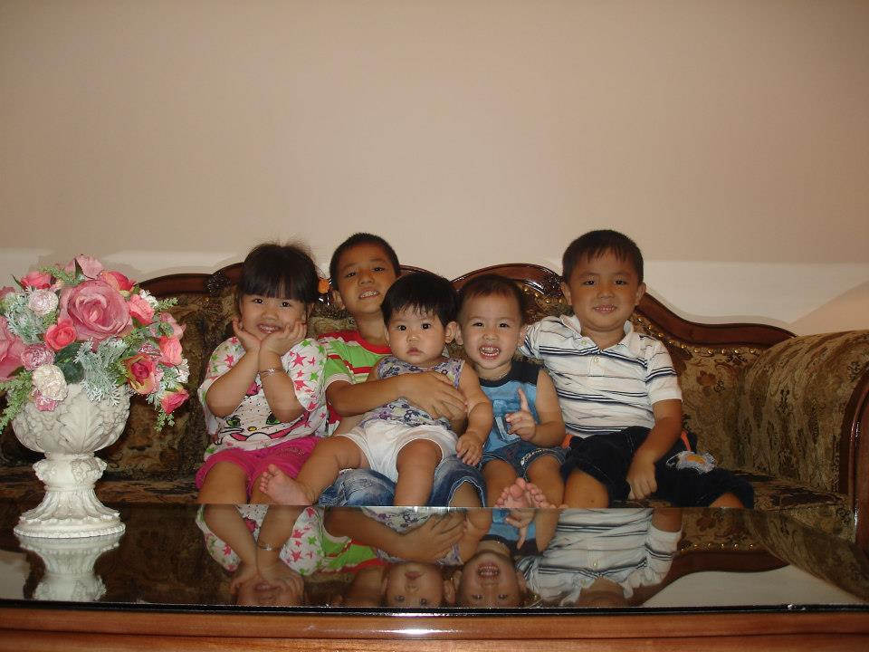
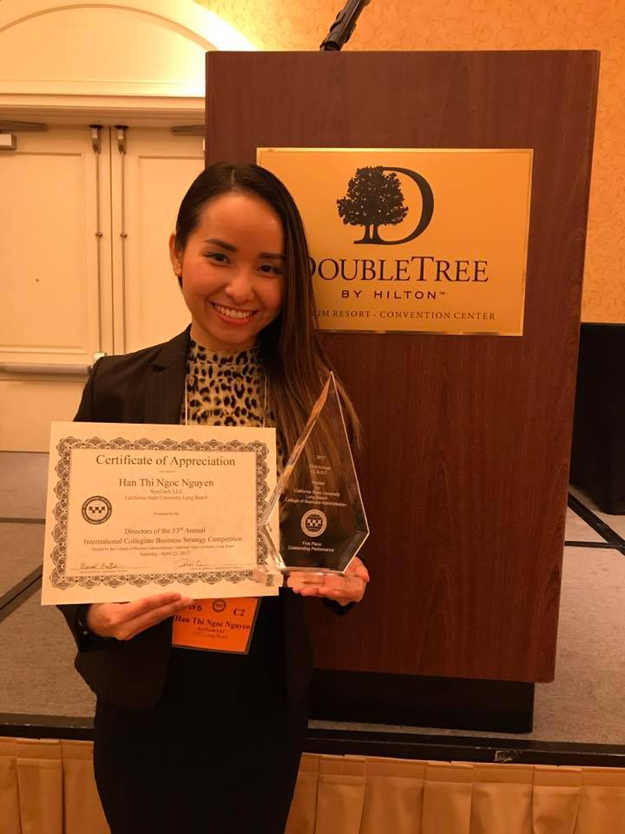
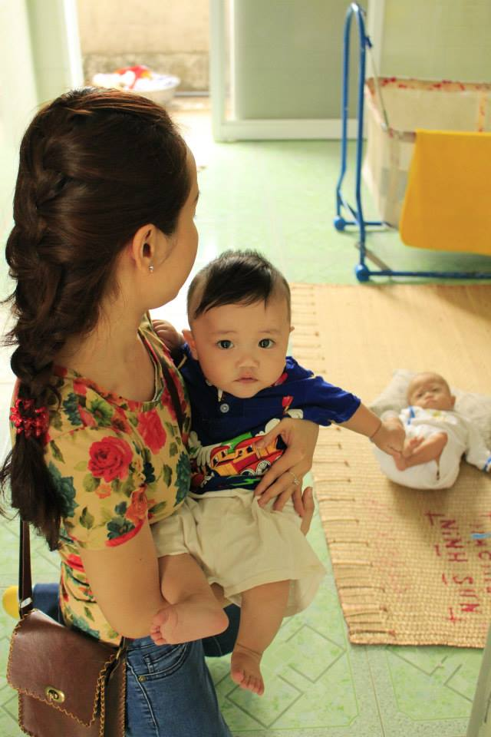
Hobbies

Slide 4
My professional career
Education Consultant
Corporate Relationship Manager
CS Representative
Associate Director – Global Subsidiary Group

Slide 5
A typical working day

Slide 6
Skillsets of a financial professional
Industry knowledge
Analytical thinking
Entrepreneurial mindset
Resilience in high-pressure environment
Visionary focus

Slide 7
Activities to practice
Self-reflection
Motivation
Empathy
Appreciation
Communication

Slide 8
Thank you for being a beautiful part of my journey !!!

