Slide 1
INTRODUCTION
My name is Bonnie Mizrahi and I am 55+ years old.
I work for Commercial Bank of California.
My company is a community bank that focuses on business and commercial lending.
I am Sr. VP/CRA and Compliance Officer at the Bank.
Every day I review policies, procedures, and transactions to be sure the Bank has provided required disclosures and followed bank regulations.
I also review the Bank’s performance in making loans in our community and I look for ways that the Bank can make a positive difference in our community.

Slide 2
My childhood
I was born in Los Angeles and raised in Sepulveda (now known as “North Hills”)
This is a picture of me at age 2.
Ever since I can remember, I have loved horses! I was a “horse-crazy” girl!
I have always loved animals and would try to save every stray cat or dog.

Slide 3
My family
A little about my family
My dad had his own business and all of our family pitched in to help.
My brother and I used to fight a lot when we were kids but we also looked out for each other.
This is a picture of me and my brother.
We went to Langdon Avenue school in Sepulveda.

Slide 4
MY HIGH SCHOOL
I attended Monroe High School in Sepulveda, California
A few things have changed since I graduated:
Sepulveda is now called “North Hills”
The “little kid” Viking mascot has been replaced
There is now a Wellness Center on one corner of the school
Yearbook from my senior year.

Slide 5
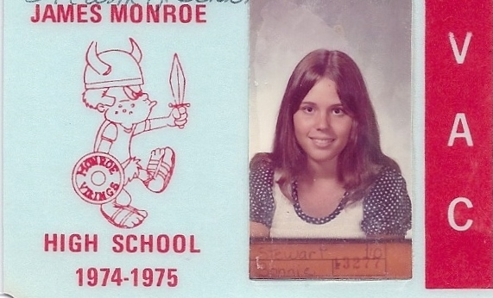
High School
As a HS student I was shy and nerdy.
I played the cello
I was in AP/honors classes.
I was in Student Government mainly to have a place to eat lunch!
Here is a my old school ID Card

Slide 6
High School
Things that I really liked in High School were:
Art
English
History
French class
Yearbook

Slide 7
High School
Things that felt difficult or challenging for me while I was in High School were:
Trying to fit in and not get bullied by the popular girls.
Feeling embarrassed that I couldn’t afford “cool” clothes and didn’t have much money.
I used to get into trouble for drawing horses on the edges of my class notes and homework assignments.
My teachers always told me to live up to my potential.

Slide 8
High School
Jobs I worked while I was in High School were:
Babysitting. Lots and lots of babysitting.
Swenson’s Ice Cream
Robinson’s Department Store
Working with other kids from French class one summer to teach the children of Vietnamese refugees how to speak English.
I was also on the Yearbook staff in my senior year. I think that was the most fun I had in High School.

Slide 9
Getting in to College
The top few things I did to ensure I got into college were:
I took Advanced Placement classes and scored well on the AP Tests.
I studied hard for the SAT and got high scores.
I wanted to be an artist but everyone in my family told me I should be practical and get a degree in business management.
I quickly learned I did not like business management classes!

Slide 10
College
I started part time at CSUN but after my father’s business went under, I got a job in a bank and transferred to Los Angeles Valley College so I could take classes at night.
I graduated LAVC with an Associate of Arts degree and continued working in banking ever since.

Slide 11
My Career Path
I took the jobs that no one else wanted and focused on compliance including consumer protection, community reinvestment, and Anti-Money Laundering.
I started as a “temp” and was then hired full time to work in “Customer Service”
I am now a Senior Vice President and in charge of the Compliance and Community Reinvestment Act Program.
Notes:
You may use this chart to describe your journey to the current career

Slide 12
My Career
I was already working in banking when I graduated college.
I started as a “temp” and was hired full-time after a month.
I started in “Customer Service”, spent time in the Note Department, did collections, new accounts, loan documentation, loan underwriting, back office operations, and basically almost every job in a bank EXCEPT being a teller!

Slide 13
My Career
Challenges I have had to overcome throughout my career are:
Balancing family life and work.
Balancing regulatory requirements with the fact that the bank needs to make money.
Raising awareness of consumer protection laws.
Raising awareness of money laundering crimes.
Raising awareness of why ethics are important in the work place.
Finding ways to help both the community and the bank prosper and grow.

Slide 14
My role within organization
I am part of the Senior Management Team.
I report to the Chief Credit Officer who reports directly to the President of the Bank.
I coordinate our officers and employees to work with community organizations.
I conduct monthly meetings with the other senior officers and go over our compliance and CRA program.
I keep up with changes in consumer laws and anti-money laundering requirements.
Notes:
Use this graph to give more description of your role specifically (responsibilities, typical work week, direct reports, etc.)

Slide 15
More than just work
When I am not at work I like to:
After spending more than 50 years wanting a horse, I finally got a horse a few years ago.
The horse is an ex-racehorse who was rescued from going to slaughter after his last race.
I am now learning the finer points of riding and how to handle a spirited Thoroughbred.

Slide 16
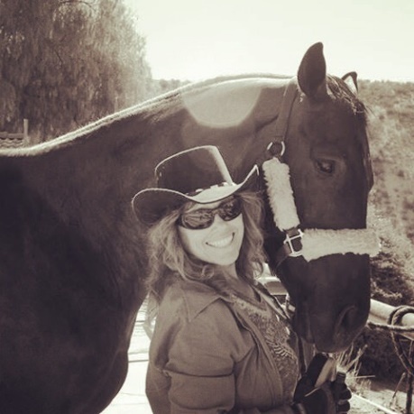
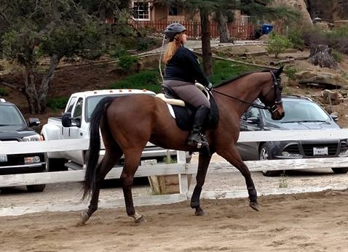
Do it all over again?
If I could talk to my high school self, what would I say?
Don’t worry about those popular kids. Most of them did not do that well after high school.
Focus on what you enjoy and don’t force yourself to be something you aren’t.
Skip the Prom! It wasn’t worth it.
Follow your passion.

Slide 17
QUESTION AND ANSWER
Jobs in banking
Consumer protection and financial survival skills
Anti-money laundering
Community Reinvestment

