Slide 1
Digital entrepreneur
Te-Erika Patterson

Slide 2
What is a digital entrepreneur?
Digital entrepreneurs are entrepreneurs focused exclusively on digital commerce.
I create multiple streams of income from creating digital based platforms and products that you can not touch.

Slide 3
What is a digital entrepreneur?
I sell INFORMATION

Slide 4
What is a digital entrepreneur?
The major benefits of being a digital entrepreneur:
You never have to ask permission to earn income
You can never get fired from your job
You don’t have to worry about having a physical store or products
You are paid for information and skills instead of trading the hours in your day for wages
You work all day in your underwear

Slide 5
What is a digital entrepreneur?
The goal is to establish FINANCIAL FREEDOM
Financial freedom is established when your active passive income exceeds your active monthly bills.

Slide 6
What is a digital entrepreneur?
The goal is to establish FINANCIAL FREEDOM
Financial freedom is established when you earn enough income from your businesses that you don’t have to wake up and go to work to pay your bills.

Slide 7
What is a digital entrepreneur?
The goal is to establish FINANCIAL FREEDOM
Working for hourly wages limits your potential income because there are only 24 hours in a day.

Slide 8
What is a digital entrepreneur?
The goal is to establish FINANCIAL FREEDOM
If you make $20 an hour and you work 24 hours you can only earn $480 for one day.

Slide 9
What is a digital entrepreneur?
The goal is to establish FINANCIAL FREEDOM
If you create one product and you sell it for $480 you still have 24 hours to create other income versus the man who is trading the hours of his life for wages.

Slide 10
What is a digital entrepreneur?
The goal is to establish FINANCIAL FREEDOM
You can create financial freedom by deciding that you will not make a career out of working for wages.

Slide 11
What is a digital entrepreneur?
The goal is to establish FINANCIAL FREEDOM
Decide you will offer value to this world and you will always set your own prices.

Slide 12
What is a digital entrepreneur?
The goal is to establish FINANCIAL FREEDOM
When you ask someone for permission to work for them you have to accept what they pay you.

Slide 13
What is a digital entrepreneur?
The goal is to establish FINANCIAL FREEDOM
When you set your own prices by owning your own business you never have to settle for what someone is willing to give you.

Slide 14
What is a digital entrepreneur?
The goal is to establish FINANCIAL FREEDOM
How did I get started on my path to financial freedom?

Slide 15
I am a blogger
A blog is a website that is updated with content regularly. The content is labeled by date. It is usually focused on one topic. Each article written on a blog is called a blog post.

Slide 16
I am a blogger
I created my first blog in 2003 just before graduating with a BS in Journalism from The University of Florida.

Slide 17
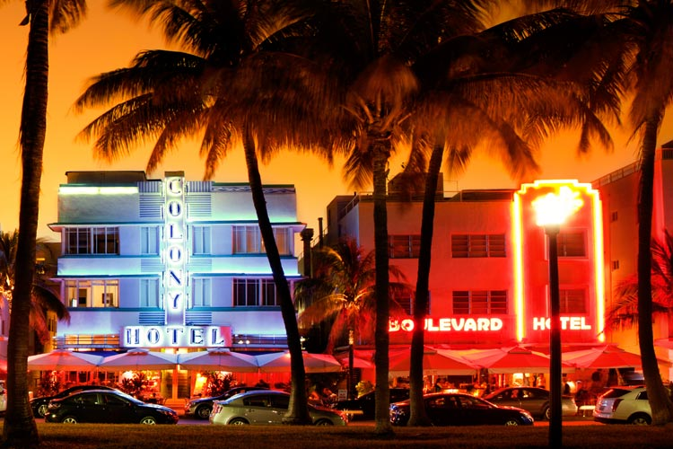
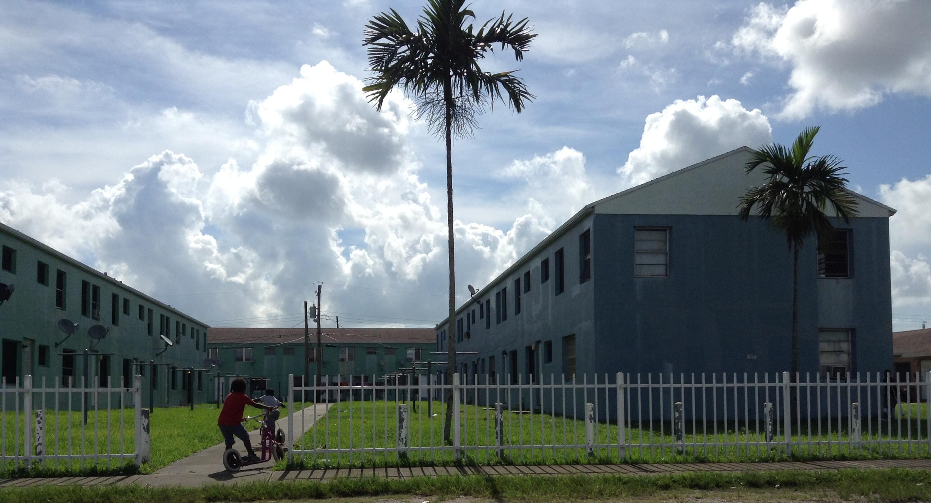
I am a blogger
I grew up in Miami, Florida where I decided I would one day become a Journalist and author.

Slide 18
I am a blogger
I never found my purpose in life, I chose what I wanted to do and stuck with it.

Slide 19
I am a blogger
Now I have 6 blogs and they are my main source of income.

Slide 20
I am a blogger
Blog Topics:
Women’s Empowerment
Moving To Los Angeles
Being Single & Satisfied
Female Led Relationships
Female Led Society
Abuse Is Not A Secret

Slide 21
I am a blogger
I also earn income by writing for other websites and blogs about topics like entrepreneurship, marketing, lifestyle and success.
Entrepreneur.Com
Forbes.Com
The Atlantic
The Huffington Post
The Miami Herald
YourTango
DigiDay
Fox News

Slide 22
I am a blogger
How do I earn income from my blogs?
Blog Traffic
Create books/ebooks
Lead coaching programs
Lead workshops
Create an online school
Create an online store
Create paid membership communities
Create Youtube channels
Become an expert on a topic and get paid to write about it
Create marketing strategies for small businesses

Slide 23
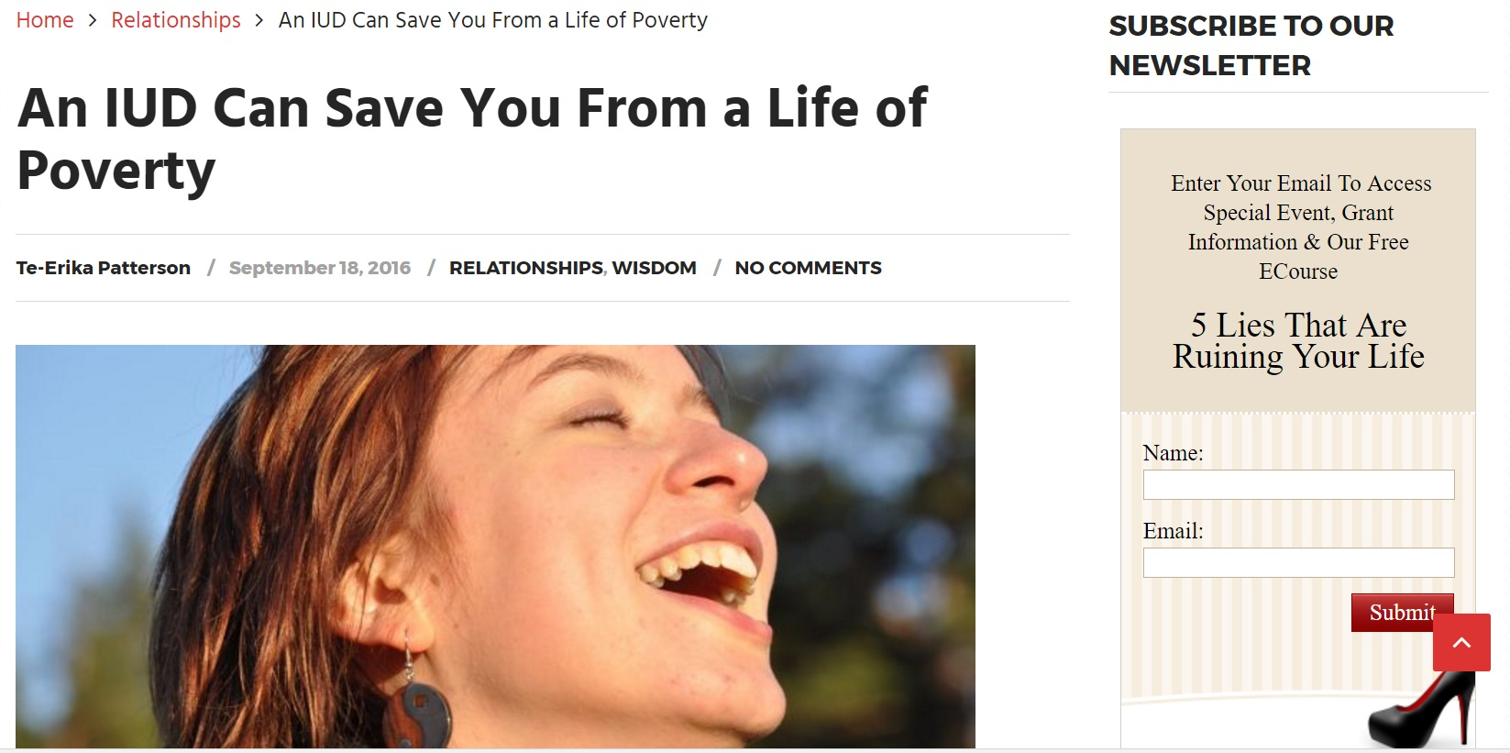
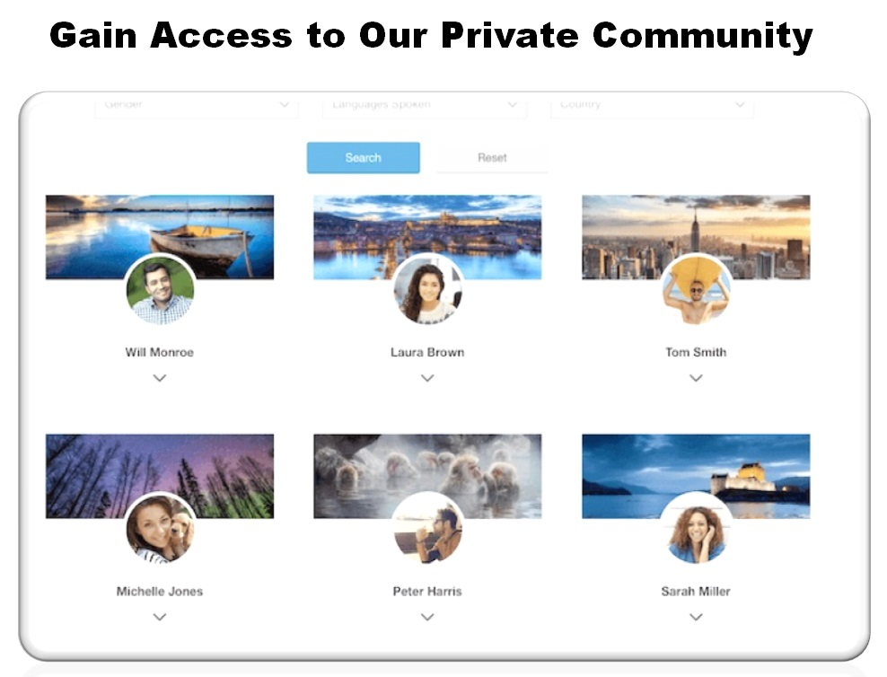
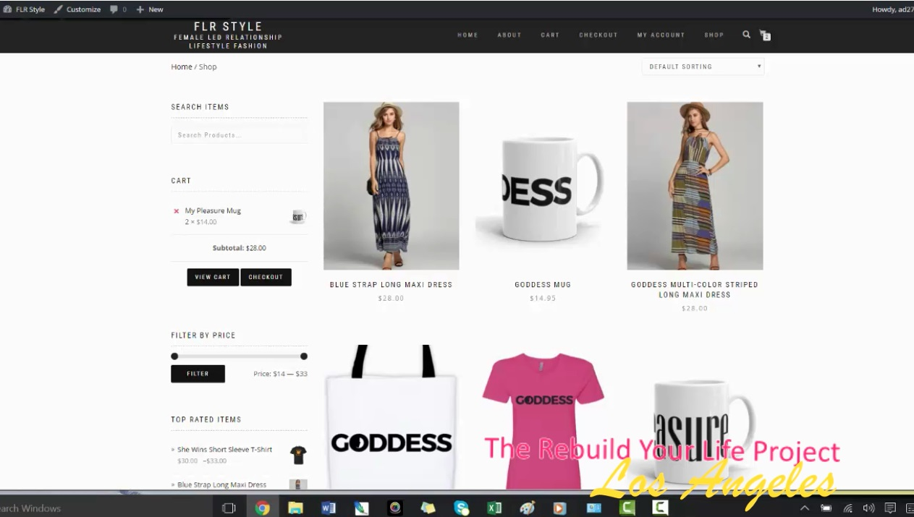
I am a blogger

Slide 24
I am a blogger
My biggest challenges???
Maintaining websites
Managing writers
Marketing to subscribers
Working 7 Days a Week
Intersecting current affairs with blog topics

Slide 25
I am a blogger
Blog Post Challenge
How do you create topics for your blog posts?
Write about exciting news around your blog topic.
Answer questions from readers about your topic.
Take the current hot subject and intersect it with your blog topic.

Slide 26
I am a blogger
Blog Post Challenge
Name a current trending topic & match the trending topic with the blog topic
You have a blog about Hot dogs
You have a blog about Hair
You have a blog about Shoes

Slide 27
I am a blogger
Creating Blog Post Titles
SEO = Search Engine Optimization
Use keywords that people will google to find your topic
If you want fans of Justin Beiber to find your blog use the words Justin Beiber in your blog post title

Slide 28
I am a blogger
Creating Blog Post Titles
SEO = Search Engine Optimization
Use keywords that people will google to find your topic
If you want people who have pitbulls to find your blog use the word pitbull in your blog post title

Slide 29
I am a blogger
How to create your own idea for a blog?
Choose a topic that you never get tired of learning about. As you learn you will share on your blog.
Choose a topic that others ask you questions about and you know the answers. As people ask questions you will share them on your blog.

Slide 30
I am a blogger
Rules for Being a Successful Blogger
Be consistent.
Never stop sharing.
Reach out to others who share your passion, interview and write about them.
Create different ways to share with your audience
Having an email subscriber list is MANDATORY

Slide 31
I am a blogger
If you take my suggestion…

Slide 32
I am a blogger
Best Advice For Life
Life is NOT A TEST

