Slide 1


Slide 2


























Our Partners
5
￼

Slide 3
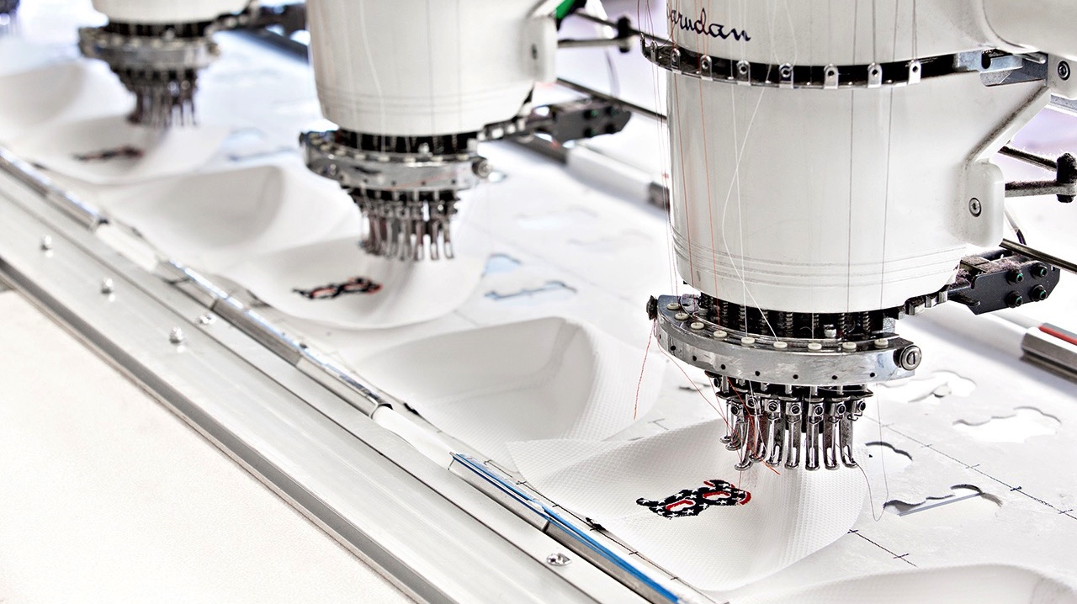








CATEGORY
EXPERTISE
While most sourcing companies are limited to working within a few industries, BAMKO has a wide range of expertise, making us ready to take on projects over
a broader scope of product categories.
  PACKAGING
  Folding Cartons
  Window Boxes
  Rigid Setup Boxes
  CUT & SEW
  Plush
  Bags
  Apparel
  ELECTRONICS
  Audio
  Lighting
  Thermals
PROMOTIONAL
We not only
offer the best promotional products found in today’s market,
but we also
have the capabilities
to create fully custom products, enhancing your brand’s unique identity and your consumer’s connection.
  PLASTICS
  Injection Molding
  Blow Molding
  Compression Molding
  METALS
  Stainless Steel
  Aluminum
  Tins
  GLASSWARE
  Hand Blown
  Machine Blown
  Semi-Automated
￼

Slide 4

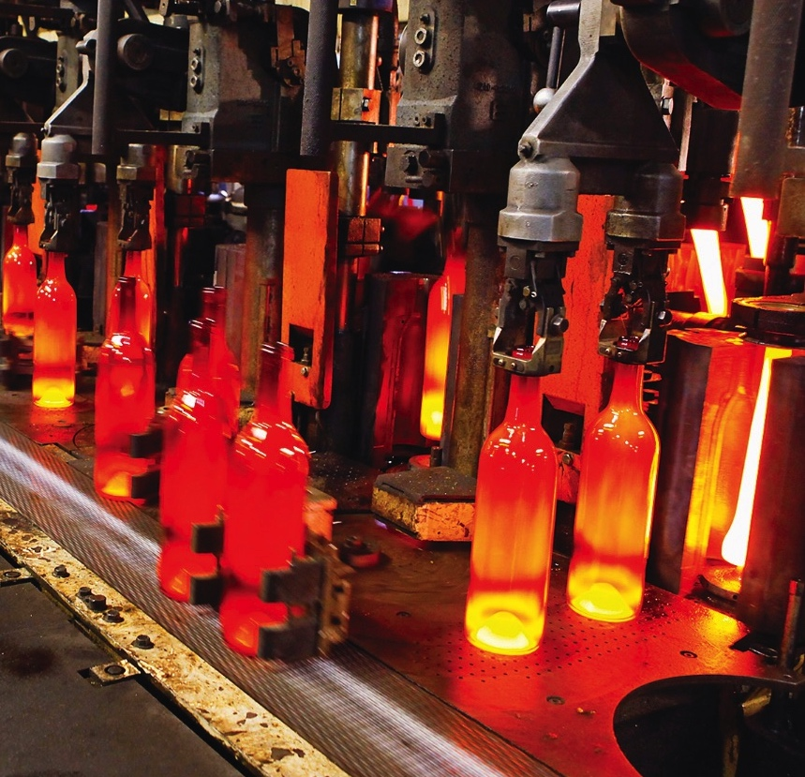
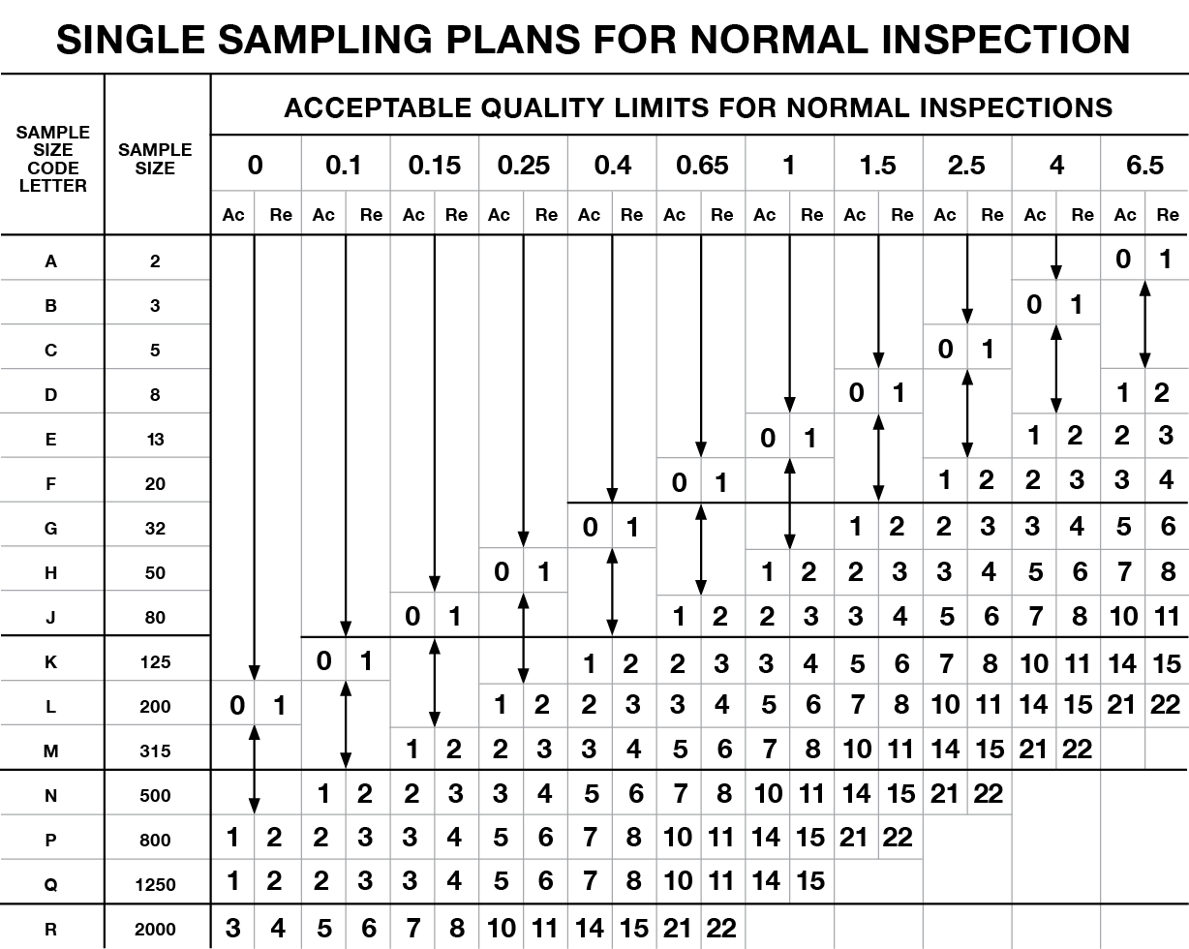



QUALITY
EXCELLENCE
The BAMKO QC team keeps its boots in the factory during production to make sure you get nothing less than what is expected. Our product safety library is one of largest collections of incidents, recalls, and protocol in the world–2nd only to the United States Consumer Product Safety Commission’s library.
INDUSTRY STANDARD
SAMPLING PLAN
  Level I Sampling Plan
  Level II Sampling Plan:
  A larger # of samples inspected
ACCEPTABLE QUALITY LEVELS
  Critical - 0
  Major - 2.5
  Minor - 6.0
  Critical - 0
  Major - 1.5
  Minor - 4.0
INSPECTION FREQUENCY
  Final inspection
  prior to loading
  the container
  Inspections during sampling, raw material production, beginning/middle/end of mass production
￼

Slide 5
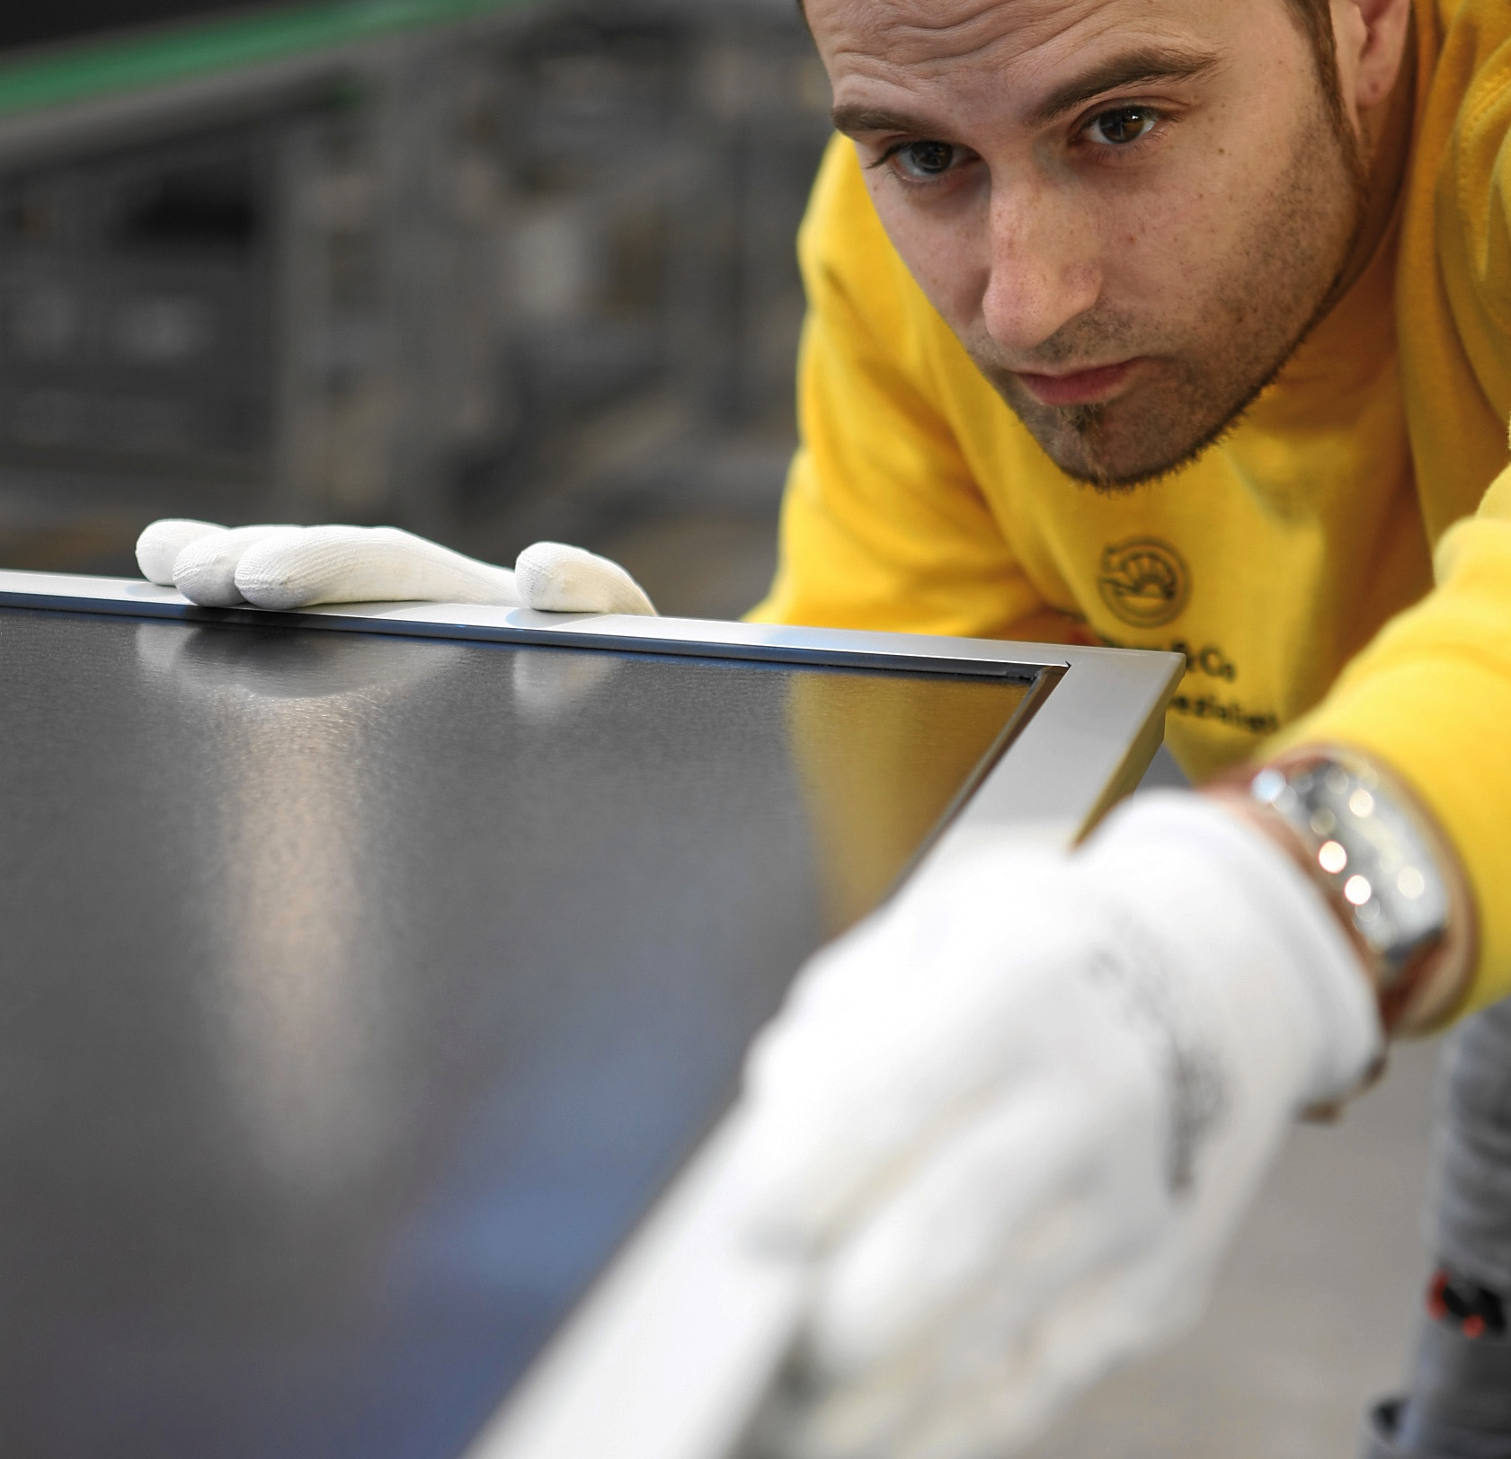


PRODUCT
SAFETY
BAMKO’s staff has extensive experience in assisting clients through each phase of the testing process. BAMKO's Quality Control and Testing departments are comprised of experienced veterans from SGS, Intertek, BV and UL. The two departments work together to monitor our products' compliance with all applicable regulations. BAMKO’s growth is attributed to the bond with their clients which relies heavily on understanding the importance of product safety and upholding their brand’s reputation.
￼

Slide 6
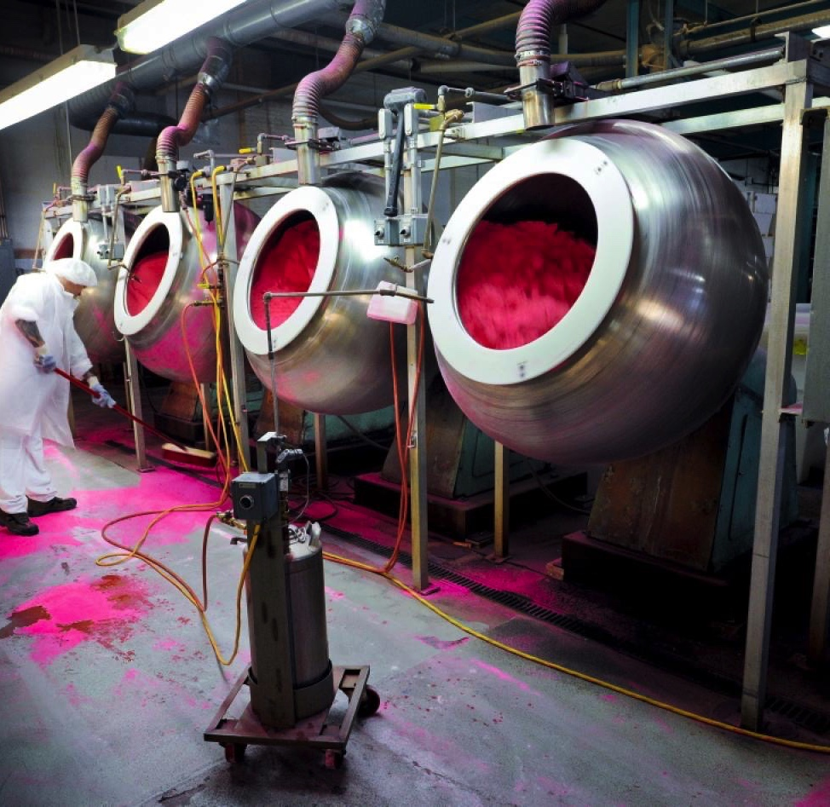
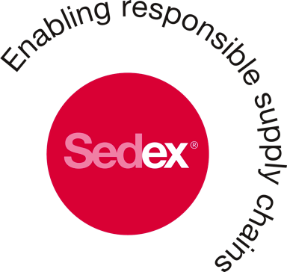




FACTORY
AUDITING
All of BAMKO’s factories are audited prior to the issuance of any purchase order. These factories are monitored throughout the year and formally audited at least twice a year. BAMKO has developed and implemented its own CSR policy and Code of Conduct, but also complies with over 125 different client code of conduct policies. BAMKO has over 2,000 factories in its audit database with reliable, current information about each factory’s compliance status with standards such as ISO 14001, ISO 9001, SA 8000, CTPAT and others. BAMKO has established a strong reputation in the CSR industry by remediating over 80 factories in the last 5 years.
￼

Slide 7


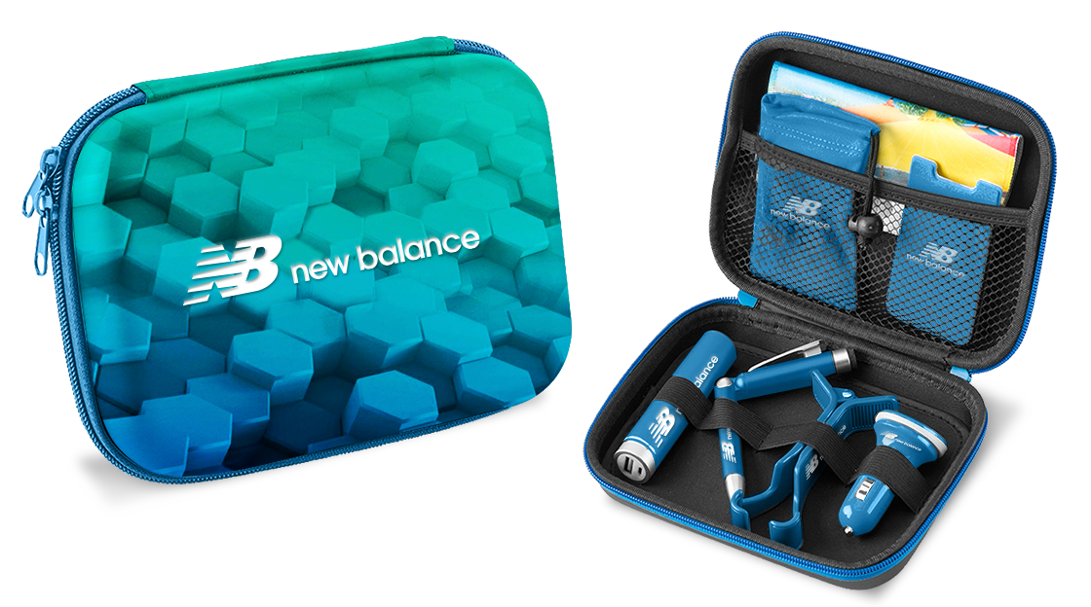
+
ELECTRONICS CASE
Never go without power or the right cord with the portable electronics case! Elastic bands and a roomy mesh pocket allow for all your accessories to be in one place.
7
Notes:
New pic

Slide 8


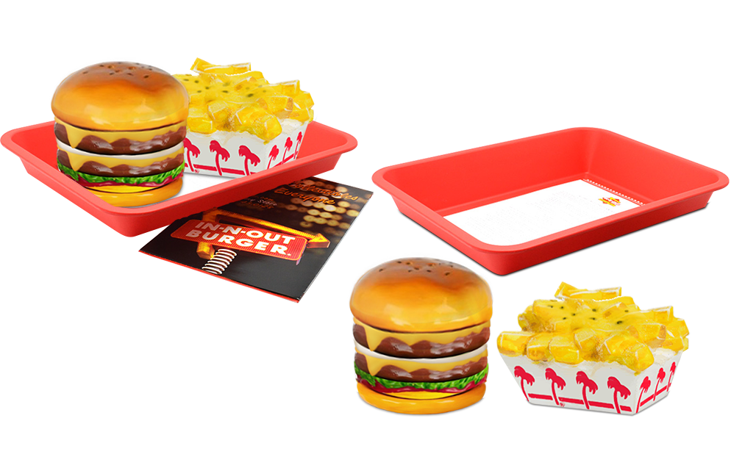
+
SALT AND PEPPER SHAKER SET
Enjoy your burgers and fries while using this In-N-Out salt and pepper shaker set!
8
Notes:
New pic

Slide 9
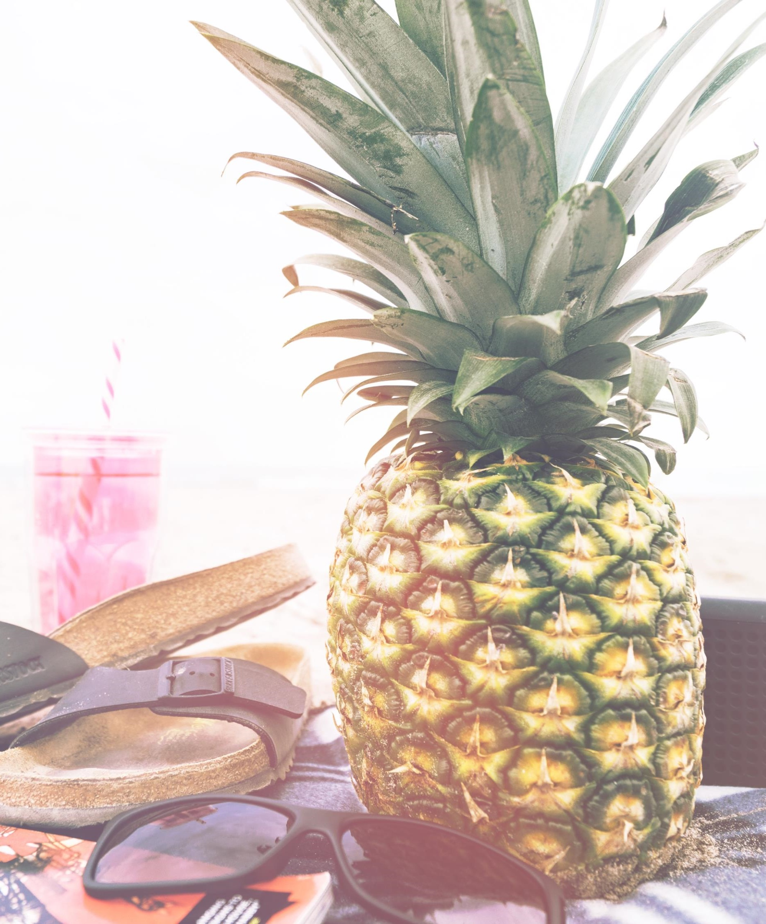

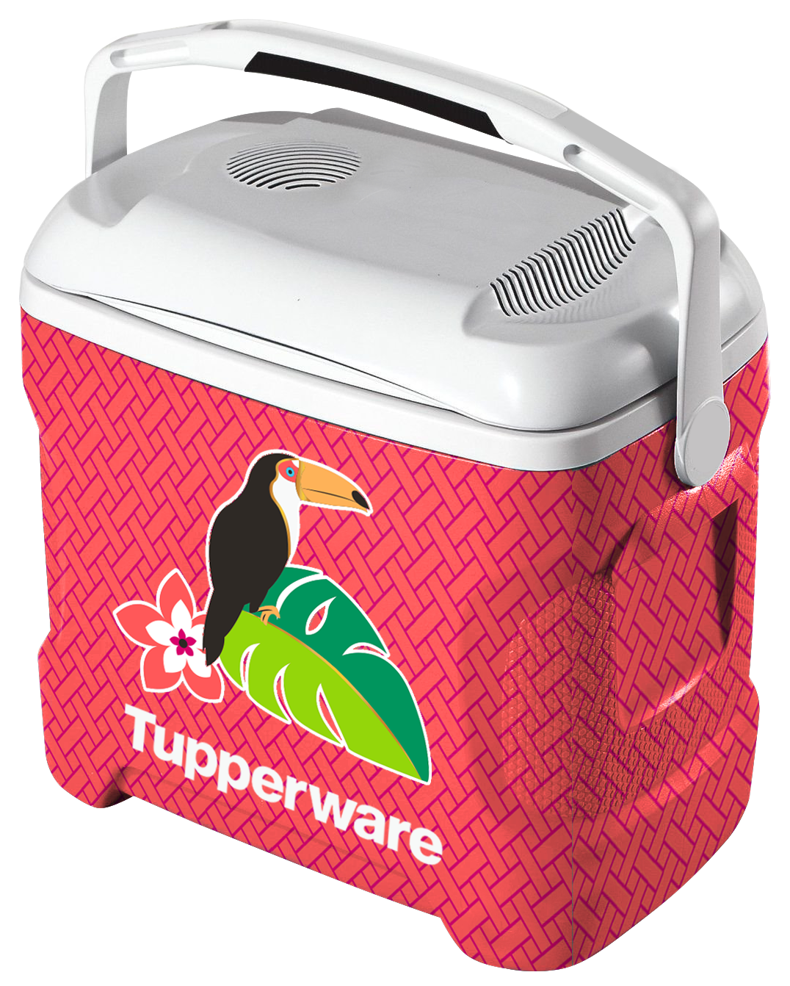
+
BLUETOOTH WIRELESS COOLER
There’s no need to take both speakers and a cooler when you can just take this all-in-one Bluetooth Wireless Cooler to the beach!
9
Notes:
New pic

Slide 10


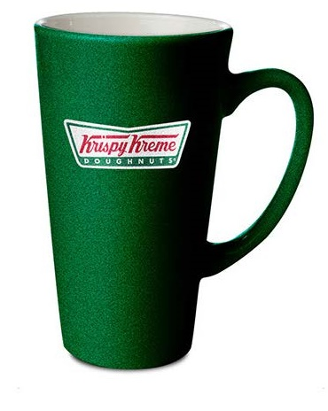
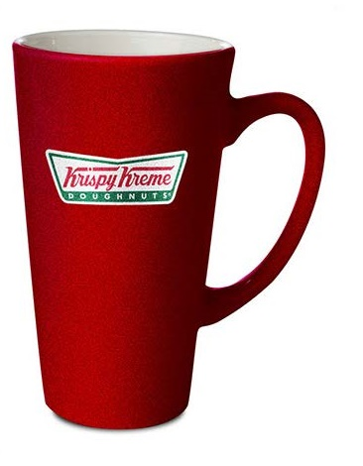
+
SHIMMER MUG
Great for a holiday or a special occasion, these ceramic mugs have a glitter finish that will add a touch of celebration every time they are used.
10
Notes:
New pic

Slide 11


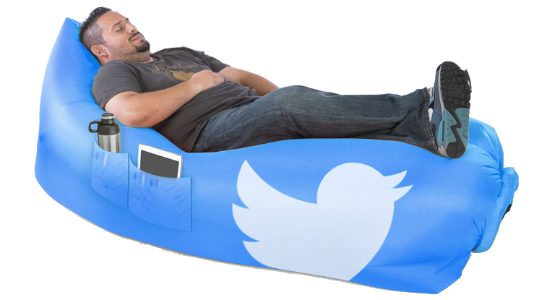
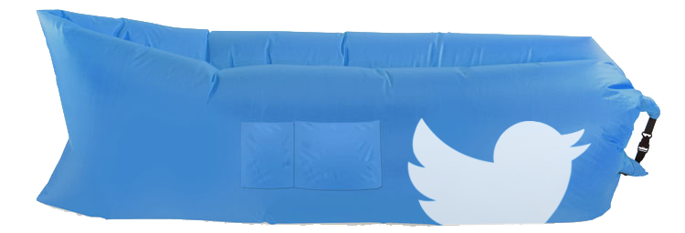
+
PORTABLE LOUNGER
Rapidly self-inflating and ultra light-weight, the Portable Lounger is a whimsical and utilitarian solution for a variety of outdoor activities.
11
Notes:
New pic

Slide 12
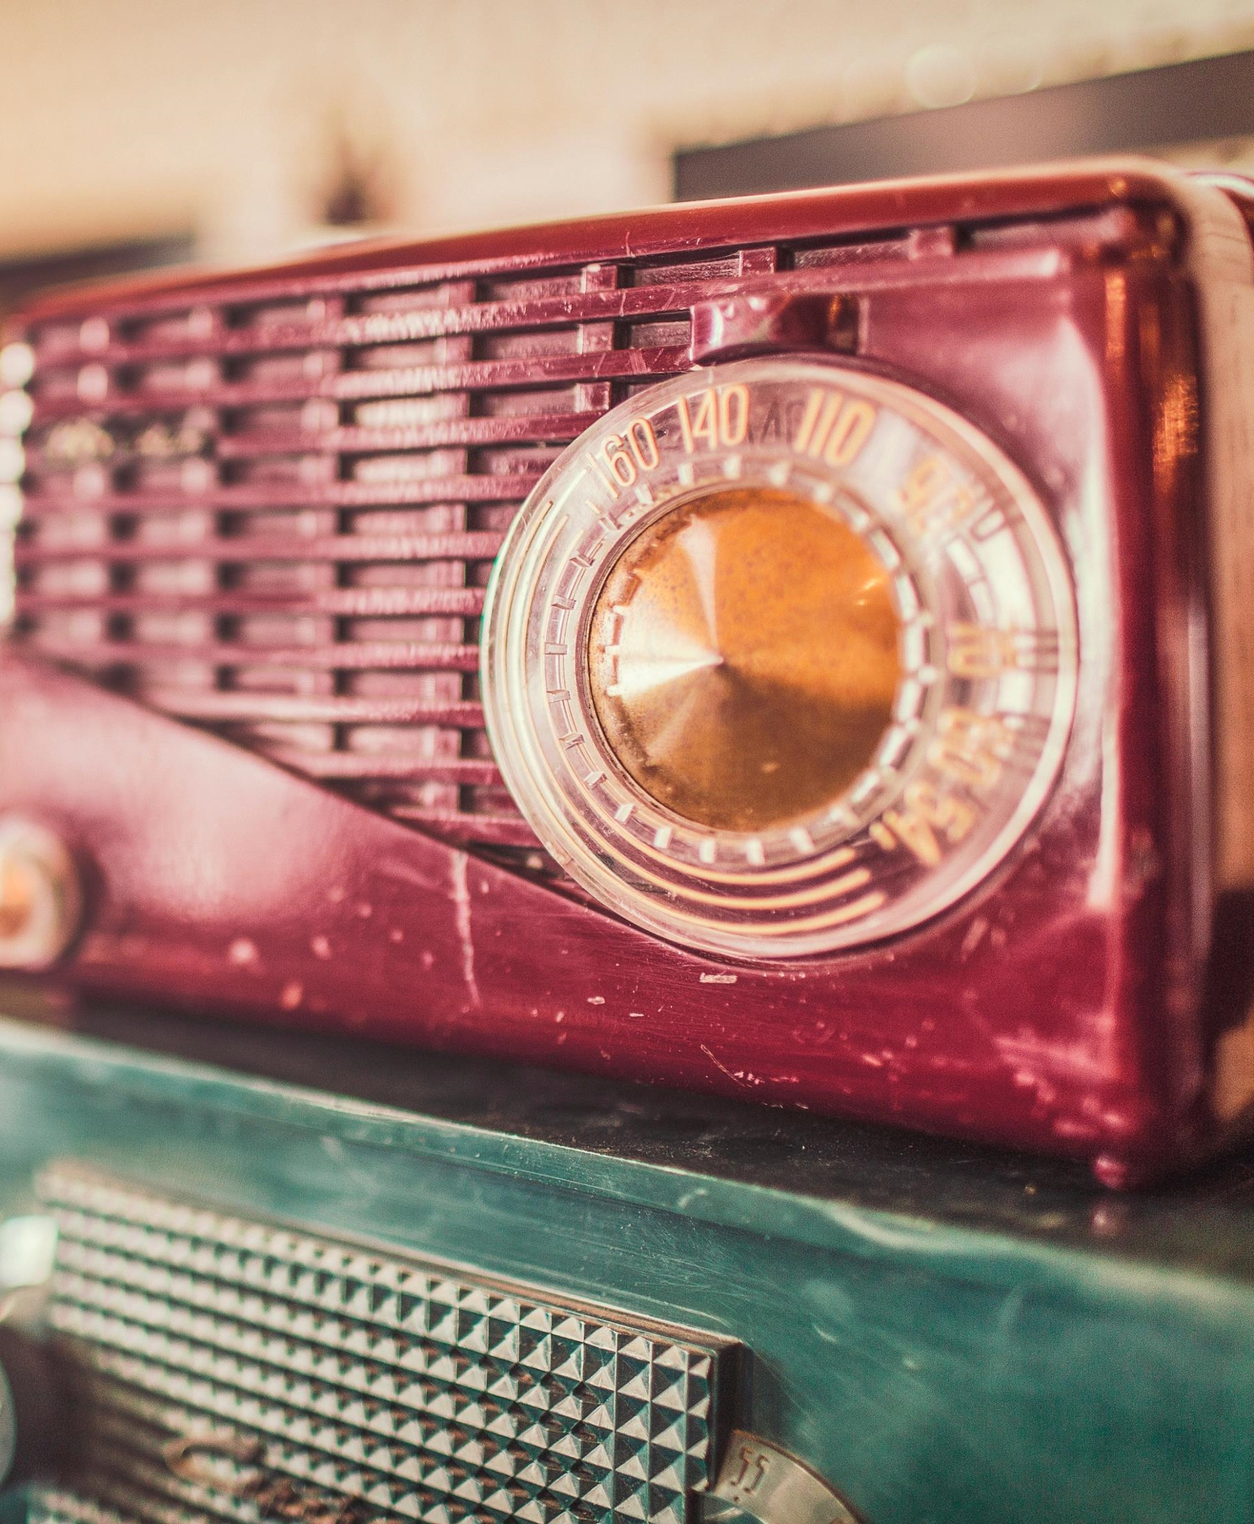

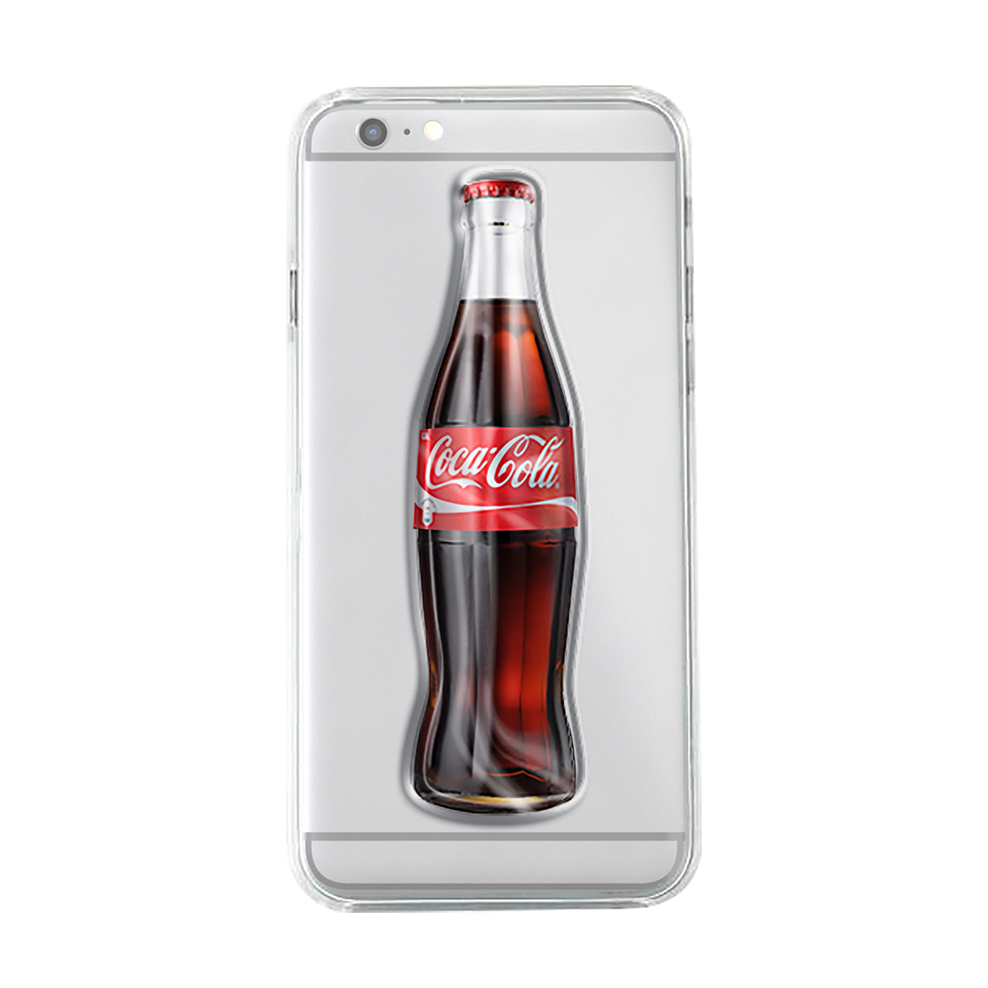
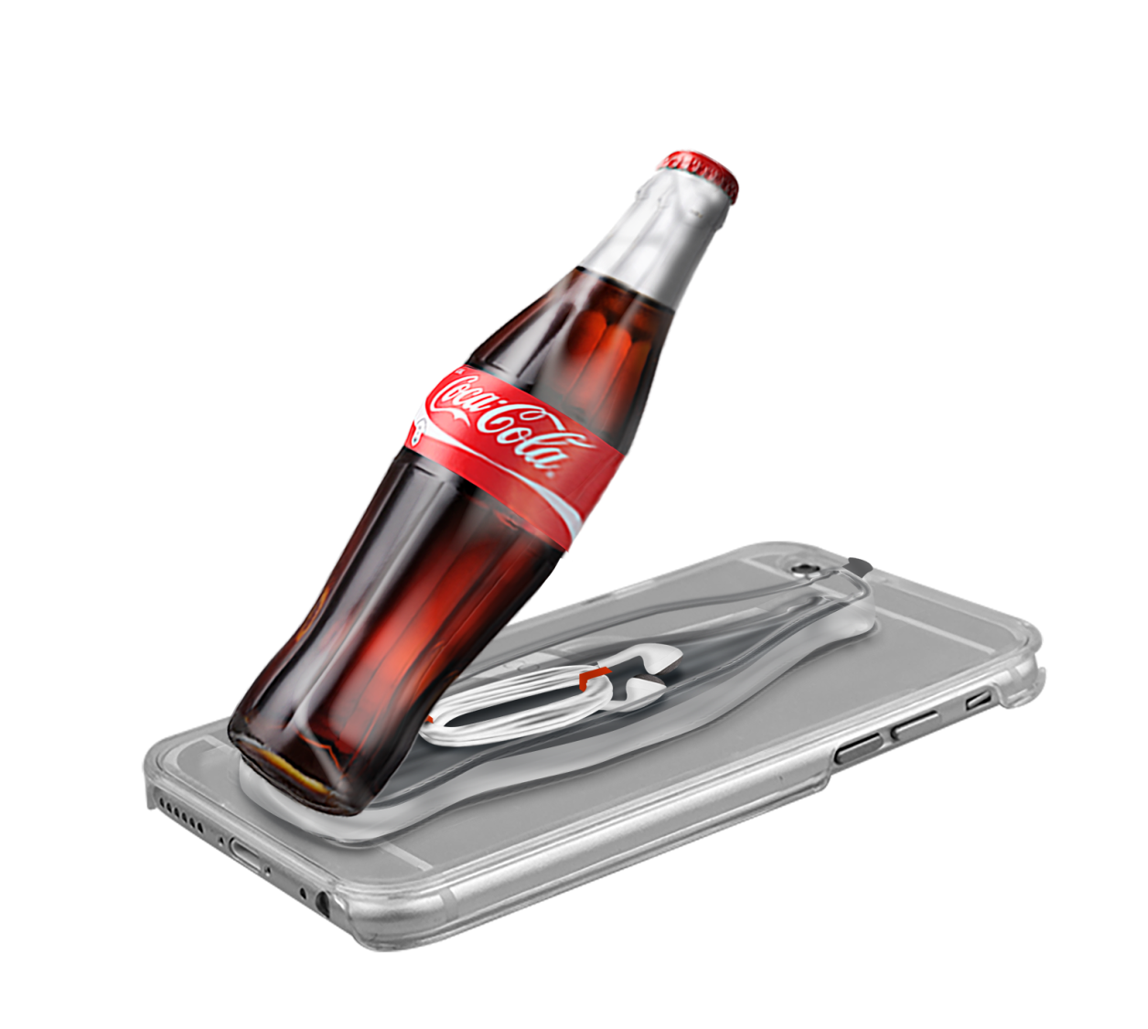
+
EARBUD CASE HOLDER
This innovative earbud holder sticks securely to the back of your case with a strong adhesive tape. It is made with a compartment to store your earbuds.
12
Notes:
New pic

Slide 13

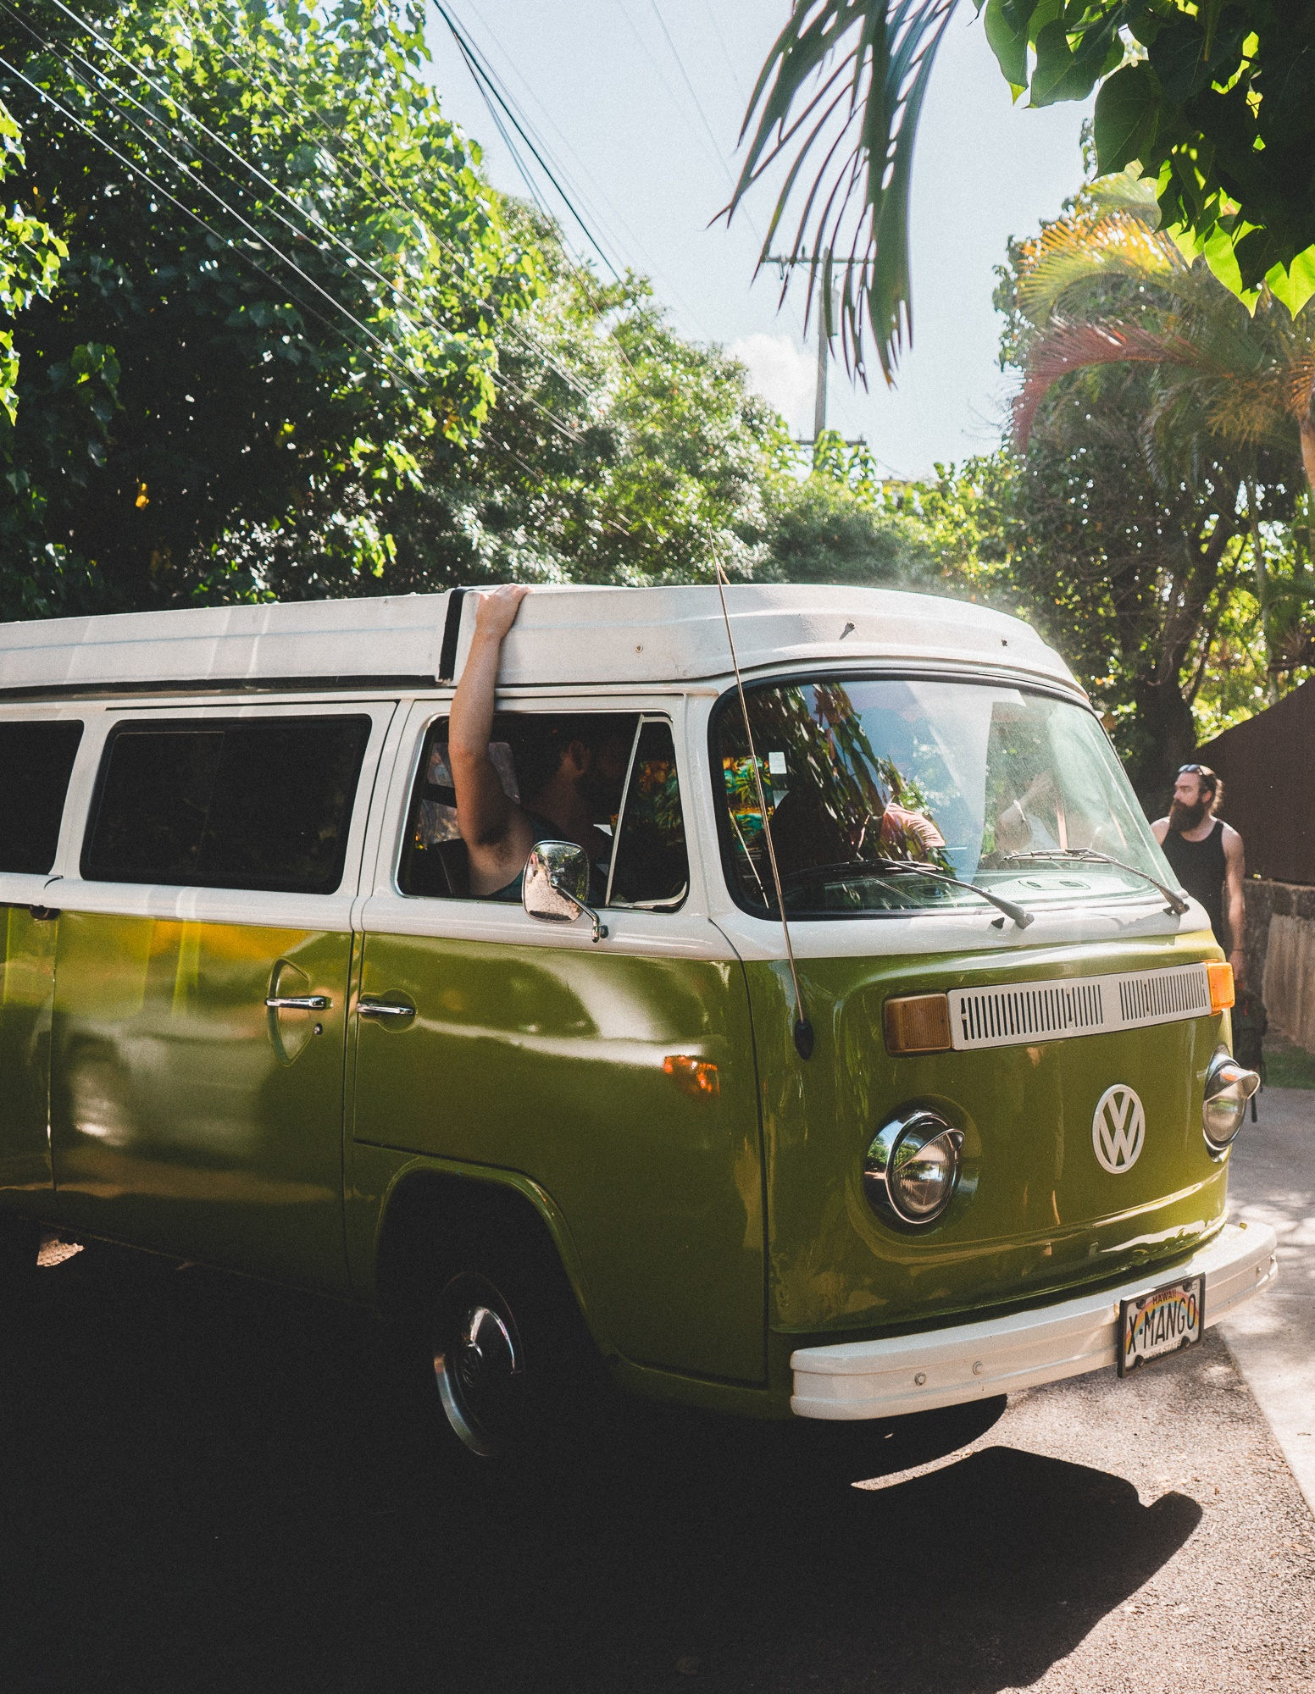
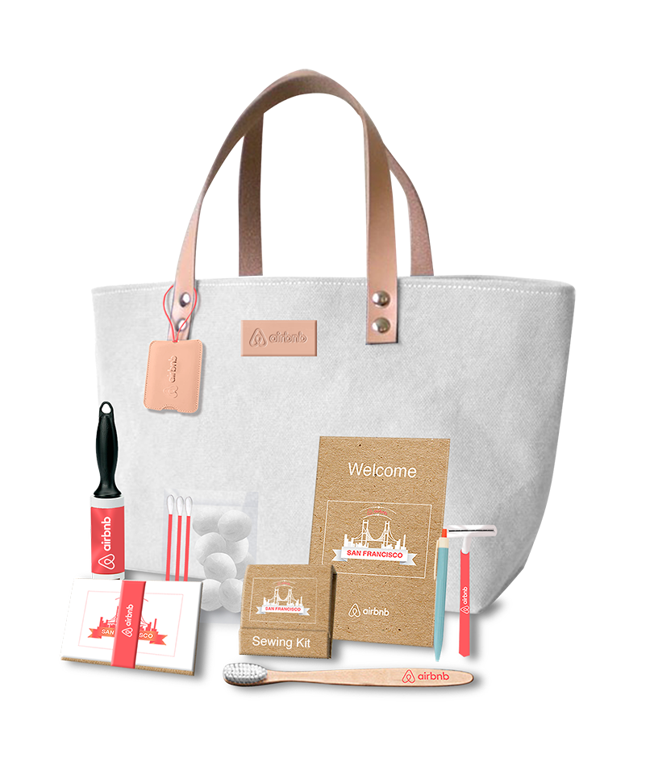
+
TRAVEL TOTE KIT
Send a big welcome to whoever is staying in your home with this spacious tote and practical travel kit!
13
Notes:
New pic

Slide 14


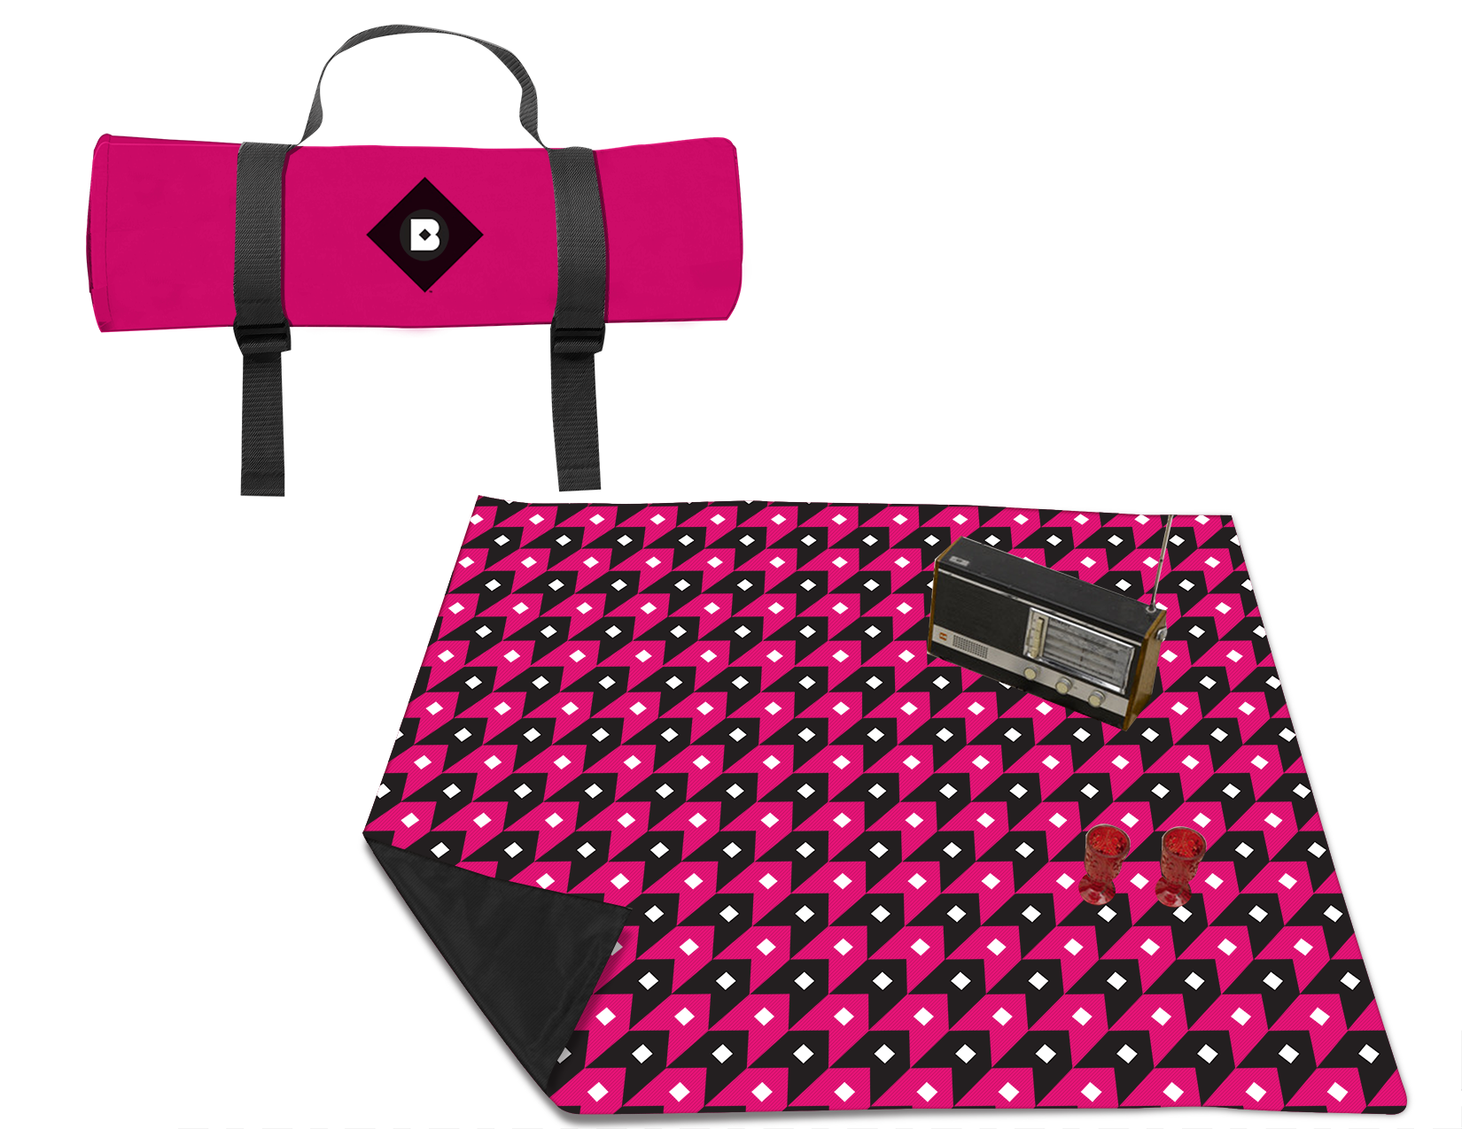
+
ROLL-UP PICNIC BLANKET
Make your trip to the park a stylish and easy one with this bright printed roll-up picnic blanket.
14
Notes:
New pic

Slide 15


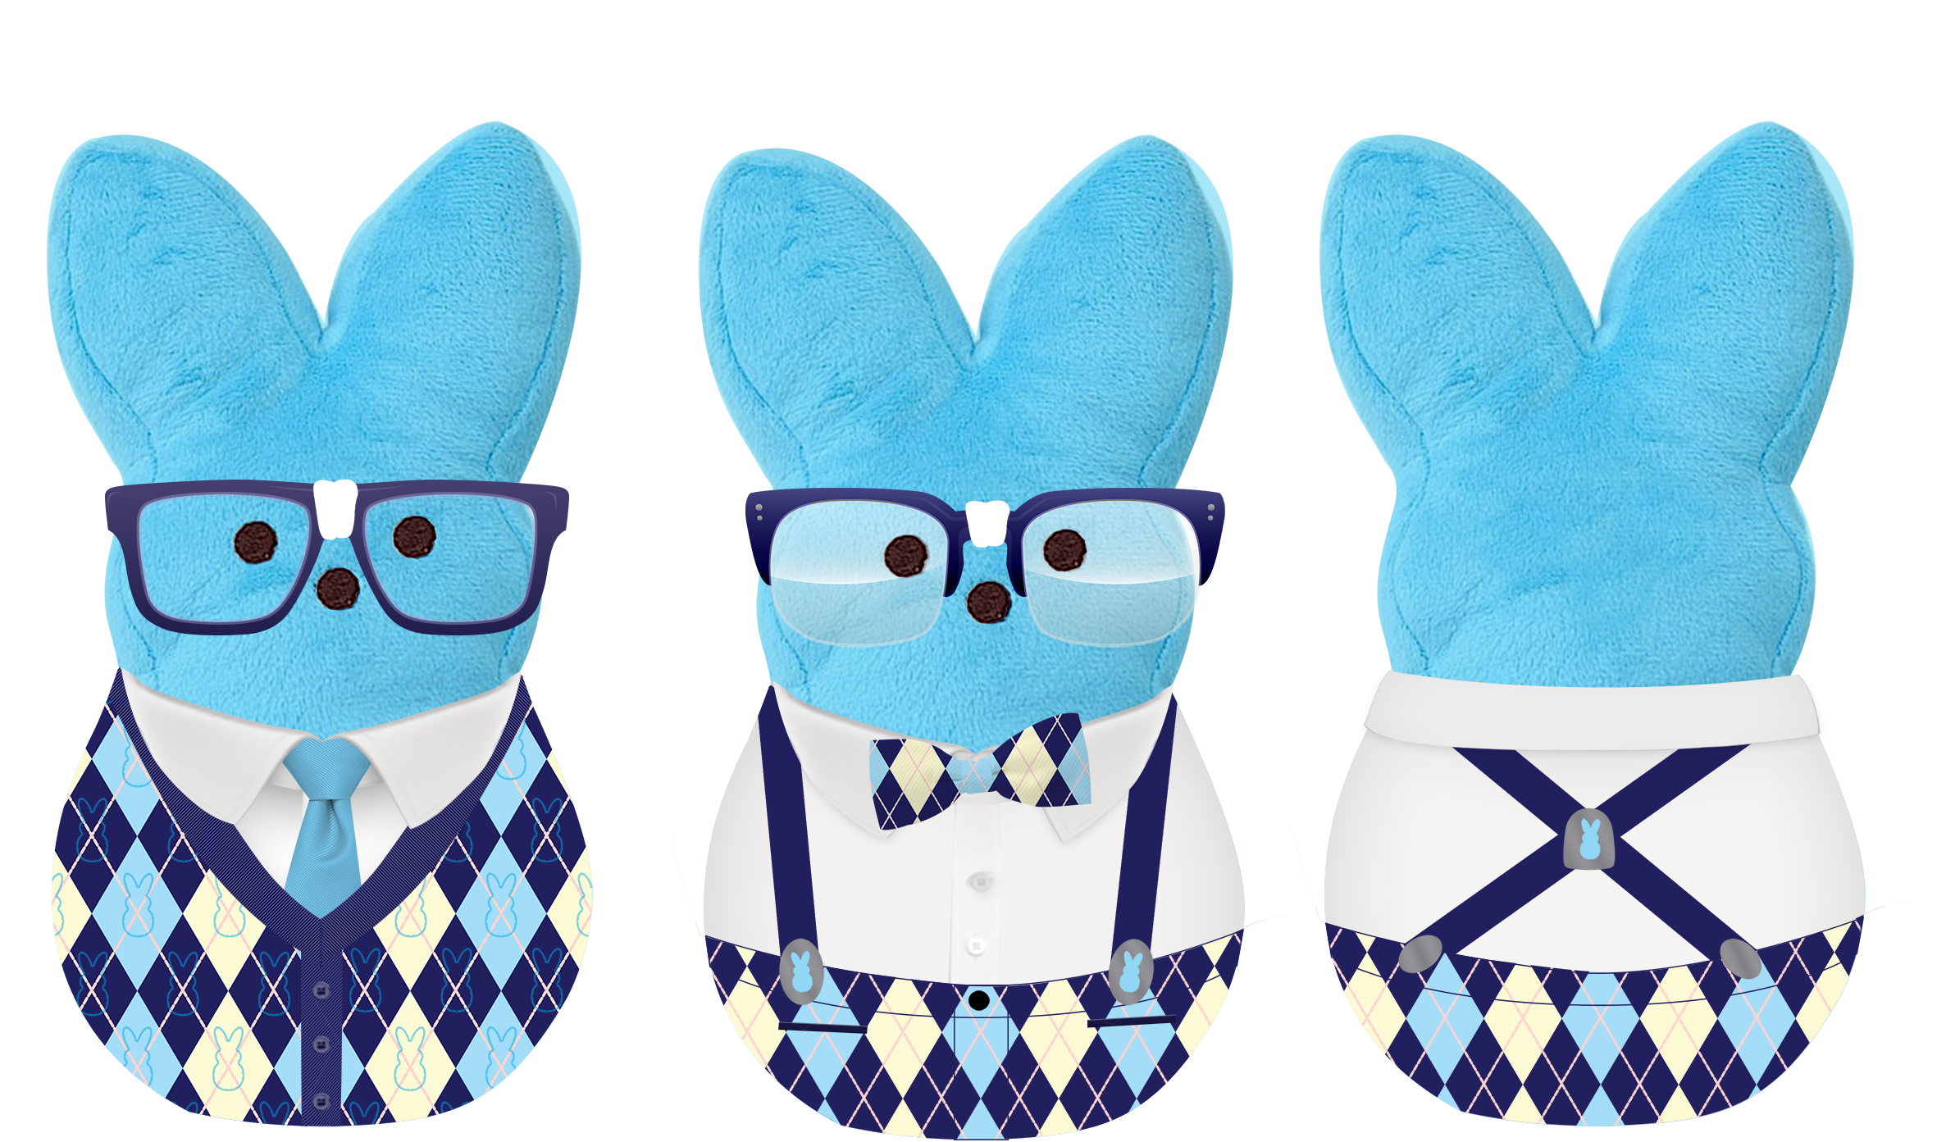
+
NERD PEEP BUNNY
Keep it cute and nerdy with this intellectually challenged bunny Peep!
15
Notes:
New pic

Slide 16


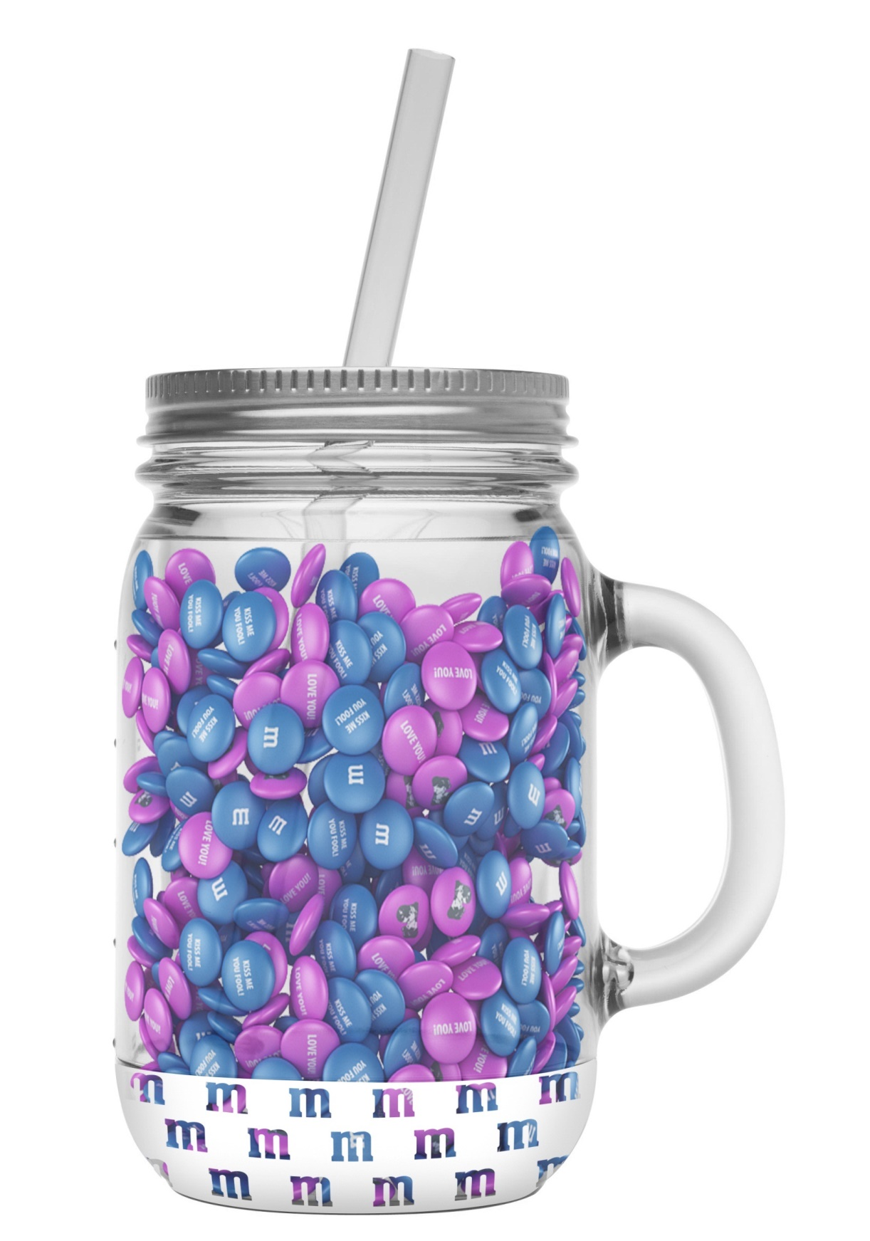
+
MASON JAR MUG WITH STRAW
Mason jars are quite the rage. This mug comes with a straw and has a handle.
16
Notes:
New pic

Slide 17


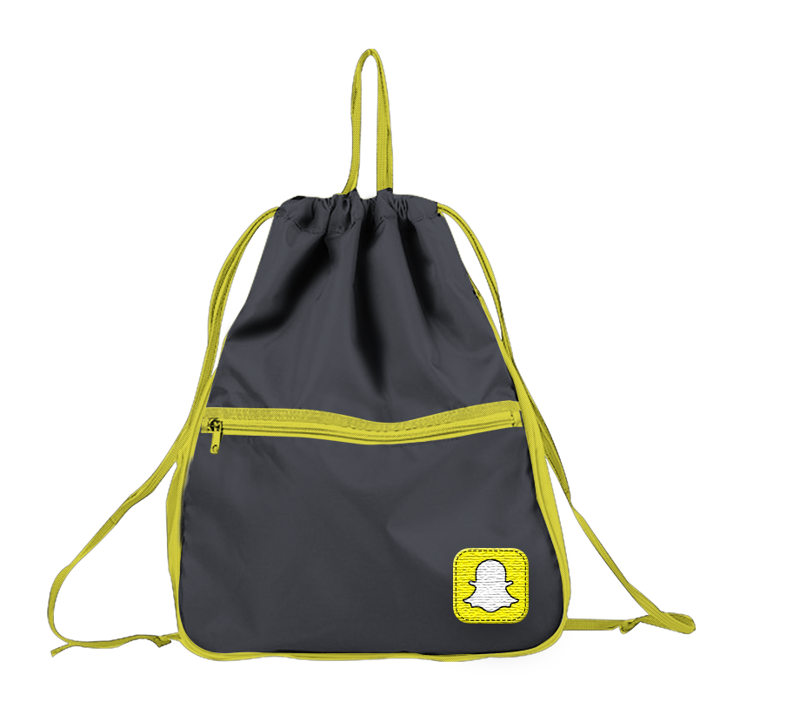
+
CINCH SACK
Constructed from durable flight nylon, this cinch sack with extra zipper pouches can go from gym, to train, to washing machine and back again.
17
Notes:
New pic

Slide 18


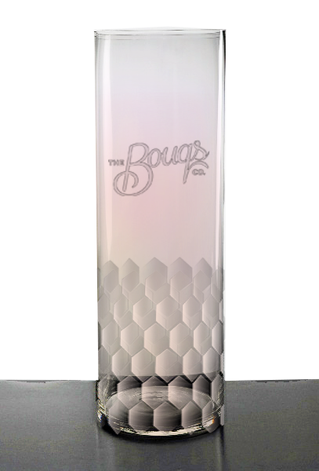
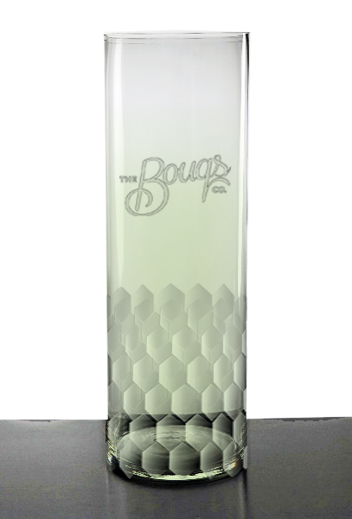
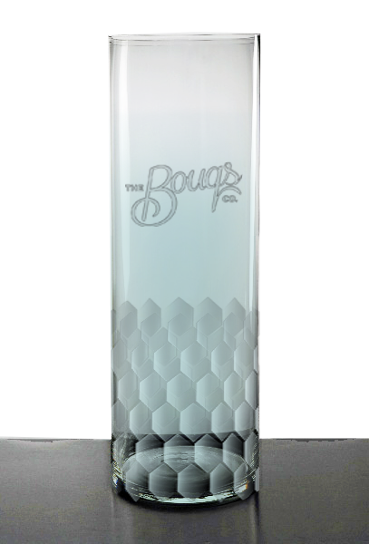
+
PRISM VASE
These lovely tinted pastel vases make a beautiful addition to any home.
18
Notes:
New pic

Slide 19

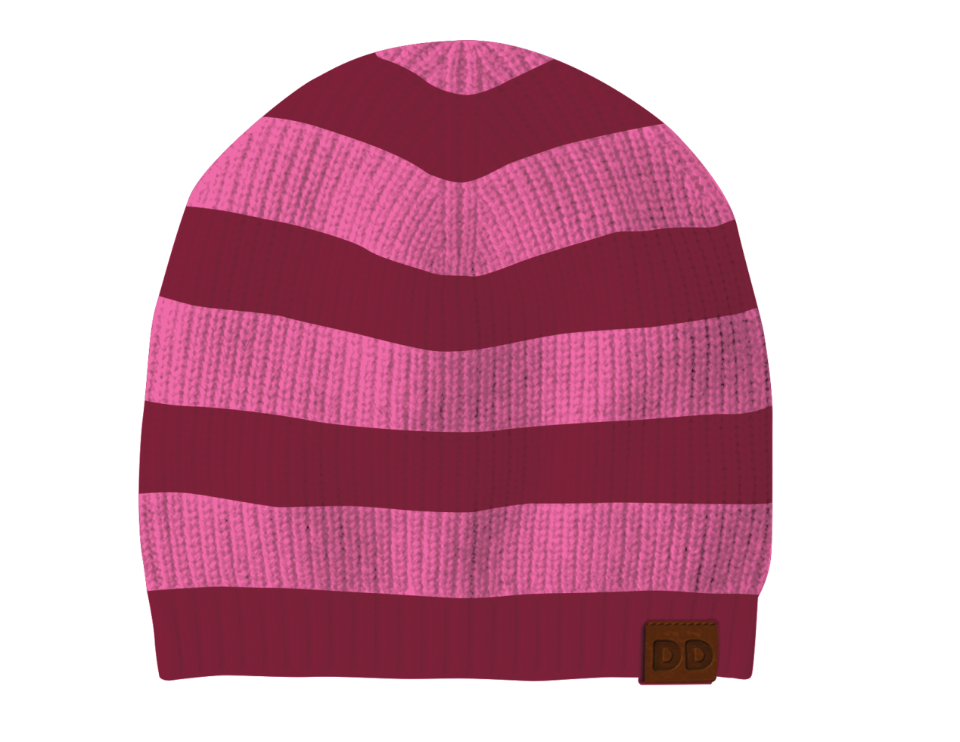
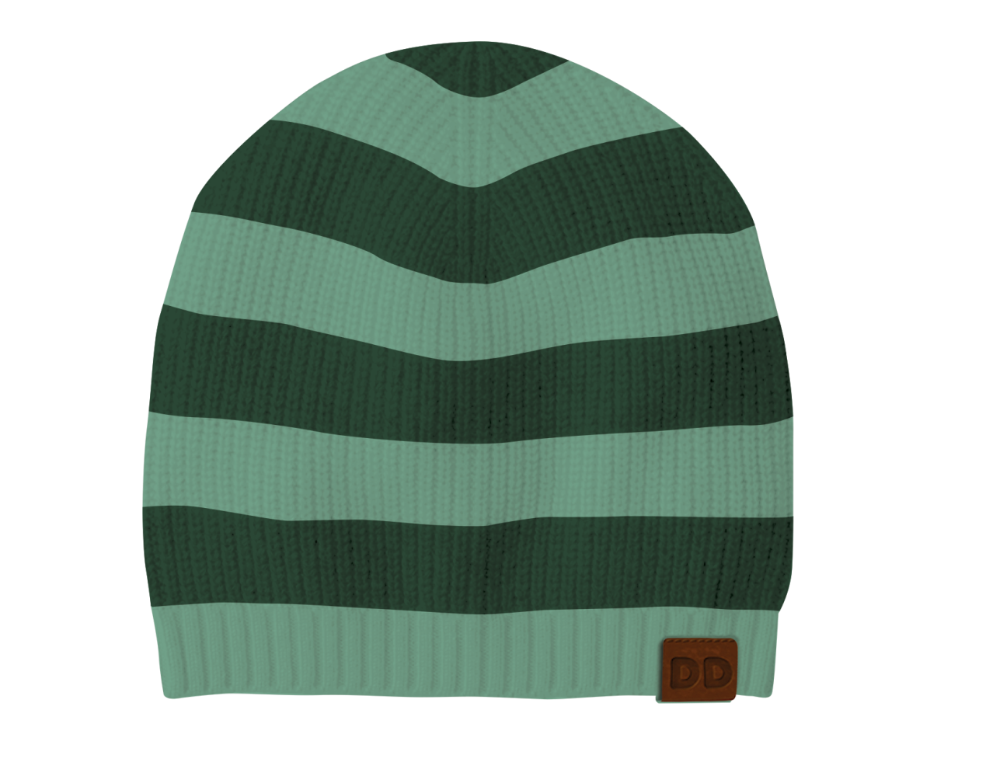
+
STRIPED BEANIES
Cozy and comfortable, the slouchy beanie is not just for warmth but a style staple as well.
19
Notes:
New pic

Slide 20


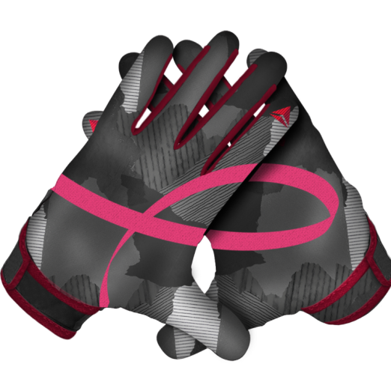
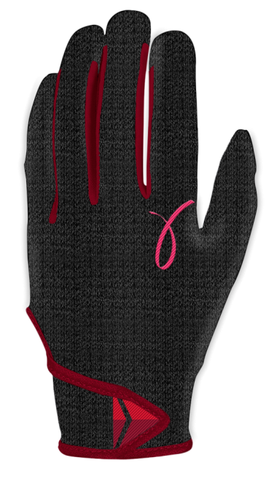
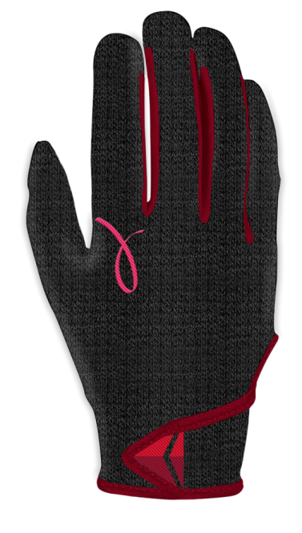
+
GLOVES
Keep your hands warm with these hip all-weather gloves. The velcro strap on the bottom will make sure that they fit snugly.
20
Notes:
New pic

Slide 21

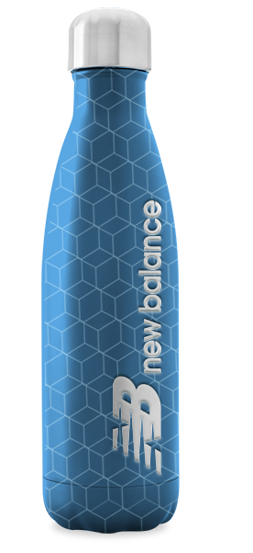
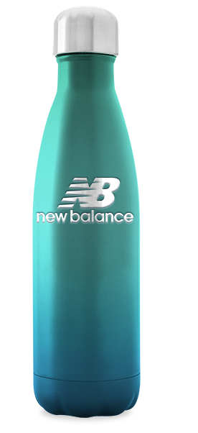
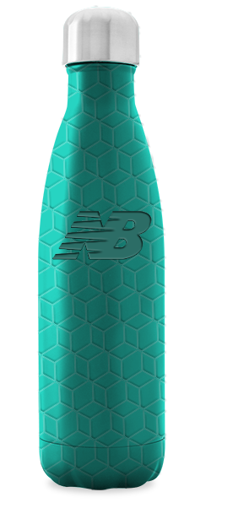
+
STAINLESS STEEL BOTTLE
Keep hydrated and stylish at the same time with this chic hydration bottle.
21
Notes:
New pic

Slide 22


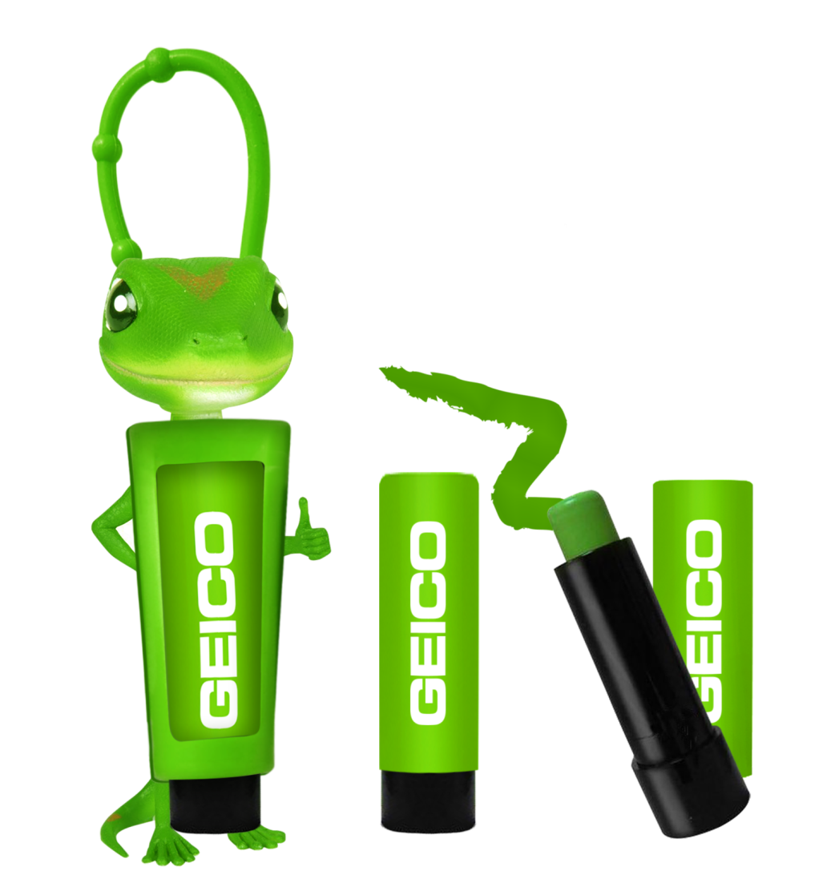
+
ZINC HOLDER AND TUBE
Make sure you stay safe in the sun with the colorful zinc balm tube. It comes inside this adorable lizard holder so you can take it with you anywhere.
22
Notes:
New pic

Slide 23

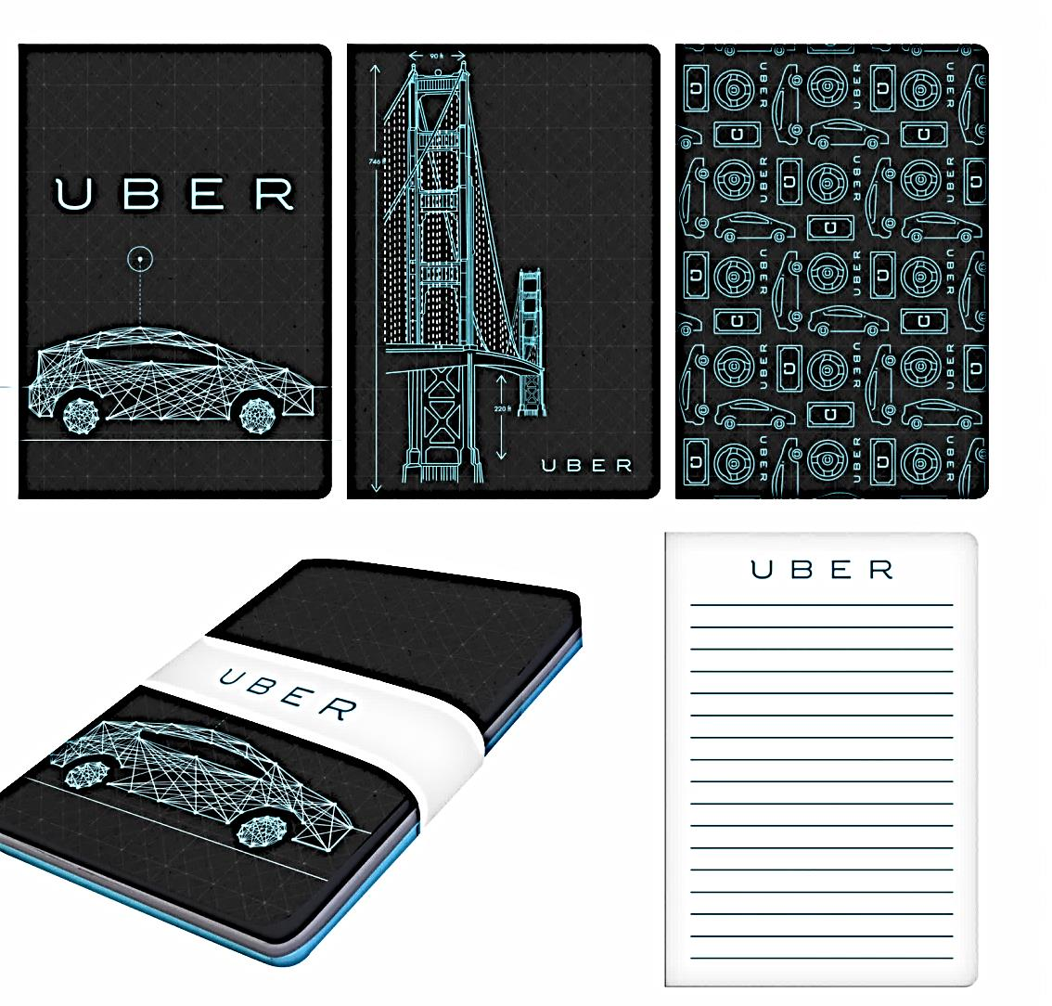
+
JOURNAL
Make sure you keep organized with this handy journal. You will never forget an appointment or important notation again!
23
Notes:
New pic

Slide 24


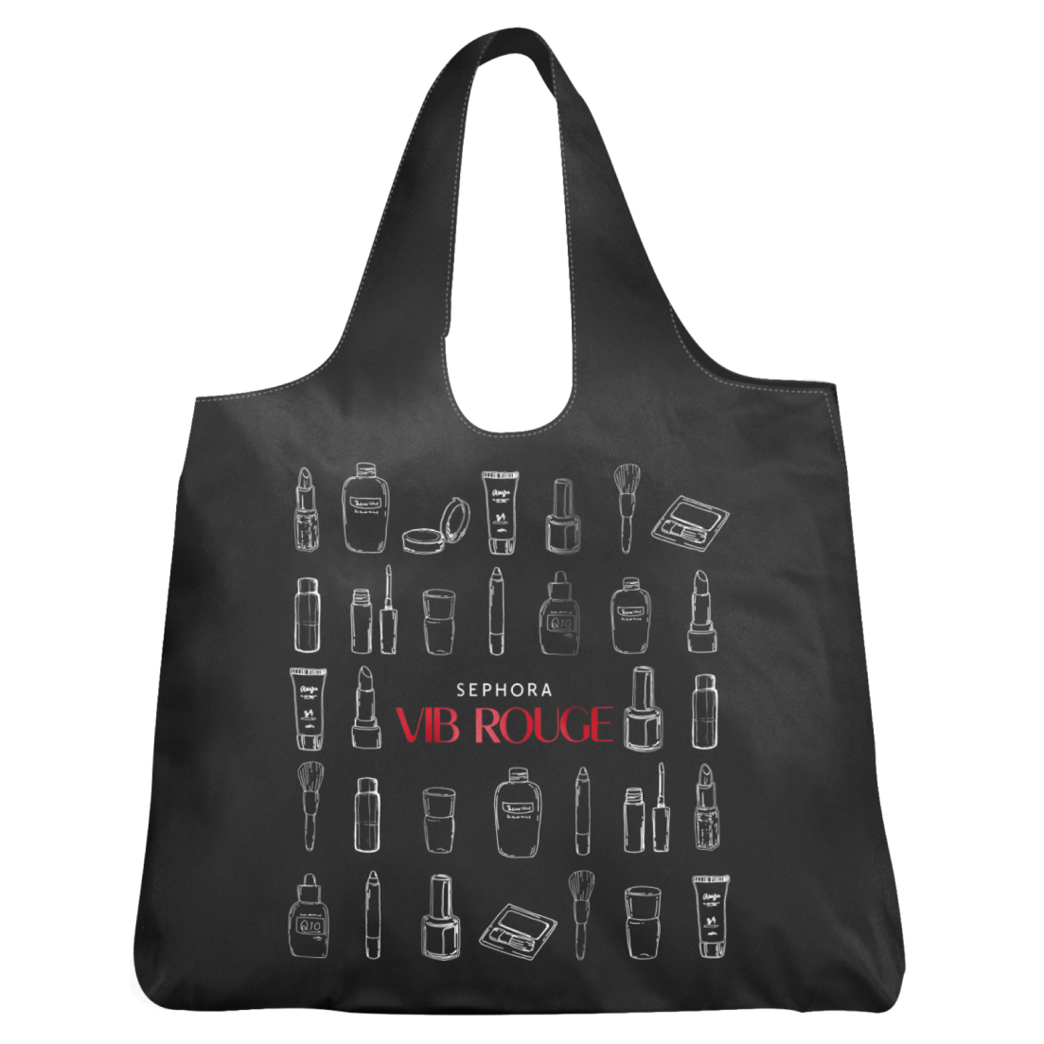
+
VIB ROUGE TOTE
A stylish shopping tote can do wonders to promote a brand. This sketched tote is a lovely addition to any wardrobe!
24
Notes:
New pic

Slide 25


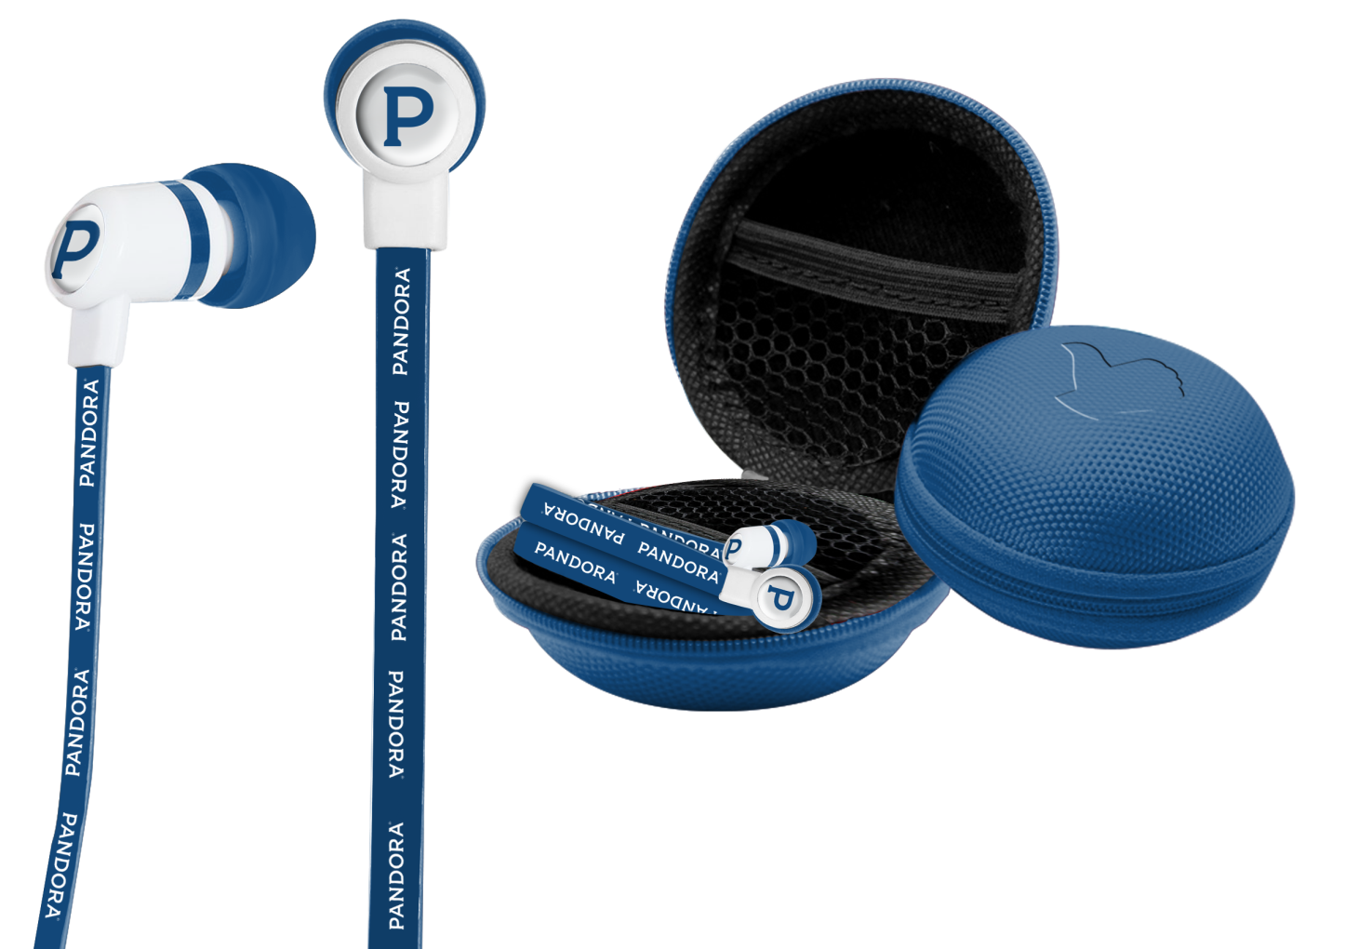
+
EARBUDS & CASE
When you need to tune it all out and turn it all up, put in your earbuds and feel the burn.
25
Notes:
New pic

Slide 26


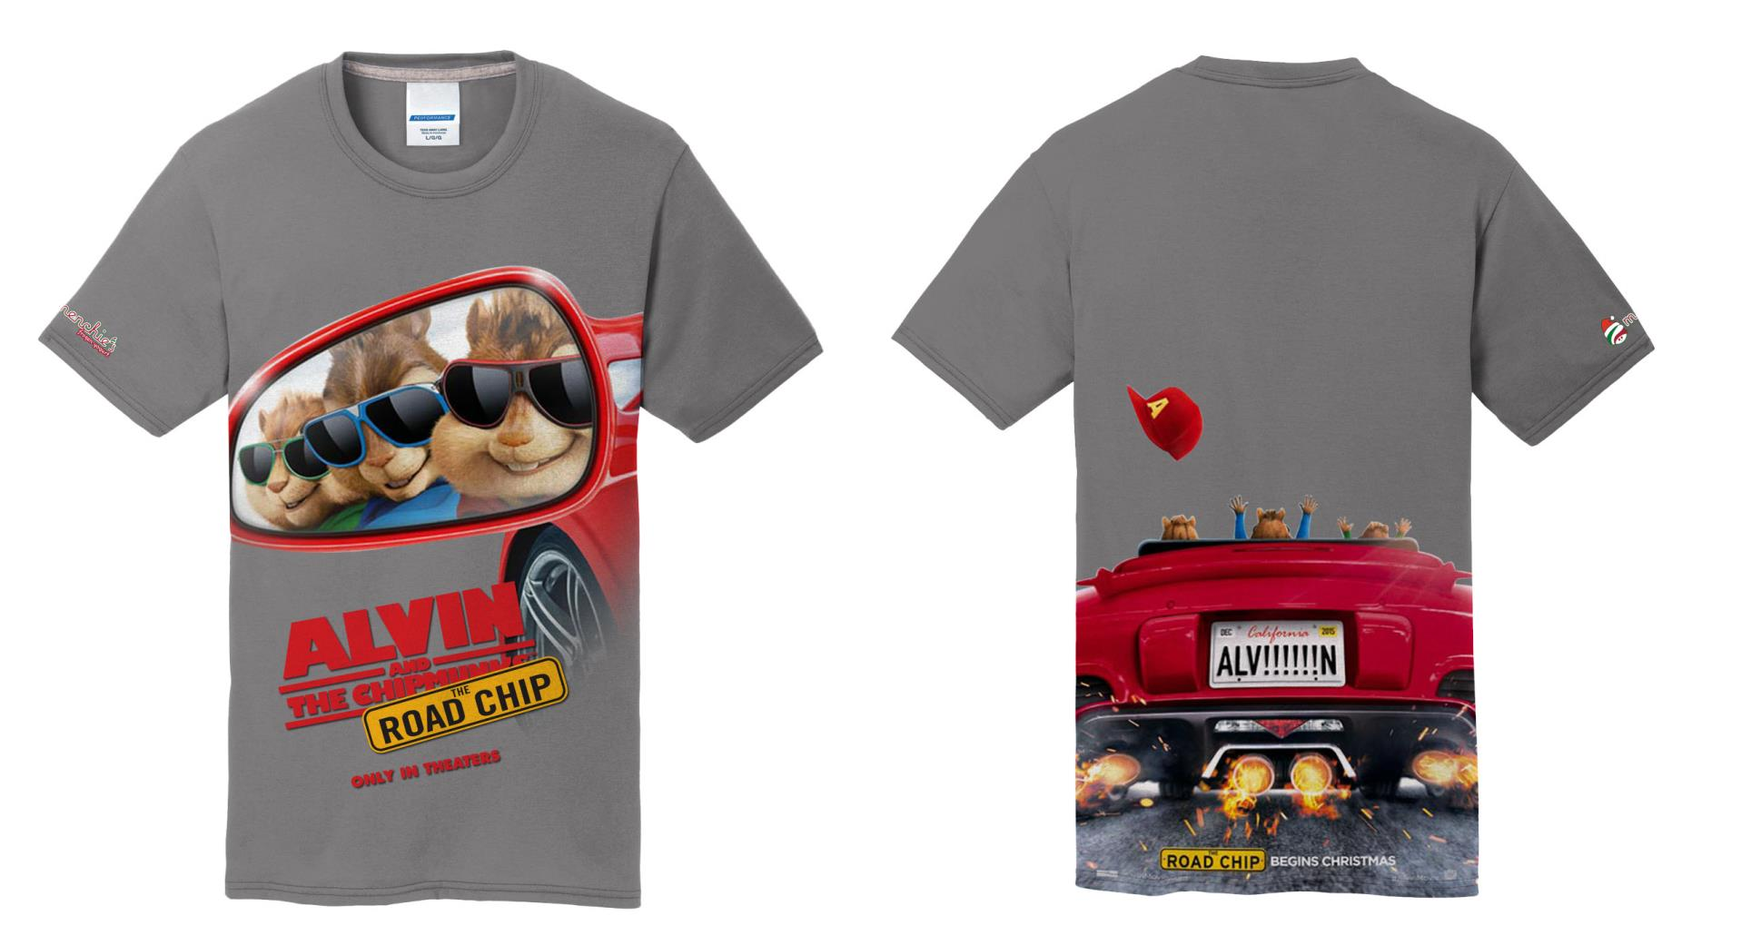
+
CHIPMUNKS T-SHIRT
This cute t-shirt features all of the Chipmunks together! The shirt is made of 100% cotton and comes in all sizes.
26
Notes:
New pic

Slide 27

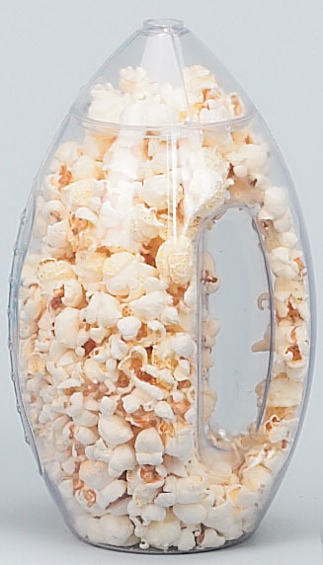
+
FOOTBALL CONTAINER
Celebrate game day right with this awesome football shaped snack container.
27
Notes:
New pic

Slide 28

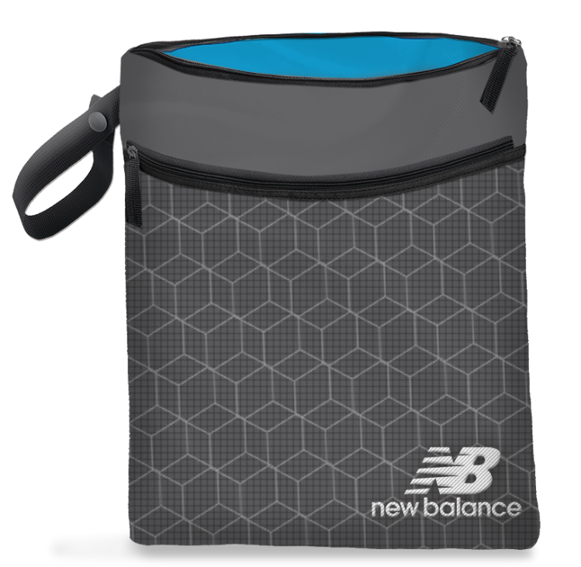
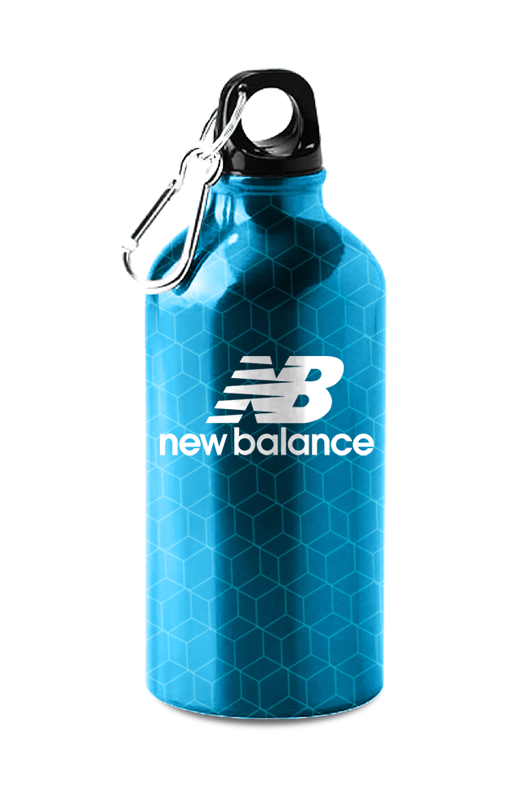

+
FITNESS KIT
Get an amazing workout with this portable travel kit! Kit includes a wet/dry bag to keep valuables dry and safe, a stainless steel jump rope with plastic casing and a water bottle with carabiner!
28
Notes:
New pic

Slide 29

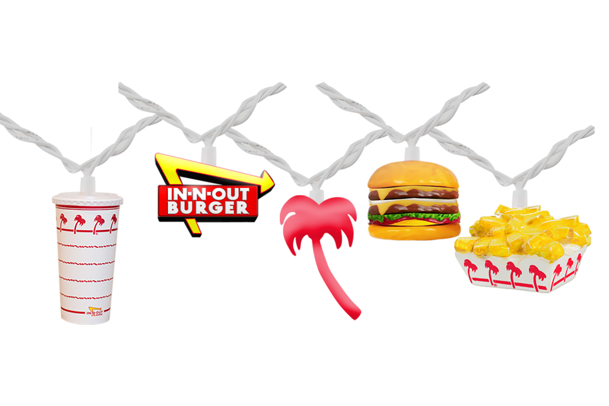
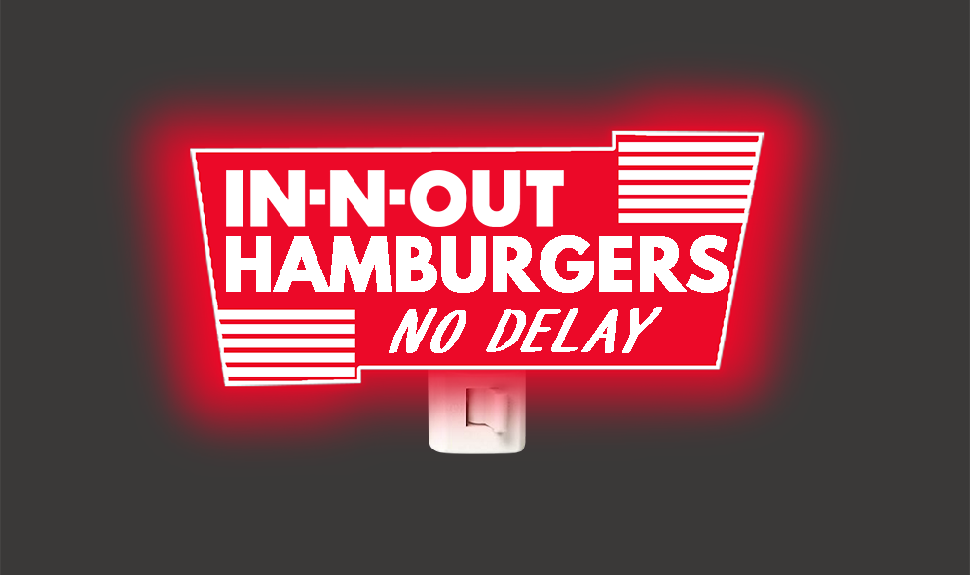
+
STRING PARTY LIGHTS & NIGHTLIGHT
Nothing sets the mood better than party string lights, especially at an evening party.
29
Notes:
New pic

Slide 30
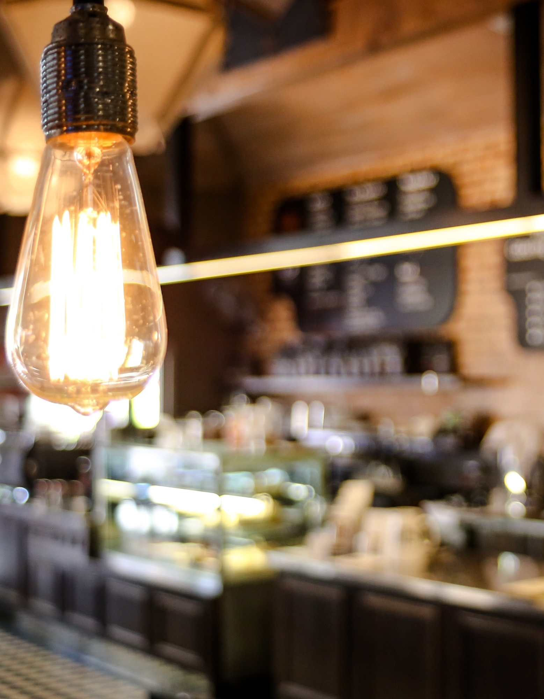
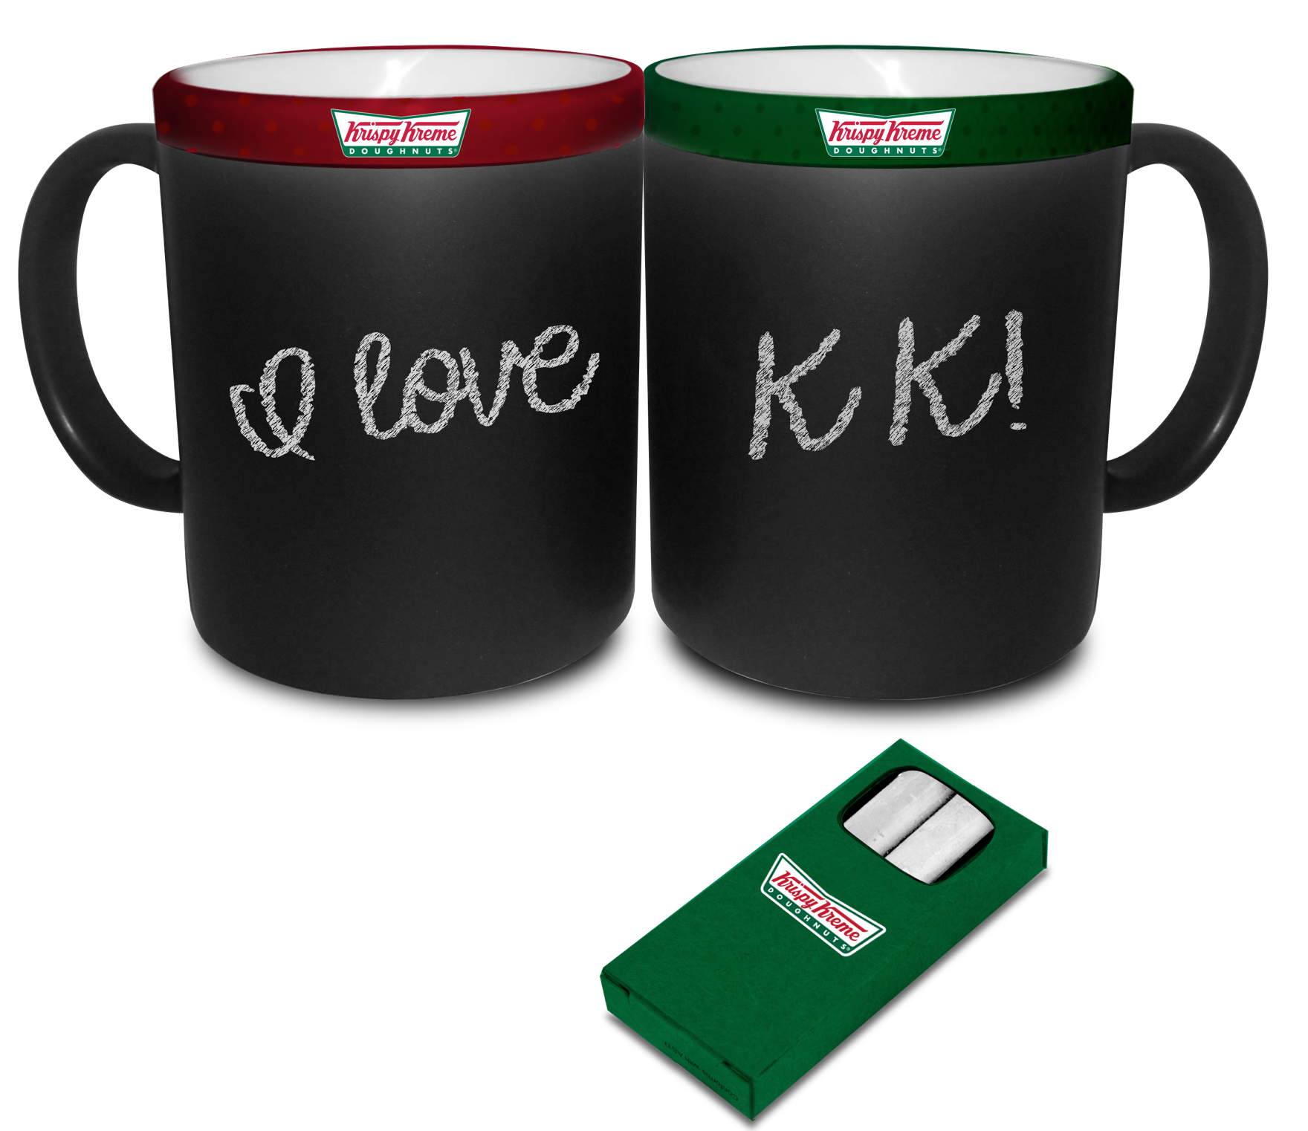
+
CHALK MUGS
Enjoy your coffee and express yourself at the same time with these fun artsy chalk mugs. Chalk is included.
30
Notes:
New pic

Slide 31
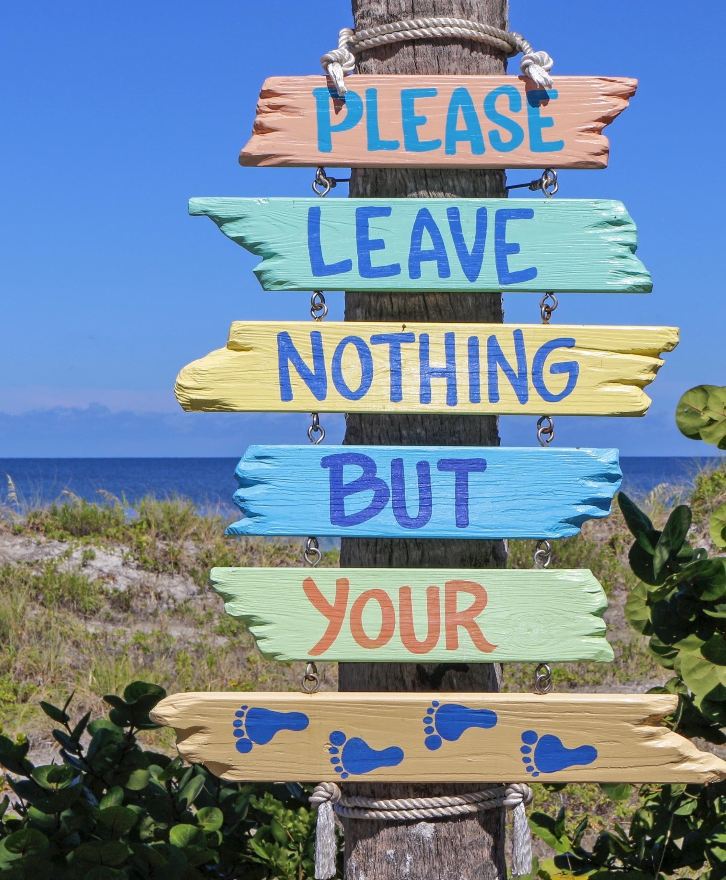
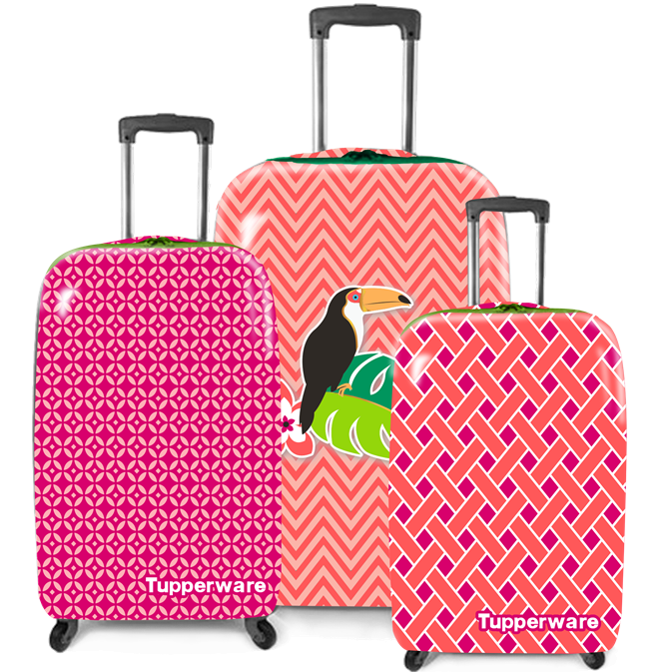
+
ROLLING LUGGAGE
Travel in style with this lovely luggage set. Each piece is a different size and has retractable handle and wheels.
31
Notes:
New pic

Slide 32

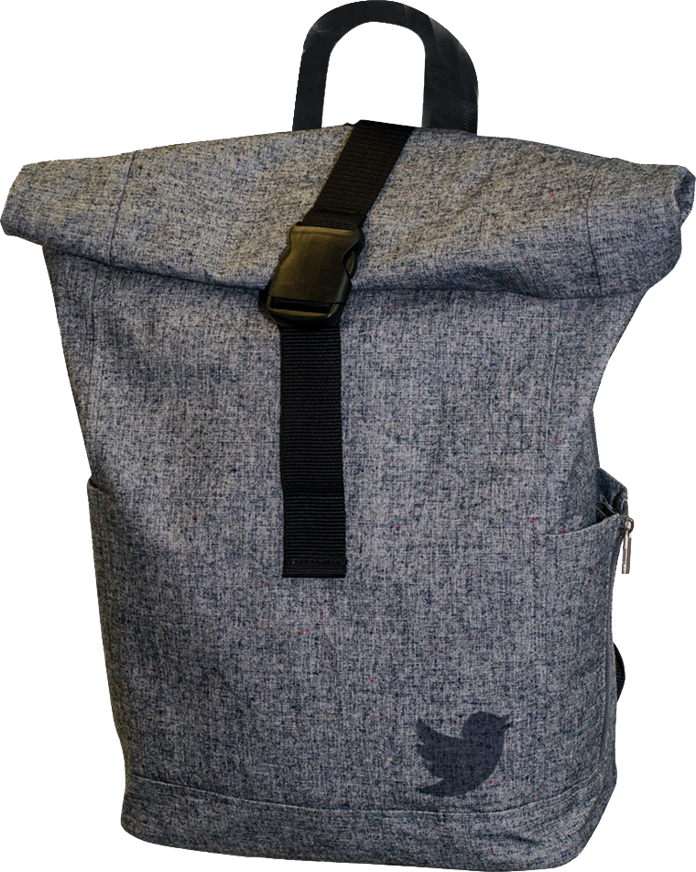
+
DENIM ROLL TOP BACKPACK
Meticulously crafted on a rich canvas of denim slub, this laptop backpack is resplendent with unique touches of elegance and style.
32
Notes:
New pic

Slide 33

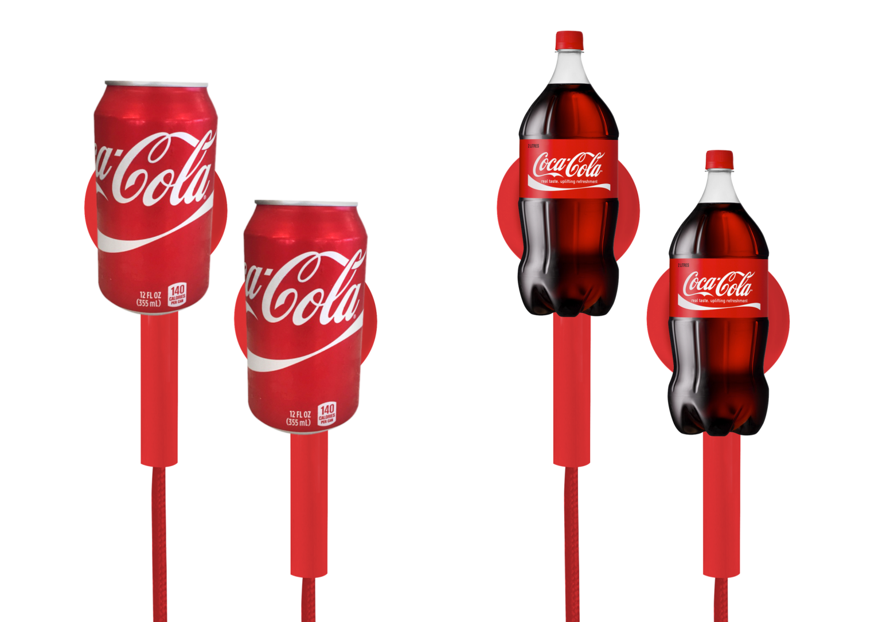
+
COCA COLA EARBUDS
These novel earbuds will always keep the Coca Cola brand in mind. Don’t be surprised if you start wanting to drink a Coke every time you listen to music!
33
Notes:
New pic

Slide 34


+
TRAVEL AMENITY KIT
A travel kit is not only a great way to welcome guests, but also a smart way to promote your brand. These useful items will be used over and over again!
34
Notes:
New pic

Slide 35


+
TOWEL TOTE BAG
A trip to the beach doesn’t have to be cumbersome. Keep your towel and belongings all together with this colorful towel bag.
35
Notes:
New pic

Slide 36


+
BALLERINA PEEP BUNNY
Your princess will absolutely love this sweet ballerina Peep. She looks lovely in lace and rhinestones!
36
Notes:
New pic

Slide 37


+
GHOST POWER BANK
Keep your phone charged at all times with this fun ghost shaped power bank.
37
Notes:
New pic

Slide 38



+
MASON JAR VASE
A mason jar can also be used as a lovely vase. It will add a rustic feel that is stylish without being over the top.
38
Notes:
New pic

Slide 39


+
OMBRE TUMBLER
Quench your thirst with these colorful ombre tumblers. Straw is included.
39
Notes:
New pic

Slide 40



+
CUPCAKE CONTAINER
Now you can keep your small sized belongings organized with these cute cupcake containers.
40
Notes:
New pic

Slide 41


+
BASEBALL CAP
Constructed with moisture wicking anti-microbial stretch fabric, this hat keeps you cool and fresh.
41
Notes:
New pic

Slide 42



+
VR VIEWER
This VR viewer is lightweight and holds a smartphone. It’s a unique gift and a great way to show that your brand is on top of the technological trends.
42
Notes:
New pic

Slide 43


+
FOLDABLE TOTE
Everyone needs an extra bag, especially with the ever-changing plastic bag regulations. Why not have one folds into an iconic lizard!
43
Notes:
New pic

Slide 44


+
EARBUD HOLDER
With the myriad of cords we carry, it’s not uncommon to get them mixed up or tangled. With this earbud holder, keep your cords organized with a snap of a button!
44
Notes:
New pic

Slide 45


+
VIB ROUGE TOTE
Sketched art is not only trending, it’s also a great way to get noticed. This colorful lipstick tote is sure to turn heads.
45
Notes:
New pic

Slide 46


+
HEADPHONES
Drown out distracting noises so you can experience all that music has to offer with these colorful headphones.
46
Notes:
New pic

Slide 47


+
DEADPOOL T-SHIRT
Check out Deadpool with his signature pointing stance! T-shirt is 100% cotton.
47
Notes:
New pic

Slide 48


+
SPORTS JERSEY
A sports jersey is the perfect piece of clothing to wear on game day or to get active at the gym or the park!
48
Notes:
New pic

Slide 49


+
BLUETOOTH SPEAKER CLIP
Keep the tempo and your motivation going with the portable Bluetooth Speaker Clip.
The colorful carabiner clip can be clipped onto a bag, backpack or other fitness apparel.
49
Notes:
New pic

Slide 50


+
TRAVEL DUFFLE
Keep all your belongings in one bag with this handy duffle with shoe compartment.
50
Notes:
New pic

Slide 51


+
TRAVEL TRAINCASE
Keep all of your cosmetics together in this beautiful train case. The top has a special compartment to keep your brushes separate.
51
Notes:
New pic

Slide 52



+
RETRO TUMBLERS
Keep your drinks cold with these classy retro tumblers. The chrome band and plaque will make your brand stand out.
52
Notes:
New pic

Slide 53


+
BEANIE, SWELL BOTTLE, JOURNAL IN GIFT BOX
For those who are special on your list, this gift set will leave a long-lasting positive impression. Our gift box will feature: 1) A rustic and sophisticated notebook;
(2) an on-brand thirst quenching S’Well water bottle; and (3) a knit branded beanie.
53
Notes:
New pic

Slide 54


+
SILICONE ICE CUBE TRAY
Keep your drinks ice cold with these bottle shaped ice cubes! Just fill the silicone tray with water and watch it transform into the iconic drink bottle.
54
Notes:
New pic

Slide 55



+
ROBE SET & SHEETS
Keep cozy and warm with new sheets, a robe and slippers. Not only will your guests feel special, they will also tell all their friends about the thoughtful gifts they received.
55
Notes:
New pic

Slide 56


+
ACRYLIC TUMBLER
Keep hydrated and save the environment with this reusable printed tumbler with straw.
56
Notes:
New pic

Slide 57

57
Notes:
New pic

