Slide 1
Jason Feuerstein Senior Vice President, Bank of America Technology, Media and Entertainment May 2017

Slide 2
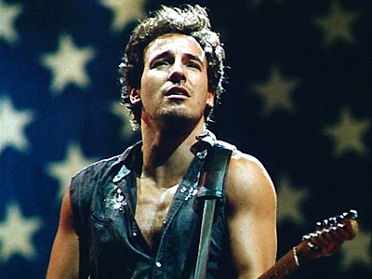
Guess Where I’m From…

Slide 3
My Jersey Was a Little Different…
My Parents:
- Berna: sells bath, tile and furniture
- Michael: imports and sells French wine
- Todd, brother (not pictured): invests in real estate
Tenafly Demographics:
White: 58.8%
Asian: 26.9%
Hispanic: 10.2%
Other: 3.8%

Slide 4
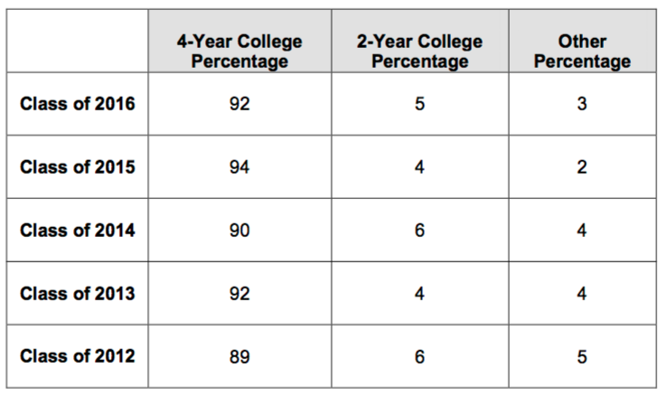
Tenafly Schools and Demographics at a Glance

Slide 5
Quiz #1
Q: Which major would you expect a banker to have:
Finance
Accounting
Statistics
Double major in English Literature and Eastern and Western Philosophy

Slide 6
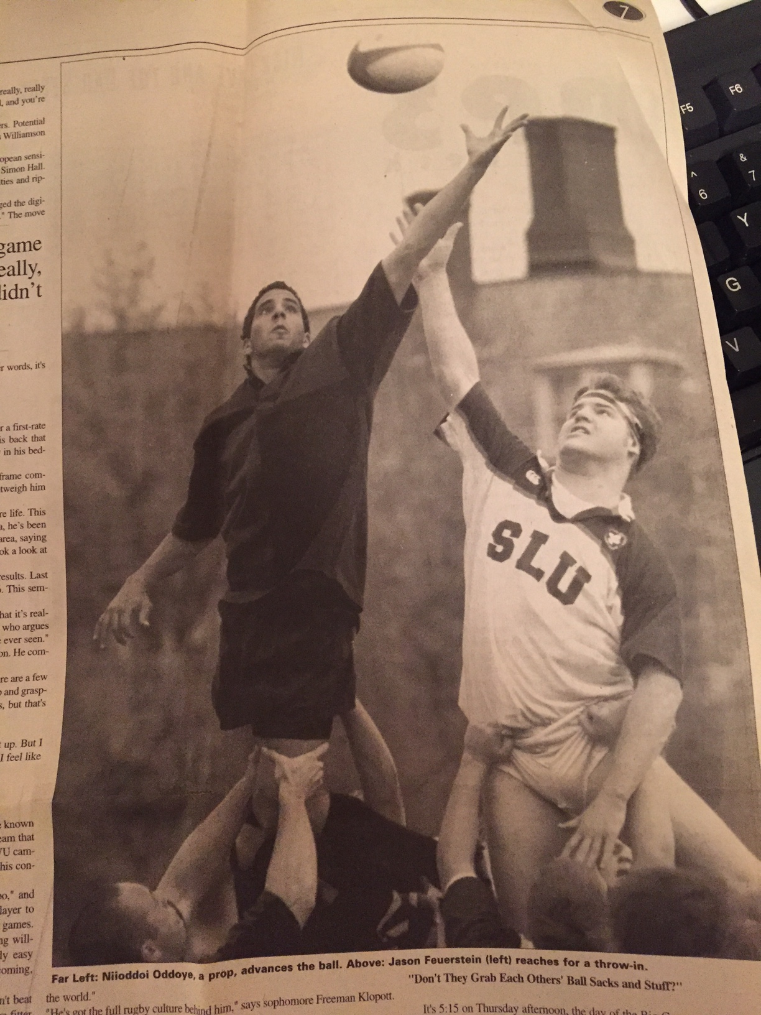
Washington University in St Louis
Why Wash U?
Beautiful school, with strong academics
Off the east coast (at the time I thought I’d live my whole life in NY)

Slide 7
Quiz #2
Q: How do you go from a English and Philosophy Major to a BofA Banker?
A family connection gets you a first job in banking, even though you’re unqualified
You get lucky and ace an on campus interview for banking that you were totally unprepared for
A family connection gets you a first job in television commercial production (basically answering phones and making coffee), even though you’re unqualified

Slide 8
Work Life 1.0: Television and Film Production
Job | What I Wanted to Be Doing | What I Was Doing
Moxie Pictures (2001-05) | Learning how to film things | Learning how to manage executives A little bit of learning how to film things
Applehead Pictures (2005-07) | Learning how to make movies and read screenplays | Learning how to cope with stress
Elevation Pictures (2007-08) | Making a feature film | Making a feature film Learning how to cope with more stress

Slide 9
Work Life 2.0: Entertainment Banker
My Title: Senior Vice President and Relationship Manager My Group: Technology, Media and Entertainment
My Market: Middle Market
My Product: primarily credit, but also treasury, foreign exchange and advisory services
Term | Meaning
Relationship Manager | Client facing role. I sell BofA’s products to clients and attempt to generate revenue for the bank.
Media and Entertainment | Companies that make movies, television shows, music
Middle Market | Companies from $50MM to $2BN in revenue. This means I don’t work in a branch.
Credit: | Loans. Clients borrow money, pay us interest and fees, and (hopefully) pay us back in full.

Slide 10
What Do the Following Films Have in Common?
All of these films were financed or produced by companies that are clients of Bank of America’s (and they were nominated for Best Picture at the Academy Awards).

Slide 11
How Does An Entertainment Finance Loan Happen?
Relationship Manager (me): markets prospects on deal opportunities.
Prospects: submits finance plan, project details, etc.
Credit Team: works with relationship manager to see if risk is appropriate to bank. A memo is prepared detailing: (i) opportunity, (ii) source of repayment, and (iii) risks
Risk Approver: reviews (and accepts or rejects) deal opportunity

Slide 12
Basics of Asset Based Lending in Entertainment
What are Film Assets?
Ticket sales (FIXED REVENUE STREAMS)
DVD, iTunes/Amazon, VOD sales (ESTIMATED REVENUE STREAMS)
Television or SVOD license fees (FIXED REVENUE STREAMS)
Value of future unsold rights (ESTIMATED REVENUE STREAMS)

Slide 13
Sample Film Ultimate
Film Budget | 68,921
Client Share of Film Budget | 12,923

Slide 14
Entertainment Finance Landscape --- Illustrative Borrowing Structure Considerations
Entertainment Finance Landscape
Illustrative Borrowing Structure Considerations
Eligible Receivables
Film receivables (e.g. domestic and foreign minimum guarantees) represent contractual receivables to the borrower not dependent on film performance
Tax credits (independently verified by tax consultants) are contractual rebates of a film's budget due to the borrower post completion
Film Ultimates
Distributor generated film level 10-year profit and loss statement with accompanying timing grid to value cash flows payable to producer/financier
Contains contracted and estimated sums that are discounted and margined with back testing per covenants
Library
Post “first cycle” cash flow from exploitation valued by qualified third party
Primarily estimated values discounted and margined with annual or semi-annual re-valuation
Unsold Rights
Estimated value of international rights as provided by qualified sales agent
International distributors acquire rights to distribute films by providing an advance against the minimum amount anticipated to be paid to a producer from exploitation after deducting fees and distribution expenses
Production
Cost basis of unreleased film inventory
Margined and controlled via conversion tests (e.g. percentage of cost basis covered by ultimate upon receipt)
Credit Risk
Eligible Receivables
Minimum Guarantees
Tax Credits
Ultimates
Library Credit
P&A Credit
Unsold Rights Credit
Production Credit
Low
Moderate
Elevated
The mix of yield and governance is predicated on the producer’s track record of success

