Slide 1
YBA Presentation
Ms. Ileana B. Ayala Bayron
Sales Manager / Pastry Chef / Business Owner / Entrepreneur

Slide 2
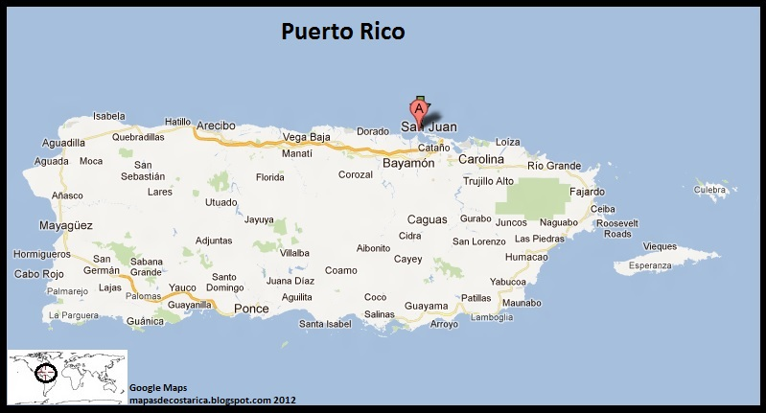
My Backstory
Mayagüez (Spanish pronunciation: [maʝaˈɣwes]) is the eighth-largest municipality of Puerto Rico. It was founded as Nuestra Señora de la Candelaria, and is also known as La Sultana del Oeste (The Sultaness of the West), Ciudad de las Aguas Puras (City of Pure Waters), or Ciudad del Mangó (City of the Mango). On April 6, 1894, the Spanish crown gave it the formal title of Excelente Ciudad de Mayagüez (Excellent City of Mayaquez).[4][5] Mayagüez is located in the center of the western coast on the island of Puerto Rico.
I am from Mayaguez, Puerto Rico.

Slide 3
I grew up as an “army brat” meaning a child from a career soldier, especially one who has lived in various places as a result of military transfers.
I have lived in Georgia, Florida, Panama, Mannheim, Germany and Frankfurt, Germany.
Moved back to Puerto Rico in 10th grade, highschool.
Family and friends all live in Puerto Rico.
Started college in San German, Puerto Rico; studied 2 years of nursing 96-98
Finished college in the Interamerican University of Ponce; Pharmacist tech, 2001
Studied European Pastry 2003-05
I have a brother, he has a MBA, MS in Computer Engineering, after college he went to the Air Force, served 6 years and is now working for Northrop Grumman as a Systems Engineer.
Northrop Grumman is an american global aerospace and defense technology company, 5th largest defense contractor in the US.

Slide 4
My Career, My Business
Worked as a Pharmacist for 2 years
Opened my first business in 2002 “Beauty Supply”, sold it after 3 years
Worked in the Pharmaceutical / Medical Device Industries for 5 years
Started working in Sales / Business Development / Recruitment
Moved to California due to work opportunities
Worked as a Business Developer for a Consulting Firm
Started my Cupcake LLC named: Barbara’s Island Cupcakes 2015
Currently working for Rescop started in March 1st, 2017
Started My Apron Line “Barbara’s Island”
Started my web-page, Instagram, Facebook, online cupcake business

Slide 5
My Business, my passion…my work.
Barbara’s Island Cupcakes is a online cake business
My work days start Wednesday evenings with online promotions, weekend offers and email blast.
From Wednesday to Sunday online business
Mondays are brainstorm days for next weekend cupcake flavors
Tuesdays are buying ingredients and prepping ingredients and materials
Wednesday’s online promotions and photos.
What do I love about my business?
  You are your own boss
  Creativity
  Interacting with people and their ideas
  Your customer is your best asset
  Your customer is your word of mouth
  Your customer can help you create your next idea.
  Your clients happiness is your success.

Slide 6
Career Highlights…how my professional career impacted my Business.
Sales people build businesses not just a sale, Think beyond a sale you’re going to get people’s attention and interested.
Build your business one customer at a time and always leverage the customer into more customers.
Listen more than speak, always ask your clients the W questions(?)
Commit and over deliver
Spend time on activities that ring the register.
Be fanatical about selling.
Great sales people consistently work on improving themselves.
Invest in networking, relationships and community…”the Difference between contact and contract is the “R” that stand for Relationships”, build relationships.
Rely on your actions not outcomes
Failed sales are INVESTMENTS IN PROCESS.

Slide 7
Career Highlights…continued
Never give up on unsold clients, someday those clients will buy.
Problems are opportunities
Invest in career, business and customers…if you do not water your lawn what will happen?
Invest in education, development and personal motivation, keep investing in your game just as a professional basketball player is always practicing.
Constantly in think, plan and prepare mode.
Always build your client base and keep your pipeline filled.

Slide 8
High school, College, Career and Life…
Be prepared to become the person you always wanted to be…army motto: Be all you can be.
Nobody can tell you who to become, that is the choice you make for yourself.
Meet as many people as possible, join different groups, forge connections and experience people your unfamiliar with (they may help you find a job someday or even provide advice).
Be open to new experiences but have Goals.
If you don’t find an internship find a job, people skills is key to growth.
Find a Mentor who can teach you about both life and career goals.
Trouble with productivity – get organized. Life runs easier under organization of time.
Don’t be afraid to ask for advice or help.
College goes by quickly enjoy every minute!

Slide 9

Question and Answers

