Slide 1
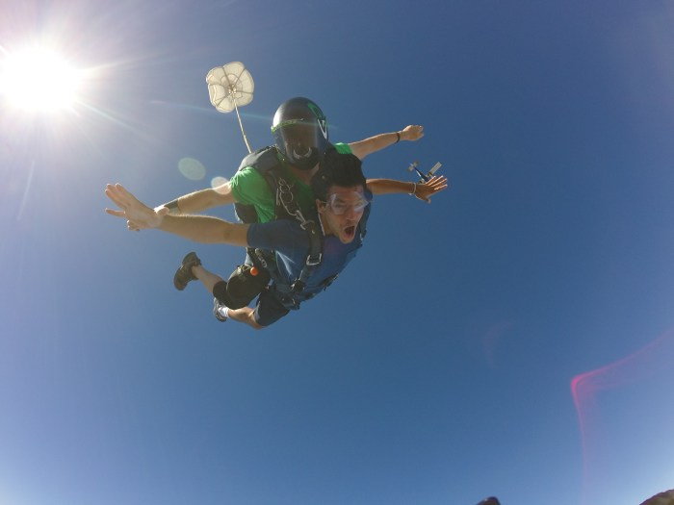
Christian Carmody
Entrepreneur & Part-time wanderer
Spring Style 20XX

Slide 2
Introduction
My name is Christian Carmody and I am 25 years old
I am the co-founder of a nonprofit called The Alternative Roadmap. We wrote a book/curriculum for high schools, homeless transition centers, drug rehabilitation centers, and juvenile detention centers.

Slide 3
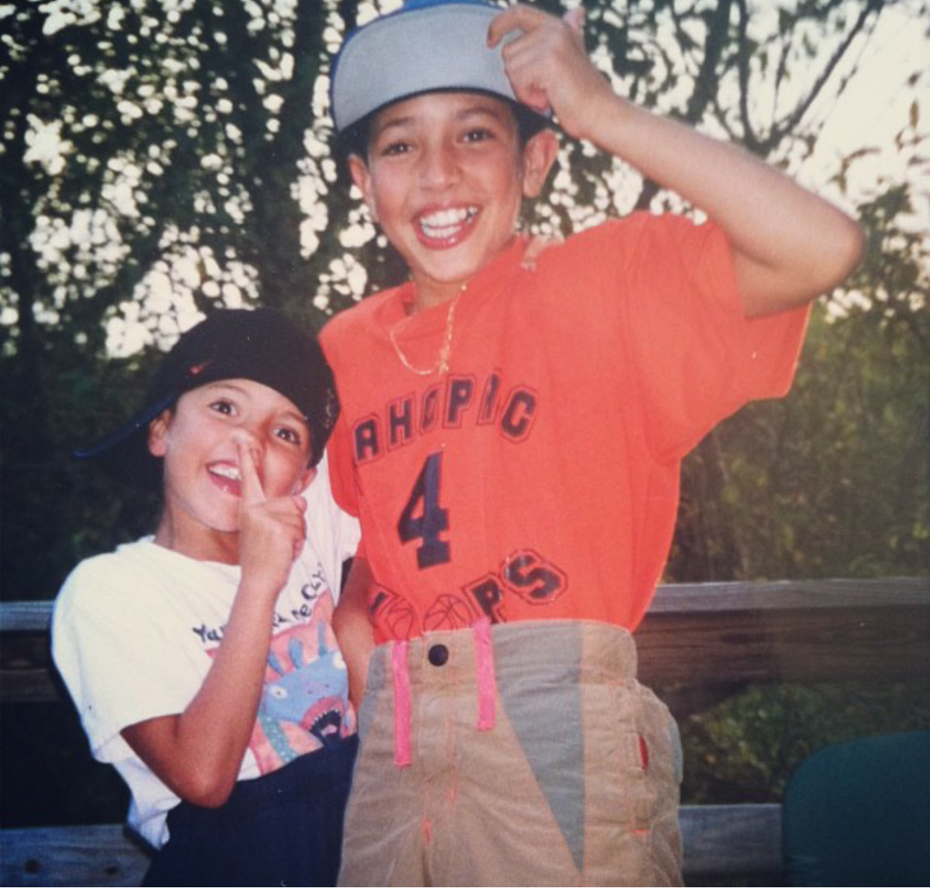
My Childhood
I was born in Manhattan, NY and raised in Mahopac, NY
I come from a large extended italian family and have one brother (dork to the left)

Slide 4
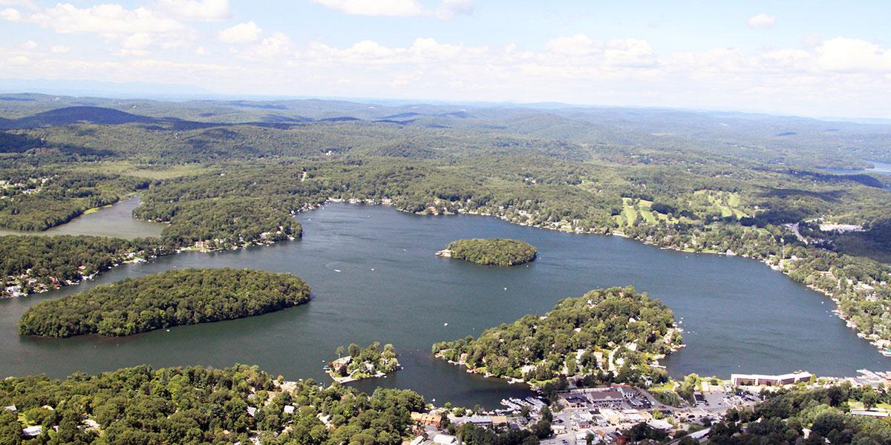
Mahopac High School
The Experience

Slide 5
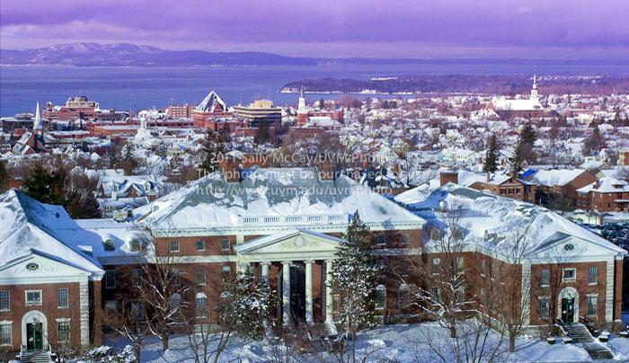

Slide 6
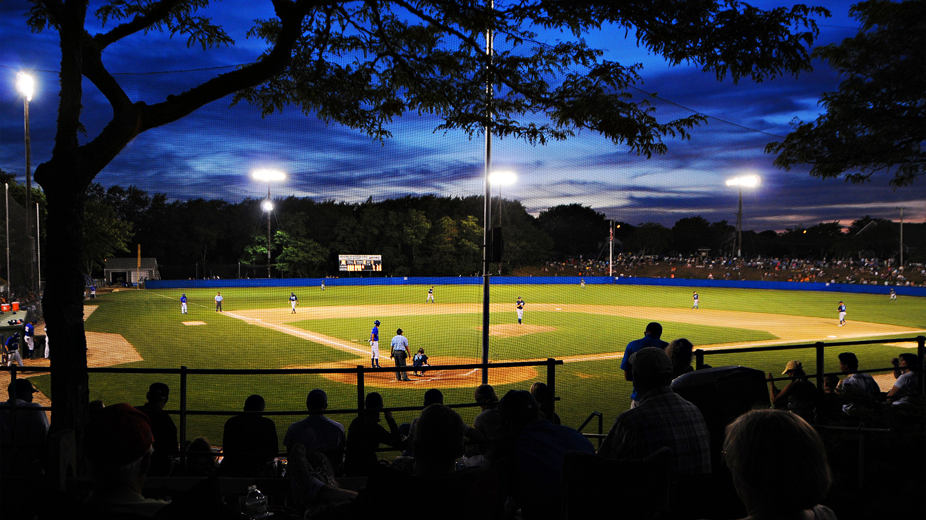
SPORTS ROUTE

Slide 7
Entrepreneurship
My discovery
My role
What I learned

Slide 8
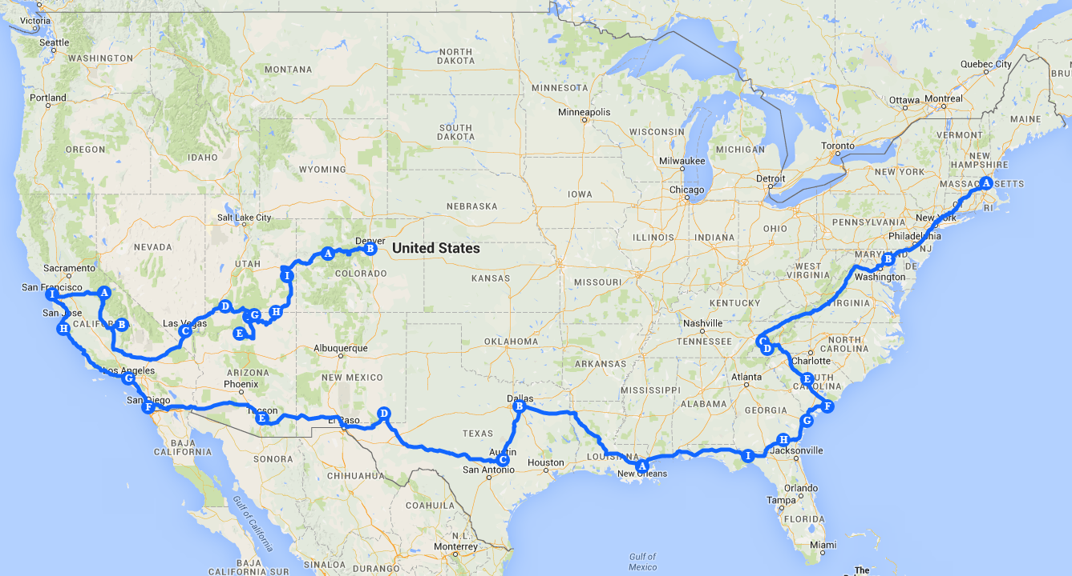

Slide 9
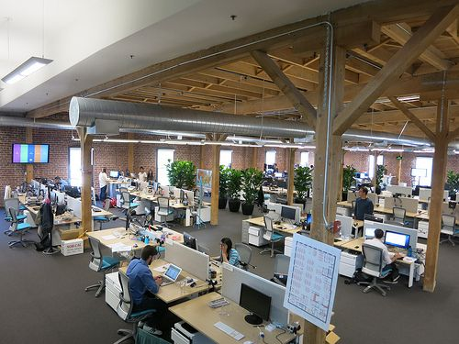
Going Corporate
The Sales Grind
Pros/Cons
What I learned

Slide 10
The Alternative Roadmap
Elliot Zettas & I meet at Xero, write a book.
Met with 20 kids in Denver to test curriculum
Move to California to pilot at a high school
Where we are now

Slide 11
You Never Know Who You might Meet

Slide 12
Class Activity
Write Down Your Field Of Interest
If you don’t know, write down 3 interests/passions
Think of 5 people you know who may be able to help
Write down 3 organizations you may want to learn more about
Tonight, reach out to all people/organizations

Slide 13
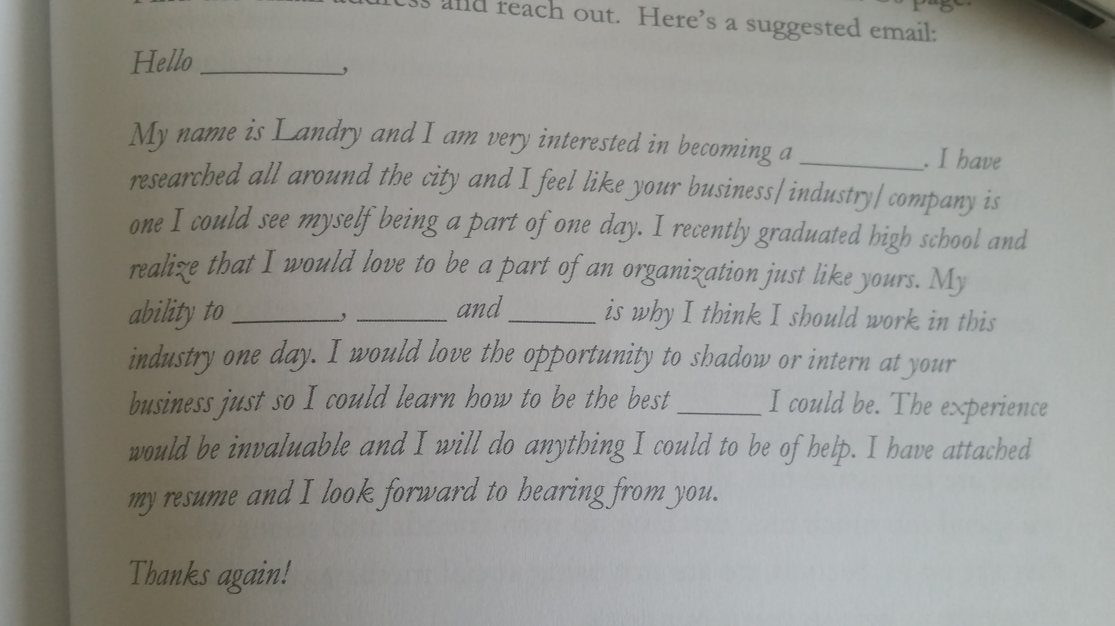

Slide 14
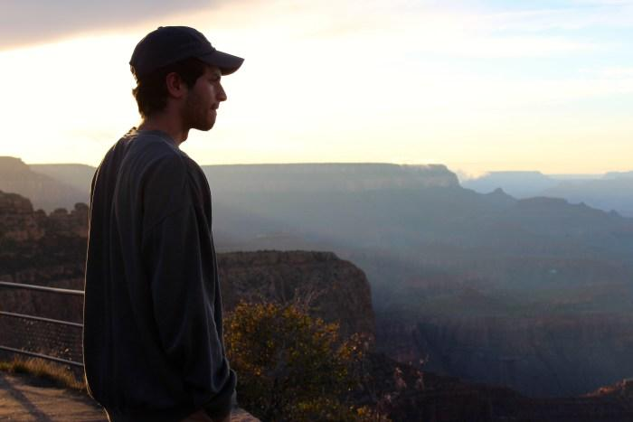
“Not All Those Who Wander Are Lost…”

