Slide 1
Animo Pat Brown HS
Guest Speaker: Elliot Zettas

Slide 2
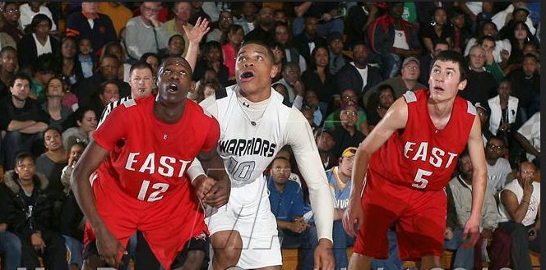
Who am I?

Slide 3
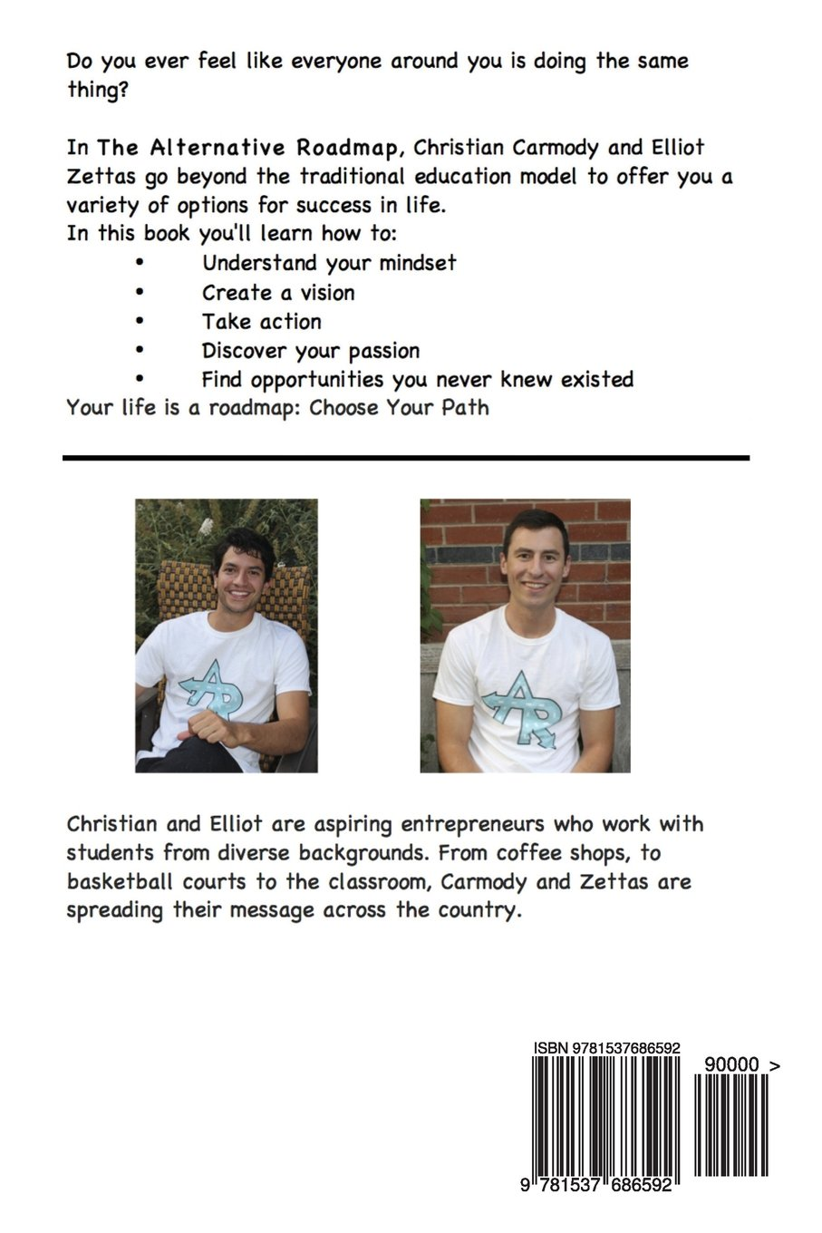
The Alternative Roadmap

Slide 4
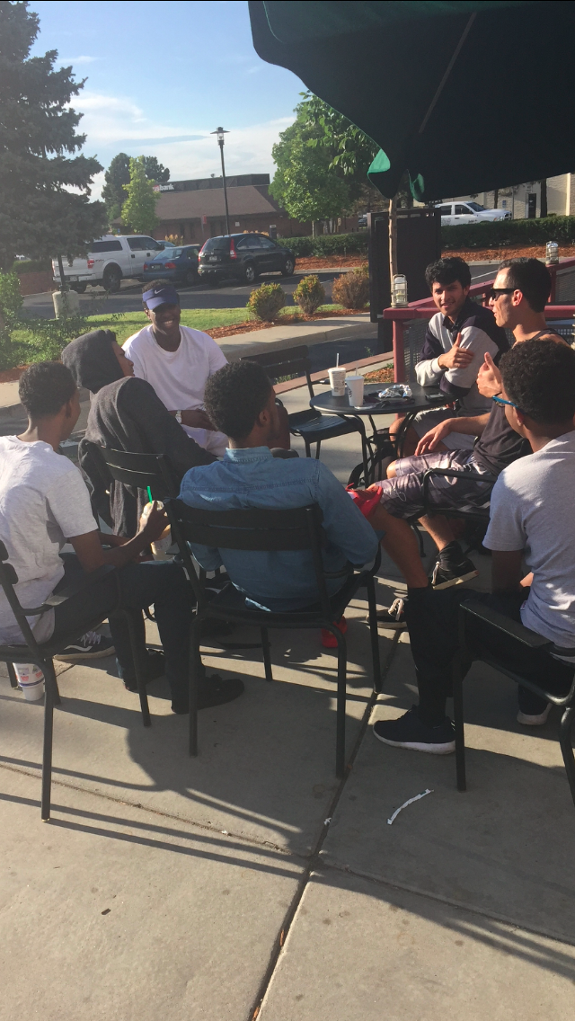
The Alternative Roadmap
Creation of AR
The Book
Hamsa/Obi
The Website
Pomona, CA
Denver, Pomona, Colorado Springs, New York

Slide 5
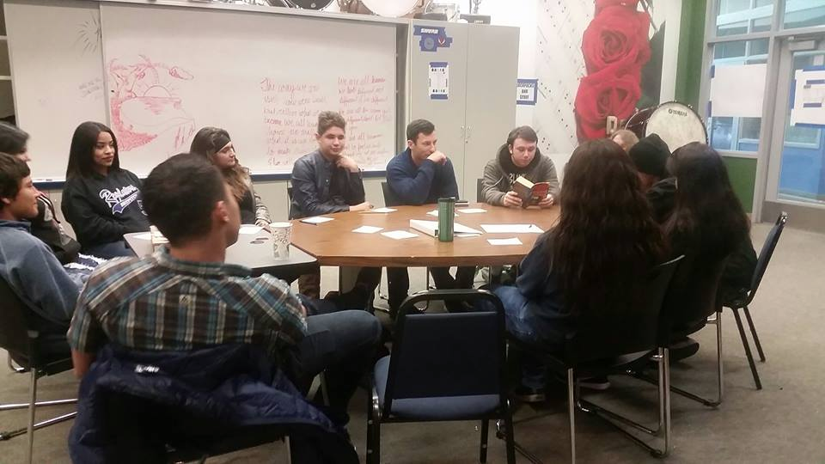
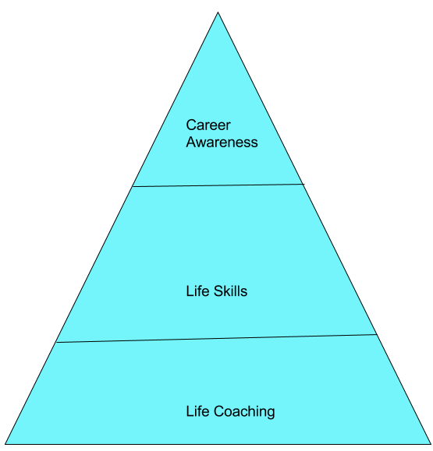
What do we do?
Life Coaching
Life Skills
Career Awareness
For what population?

Slide 6
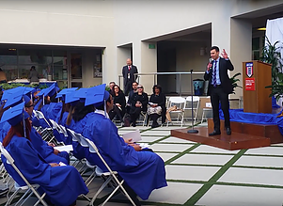
Typical Day
Skills
Teaching
Lead Generation
Phone Calls
Meetings
Emails
Accounting
Marketing
Website
Social Media
Sales
Entrepreneurship Degree
Life Coaching
Writing
Public Speaking

Slide 7
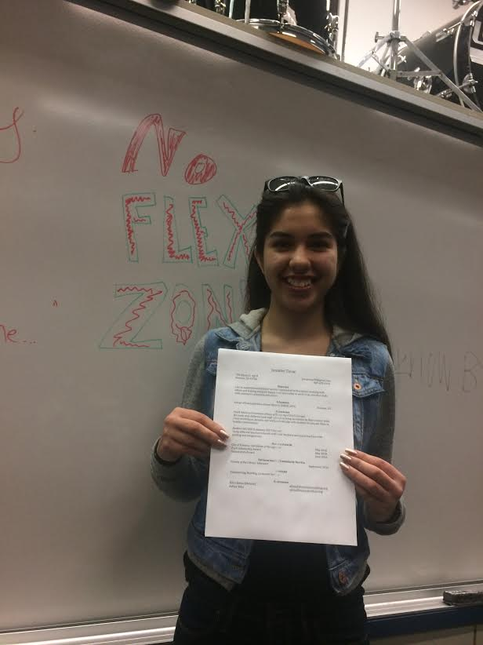
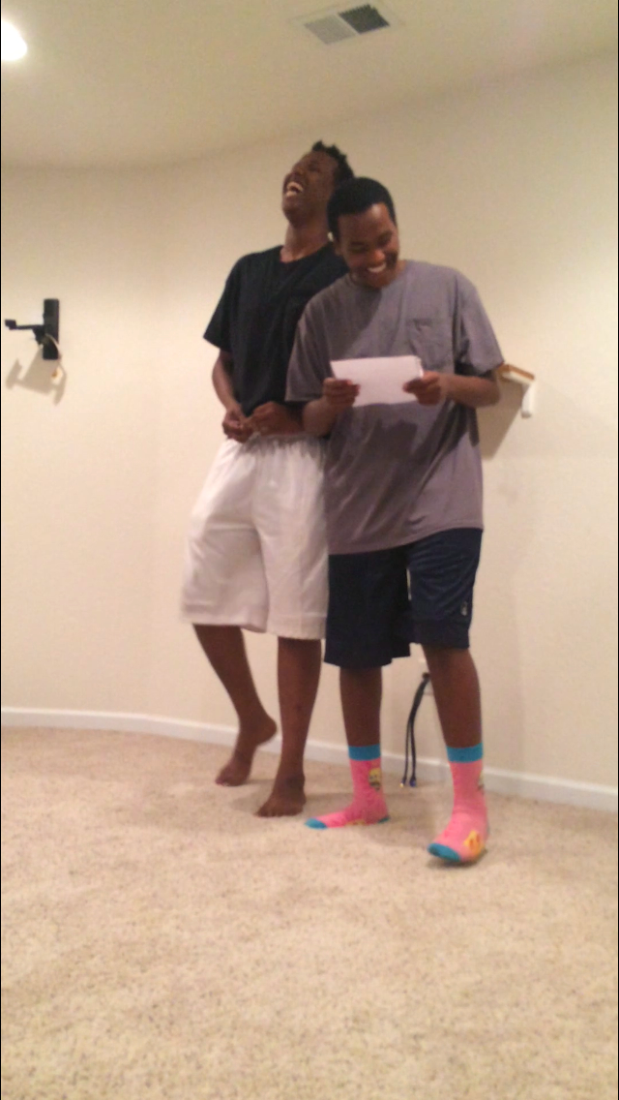
A day in the life...
What is sales?
How do you sell anything?
Why is sales important?

Slide 8
Sell me a phone (I do not have one)
Any way you want to
Write it down or put it in your phone notes

Slide 9
How do you properly sell a phone?
Build Rapport/Trust
Find the proper population
How do you do that?
Find a need that they are experiencing?
How do you find the need?
Is there an emotional connection to the product/service you’re selling?
How do you find the emotional connection?
Close the deal

Slide 10
Questions?

