Slide 1
YOUTH BUSINESS ALLIANCE
April 19, 2017
Animo Leadership High School Speaker: Carla Fedrigo

Slide 2
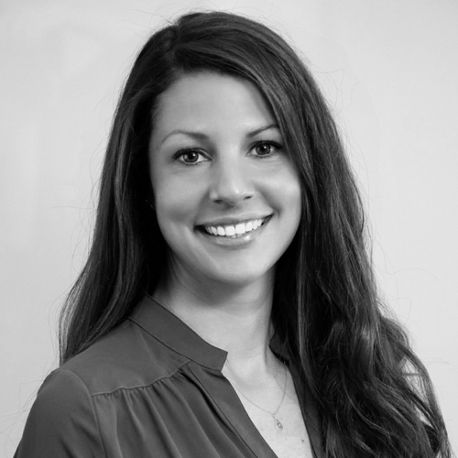
PRESENTED BY
CARLA FEDRIGO Director of Global Marketing, Infrascale Pilates Instructor, White House Pilates
Email: carlafedrigo@gmail.com
Twitter: @cfedrigo LinkedIn: linkedin.com/in/cfedrigo

Slide 3
AGENDA
1
2
3
4
BACKSTORY
CAREER
ACTIVITY
Q&A

Slide 4
BACKSTORY
A little about my background and education

Slide 5
EARLY LIFE

Slide 6
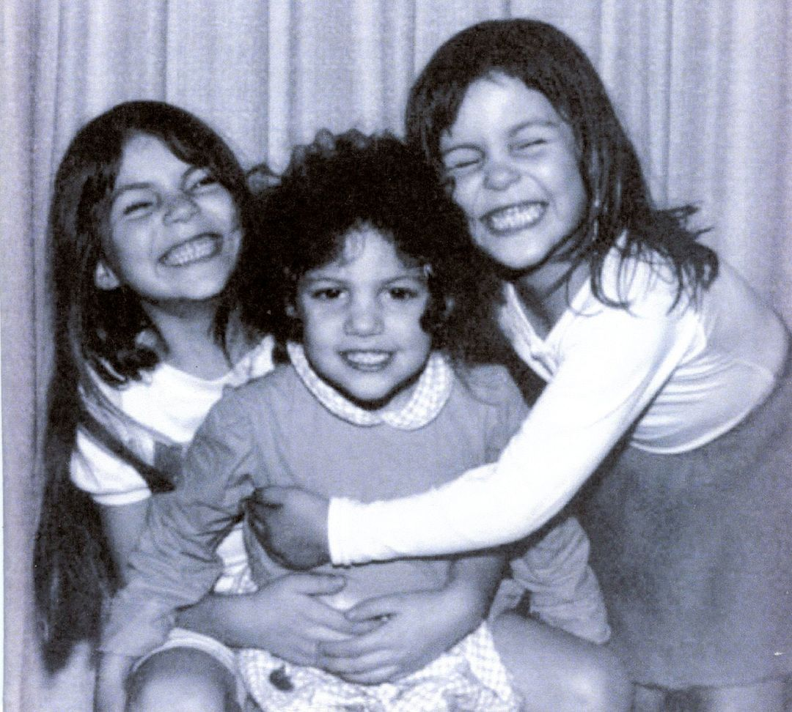
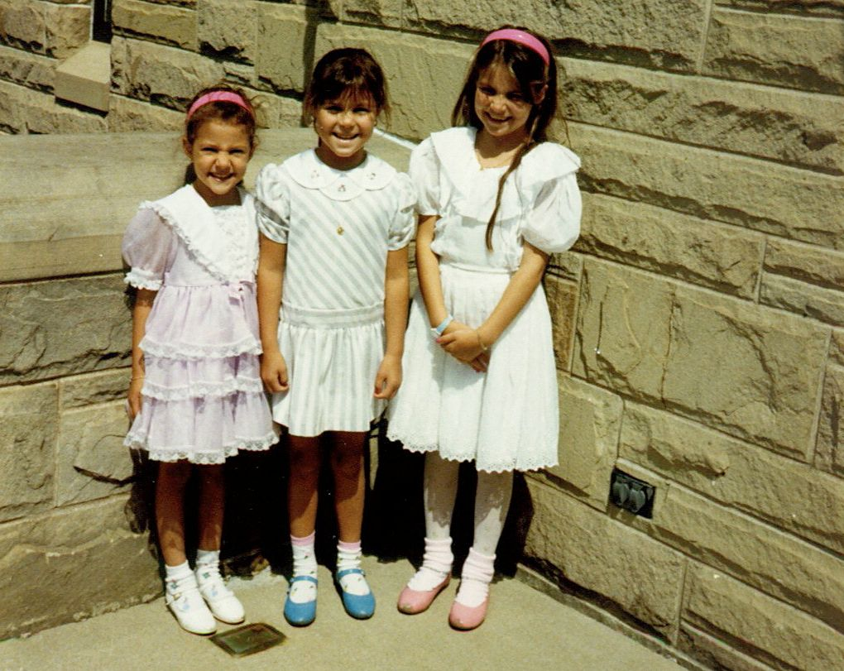
FAMILY

Slide 7
ACTIVITIES
Meals on wheels
Dance marathon
Goodness Day
Painting
Ceramics
Dance
VOLUNTEERING
ARTS
Ice skating
Swimming
Track & Field
Piano
Guitar
Violin
SPORTS
MUSIC

Slide 8
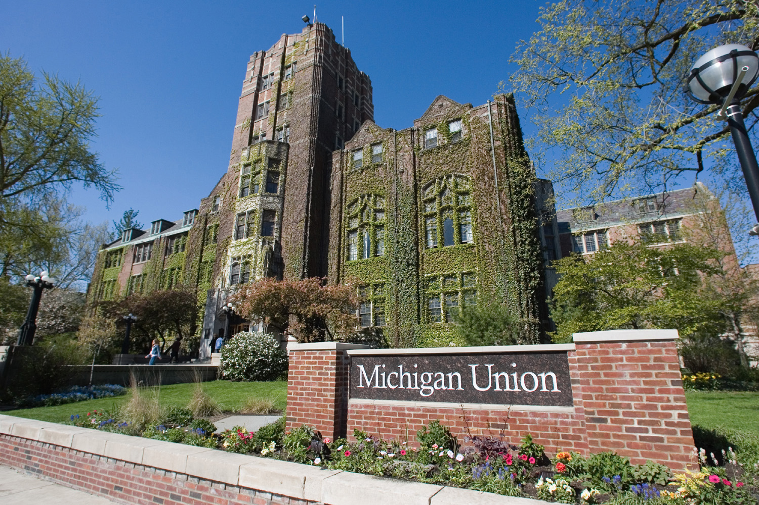
ACADEMICS

Slide 9
CAREER
A day as a director of global marketing

Slide 10
THE COMPANY
What?
Why?
Complete Data Protection
Data Protection
Cloud Backup & Disaster Recovery
On-Demand Failover
Ransomware Protection
Every company has the right to protect their valuable data and keep their operations up and running -- simply, flexibly, and affordably.
Why?
Third Party Validation
By The Numbers
Founded:
HQ:
Partners:
Customers:
Data Centers: Data Protected:
2011
Los Angeles, CA
900
1M devices protected & counting
15 global data centers
100+ petabytes of data
VISIONARY
Disaster Recovery as a Service

Slide 11
PROS & CONS
WHAT IS MOST REWARDING
WHAT IS MOST CHALLENGING
The work is interesting
I enjoy the people I work with
It allows me to have a healthy & active lifestyle (and pays the bills)
I see results of my efforts right away
Start-ups lend to more chaos (simply a function of the nature of a start-up)
A certain amount of dysfunction
Not all personalities are going to align
The technology industry involves constant innovation; steep learning curve

Slide 12
THE ROLE
MARKETING CAMPAIGNS
MARKETING AUTOMATION
DEMAND GENERATION
CF
LEAD GENERATION
METRICS & REPORTING
LEARN, REVISE, IMPROVE
ANALYSIS & OPTIMIZATION

Slide 13
GLOBAL MARKETING
Tactic | Type of Campaign | Metrics/KPIs (Key Performance Indicators)
Banner Advertising | Clickable display ads that the company gets charge for on a per-click basis. Spend includes the creation and deployment of these ads. | Click-through rate: The % of prospects who click on the banner ad based on the number of impressions and perform the next action in the chain of events, i.e. form fill-out, content download, webcast registration, etc.
Email Marketing | Segmented email campaigns sent with specific subject lines, content, and CTA (call-to-action) for the associated audience. | Click-through rate: The % of prospects who open the email sent and click on a link within it, leading them to a website, blog or other desired destination.
Live Events | User conferences, tradeshows, virtual events, webinars | Conversion rate: The % of prospects who attend our event and follow-up by setting up an appointment or downloading content related to the event.
Search Engine Optimization | Optimizing web content to show up in organic search results | CTR: The % of prospects who click on the organic search result and performs the next action in the desired chain of events, i.e. form fill-out, content download, etc
Content Syndication | Deployment of company controlled content through third-parties such as publications, websites, business partners, etc | CTR: The % of prospects who click on a web property located on the site where the content is syndicated, leading them to your website for form-fill, download, etc.
Webinars | Web-based presentations run through technology or hosted services | Conversion rate: The % of invitations to a webcast which result in registrations. The % of registrations that lead to attending, and then converting to a customer.
Video Marketing | Production and placement of videos for demand generation. | Conversions: The % of prospects who engage in a subsequent activity after viewing a video intended to generate demand.

Slide 14
ACTIVITY
A glimpse of joining the workforce

Slide 15
Q & A

