Slide 1
Designing
Susana Odriozola

Slide 2
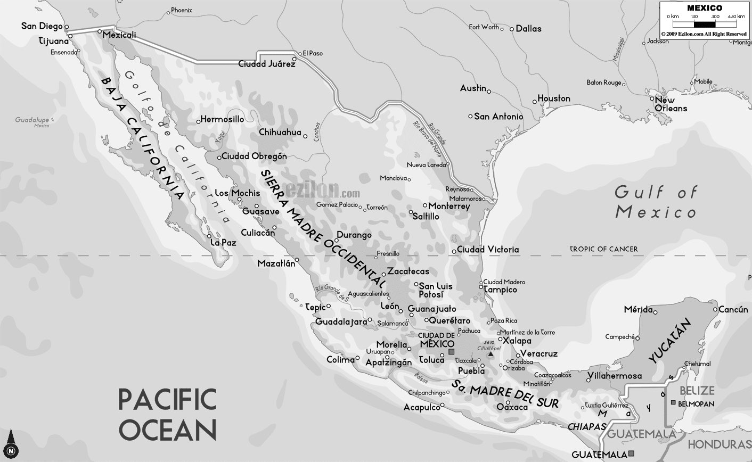
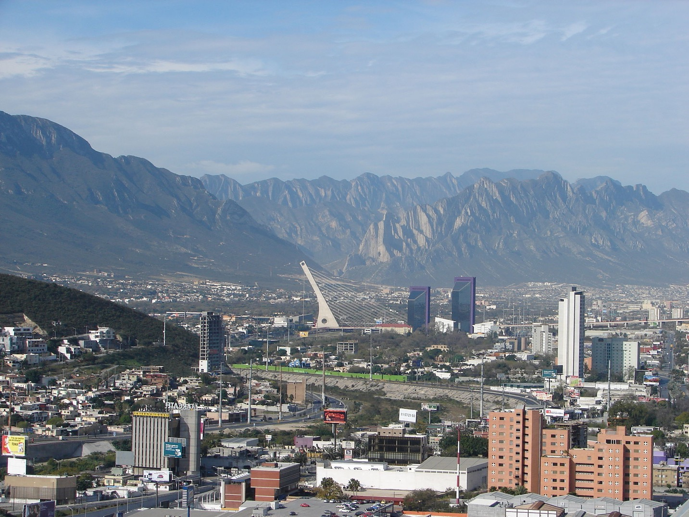
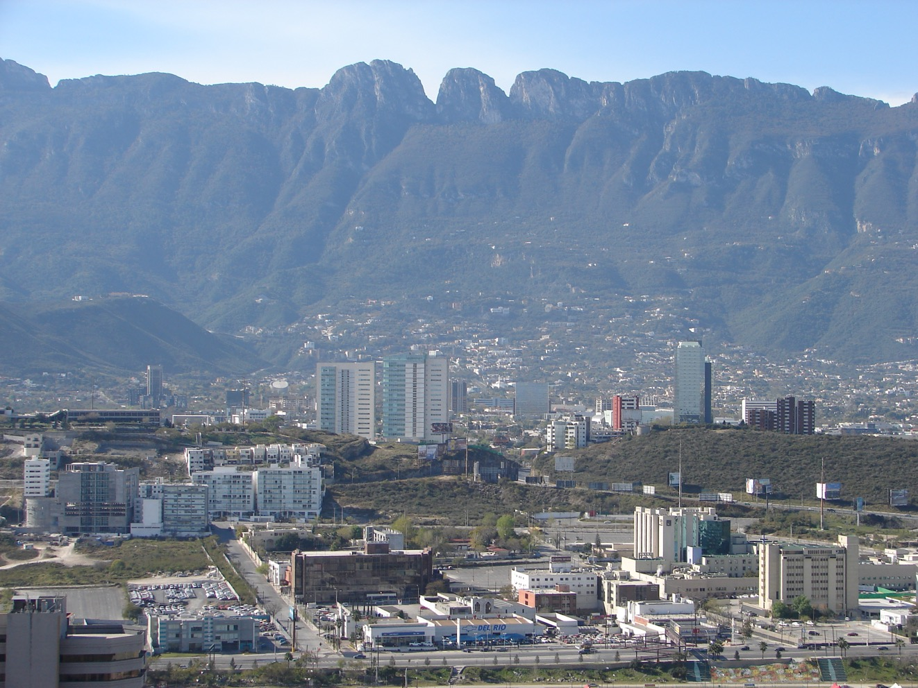

Slide 3
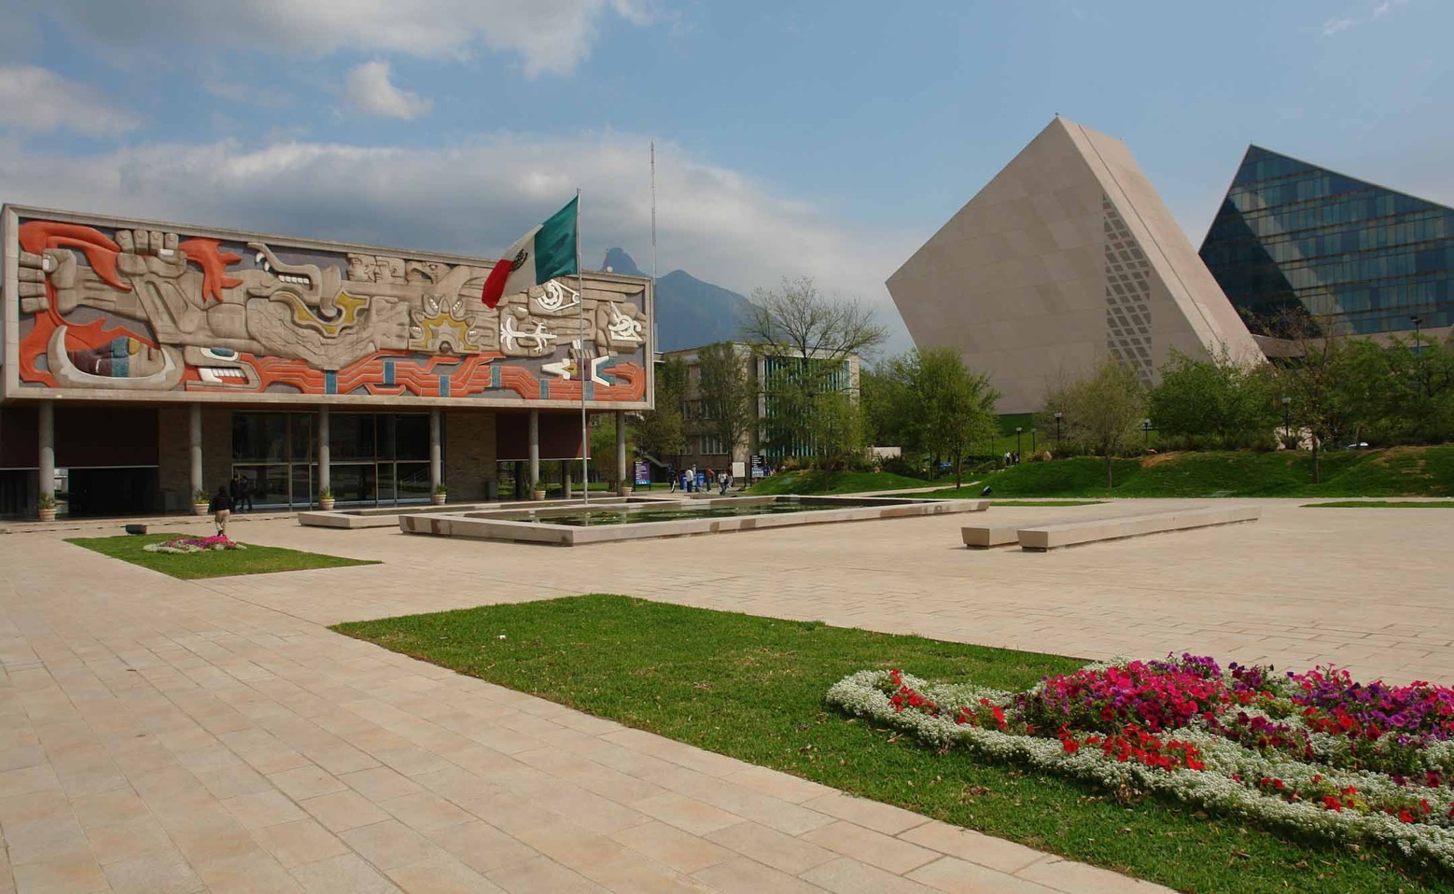

Slide 5
What is architecture?
Architecture is both the process and the product of planning, designing, and constructing buildings and other physical structures

Slide 6
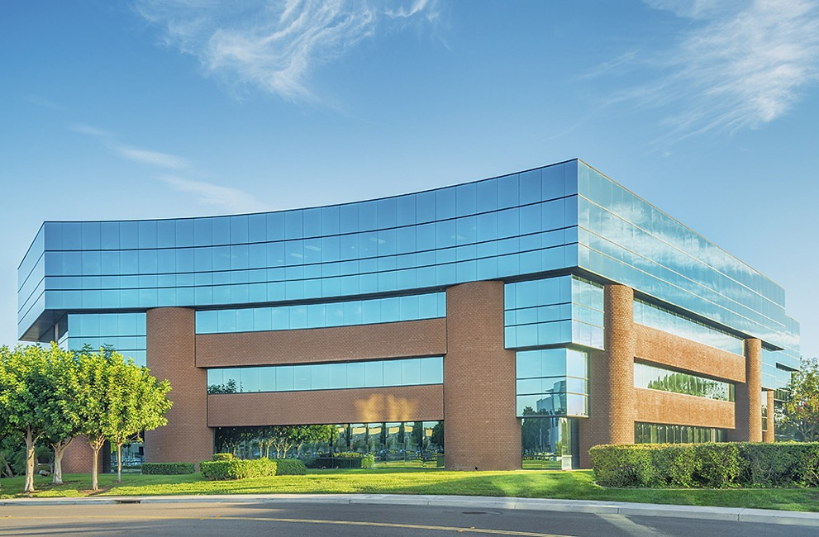
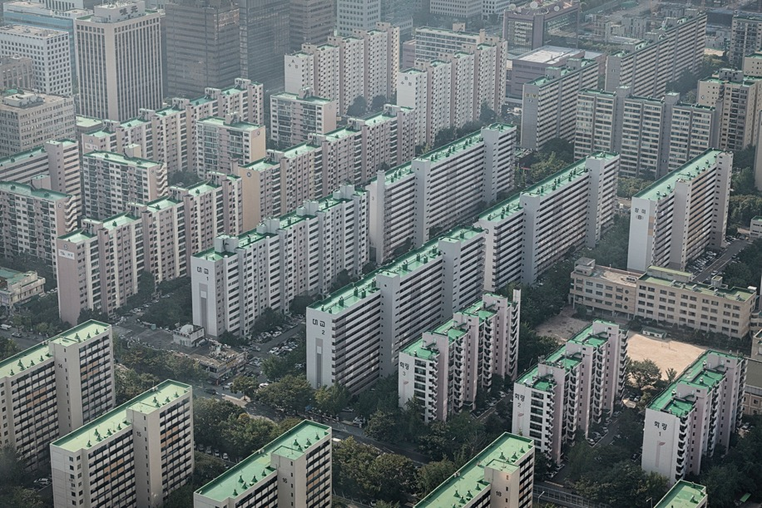

Slide 7
What is GOOD architecture?
There is beauty, and grace.
There is a sensibility to its social and cultural surroundings.
It becomes the physical space where good things can happen.

Slide 8
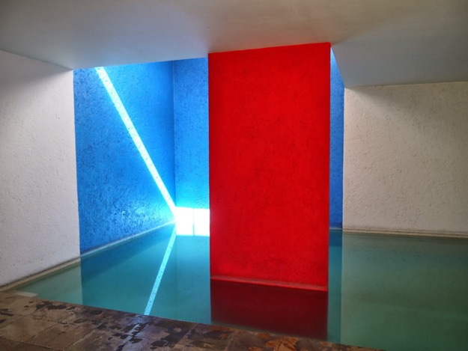
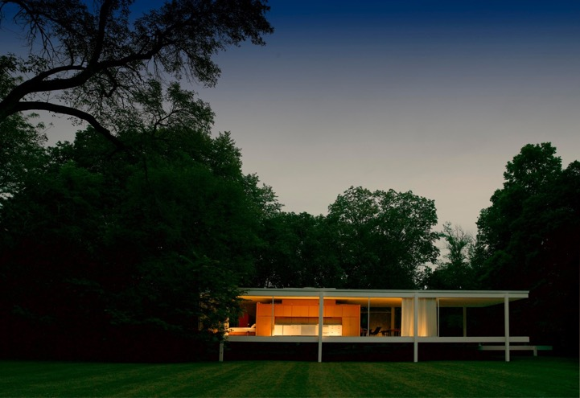
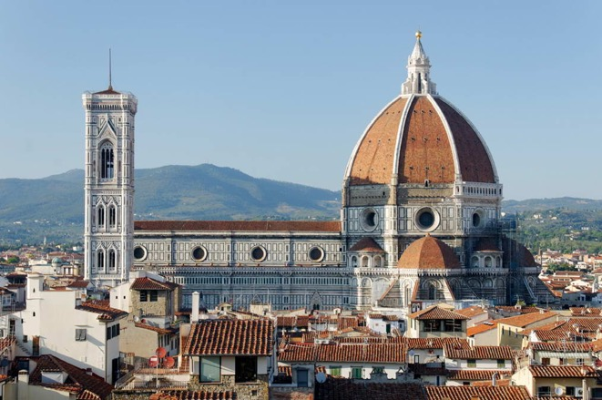
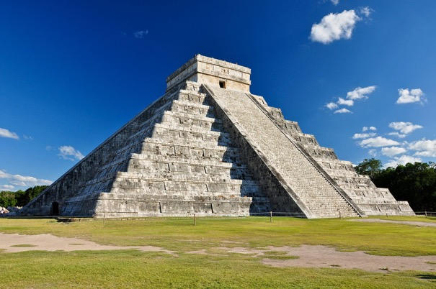
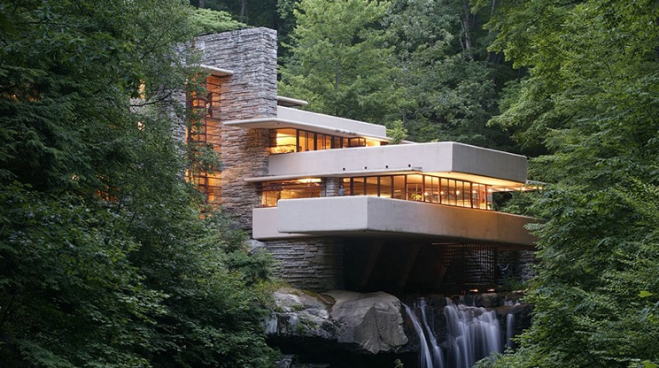
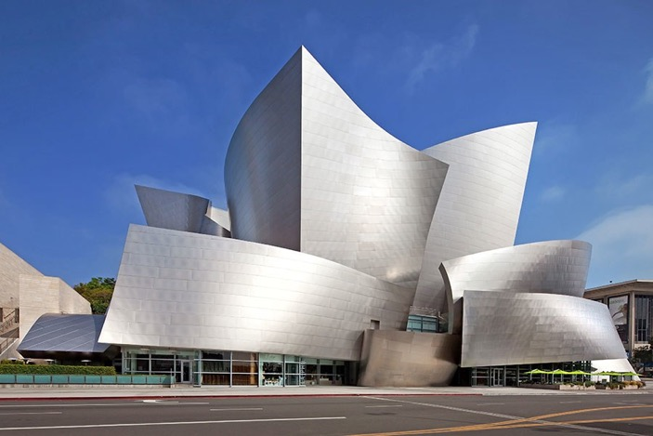
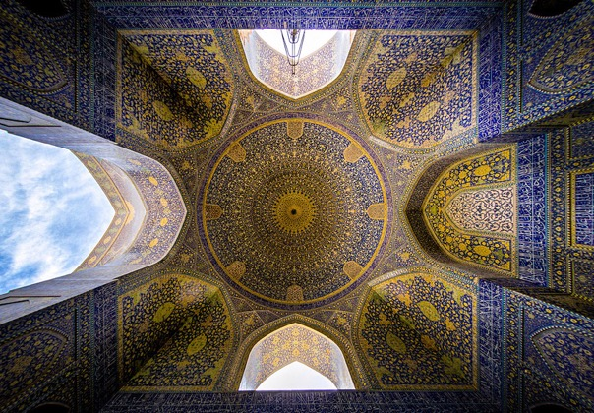
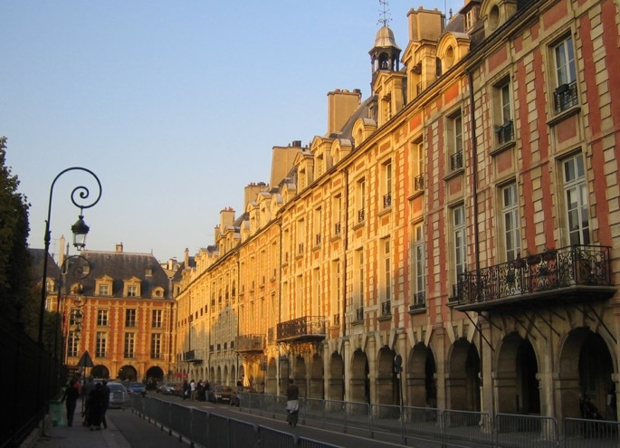

Slide 10
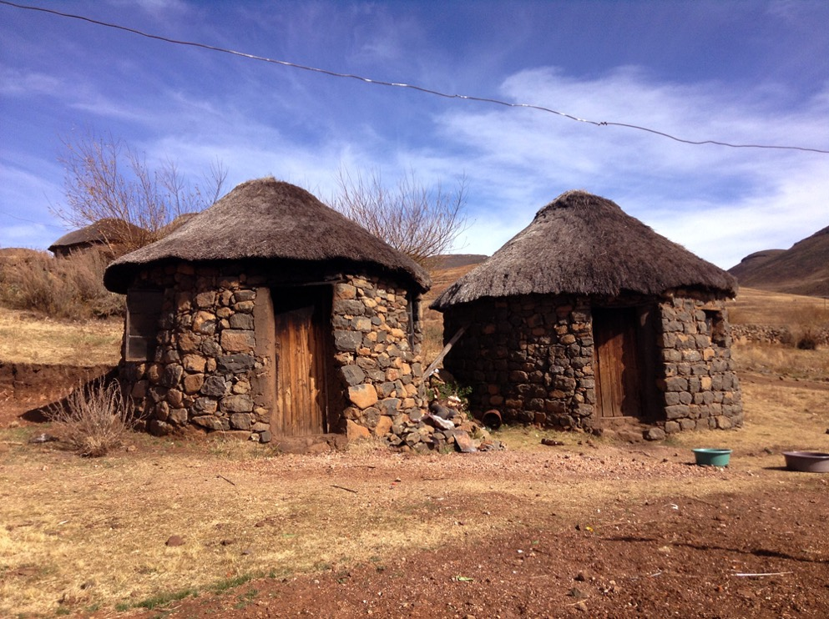
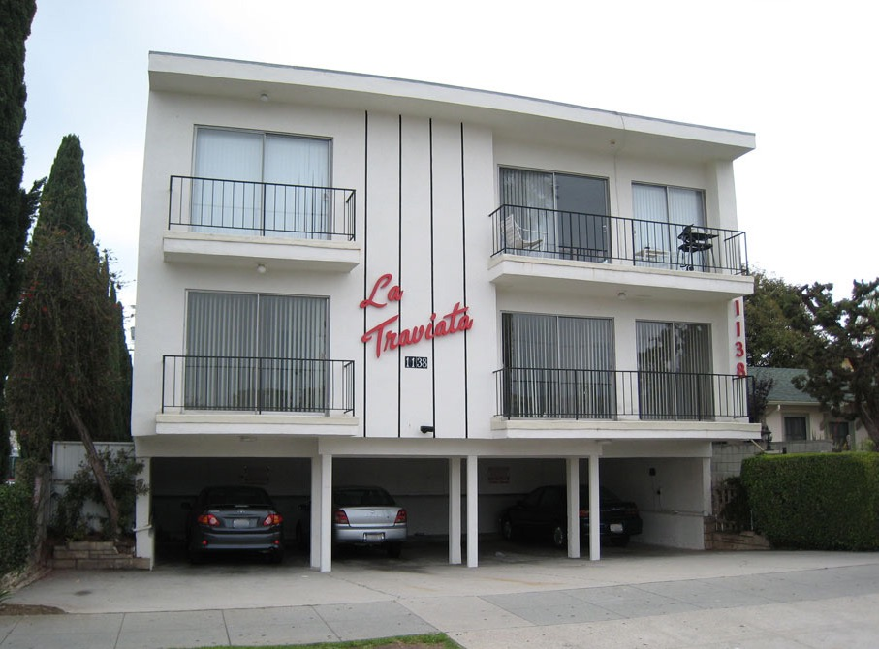

Slide 11
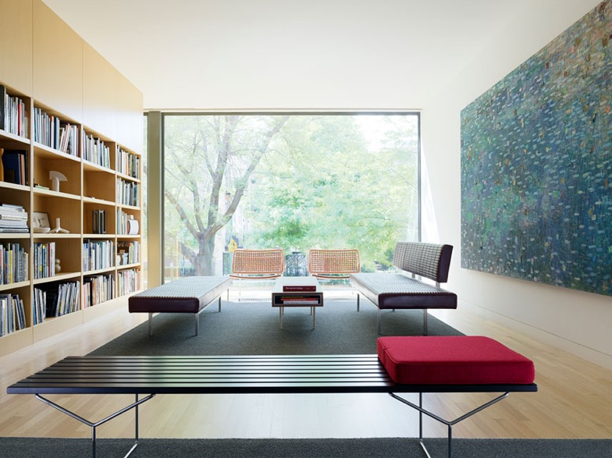
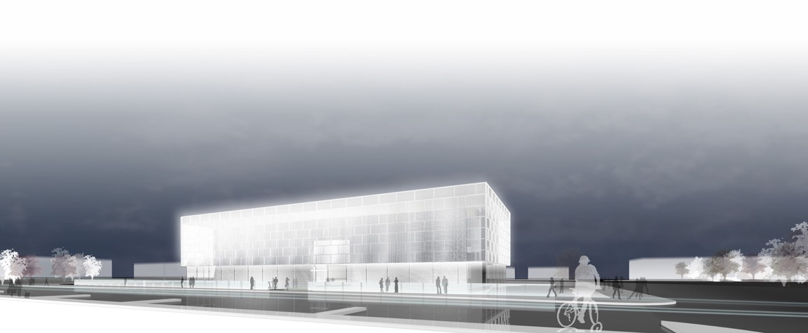

Slide 12
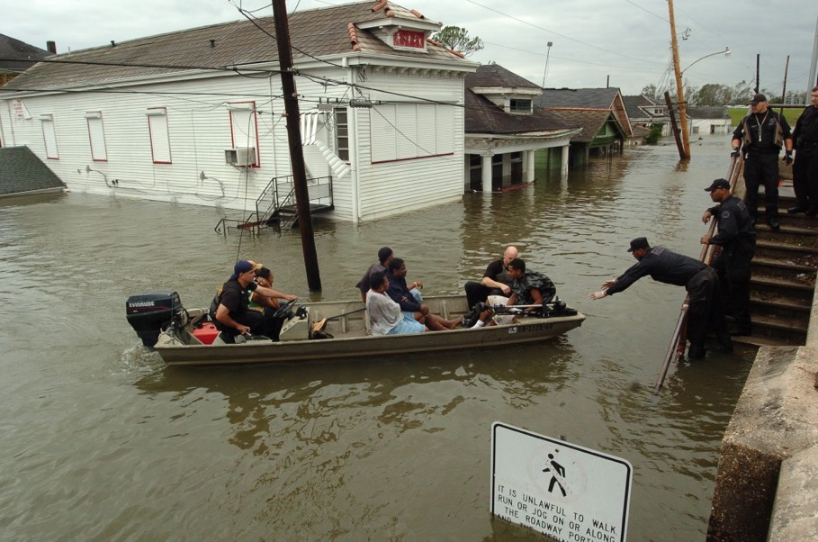
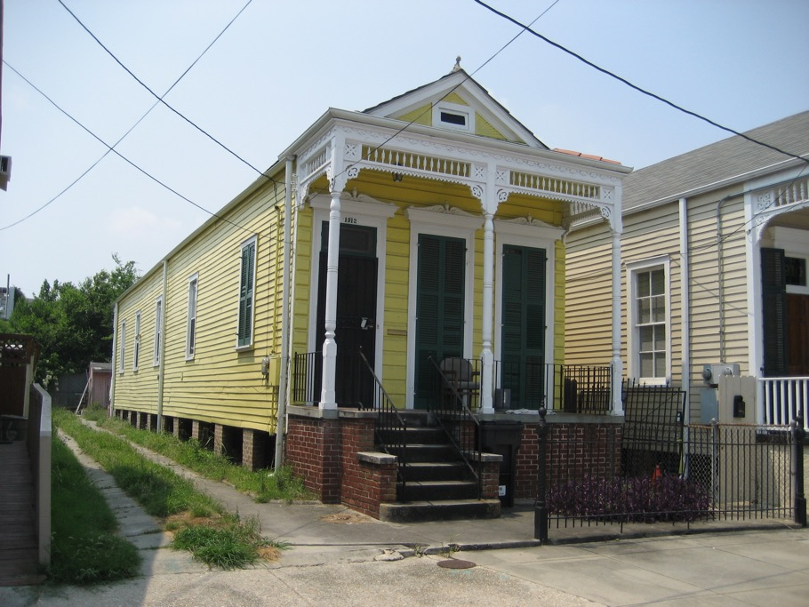
Sensitivity to a greater context
place
people
culture
history
ecological factors
economical factors
technical factors

Slide 13
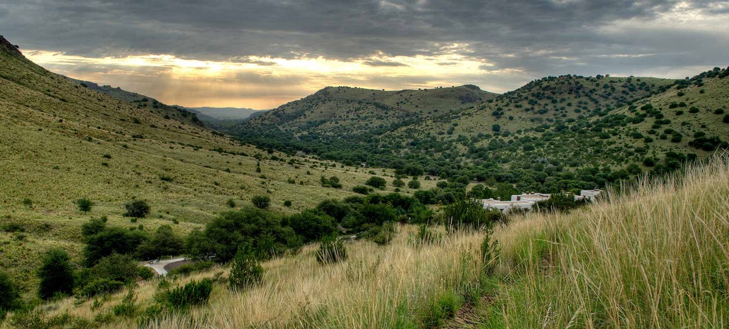
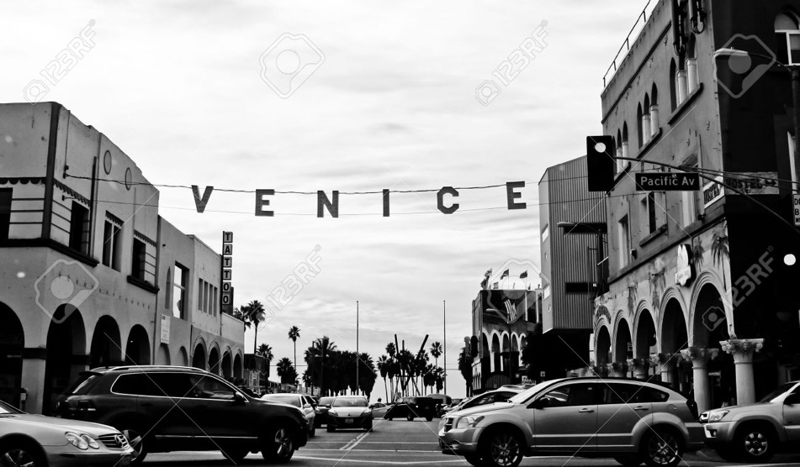
Architecture
“Everyone who’s ever taken a shower has had an idea. It’s the person who gets out of the shower, dries off and does something about it who makes a difference.”
— Nolan Bushnell
know-how skills
listen, observe end user
creative thinking
contextualize

Slide 14
lifeofanarchitect
+
-
-see your design built
-be creative
-inspire people
-work large scale (buildings)
-work small scale (furniture)
-many hats
psychologist
scientist
engineer
planner
businessman/woman
artist
-take budget into consideration
-tedious work
-annoy people
-at the mercy of city, contractors,
clients, weather…
-have to be patient
-does not pay a lot
-long hours

Slide 15
helpfulskills
+
-
-work hard, want it
-attention to detail
-visualize the grand scheme
-observe, observe, observe
-understand how things are
put together
-know your specialty,
and hire in accordance
accountant
manager
interior designer
contractor
spec writer
-negative attitude
-finger pointer
-disorganized

Slide 16
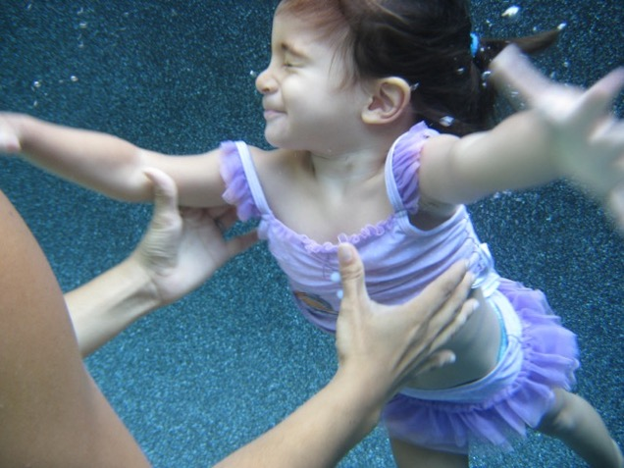
got married had three daughters moved twice
personallife

Slide 17
What is the most important thing and why?
Why?
What do you want to get out of this?
How are you going to do this?

Slide 18
What is the most important thing and why?
-To create positive, lasting impact for those at the bottom of the pyramid.
Why?
-Because it’s not fair, and because I can do something about it.
What do you hope to get out of this?
-Peace, a sense of justice, joy
How?
-Policy? Law? Nonprofits? Teaching? Med school? Architecture? Business?

Slide 19
2nd career
SOCIAL ENTREPRISE
SHORT CLIP

Slide 20
socialentrepreneurship
for profit companies
non profit organizations
be economically sustainable
do social good
SOCIALENTERPRISES

Slide 21
Human Centered Design
Firm IDEO in Palo Alto
What is something this population has in excess?
What is an opportunity that this population has?
Giradora Example

Slide 22
Short Exercise
Groups of 4 or 5
-What do you have IN EXCESS in your community?
-What are some of the OPPORTUNITIES that you see?

