Slide 1
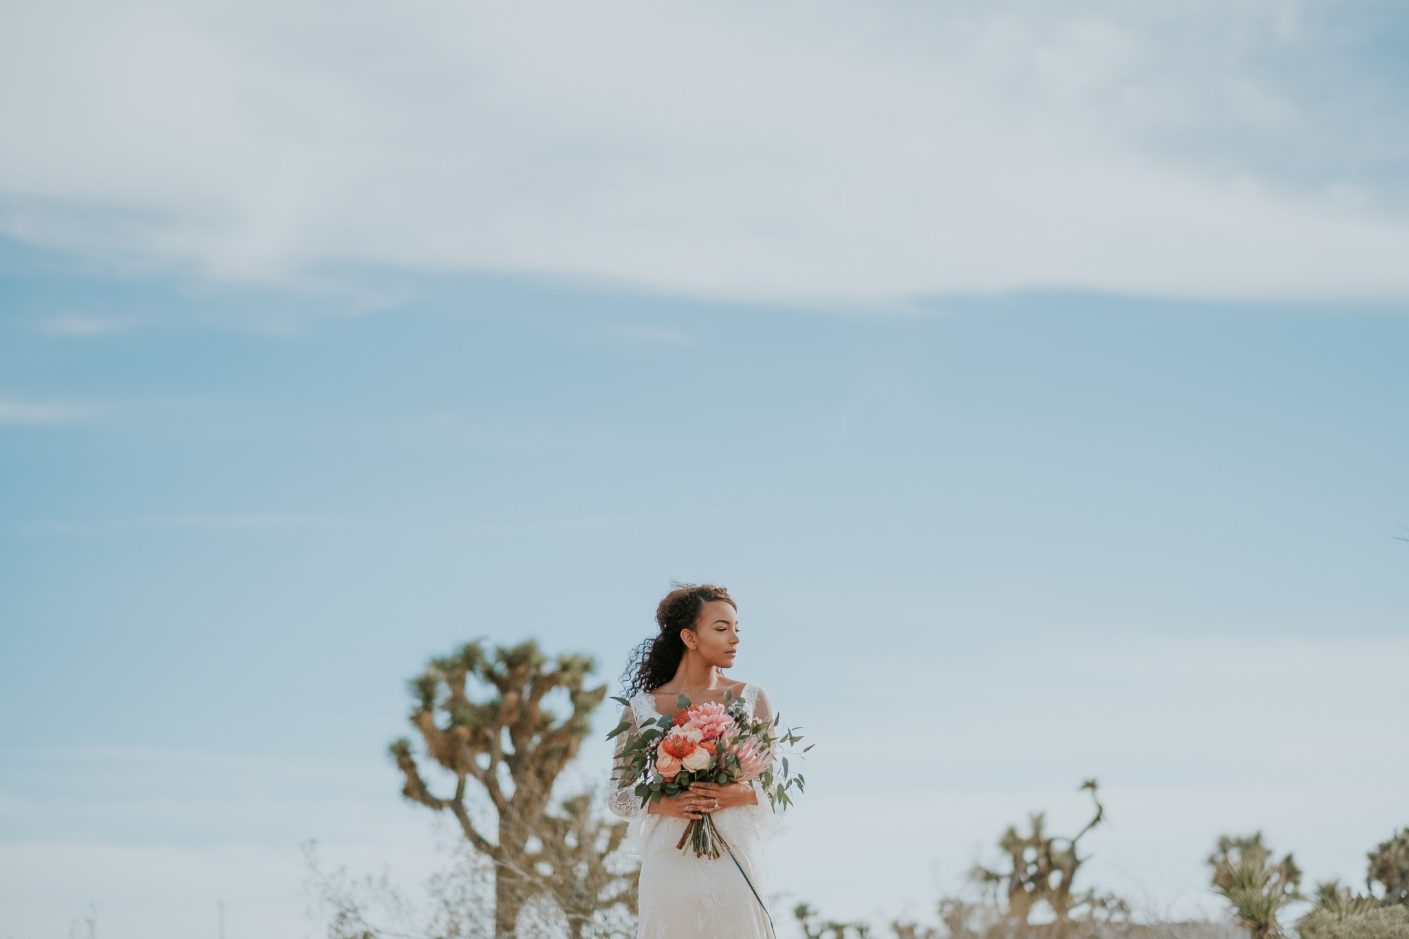
Cynthia Lau makeup & hair artistry
@BEAUTYBYBONBON

Slide 2
INTRODUCTION
My name is Cynthia Lau and I am 34 years old
Owner of Beauty by Bon Bon
Makeup & Hair Artistry
My team of freelancers and I specialize in bridal and special events makeup and hair
occasionally do editorial and photo shoots
Instagram: @BEAUTYBYBONBON

Slide 3
MY WORK HAS BEEN SEEN ON:

Slide 4
My childhood
I was born & raised in Los Angeles, CA

Slide 5
My family

Slide 6
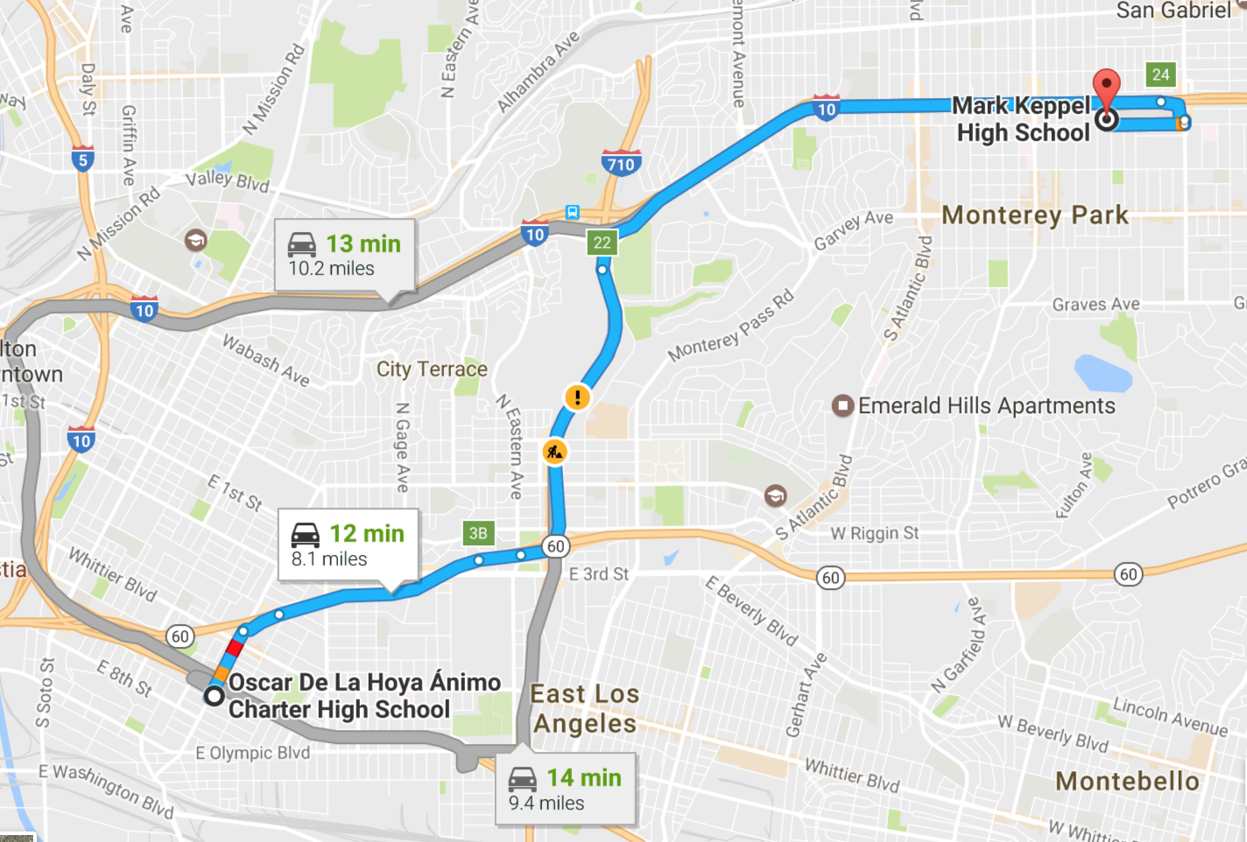
MY HIGH SCHOOL
I attended Mark Keppel High School in Alhambra, CA

Slide 7
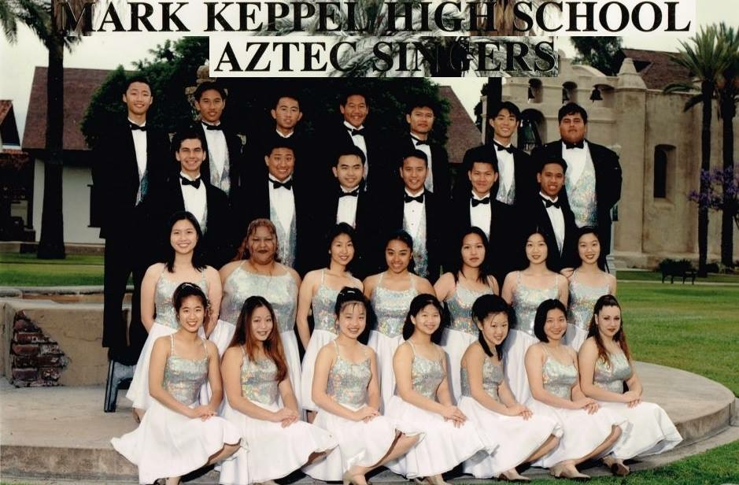
High School
As a HS student I was insecure, a people-pleaser.
Here is a picture of me in HS

Slide 8
My Career Path
1st JOB – worked retail at the mall
18 years old worked for a start up marketing company for 10 years
Almost 5 years in Corporate America at a creative staffing agency.
Now I am a full time business owner of my own company
Notes:
You may use this chart to describe your journey to the current career

Slide 9
This is My Company

Slide 10
My Career
Challenges I have had to overcome throughout my career are:
Believing that I was worth it
That success can happen to me

Slide 11
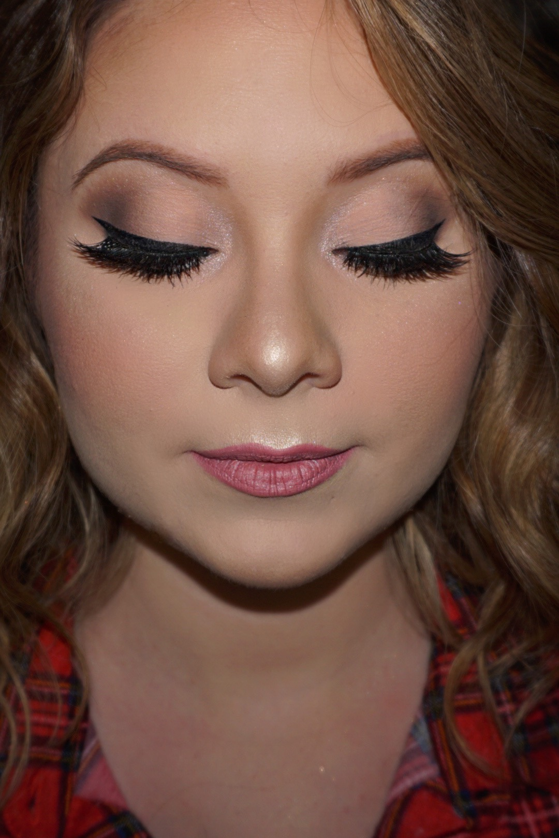
Samples of my work

Slide 12
Samples of my work

Slide 13
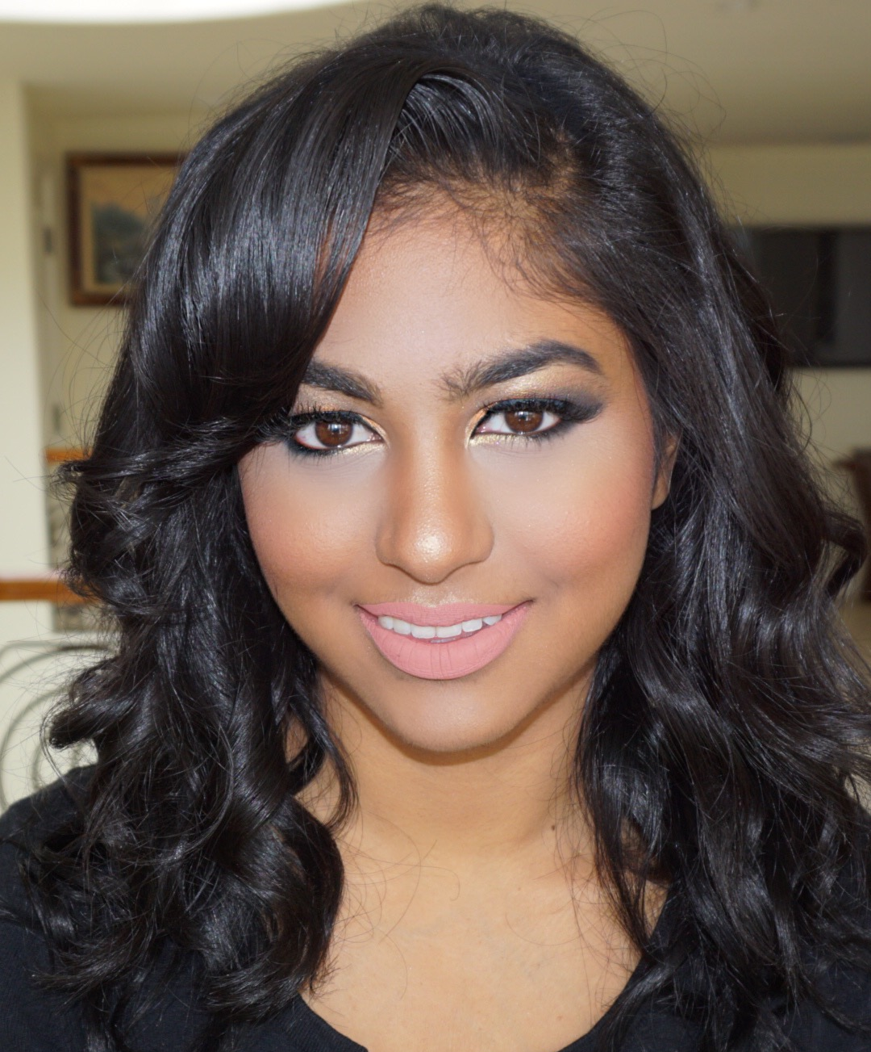
Samples of my work

Slide 14
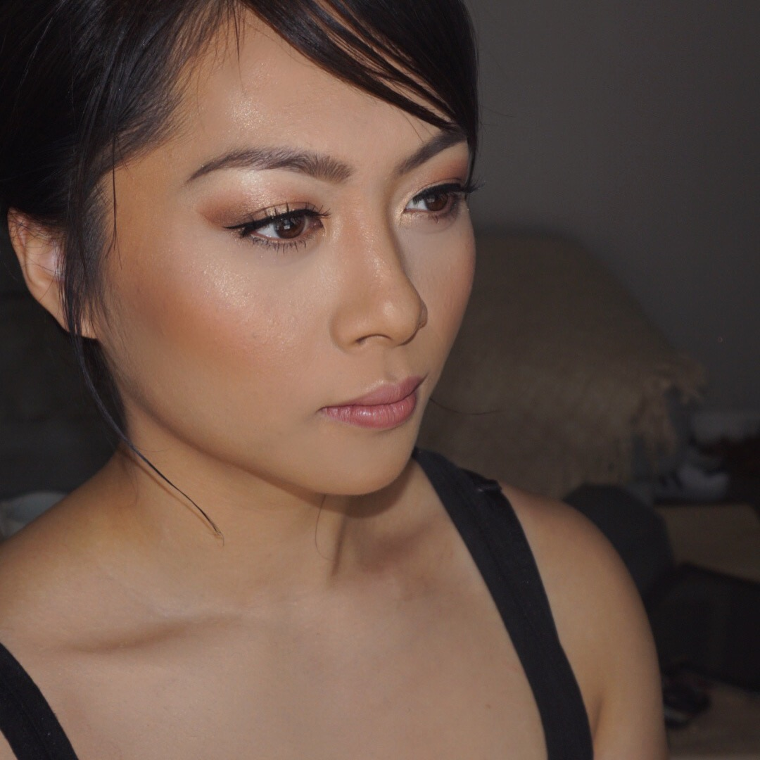
Samples of my work

Slide 15
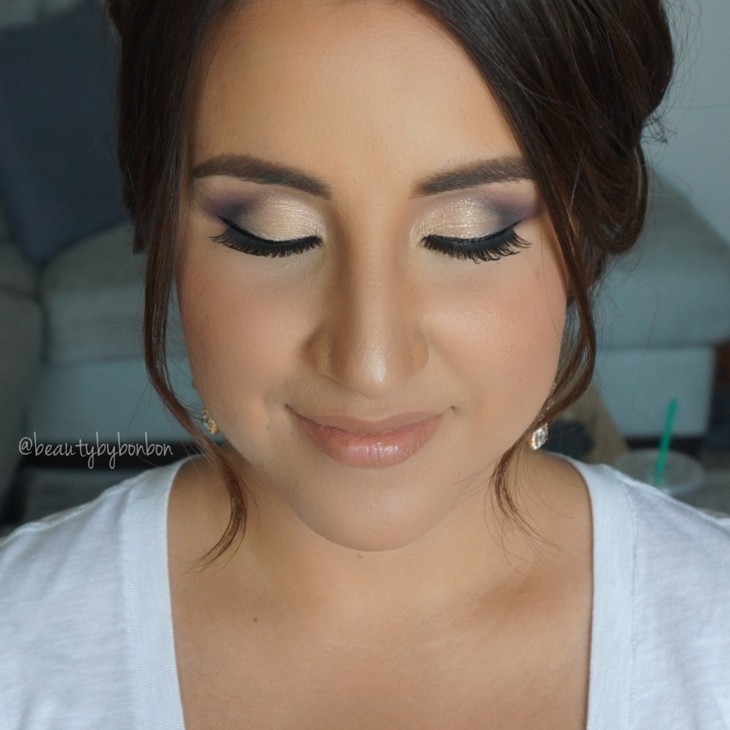
Samples of my work

Slide 16
Samples of my work

Slide 17
Samples of my work

Slide 18
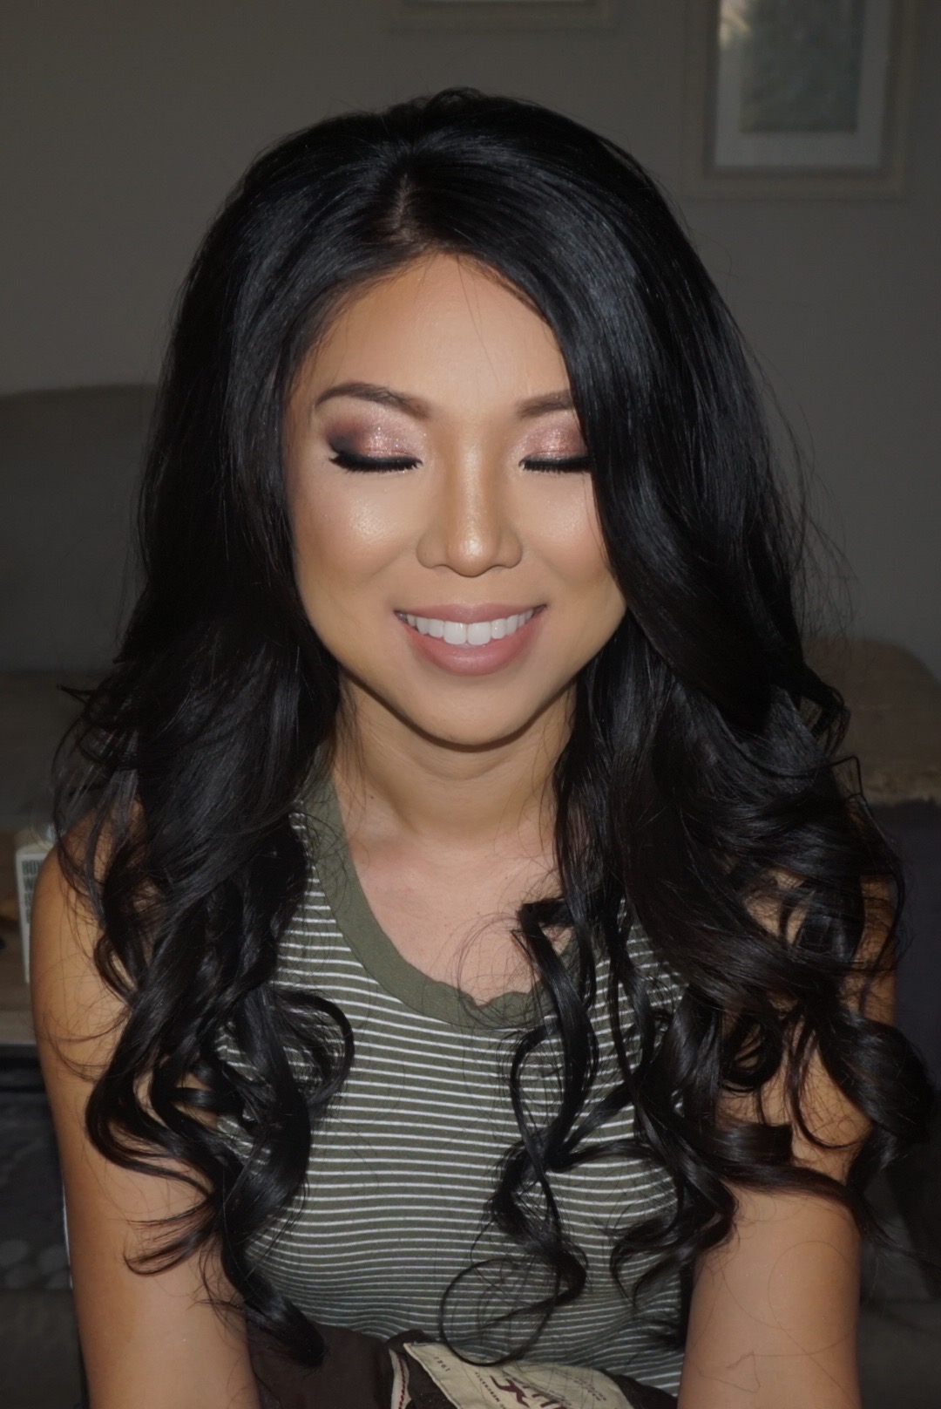
Samples of my work

Slide 19
Samples of my work

Slide 20
Samples of my work

Slide 21
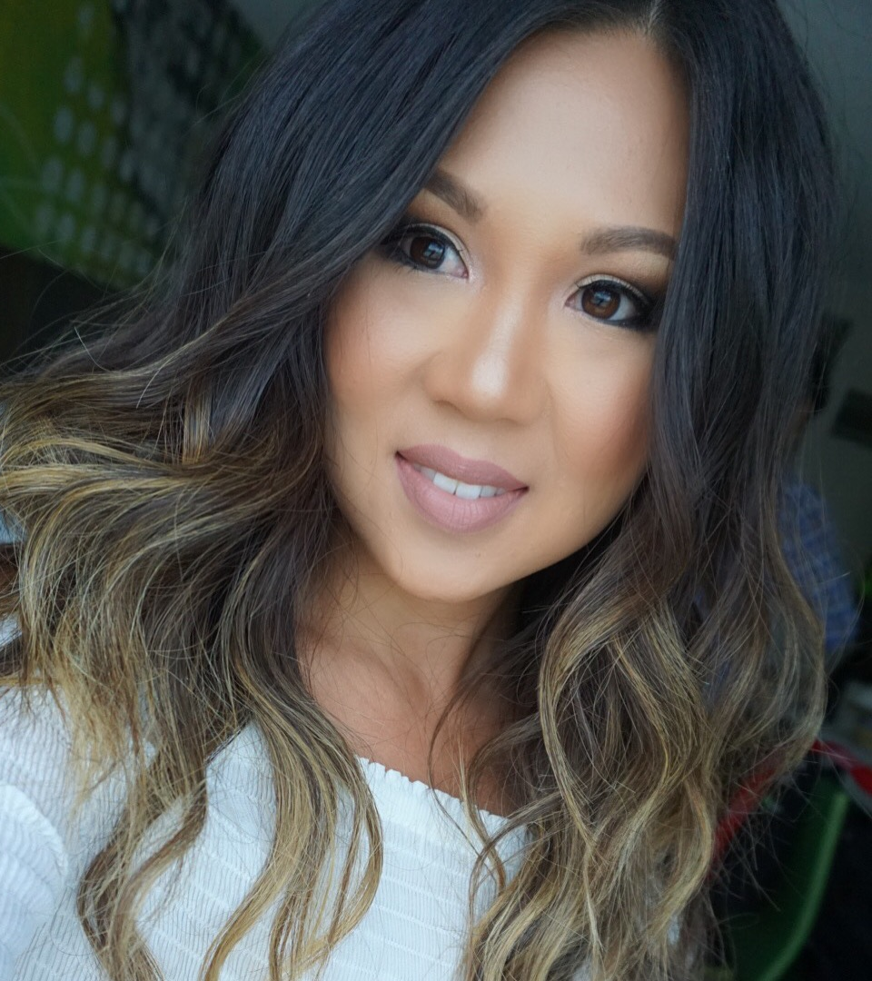
Samples of my work

Slide 22
Do it all over again?
If I could talk to my high school self, what would I say?
Don’t worry about what others say
People will judge you no matter what
Be kind to everyone
Network
Trust yourself
EVERYTHING IS GOING TO BE OK

Slide 23
QUESTION AND ANSWER

Slide 24
Thank you!!!
FOLLOW ME
@BEAUTYBYBONBON
EMAIL ADDRESS:
BEAUTYBYBONBON@GMAIL.COM

