Slide 1
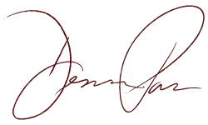
Desirée Patno
Woman Business Owner. Entrepreneur. National Speaker. Expert.

Slide 2
Backstory
Born and raised in California
Had all brothers and was a tomboy
Helped with renovations and remodeling of mother’s estate, a “mini- Hearst Castle”
No gender disparity in the family- Father cooked and did housework, while I did the yard work and manual labor around the house
Only girl in an all-male water polo league
Graduated from Moorpark College and attended Arizona State University
Notes:
Basic info needed on where you grew up, your childhood, family, school. We can just add a few pictures here if you want to just discuss this quickly.

Slide 3
Business & Career
CEO & President of the National Association of Women in Real Estate Businesses (NAWRB) and Desirée Patno Enterprises, Inc. (DPE)
Editor of NAWRB Magazine
Vice Chairwoman of NAWRB’s Diversity & Inclusion Leadership Council
Member of the Women Impacting Public Policy (WIPP) Leadership Advisory Council
Member of the Enterprising Women Advisory Board

Slide 4
Awards
Coldwell Banker Top 5 Listings Sold Award
Coldwell Banker Top 10 Closed Dollars Earned Award
Coldwell Banker Top 10 Gross Commission Income Award
Coldwell Banker Top 10 Closed Revenue Units Award
Coldwell Banker Top 10 Closed Outgoing Referrals Award
Enterprising Women of the Year Award
Small Business Administration’s (SBA) 2016 Women in Business Champion of the Year
HousingWire Women of Influence 2012, 2016

Slide 5
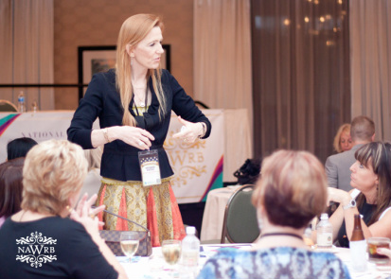

Day in the Life
Likes: Being able to make a difference for small businesses, women and future generations. Collaborating with other strong, like-minded women.
Challenges: Dealing with a scaling of resources.
Skills: Being a good listener, thinking on my feet, taking risks, being creative and having thick skin.
Notes:
What do you like about your profession?
What are some challenges of your profession?
What are some skills you have that have helped you excel?

Slide 6
DPE is a certified women-owned business specializing in the housing economy. It offers a complete range of real estate services with specialties including REO disposition, short sales, and homeownership preservation programs such as loan modifications and refinances.

Slide 7

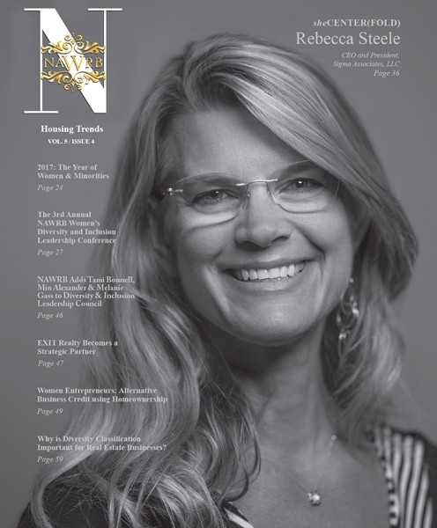

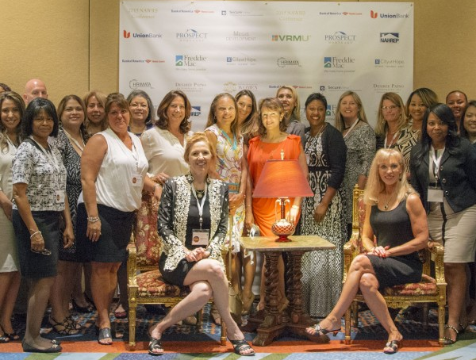
NAWRB is a leading voice for women in the housing ecosystem. We are dedicated to providing women the tools and opportunities for economic growth and expansion, while advocating and promoting

Slide 8



NAWRB Projects
The NAWRB Diversity and Inclusion Leadership Council (NDILC) is committed to raising the number of C-suite women, growing women’s employment at all levels and increasing diverse spend in the housing ecosystem.
The Women’s Homeownership Initiative (WHI) focuses on increasing women’s homeownership and raising awareness of women’s poverty levels.
The NAWRB Women’s Global Resource Center (NWGRC) provides a free women’s depository to connect vendors and clients at all employment levels and increase diverse spend.

Slide 9
Women are attaining college degrees at higher rates, which is allowing them to access higher wages
Among women ages 25 to 64 who are in the labor force, the proportion with a college degree more than tripled from 1970 to 2014, increasing from 11.2 percent to 40.0 percent
Women’s earnings as a proportion of men’s earnings also have grown over time; in 1979, women working full time earned 62 percent of what men earned; in 2014, women’s earnings were 83 percent of men’s
In 2014, female full-time wage and salary workers ages 25 and older with only a high school diploma had a median weekly earnings of $578; women with a bachelor’s degree or higher had a median weekly income of $1,049

Slide 10
Women are more independent
Married women leave their family homes to live with their husbands, but now women are delaying marriage. Only 30 percent of young women were likely to be married in 2014 compared to 62 percent in 1940
Census Bureau data proves that now, on average, women enter marriage at age 27, compared to 21.5 years in 1940

Slide 11
Women professionals & entrepreneurs are on the rise
Between 1970 and 2010, women civil engineers increased by 977 percent; pharmacists by 434 percent; physicians and surgeons by 334 percent; and lawyers and judges by 681 percent
11.3 million businesses in the United States have been started by women entrepreneurs
Women-owned businesses constitute more than one-third of registered small businesses worldwide

Slide 12
Things I wish I knew in high school
It is never too late to be who you want to be.
You can achieve anything if you work for it.
It’s okay to not know what you want to do. You’ll figure it out. The important thing is that you keep trying new things and moving forward.
Be confident in who you are. You have something to offer that no one else does.
Do not compare yourself to others. Everyone is on their own unique path.
Never stop learning! “Everyone you will ever meet knows something you don’t.” - Bill Nye
Notes:
This is just a list I made up for a template. You can edit this and add your own advice.

