Slide 1
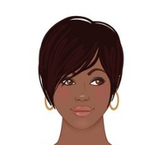
HELLO
HOLA
CIAO
Brigette Kidd
@searchkidd
BONJOUR
NAMASTE

Slide 2
About Me
South LA
TSB Safety App

Slide 3
What I Do
Operate a small business Apted, LLC
Seek new business
Teach at Community College nights
Contract with students
Volunteer – panels, workshops, classes
Bids on contracts

Slide 4
Why? Wanted solve a problem

Slide 5
Now You!
Name
Favorite subject
What’s right with your community

Slide 6
Think about a problem that needs solving
First hand experience, community, city or at school

Slide 7
Get into groups 5-6 (take 15 minutes) Write out the answers to the following
From the problems you thought of decide one to solve
What is the problem
Who has the problem
Why is it a problem
How will you solve the problem
What’s the story behind the problem

Slide 8
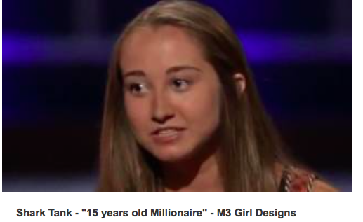
Shark Tank Pitch

Slide 9
Prepare to Pitch (2 minutes)
Decides whose doing what (everyone should speak)
What’s the story behind your problem
Why have you solved the problem
How have you solved the problem
Who will benefit from the solution
What do you want the people listening to do

Slide 10
Pitch Time!
Group 1
Group 2
Group 3
Group 4
Group 5

