Slide 2
What you don’t know About
Employment Law
(Can Hurt You)

Slide 3
My Family
How I got here? Iran, India, United States,
Schooling: David Starr Jordan, UCLA, Americorps, SCALE, Ziba Beauty, Law Office

Slide 4
How Did I Get Here?
High School: NCTE/Student Congress/ Debate Club
UCLA
Washington DC (Political Intern)
Americorps (Lexington, Kentucky) Be in Service
My Contribution

Slide 5
What is it that I Do?
Business Law (Ziba Beauty)
Employment Law (Private)
Family Law
Personal Injury
Coming Soon Immigration

Slide 6
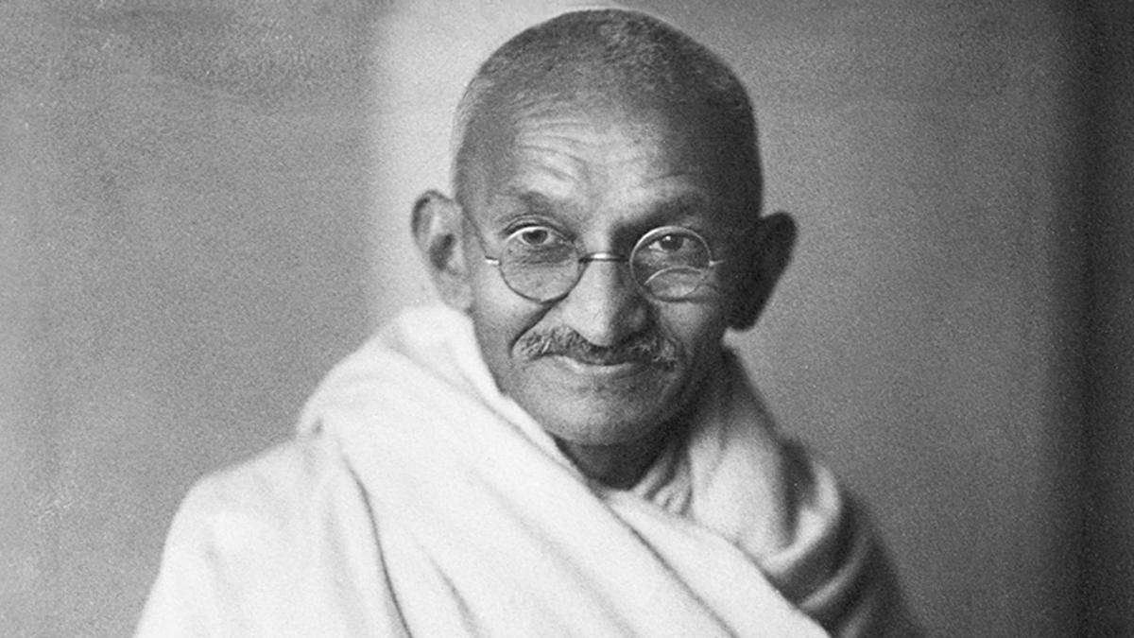
My Why?
“The best way to find yourself is to loose yourself in the service of others.” - Gandhi

Slide 8
Can You Intern for Free?
The training, even though it includes actual operation of the employer’s facilities, is similar to that which would be given in a vocational school
The training is for the benefit of the trainees or students
The trainees or students do not displace regular employees, but work under close observation
The employer derives no immediate advantage from the activities of trainees or students, and, on occasion, the employer’s operations may be actually impeded
The trainees or students are not necessarily entitled to a job at the conclusion of the training period
The employer and the trainees or students understand that the trainees or students are not entitled to wages for the time spent in training.

Slide 9
Job Interview: What They Can’t Ask You
How old are you?
How long have you lived in the U.S
Do you smoke, or drink?
Where do you live?
Where do you go to Church?

Slide 10
Overtime Pay
Overtime breaks down into two categories for nonexempt employees. The 1.5 times rate comes when the employee does one of the following:
Works more than 40 hours in one workweek
Works beyond 8 hours on a single workday, up to 12 hours
8 hours worked on the seventh work day in a row in a single workweek
The double pay rate is valid when a nonexempt employee does one of the following:
Works beyond 12 hours in a single workday
Works beyond 8 hours on the seventh work day in a row in a single workweek

Slide 11
Meal Breaks
Employees are guaranteed a meal period of a minimum of 30 minutes every time they work more than five hours. The meal time is off-duty and unpaid and should be taken before the employee reaches six hours on a shift.
California employees are also entitled to a second meal break of at least 30 minutes if they work in excess of 10 hours in a single workday. The second break must be taken before the employee's 11th hour of work begins. On-duty meals are only allowed in certain situations.

Slide 12
Rest Breaks
Nonexempt employees are also allowed an uninterrupted rest period if they work at least 3.5 hours in a day.
For every four hours worked, they may take a 10-minute rest period. Even if they work a "major fraction" of four hours, they're entitled to the break. That usually constitutes any time worked over two hours.
To encourage compliance with this law, employers are required to pay the employee an extra hour of regular pay every time the employee isn't allowed to take an appropriate meal period.
The employee gets up to three years to claim this additional pay. One hour of pay should also be given for any missed or interrupted rest break and should be included in the employee's next pay period.

Slide 13
You are Fired or I Quit
An employee who is fired (or laid off) is entitled to a final paycheck immediately
If an employee quits without giving advance notice, the employer must provide the final paycheck within 72 hours.
If an employee quits and gives at least 72 hours' notice, the employee is entitled to the final paycheck immediately, meaning on his or his last day.

Slide 14
Waiting Time Penalties
Waiting time penalties are imposed on employers who fail to pay final wage when they are due.
The penalty is the employee's average daily wage for each day the employer is late, up to a maximum of 30 days.
For example, an employer that waits two weeks before providing a fired employee's final paycheck would be liable for 14 days of wages as a waiting time penalty.

Slide 15
Contact Me
SANJAY SABARWAL
ATTORNEY AT LAW
17832 Pioneer Blvd.
Artesia, CA 90701
T. 562.250.4471
F. 562.684.4107
sanjay@sabarwallaw.com

