Slide 1
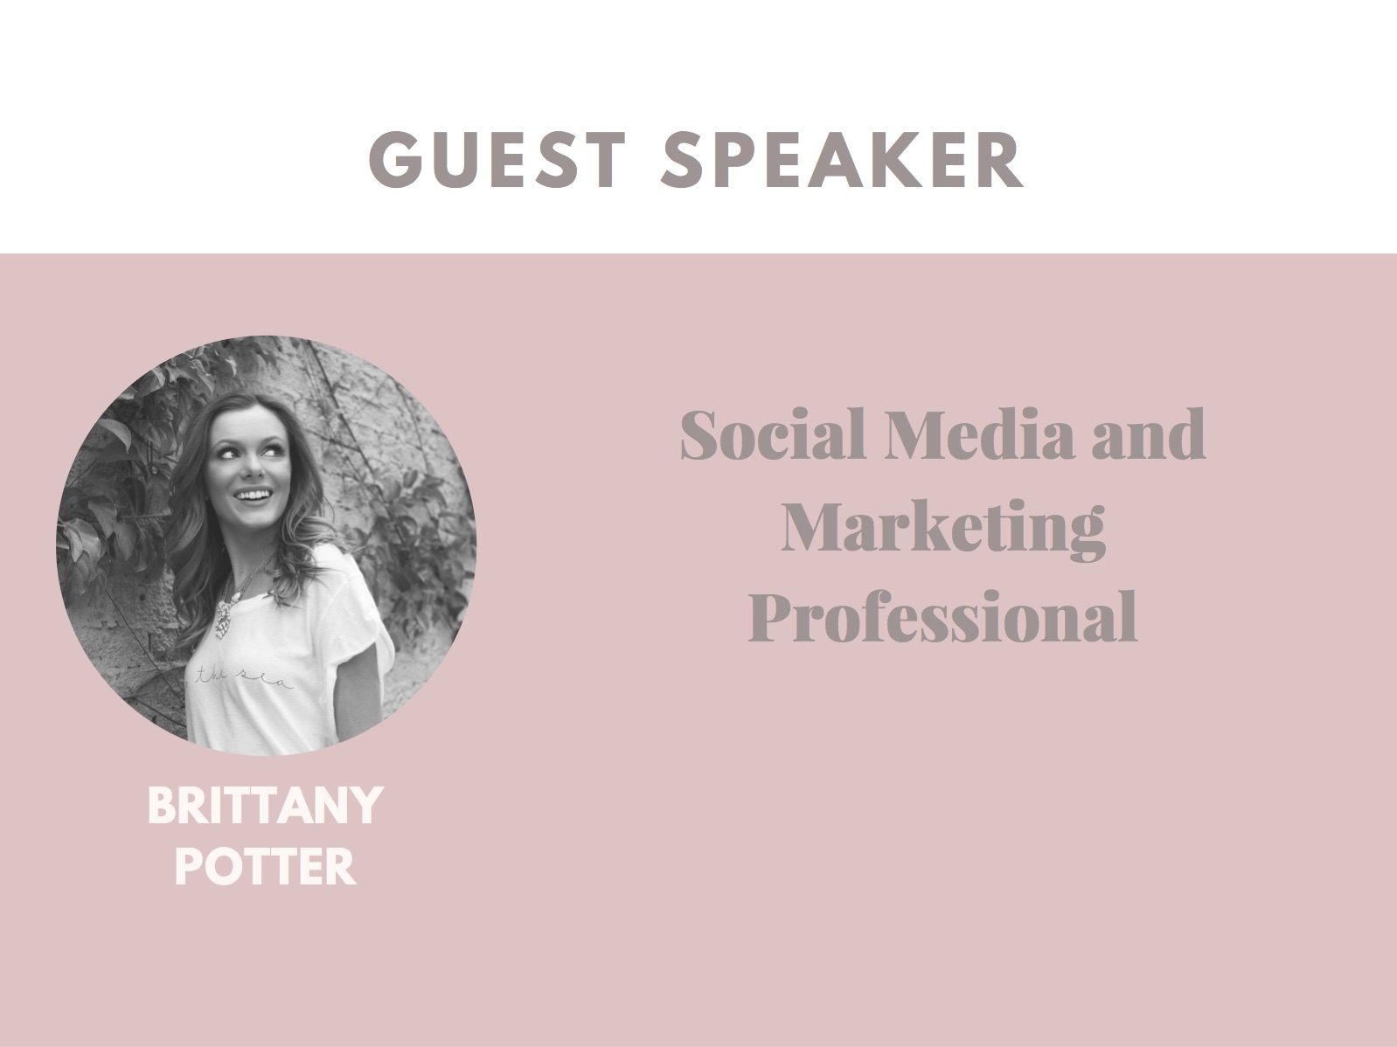

Slide 2
ABOUT ME: The Fun Facts
Moved back to LA from NYC in November
Graduated from Oregon State University in 2015 and I’ve been working full-time in Marketing ever since
3 Favorite Snacks: Goldfish, Olives, Cheese
Currently watching: Mr.Robot, I’m obsessed
Currently listening to: Ed Sheeran’s new album, ‘Divide’
Next place I’m traveling: New Orleans
My roommate’s name is also Brittany Nicole

Slide 3
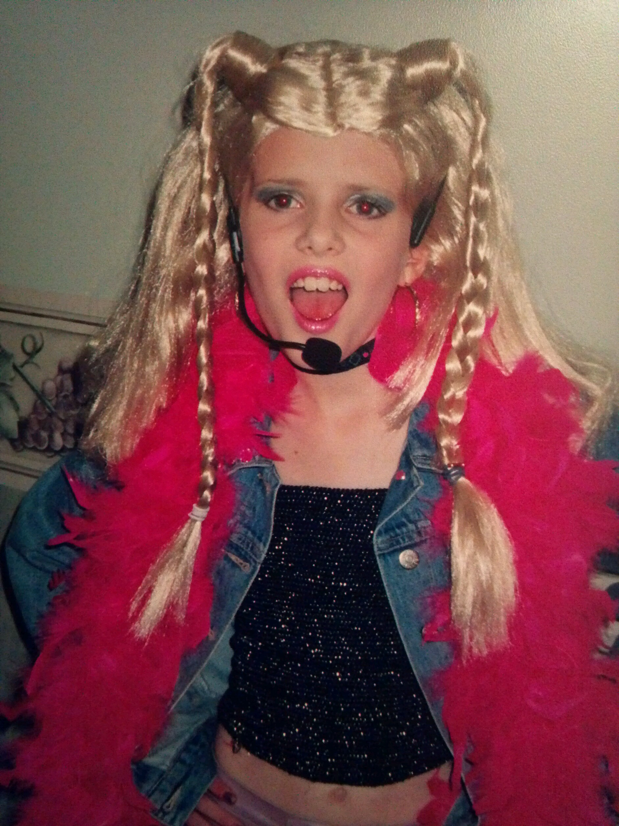
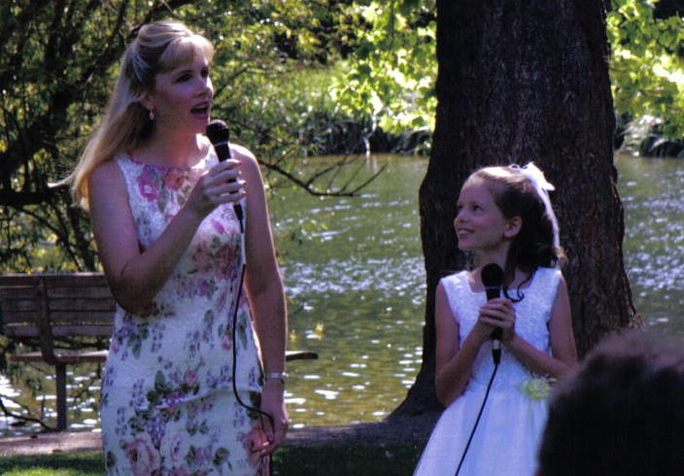
BACKSTORY
Grew up in Portland, OR
Career goals ages 3-12: Become a famous singer

Slide 4
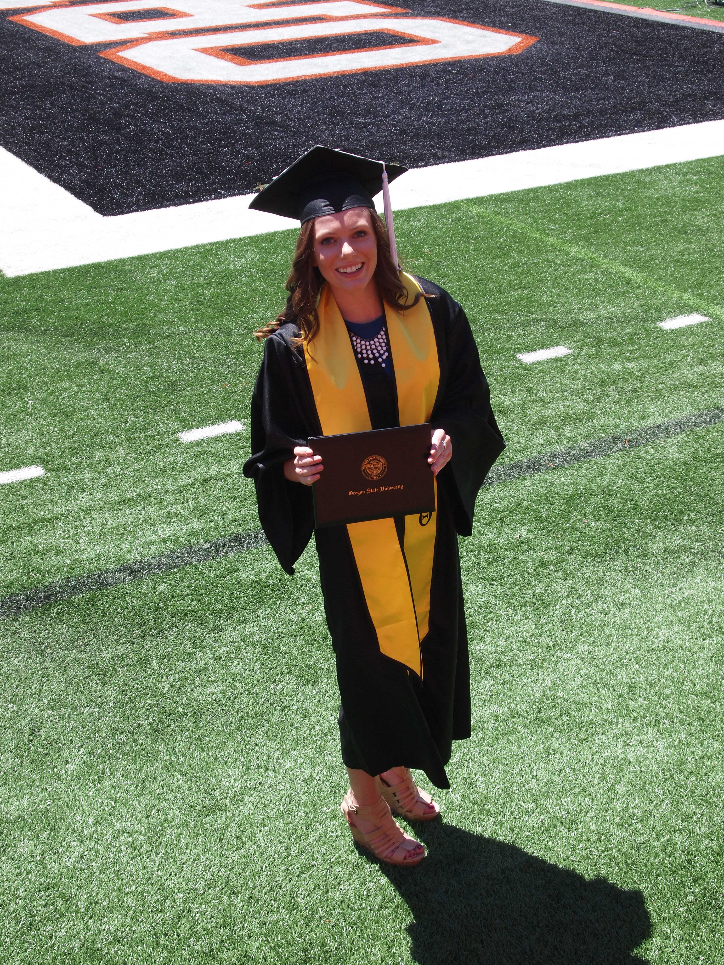
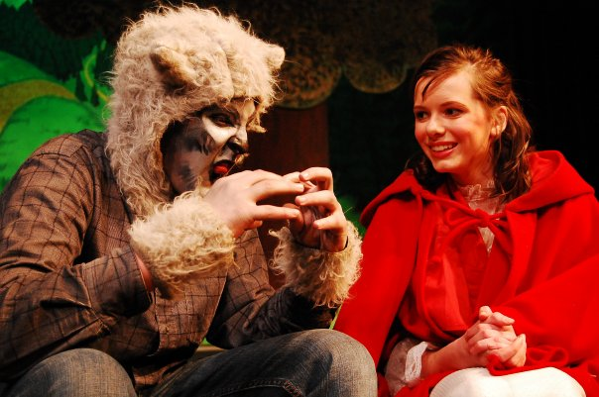
ABOUT ME
Throughout high school and college pursued theatre
Found a love for pop-culture, media, and technology
Majored in Speech Communications at OSU.

Slide 5
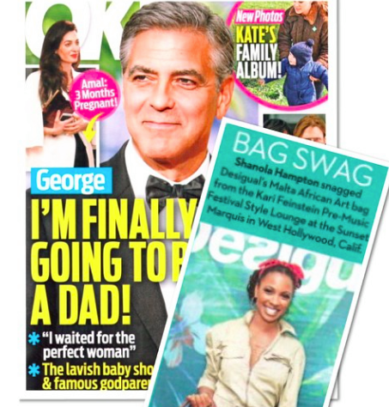
FINDING AN INTERNSHIP
Kari Feinstein Public Relations
Opportunity to work with influencers and celebrities
Product placements and celebrity endorsements
Securing sponsors for gifting suites
Managing multiple social media accounts

Slide 6
SKILLS FROM KFPR
Writing a great email
Using excel
Learning to take whatever’s thrown at you and roll with it
Organizational Skills
Helped me narrow down what I was looking to do after college

Slide 7
SOCIAL MEDIA MARKETING- What is it?
More than Instagramming for a living
People use social platforms for brand discovery
Social media manager determines how a brand is going to be perceived across those channels
Determine brand voice and ethos

Slide 8
ACCOUNT MANAGEMENT
What are the brand’s goals? (Raise awareness, sell a product, increase engagement, etc.)
What are the brand guidelines? Brand colors, font, voice, and personality.
Who is the target audience? Gather audience data to create a customer profile.
Use programs like Hootsuite to manage social accounts and automate postings.
How much content will I need to create? How will I get UGC? Will I repost content from other creators?

Slide 9
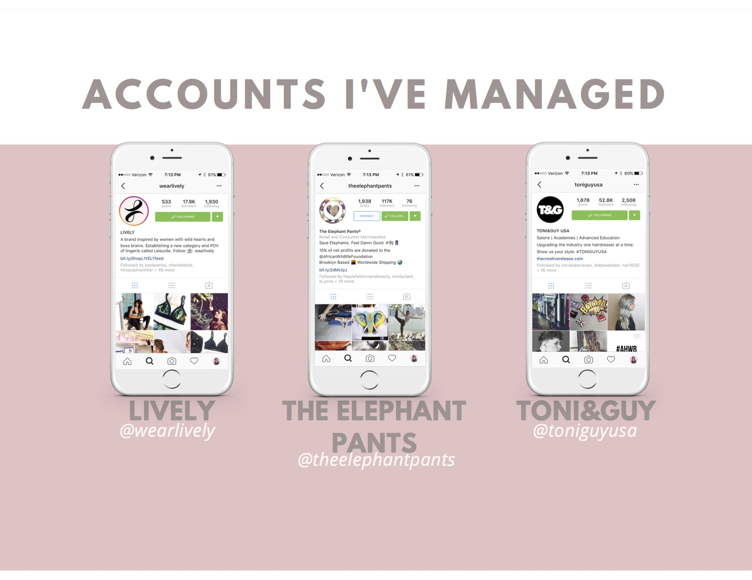

Slide 10
OUTREACH
When reaching out to influencers and media, create an Outreach Tracker with contact information, dates of the last correspondence and notes on whether or not to follow-up.
It’s okay to create an email template when doing mass outreach but the template should be modified to make each email personalized.
Prioritize influencers and media who best fit your brand. Even if they are smaller, you may be more likely to reach your target audience.

Slide 11
RELATIONSHIP MANAGEMENT
Important for brand to maintain relationship with followers. Relationship management in regards to social media has to do with the brand being attentive to followers comments and concerns.

Slide 12
ASSET CREATION/ COPYWRITING
Social Media Manager will often have to work with a creative team to acquire the assets needed for social posts. (ie. photoshoots, graphics from graphic design)
The social media manager must possess great writing skills as they will be responsible for writing copy for blog posts and social media posts.

Slide 13
AFFILIATE MARKETING
Affiliate marketing is when a brand invites people who are passionate about the brand to spread the word, and in return they will receive a profit. Affiliate marketing is essentially a commission program where the Affiliate, often called a “brand ambassador” receives a percentage of the profits from the sales they made.

Slide 14
ENGAGEMENT & REACH
Reach: How many people are you reaching across various social media platforms? How many unique people are seeing your posts?
Engagement: How many people are clicking, liking, commenting, and sharing?
Example: The Elephant Pants

Slide 15
ACTIVITY: Instagram Analysis
Who is the target audience? Who do you think this brand is trying to reach?
What kind of visuals are being used? Do you think they’re effective? Why/why not.
Can you identify posts relating to a specific campaign?
Are there any branded hashtags?
What do you think about the bio?
Is the brand asking followers to engage? (Asking questions, hosting contests, etc.)

Slide 16
ACTIVITY
@eosproducts
@sharpie
@shakeshack
@frank_bod
@WeWork

Slide 17
CONTACT ME!
Email: hibrittanyp@gmail.com
Instagram: @brittanyypotter

