Slide 1
Tara emerson scheibel

Slide 2
FAMILY

Slide 3
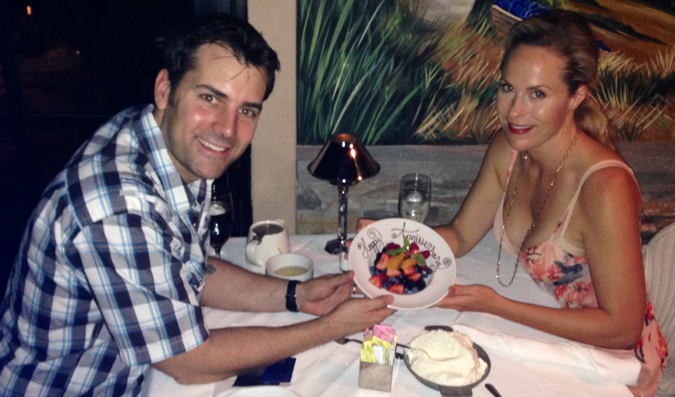

Slide 4
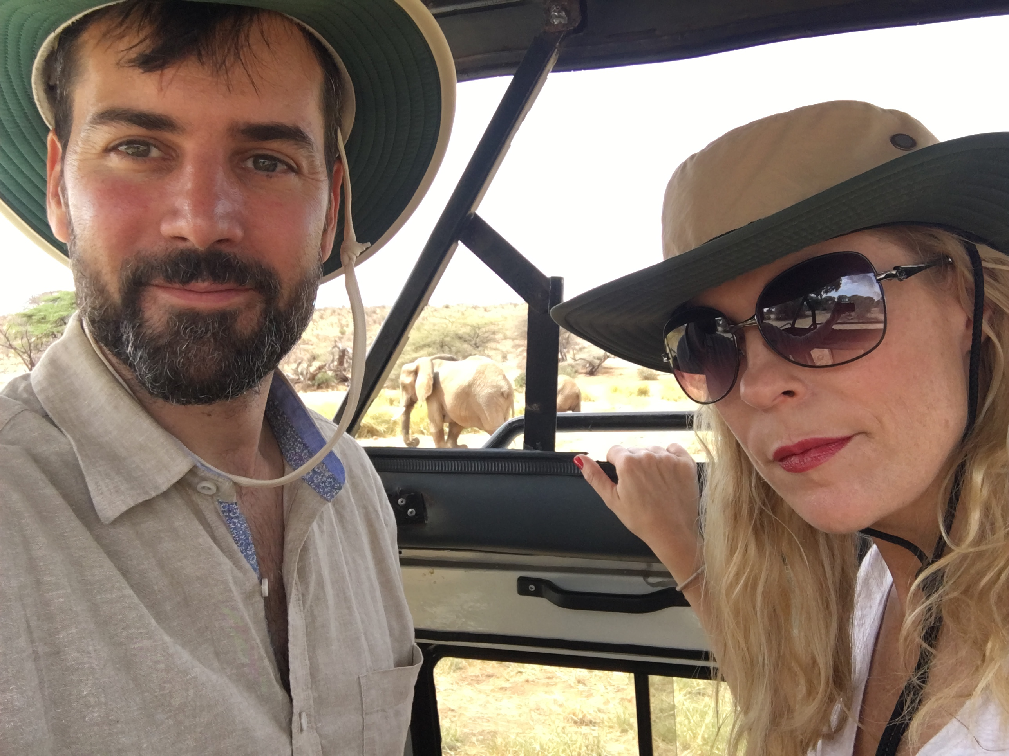
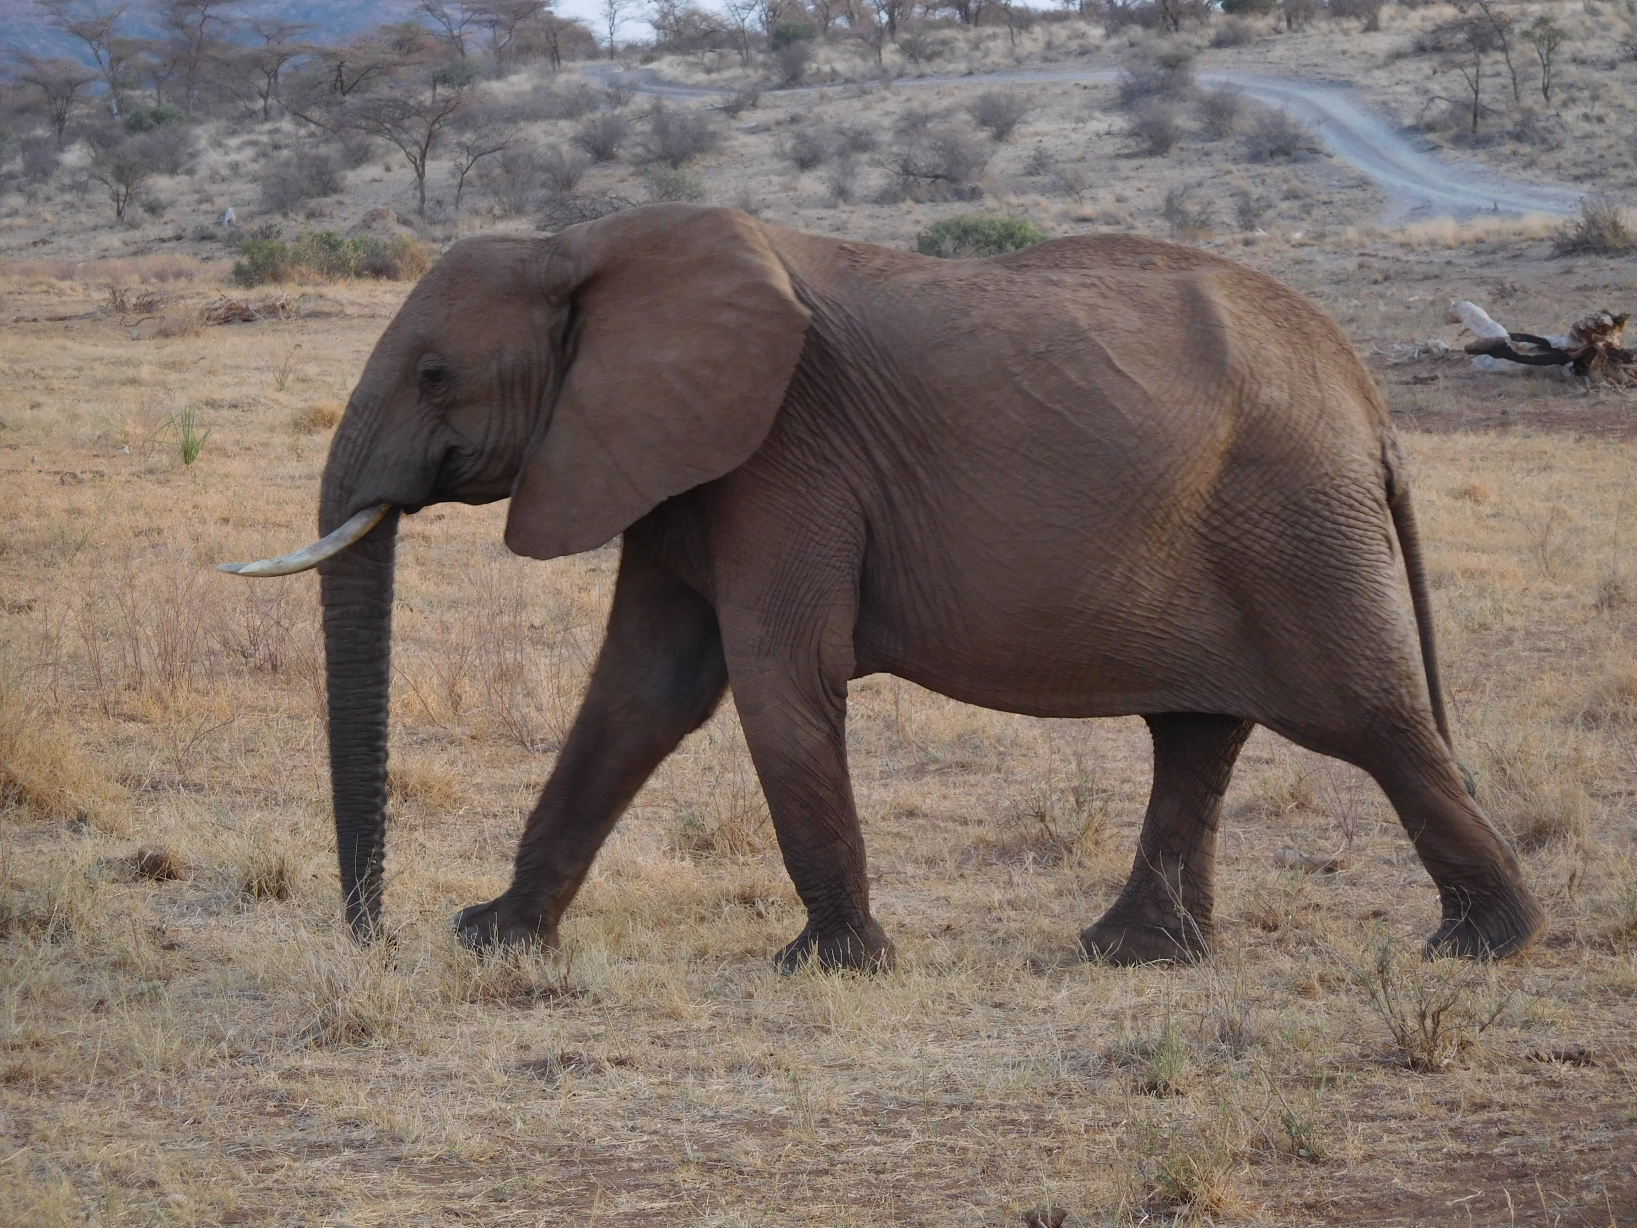

Slide 6
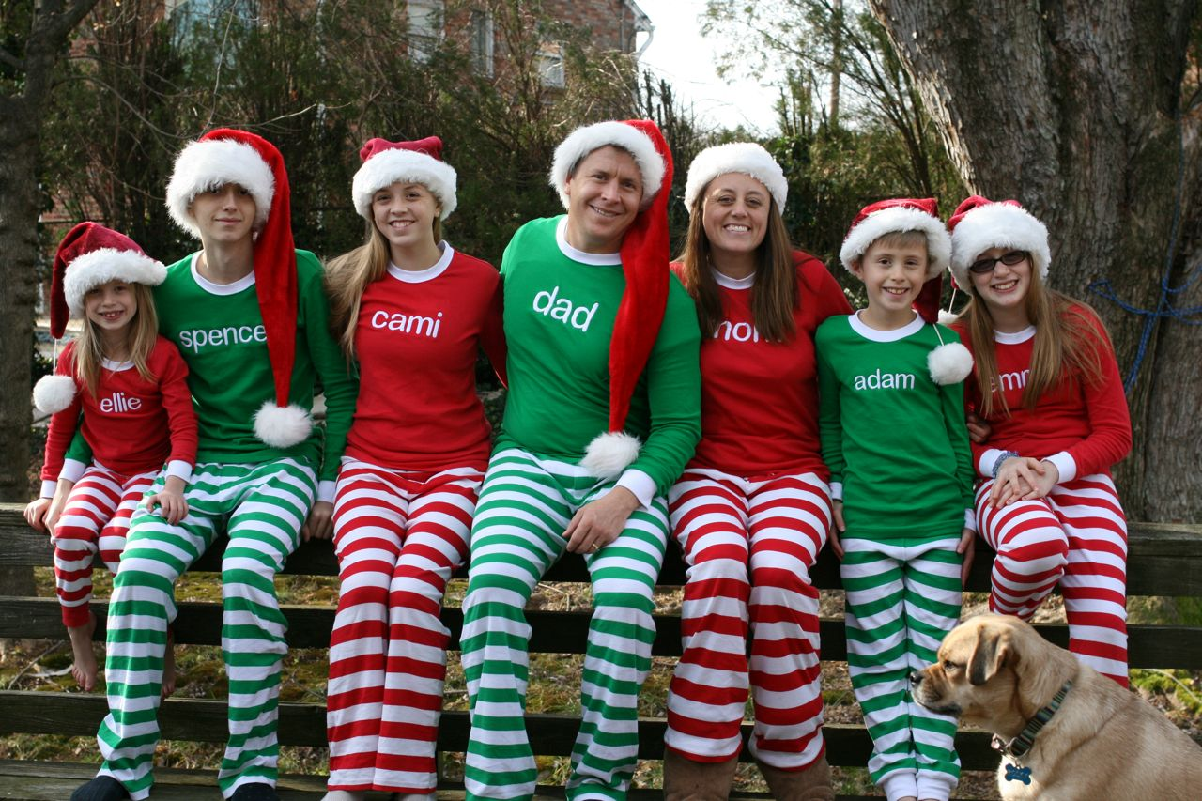

Slide 7
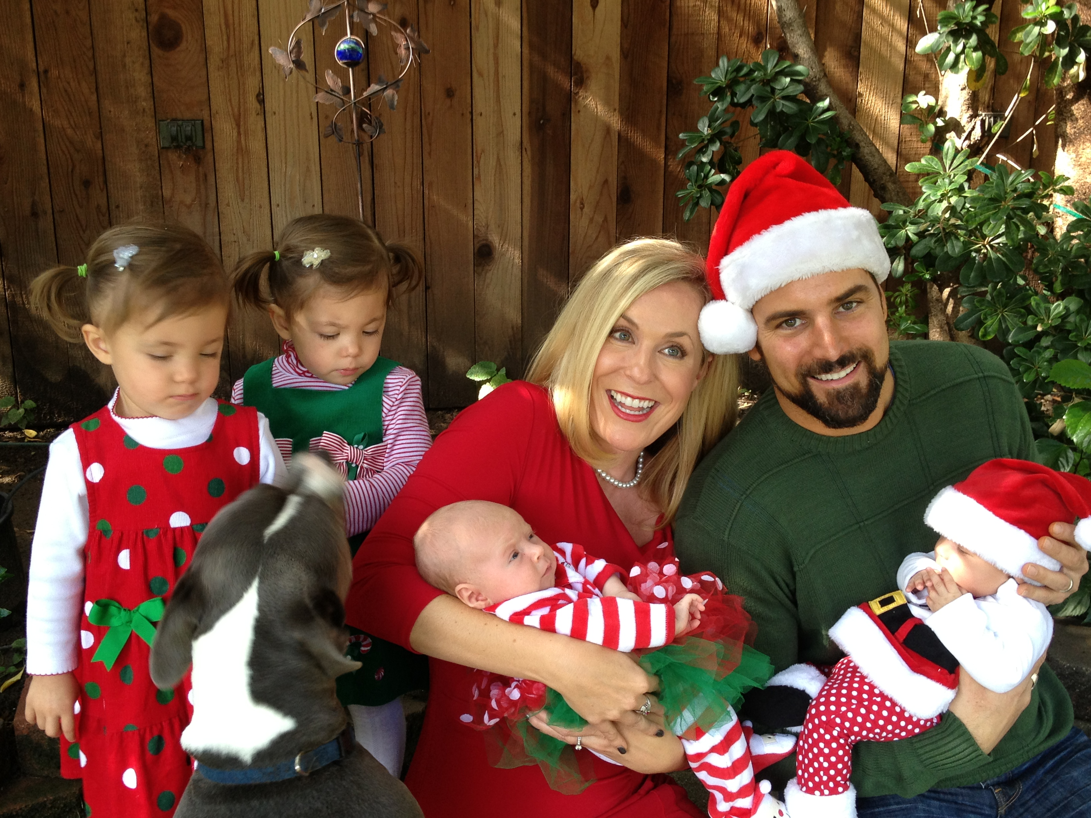

Slide 8
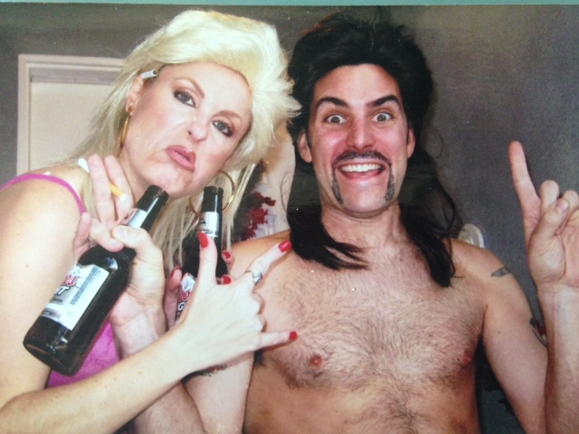

Slide 9
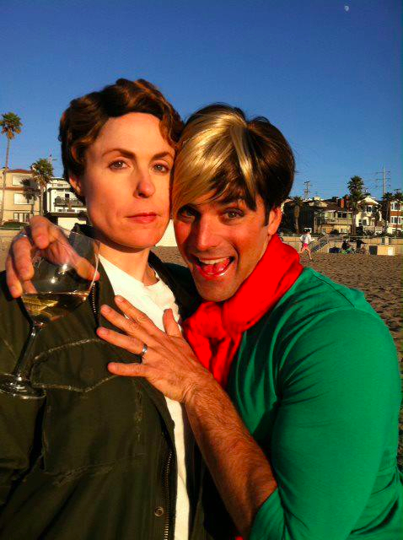

Slide 10
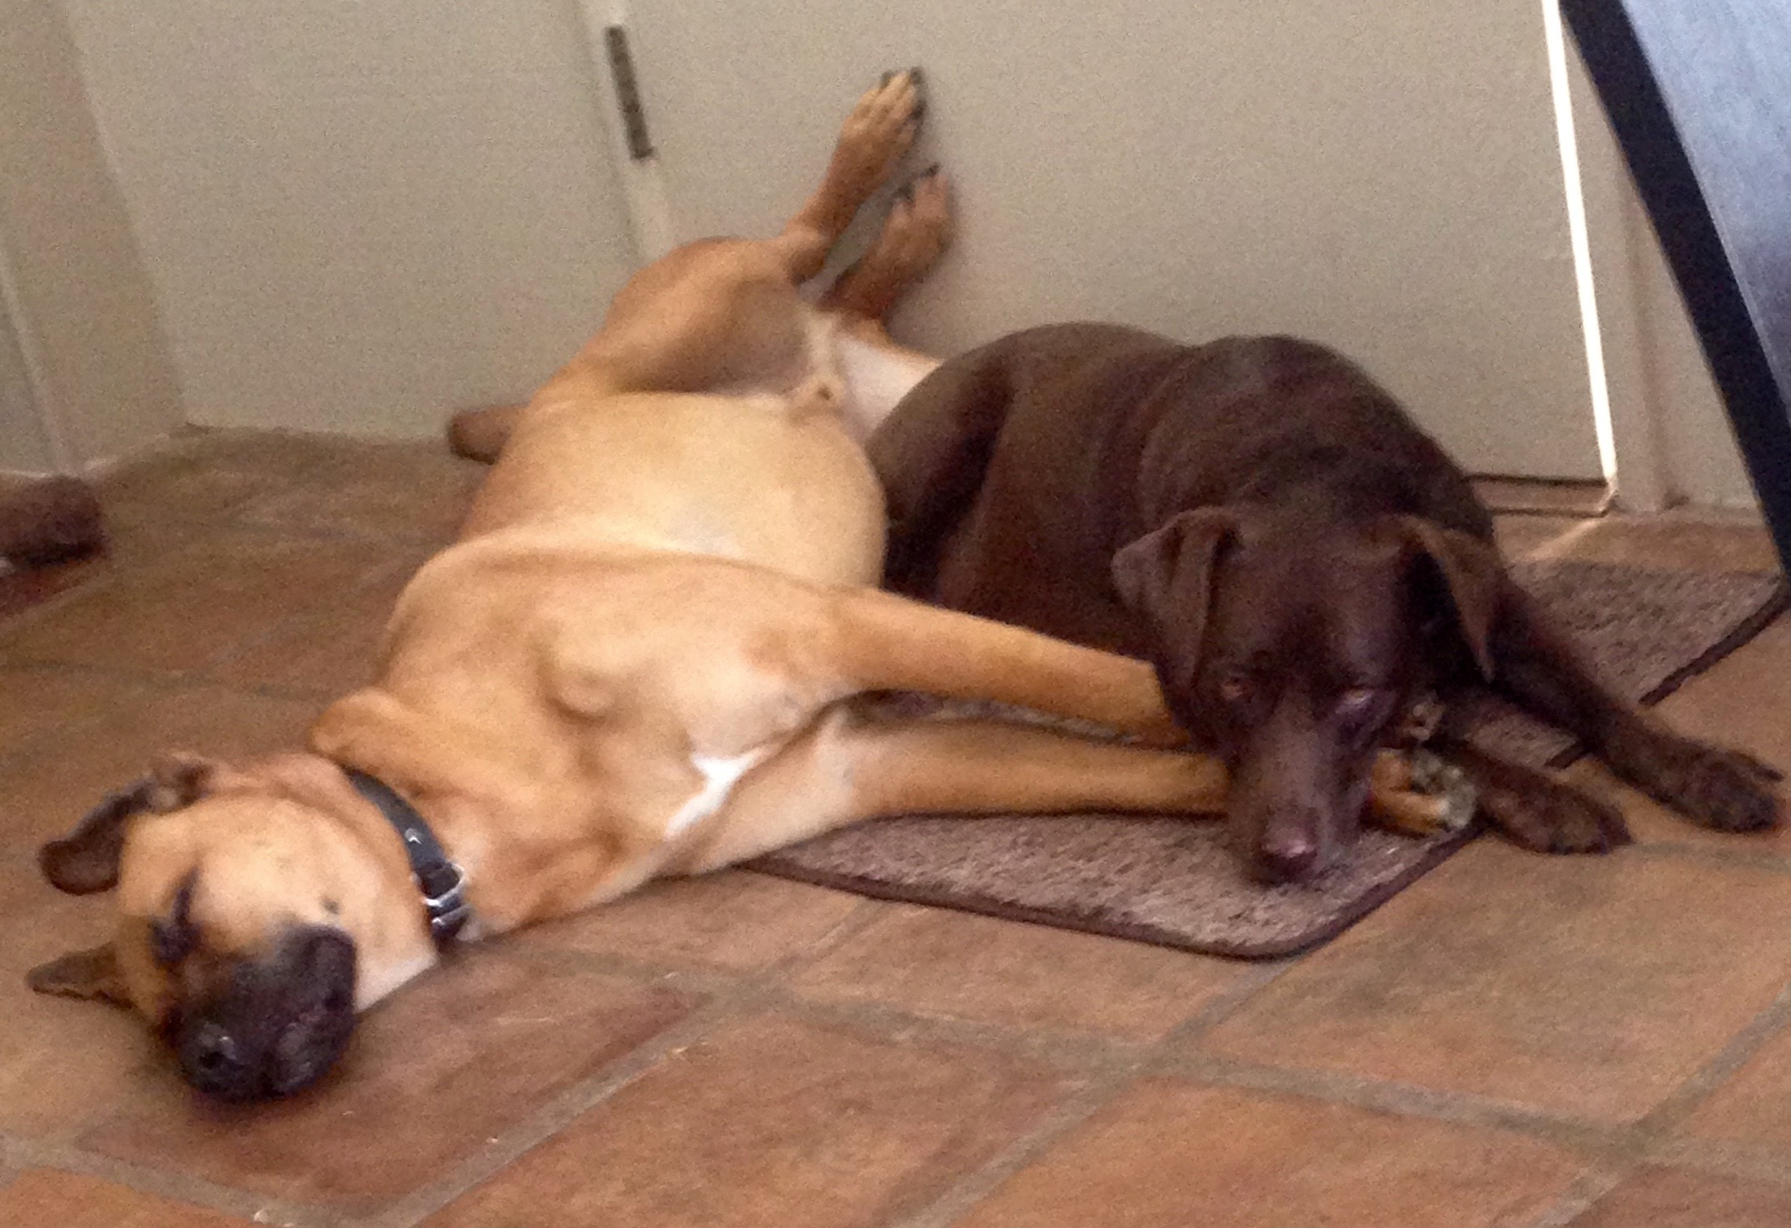

Slide 12
CAREER

Slide 13
Pharmaceutical sales rep
Salix Pharmaceuticals

Slide 14
Actress
ANYONE WHO WILL HIRE ME

Slide 15
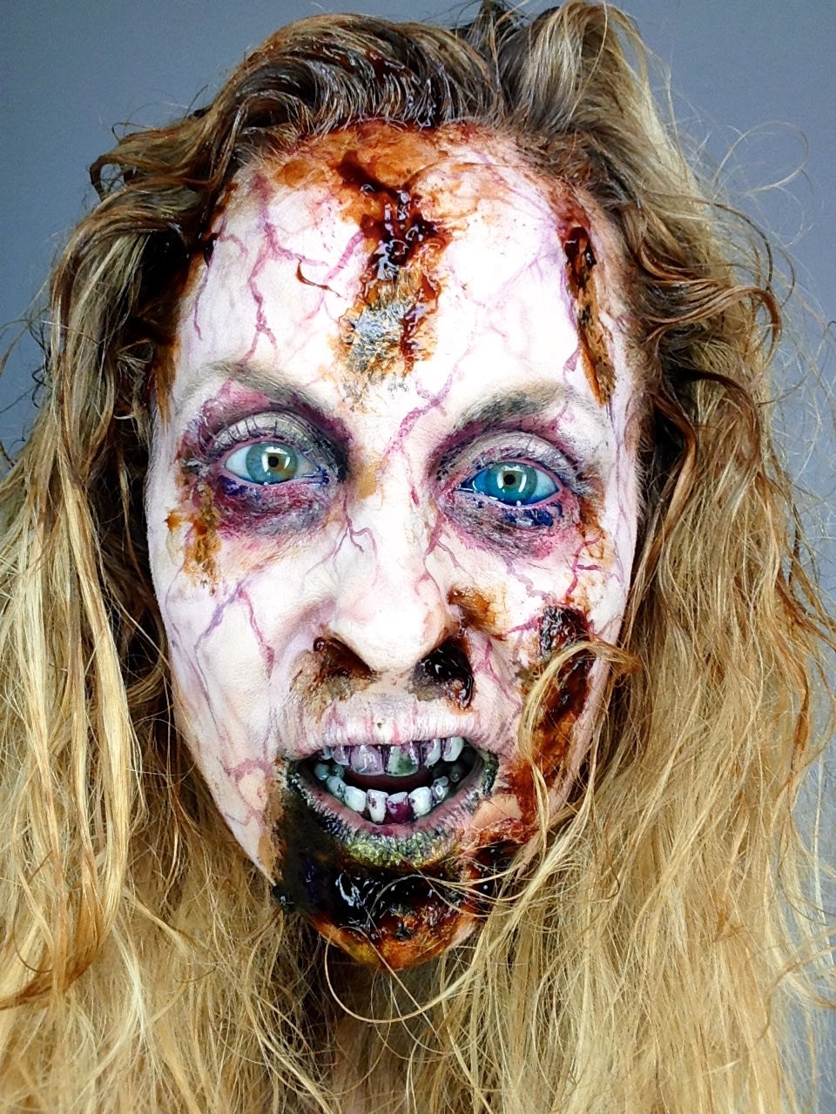
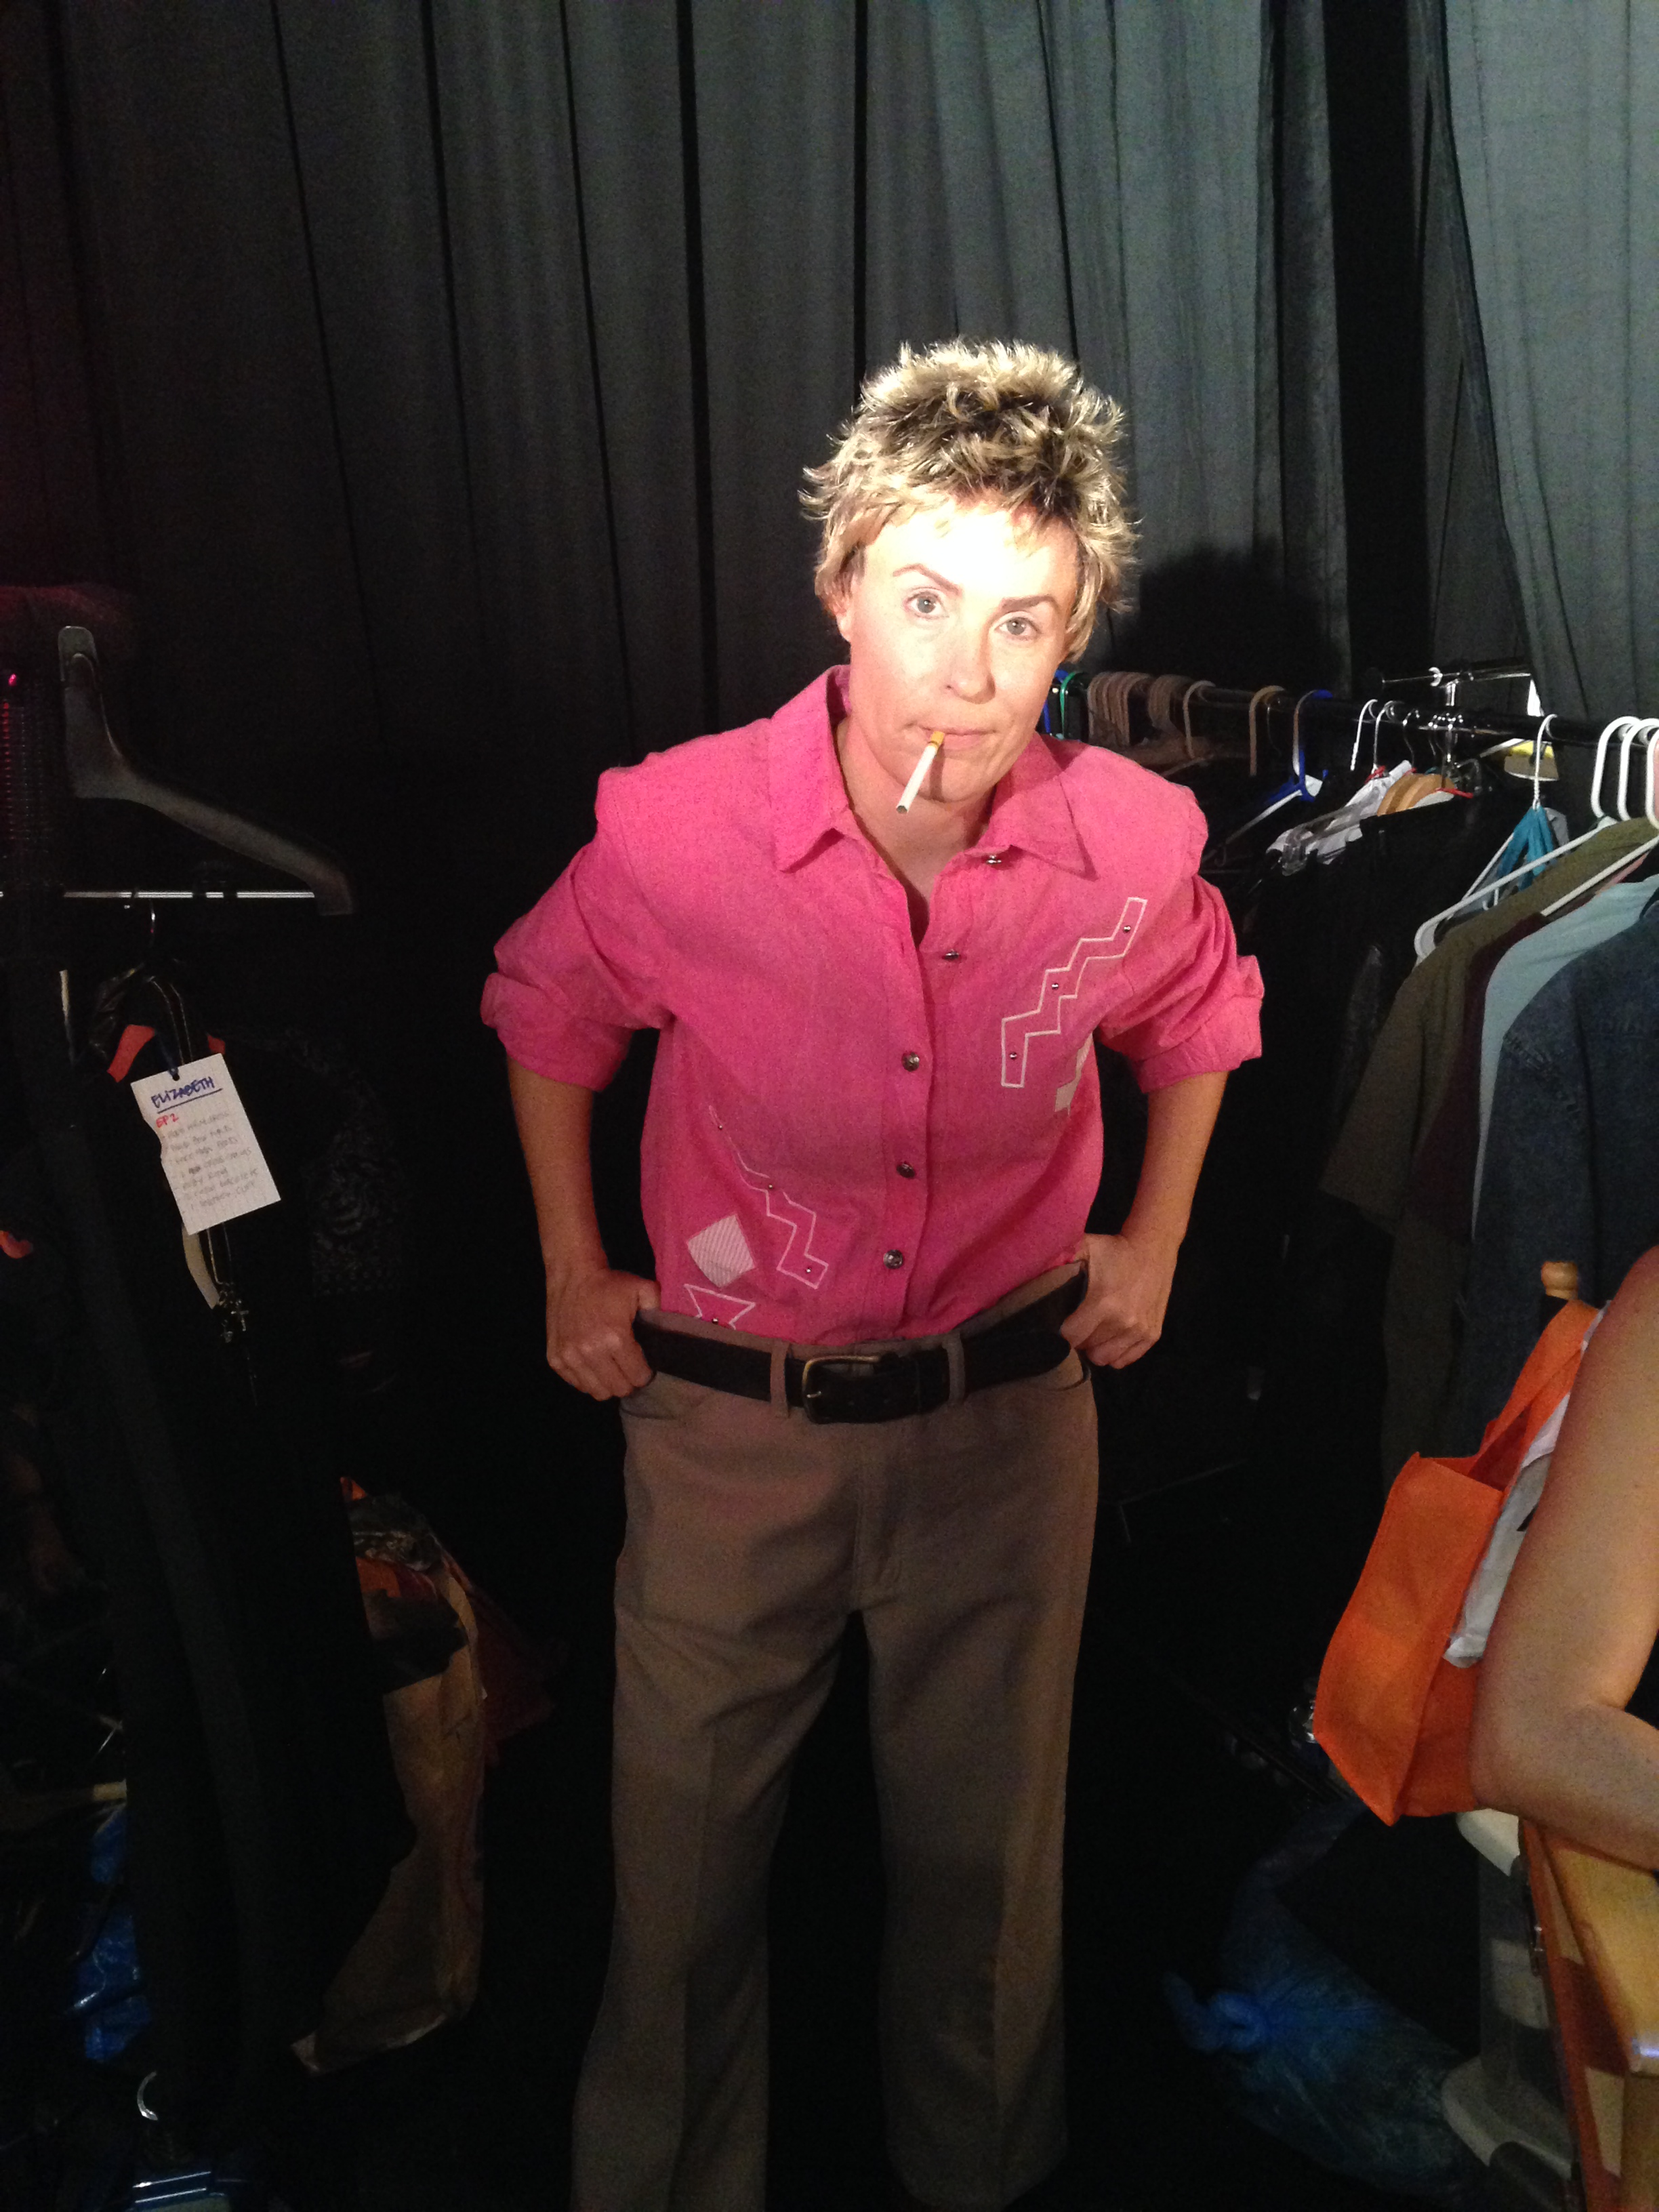

Slide 17
FAILURE

Slide 18
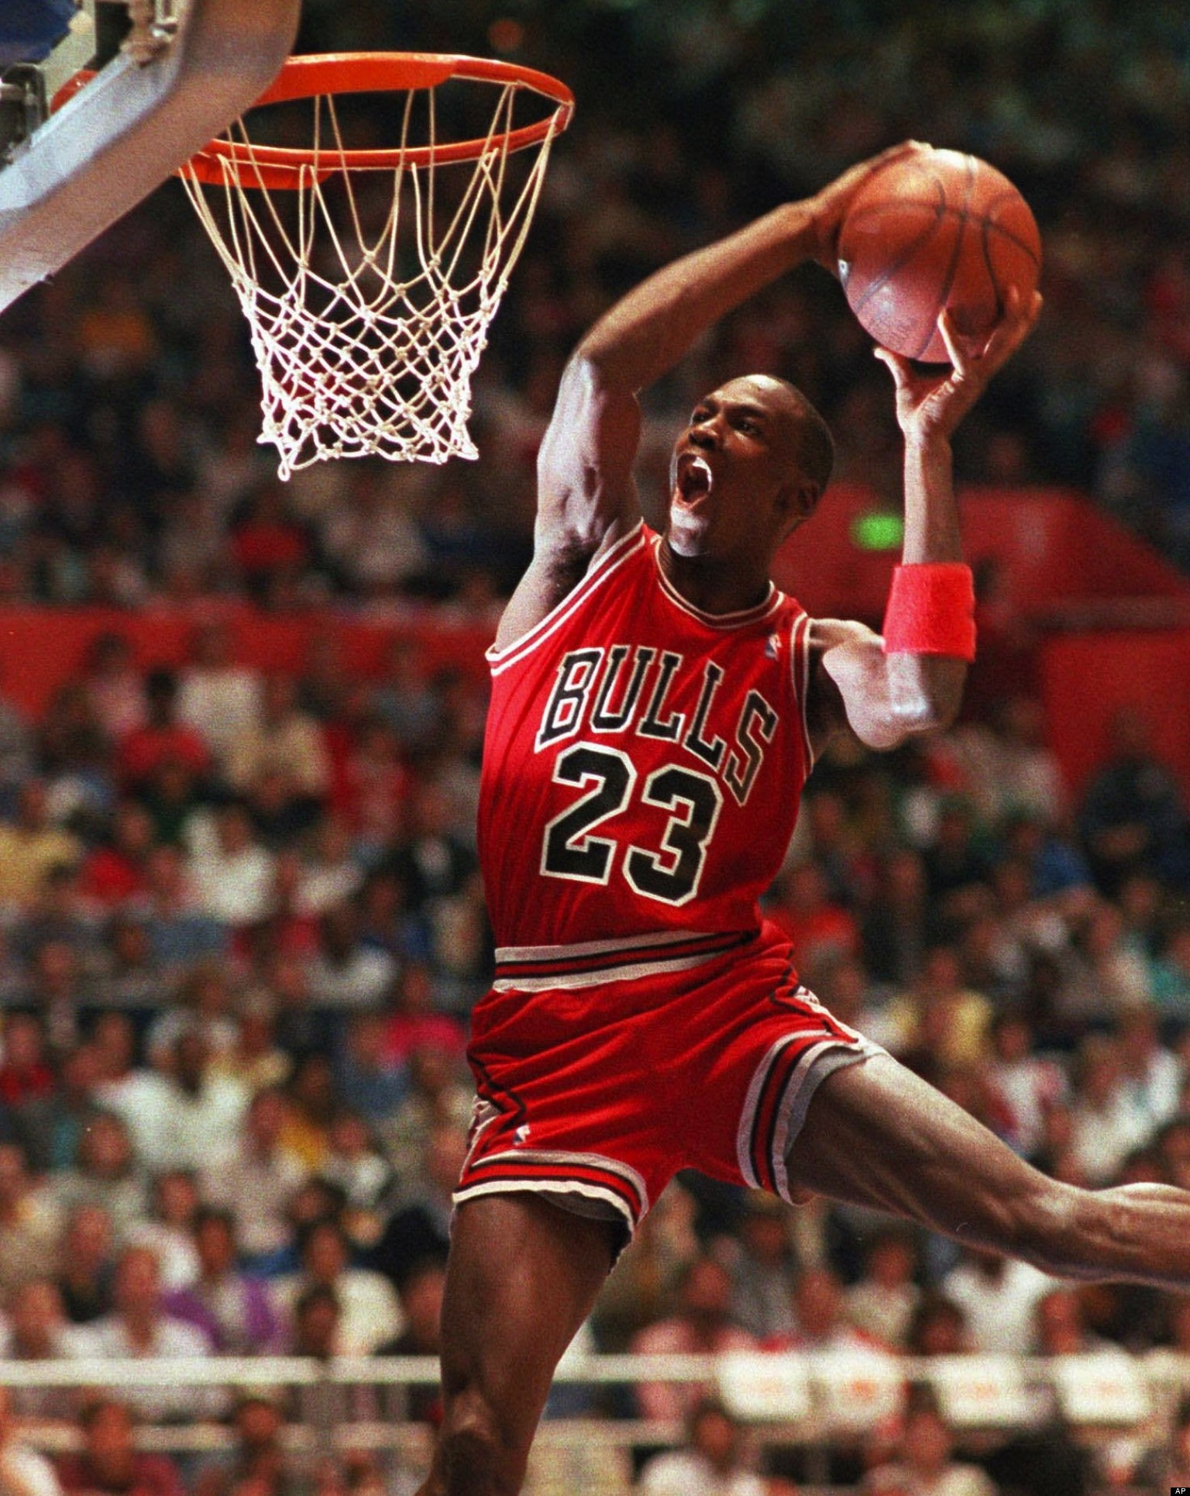

Slide 19
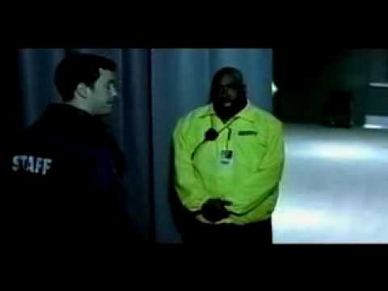

Slide 20
Ten thousand hours

Slide 21
What inspires you?

Slide 22
passion

Slide 23
flexibility

Slide 24
First impressions

Slide 25
Set goals
BUT DON'T BE ATTACHED TO THE OUTCOME

Slide 26
Overcoming obstacles

Slide 27
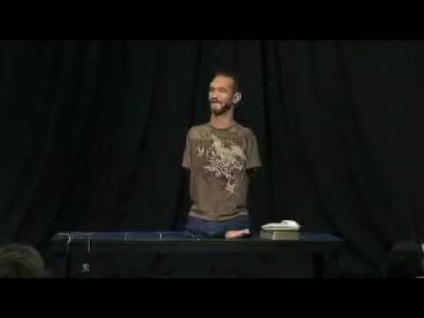

Slide 28
Feel the fear
AND DO IT ANYWAY

Slide 29
Group activity

