Slide 1
ARE YOU BETTER THAN A MACHINE?
Shannon “Shãn” Sutherland, AIF®, AAMS®, ADPASM Wealth Advisor Simple Impact LLC 2665 Main Street, Suite 240B Santa Monica, CA 90405 Phone 310-773-4411 | ssutherland@simpleimpactllc.com Shãn Sutherland (CA Insurance Lic. #0D28620) is a Registered Representative and an Investment Adviser Representative with/and offers securities and advisory services through Commonwealth Financial Network®, Member FINRA/SIPC, a Registered Investment Adviser. Fixed insurance products and services offered by Simple Impact or CES Insurance Agency

Slide 2
Notes:
In the year 2029, twelve short years from now, machines fight men and women to be the rulers of the planet.

Slide 3
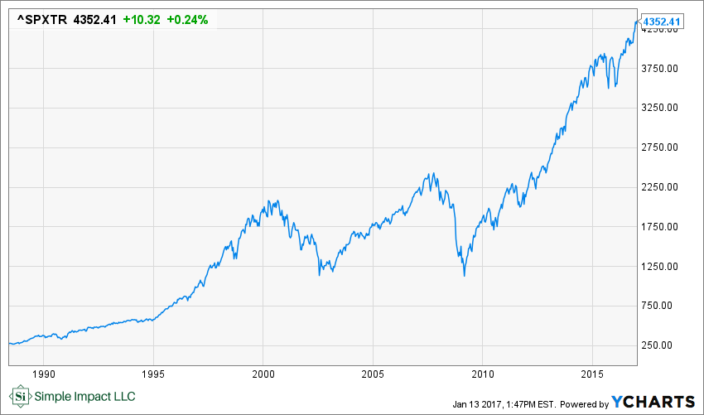
S&P 500
The Standard & Poor's (S&P) 500 Index tracks the performance of 500 widely held, large-capitalization US stocks.
-index disclosure: All indices are unmanaged and investors cannot actually invest directly into an index. Unlike investments, indices do not incur management fees, charges, or expenses. Past performance does not guarantee future results

Slide 4
Notes:
Notes from the Pit…for 07-29-16
Describe what happens in the PIT

Slide 5
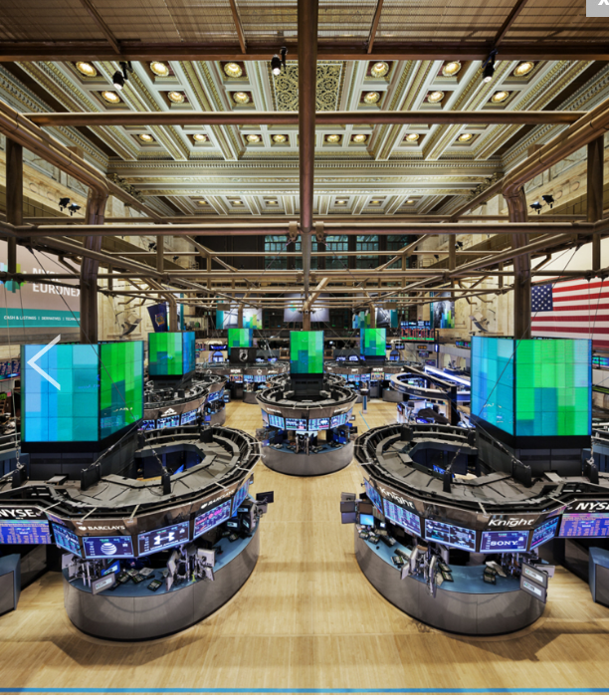
HOW DO WE BEAT THE MACHINES?

Slide 6
Sea indiscutiblemente valioso
Notes:
Be undisputedly valuable

Slide 7
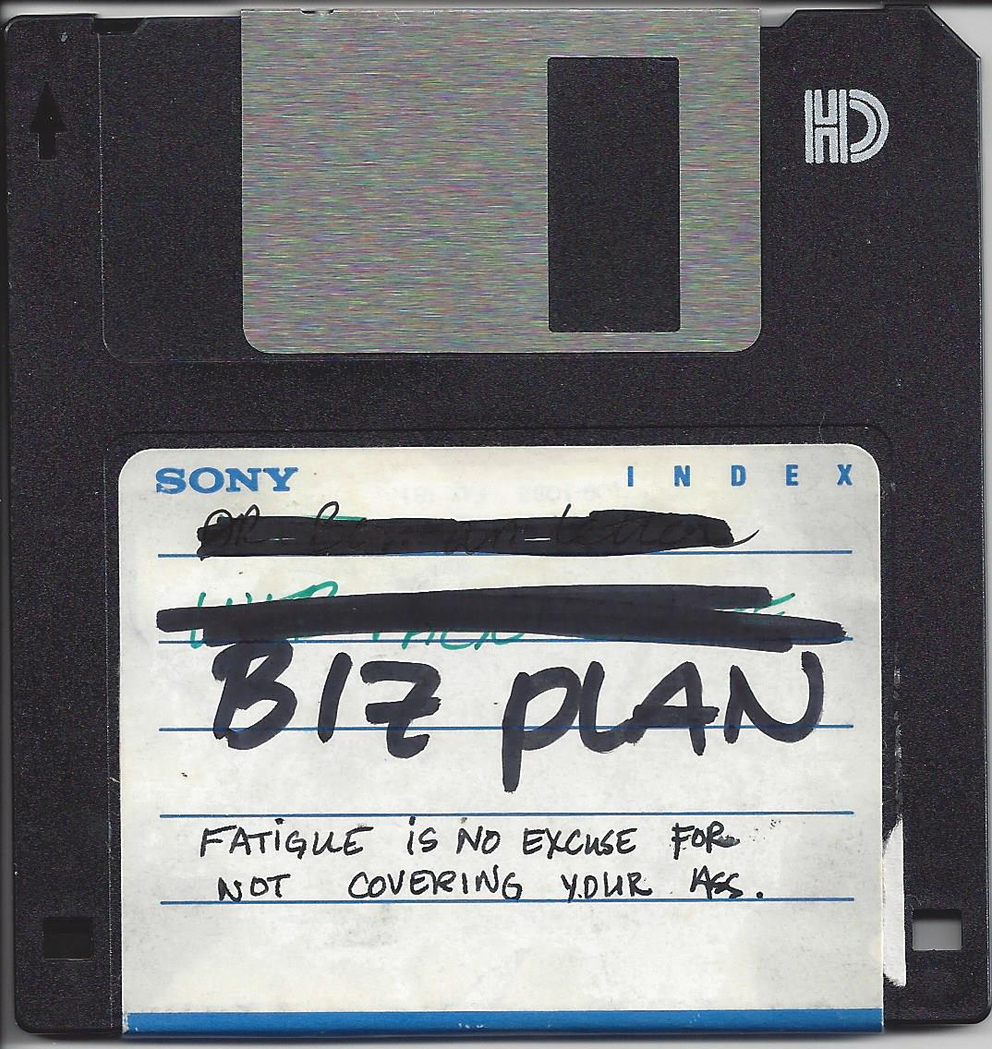

Slide 8
FAILURES ARE LEGOS OF MY SUCCESS
Notes:
https://shop.lego.com/en-US/LEGO-Creative-Building-Set-10702

Slide 11
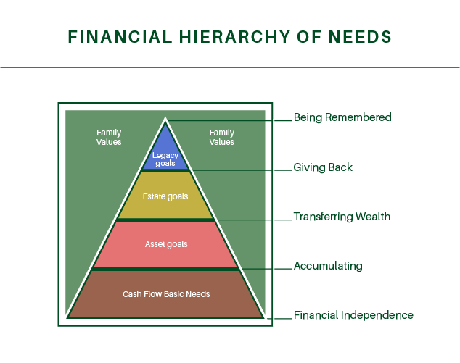
Notes:
By understanding the most basic needs of survival and security, it is possible to identify that which keeps you from progressing.

Slide 12
Source: Jim Collins “Good to Great”
PASSION
Surrender to spirit
BE BETTER THAN THE MACHINE
ECONOMIC ENGINE
Have a ride

Slide 14
Notes:
SHE- SSGA gender parity

Slide 15
Be better than a machine
Shannon “Shãn” Sutherland, AIF®, AAMS®, ADPASM Wealth Advisor Simple Impact LLC 2665 Main Street, Suite 240B Santa Monica, CA 90405 Phone 310-773-4411 | ssutherland@simpleimpactllc.com Shãn Sutherland (CA Insurance Lic. #0D28620) is a Registered Representative and an Investment Adviser Representative with/and offers securities and advisory services through Commonwealth Financial Network®, Member FINRA/SIPC, a Registered Investment Adviser. Fixed insurance products and services offered by Simple Impact or CES Insurance Agency

