Slide 1
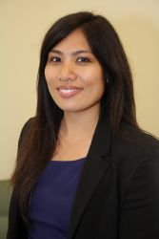
YBA GUEST
RACHELLE TEJADA

Slide 2
INTRODUCTION
My name is Rachelle Tejada.
I am an attorney.
I am also an entrepreneur.
Bar Review Hub: Provides free, online legal resources to persons studying for the bar exam.

Slide 3
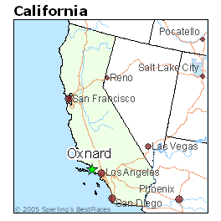
My childhood
I was born in Northern California and raised in Oxnard, California.
I’ve lived in Los Angeles, San Diego and Costa Mesa

Slide 4
My family
I grew up in a family of 5.
My Dad was in the navy and my mom was a preschool teacher.

Slide 5
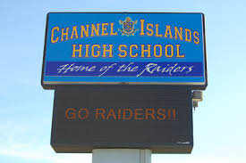
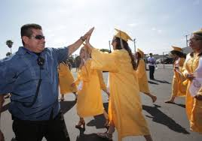
MY HIGH SCHOOL
I attended CHANNEL ISLANDS HS in OXNARD, CA

Slide 6
High School
Things that felt difficult or challenging for me while I was in High School were:
I was a shy kid
strict parents
I felt the pressure of getting good grades and going to college
Bullying and Teasing

Slide 7
Getting in to College
The top few things I did to ensure I got into college were:
Learned good habits
Learned disciplined
Got good grades
Involved in school activities that I enjoyed

Slide 8
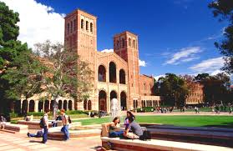
UCLA
I attended college at UCLA in Los Angeles, California
Insert map shot here

Slide 9
college
Things I didn’t enjoy in College:
Studying
Challenging Classes
Things I enjoyed in College:
Making New Friends
Volunteering
Working at my part-time jobs
Challenging Classes

Slide 10
college
Jobs I worked while I was in College were:
Proctor at UCLA School of Law
Assistant to Administrative Assistant for Physician
-Ran errands, Picked up dry cleaning, picked up Starbucks,

Slide 11
College
Things that felt difficult or challenging for me while I was in College were:
Attending a big school
Competitive Atmosphere
Learning how to balance time

Slide 12
Getting a job after College
The top few things I did to ensure I got a good job after college were:
Took advantage of the resources around me (Craigslist, LinkedIn, Instagram)
Understood my skills (enjoyed working with others, excellent writer, creative)
Became open-minded to opportunities (Thought about becoming a teacher, worked for STAR Education)

Slide 13
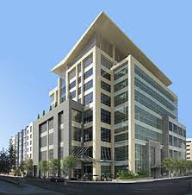
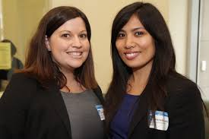
Law school
Different way of teaching
Interned at Small Business Law Center
Developed my interest in business
Thomas Jefferson School of Law in San Diego, CA

Slide 14
ATTORNEY
Legal Research
Legal Writing
Counseling Clients
Problem Solvers

Slide 15
This is My Company
www.barreviewhub.com

Slide 16
My Career Path
LAW SCHOOL
STAR EDUCATION
LAW FIRM
FOUNDER OF BAR REVIEW HUB
Notes:
You may use this chart to describe your journey to the current career

Slide 17
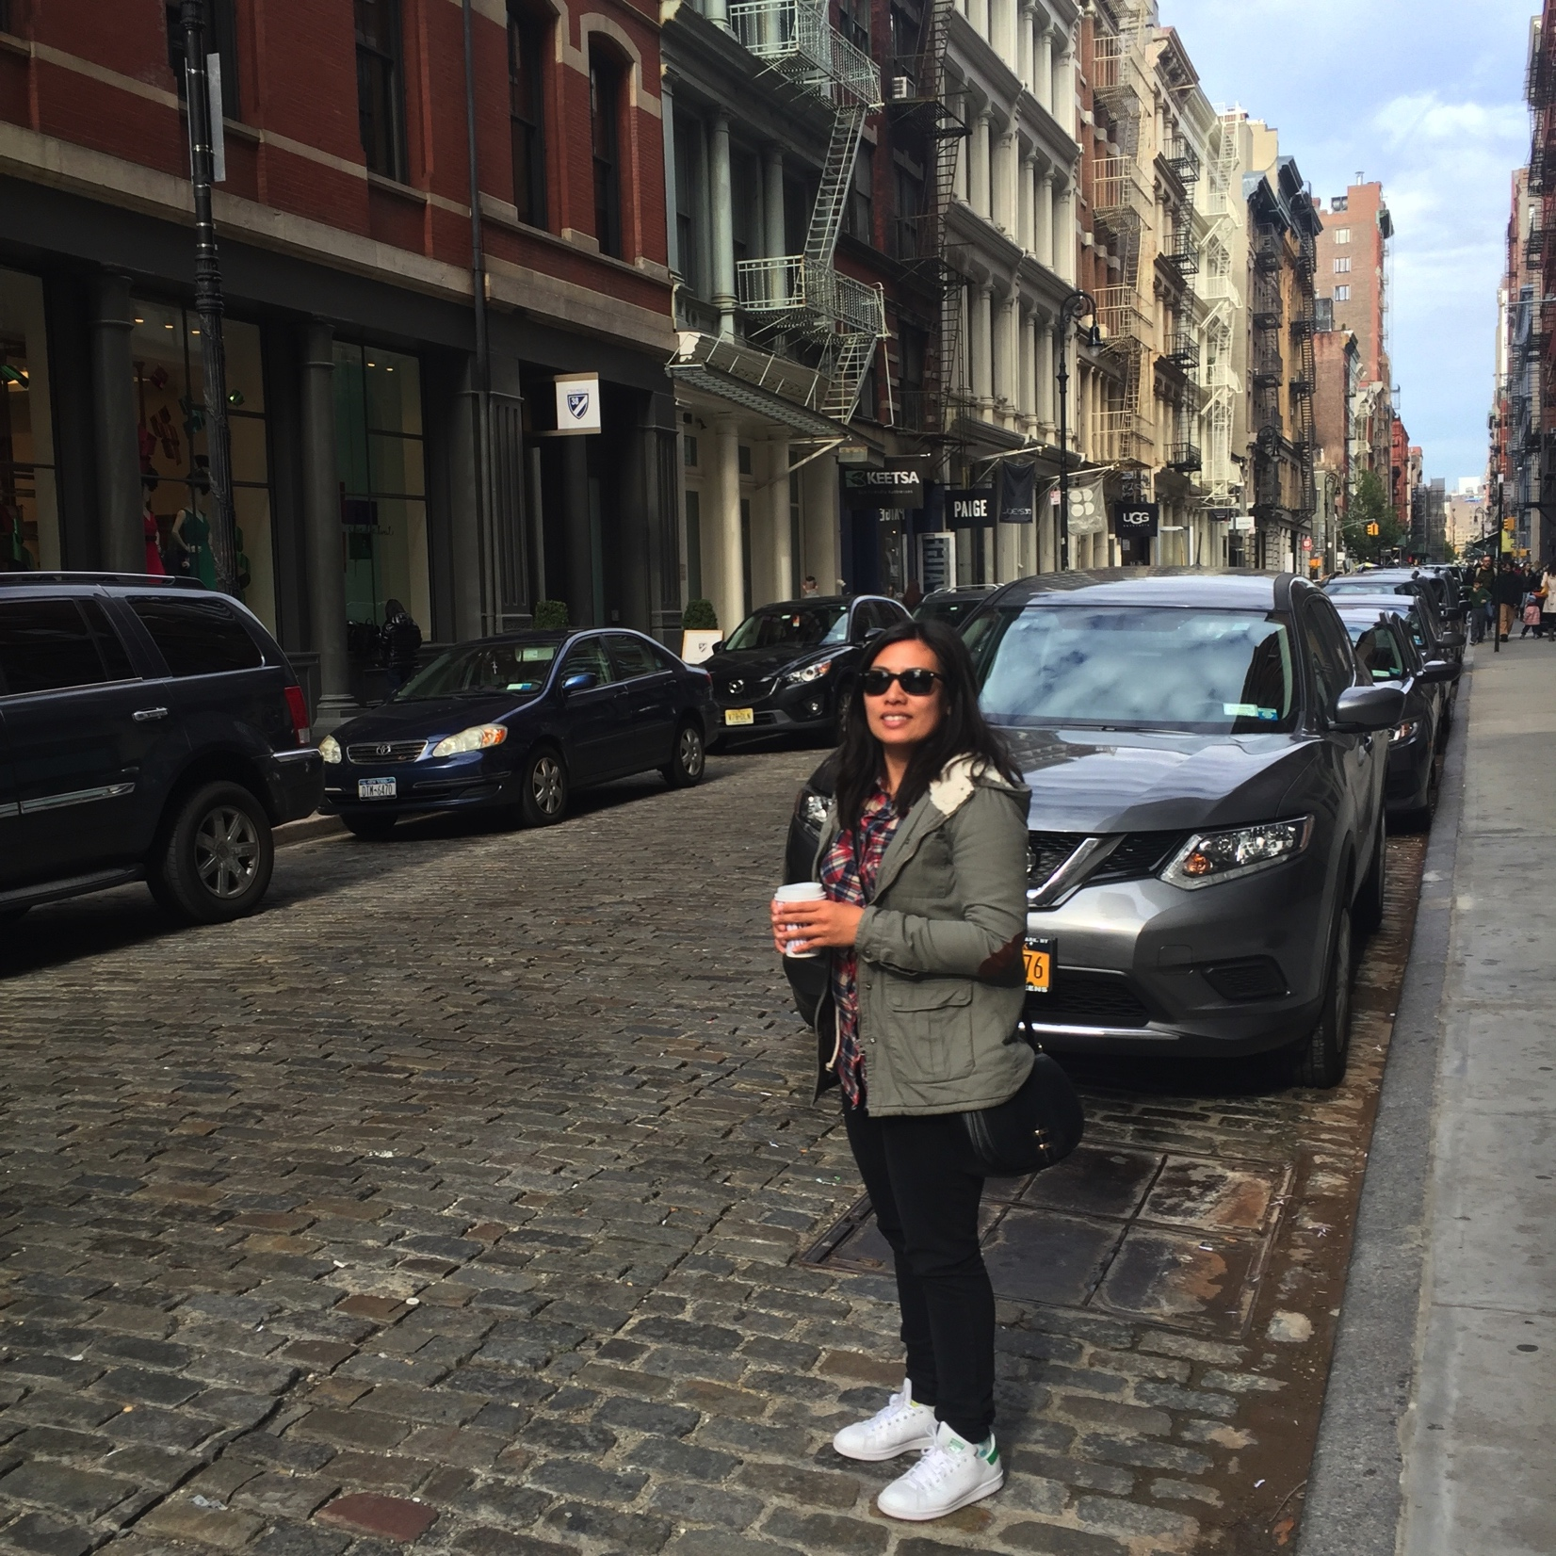
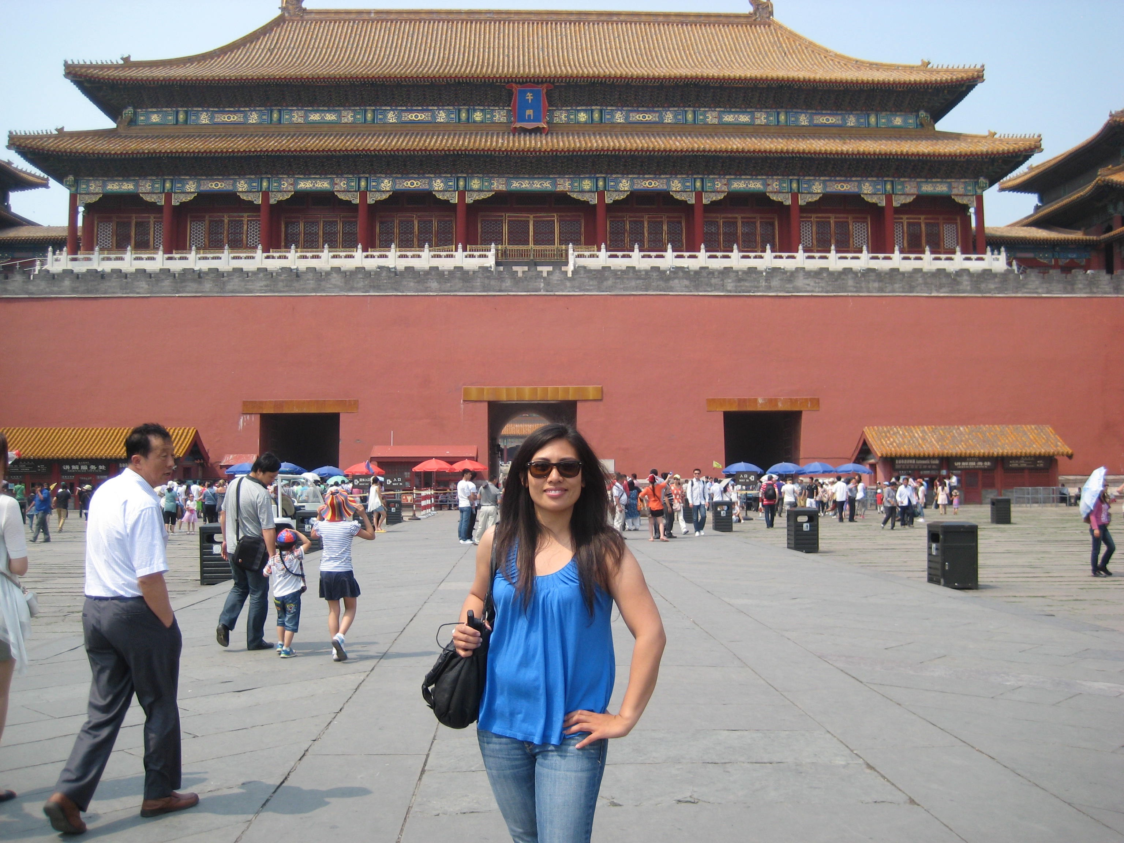
More than just work
When I am not at work I like to:
Travel
Volunteer
Try New Restaurants

Slide 18
Do it all over again?
If I could talk to my high school self, what would I say?
Work Hard
Have Fun
Take Advantage of the Opportunities in Front of You

Slide 19
QUESTION AND ANSWER

