Slide 1
Stephanie Powers Kurtz
Veltek Associates, Inc.
Southwest territory sales manager

Slide 2
Background

Slide 3
Artificial disc replacement (ADR)

Slide 4
career

Slide 5
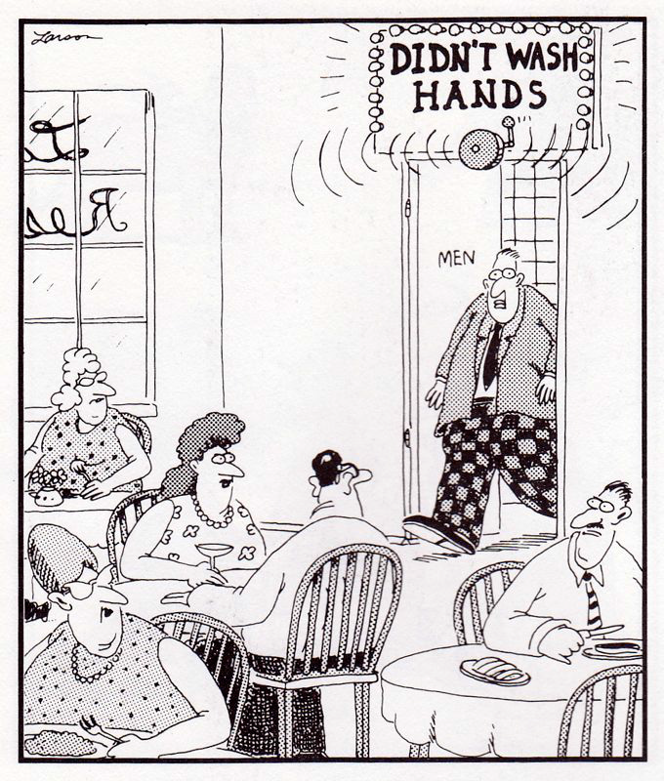
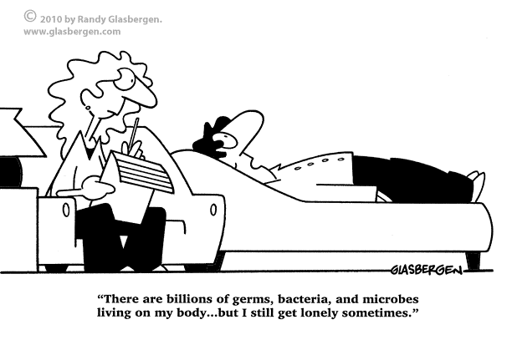
Humans are the #1 source of contamination

Slide 6
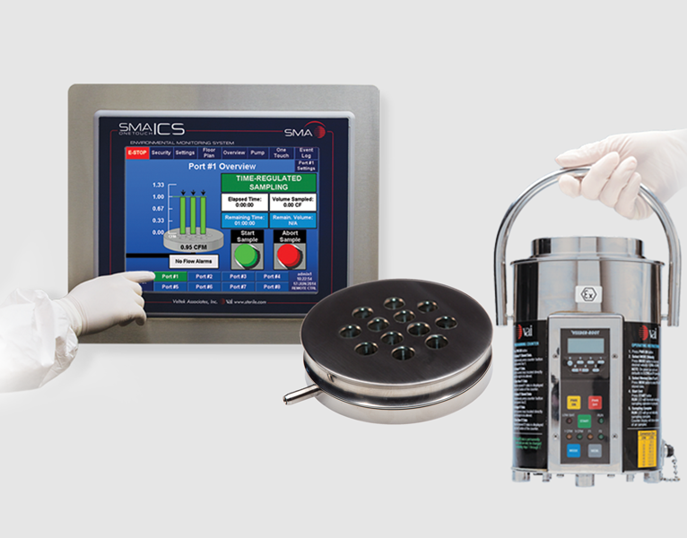
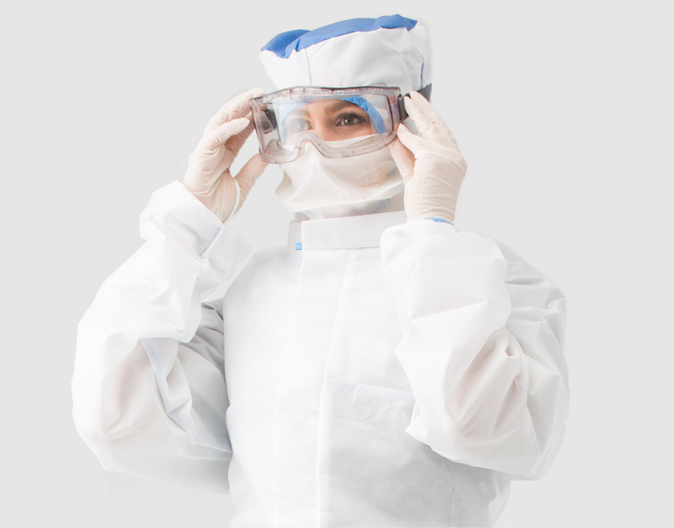
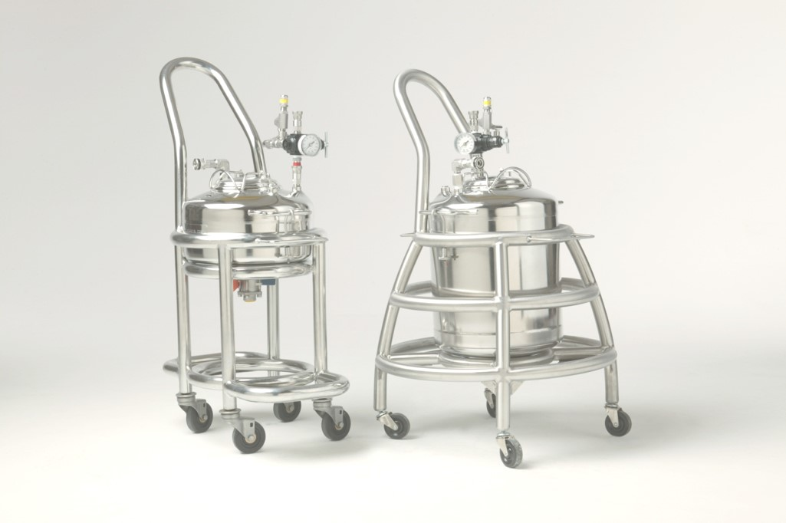
Veltek Associates, Inc.

Slide 7
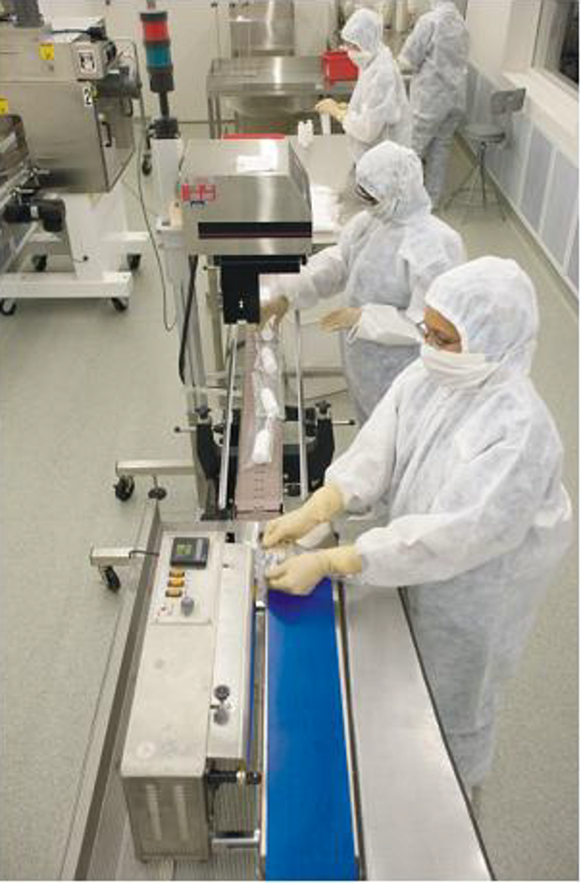
Sterile manufacturing

Slide 8
Sales role
Education
Support
Service
relationships

Slide 9
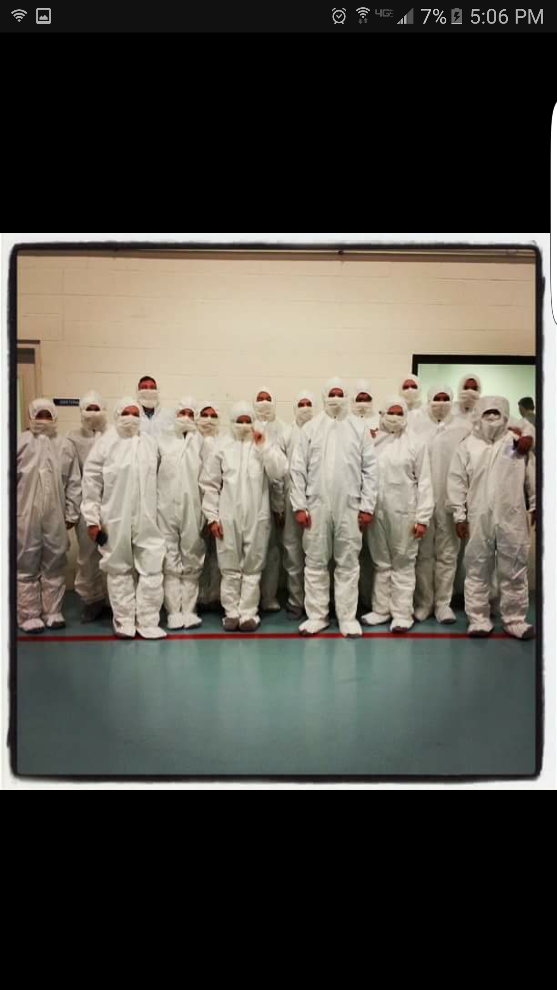
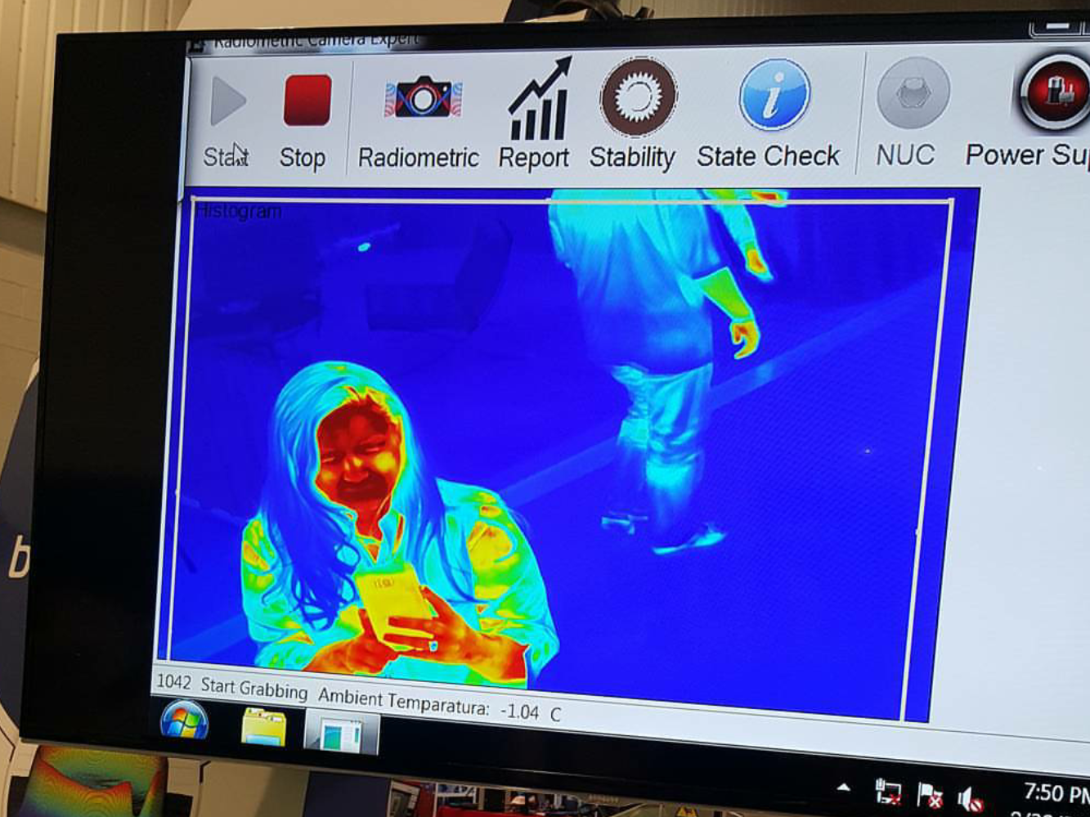
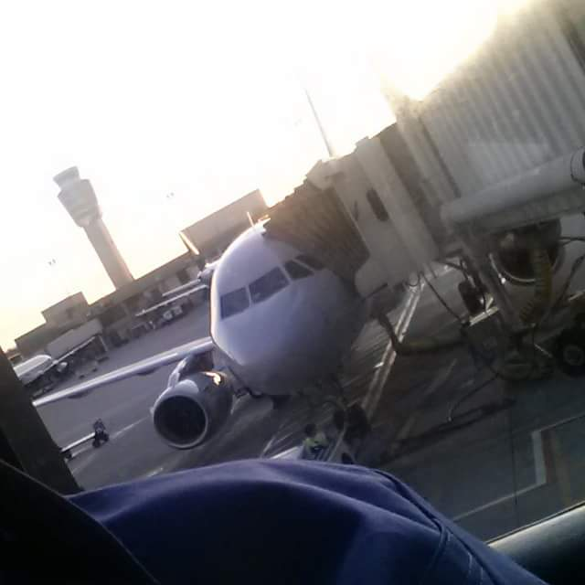
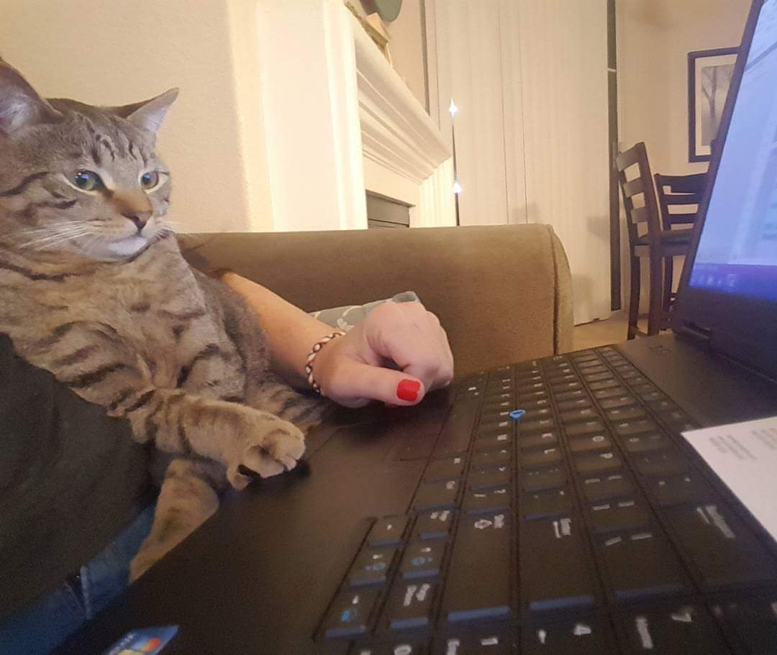
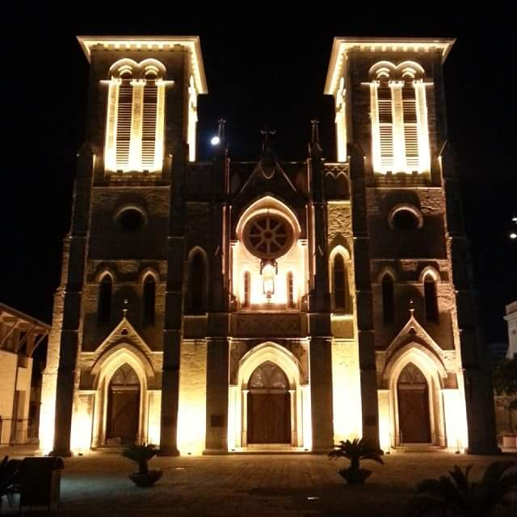

Slide 10
activity

Slide 11
Questions???

