Slide 1
Ralph Michael Brekan
Artist/Actor

Slide 2
INTRODUCTION
My name is Ralph Michael Brekan and I am 42 years old.
I work for FLS International.
My company does:
Offers study abroad programs for non-English speakers.
My role at FLS International is Creative Director
Every day I work directly with our sales and marketing staff to create compelling multimedia assets that communicate our products and services to agents and prospective students.

Slide 3
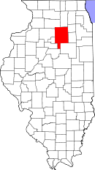
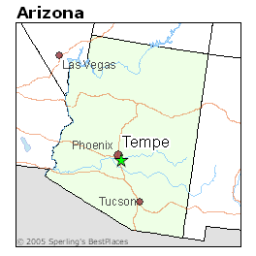
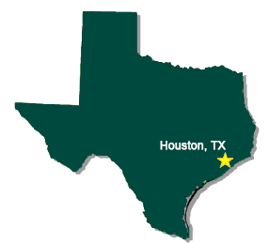
My childhood
I was born in La Salle, Illinois and raised in Tempe, Arizona.
Illinois
This is a picture of me at age 12 in Houston
1986-2014
1974-1983
1983-1986

Slide 4
My family
A little about my family
I am the eldest of three sons. I have no sisters.
Both of my parents worked full-time.
I had many responsibilities helping care for my younger brothers.
This is a picture of me and my brothers Douglas and Jonathan

Slide 5
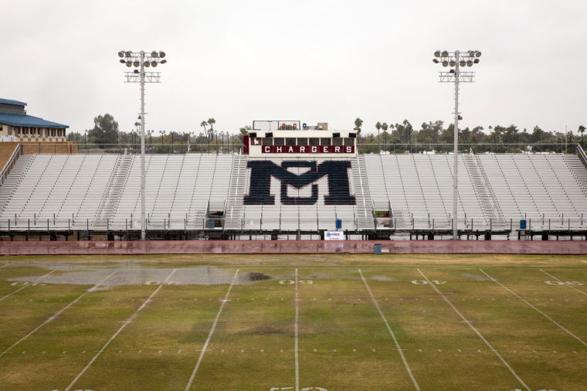
MY HIGH SCHOOL
I attended McClintock HS in Tempe, AZ

Slide 6
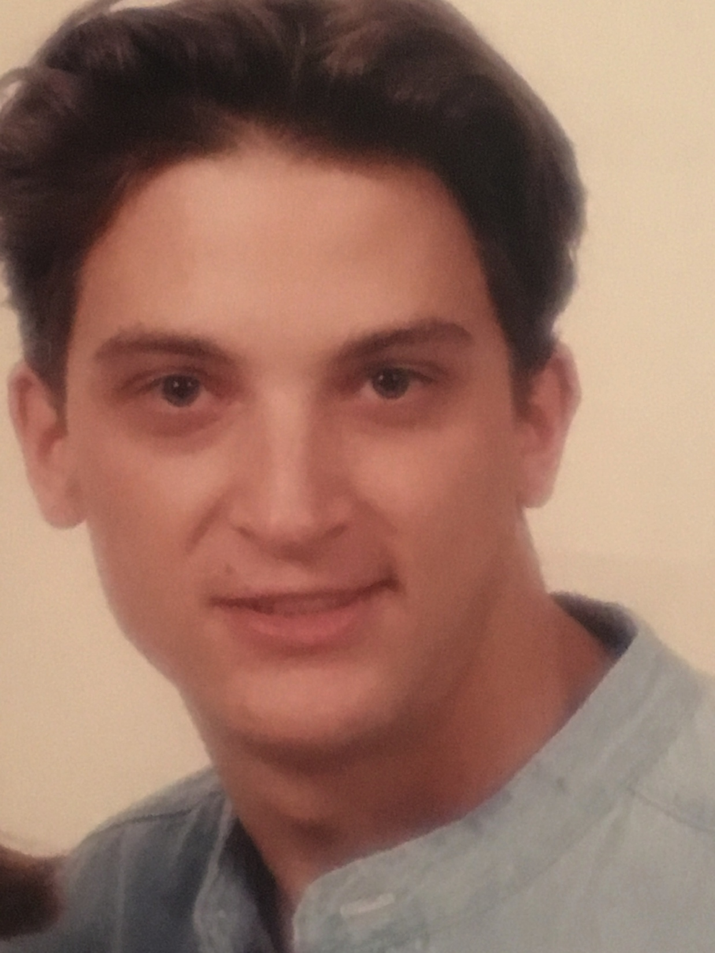
High School
As a HS student I was very outgoing to compensate for my small size. I was what they call a ‘late bloomer.’ I was only 4’11” tall my freshman year and didn’t grow until the end of eleventh grade! My size did not stop me from playing baseball, acting in school plays and creating art.
Here is a picture of me in HS

Slide 7
High School
Things that I really liked in High School were:
The ability to choose my own schedule and elective courses.
Extra curricular activities: like musical theatre, speech and debate competitions, art exhibitions and sporting events.
Weekly dance parties after the Friday night football games.
Open campus. We were allowed to leave campus for lunch.
Large and diverse student body population.

Slide 8
High School
Things that felt difficult or challenging for me while I was in High School were:
I was very small so I was often overlooked for sports and dates.
I struggle with ADHD, which meant classes like science and math were very challenging.
I failed algebra three times and had to take summer school after my senior year to graduate.
I made poor choices in some friends I associated with and was shot in a drive by shooting after school.
Poor academic discipline limited my college choices.

Slide 9
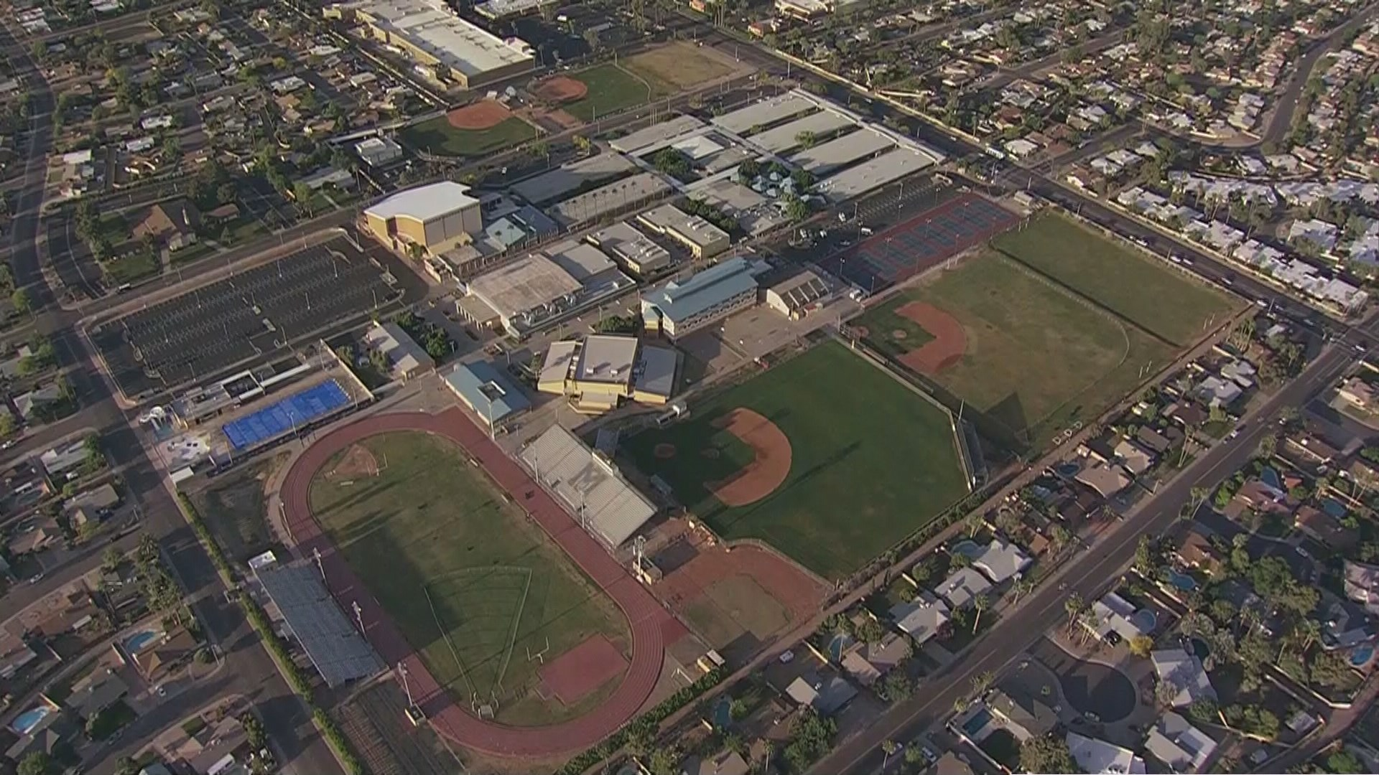
High School
Jobs I worked while I was in High School were:
I had a paper route my freshman year.
I worked at JC Penney & Co. as a clerk my junior year.
I worked in a fundraising phone bank my senior year.

Slide 10
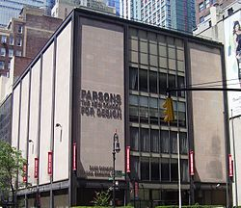
Getting in to College
The top few things I did to prepare for college were:
AP coursework in fine art
Portfolio reviews for admissions into art schools
Travel to visit art schools in Chicago and New York.

Slide 11
College
I entered college in Scottsdale, Arizona at Scottsdale Community College.

Slide 12
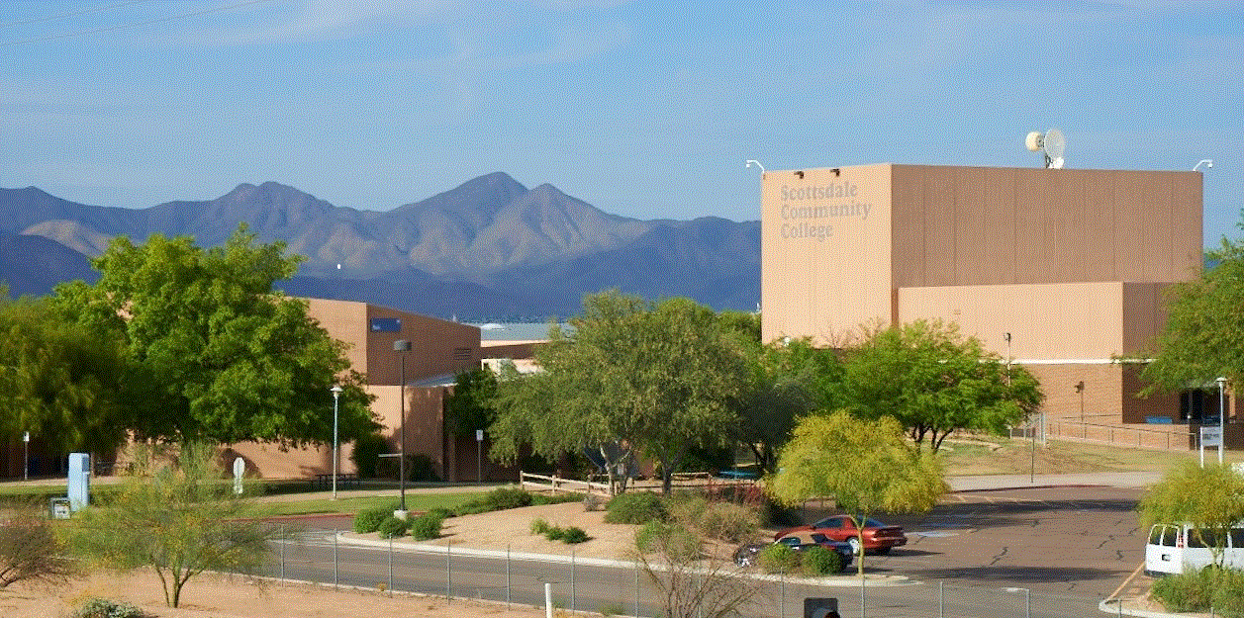
College
Things I enjoyed in College
Things I didn’t enjoy in College
Student film projects
Late night raves
Going to class

Slide 13
College
Favorite classes
Least favorite classes
Motion Picture production
Creative Writing
Studio art
Algebra

Slide 14
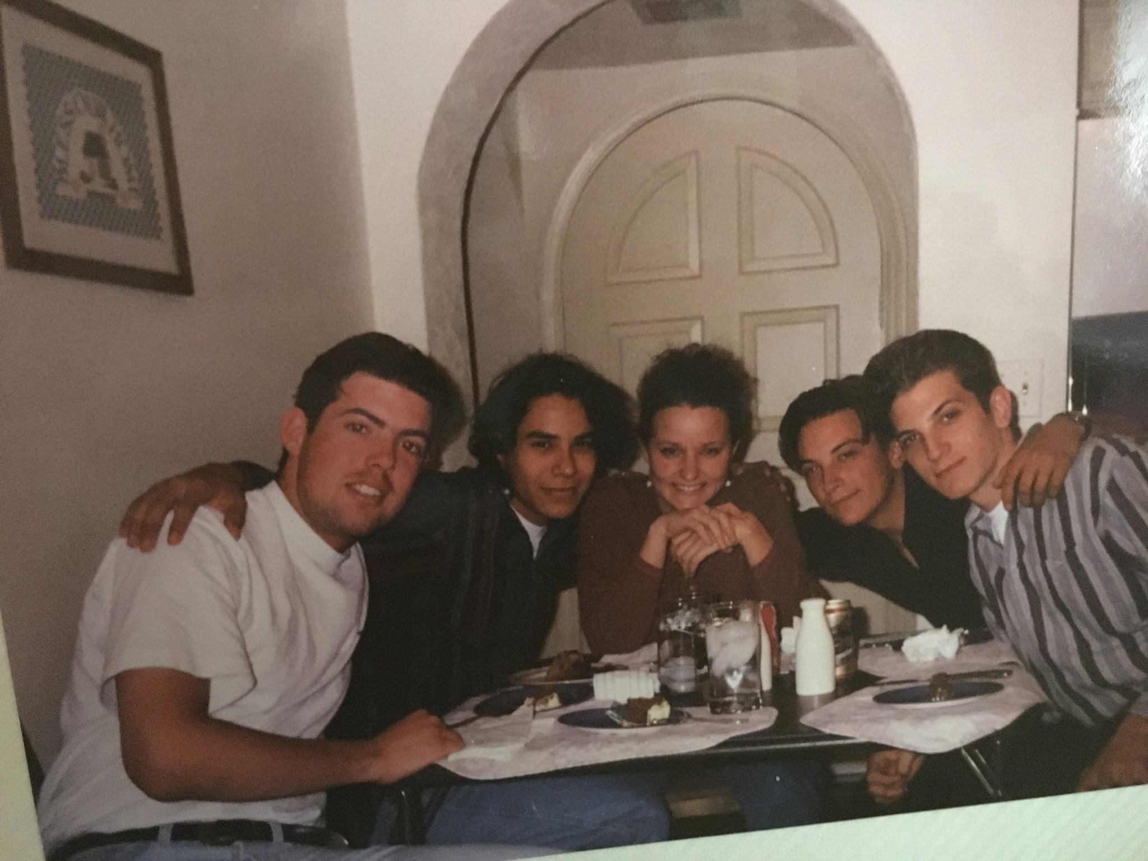
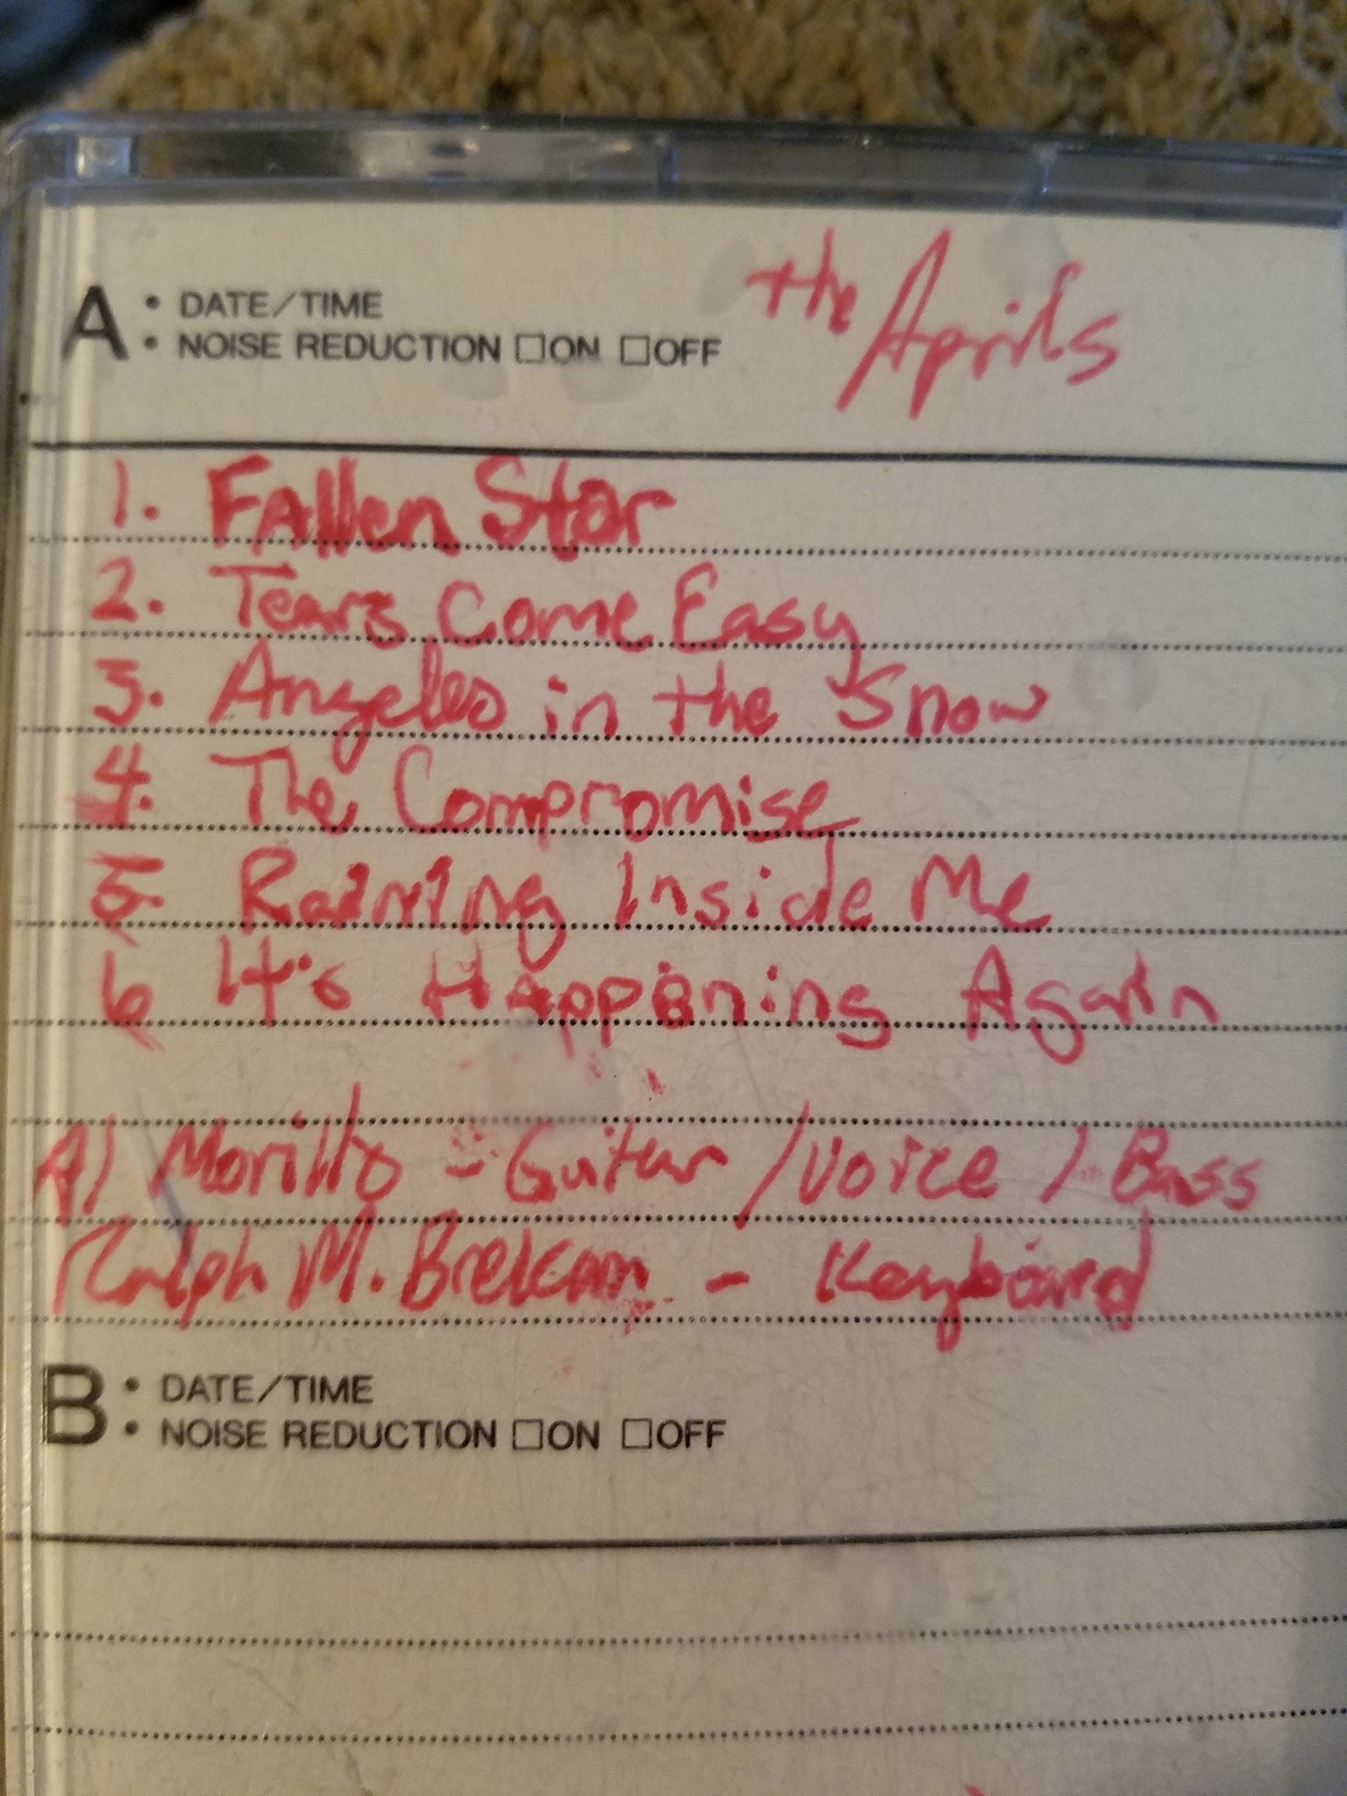
College
Jobs I worked while I was in College were:
I played in a band
I worked at a coffee shop as a barista
I worked as a graphics artist for a real estate firm

Slide 15
College
Things that felt difficult or challenging for me while I was in College were:
Paying for it out of pocket; I earned scholarships for art and worked to pay tuition.
Getting my parents to understand the value of pursing art as a career
Paying attention in classes that were not interesting to me.

Slide 16
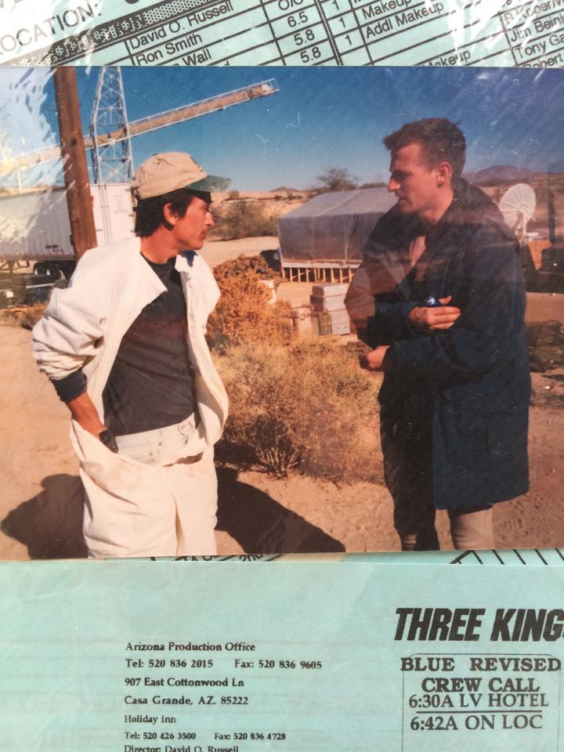
Getting a job after College
The top few things I did to ensure I got a good job after college were:
I joined the trade union, International Alliance of Theatrical Stage Employees Local 485, motion picture studio mechanics.
I continued professional development with trade certification in audio and video production.

Slide 17
This is My Company
Every day at my company:
• Develop user interface and user experience for the production websites.
• Work on the graphic development of all visual communication assets.
• Interact with copywriters to develop and pitch creative concepts.
• Possess solid understanding of the science and market dynamics of assigned products.
• Work closely with account executives to schedule and monitor all
• DSLR video production and post production.

Slide 18
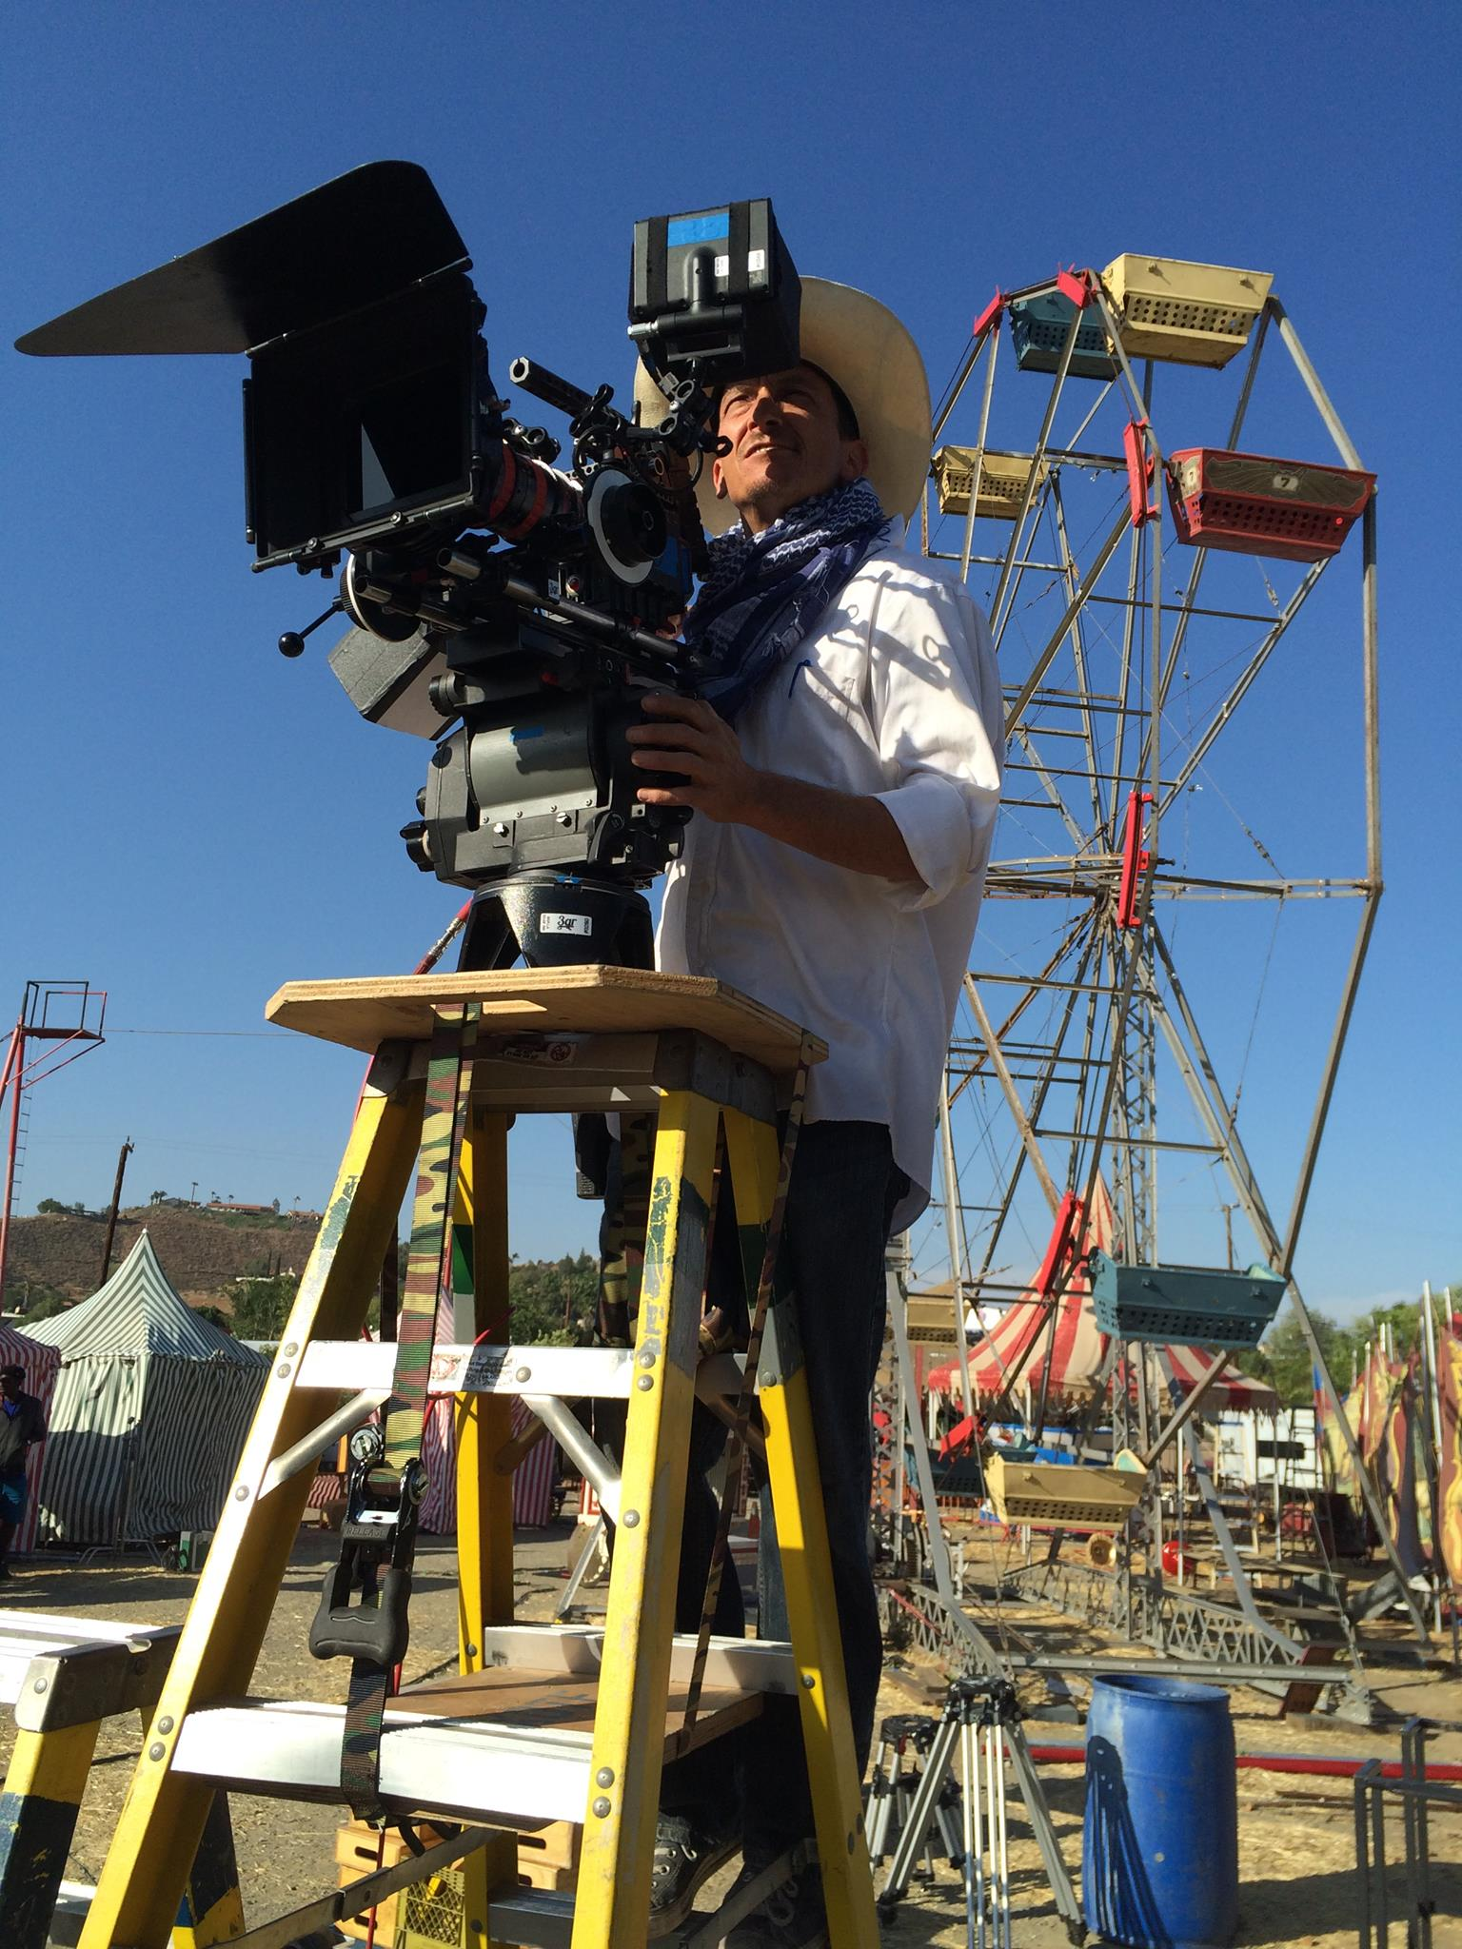
My Career Path
I completed my diploma in visual communications from the University of Phoenix
I was made a Journeyman stagehand in IATSE
I am now the Creative Director of an International language school, an internationally exhibited fine-artist and a guest star on television programs.
Notes:
You may use this chart to describe your journey to the current career

Slide 19
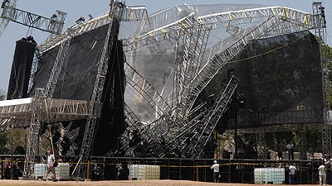
My Career
The first job I had after college was:
Working for JR Russell Systems building stage sets
The worst job I have ever had was:
Working for JR Russell Systems building stage sets. JR is notorious for underpaying and putting his employees in dangerous environments.
It was working for JR that I decided to apply to join IATSE which provided better pay and safer working conditions.
NON UNION STAGEHANDS ARE DANGEROUS

Slide 20
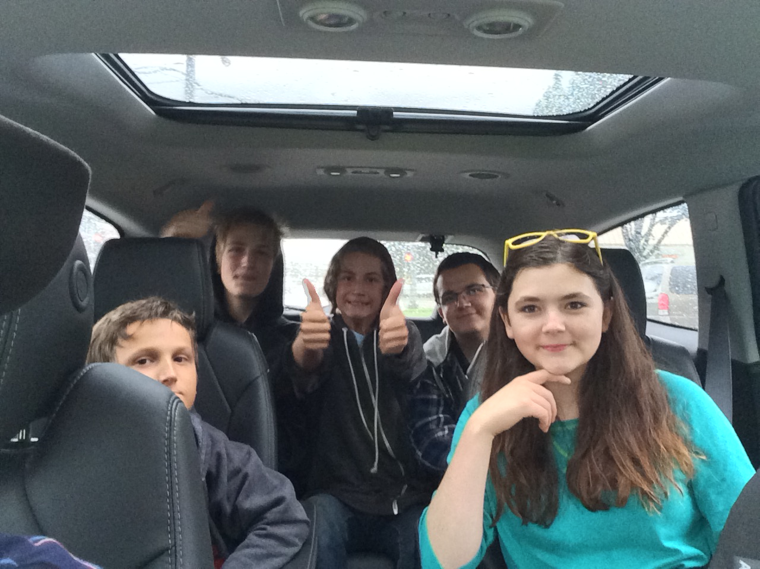
My Career
Challenges I have had to overcome throughout my career are:
The lack of a college degree held me back from management positions until I completed my diploma in 2010.
ADHD and interpersonal communication issues.
Early success and fanfare lead to sense of entitlement.
Maintaining a large family on a variable income.
MY FIVE CHILDREN
☺

Slide 21
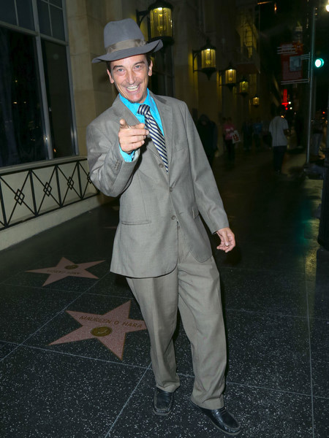
My role within organization
CEO
ME
PROGRAMMER
ARTIST
DESIGNER
Notes:
Use this graph to give more description of your role specifically (responsibilities, typical work week, direct reports, etc.)

Slide 22
Compensation at my company
C-Suite
($250K)
Management
($150K)
Middle Manager
($75K)
Entry Level
($20K)
Notes:
Use this graph to show general compensation ranges for people in various roles in your company

Slide 23
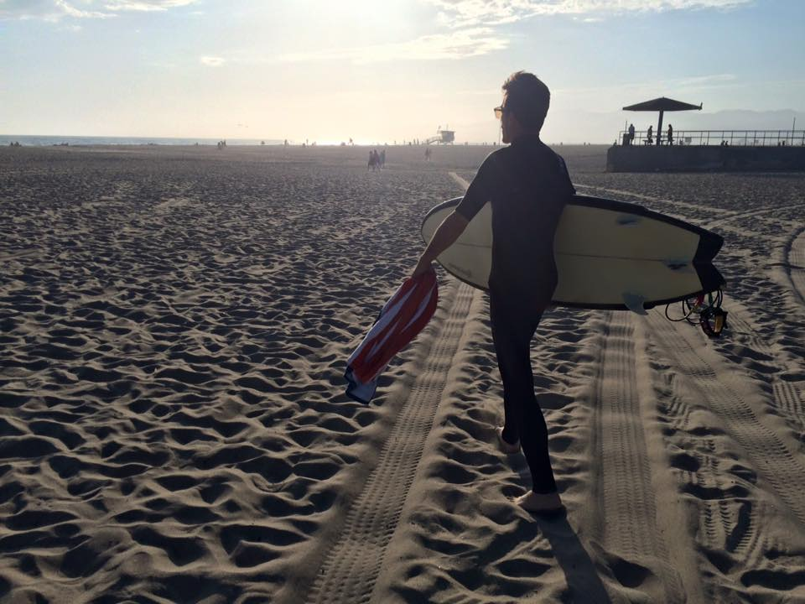
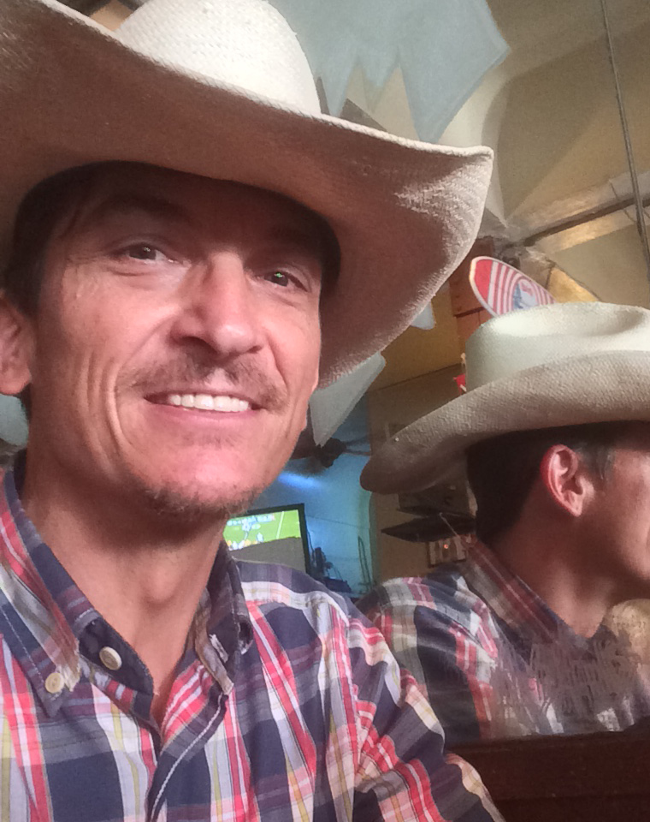
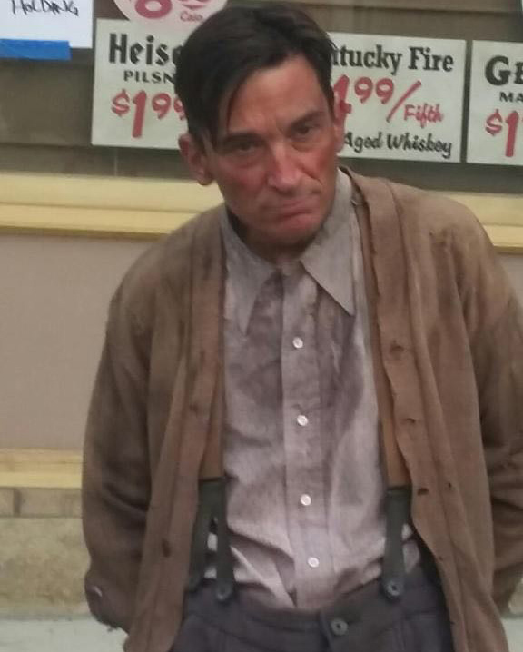
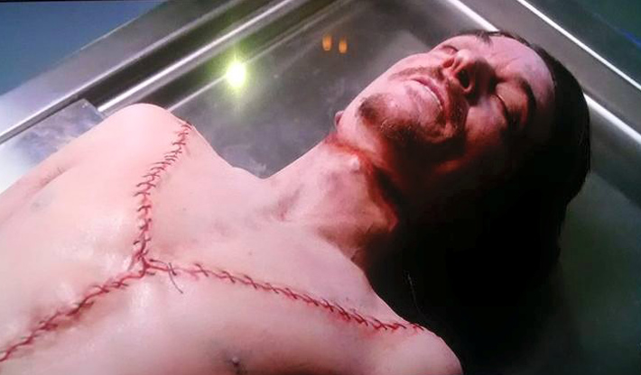
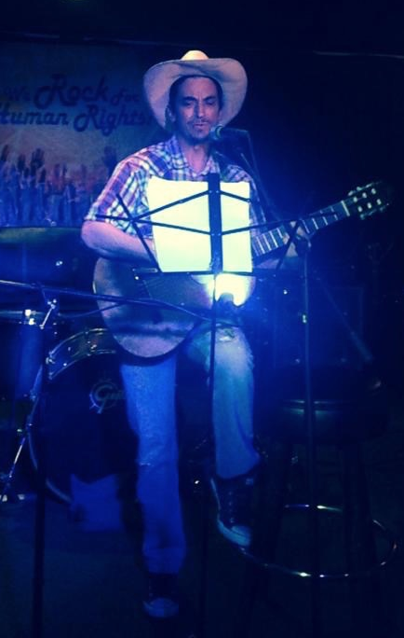
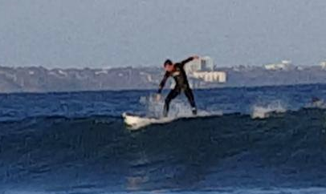
More than just work
When I am not at work I like to:
Surf
Play & sing music
Act

Slide 24
Do it all over again?
If I could talk to my high school self, what would I say?
Don’t wait for others.
Don’t explain yourself to others.
There may be a faster way, but it may not be fun.
Money matters.

Slide 25
QUESTION AND ANSWER

