Slide 2
“ENTREPRENEUR”

Slide 3
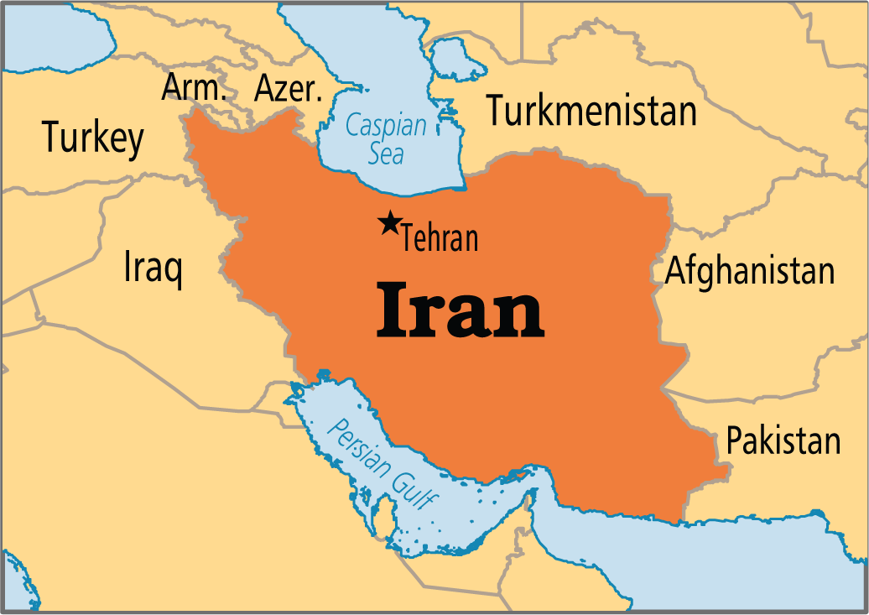

Slide 4
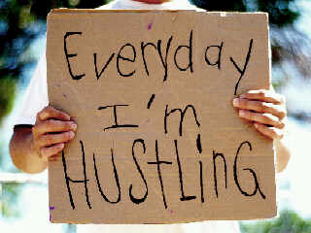

Slide 7
Who do you need to be? What do you need to have? …to start a business?

Slide 8
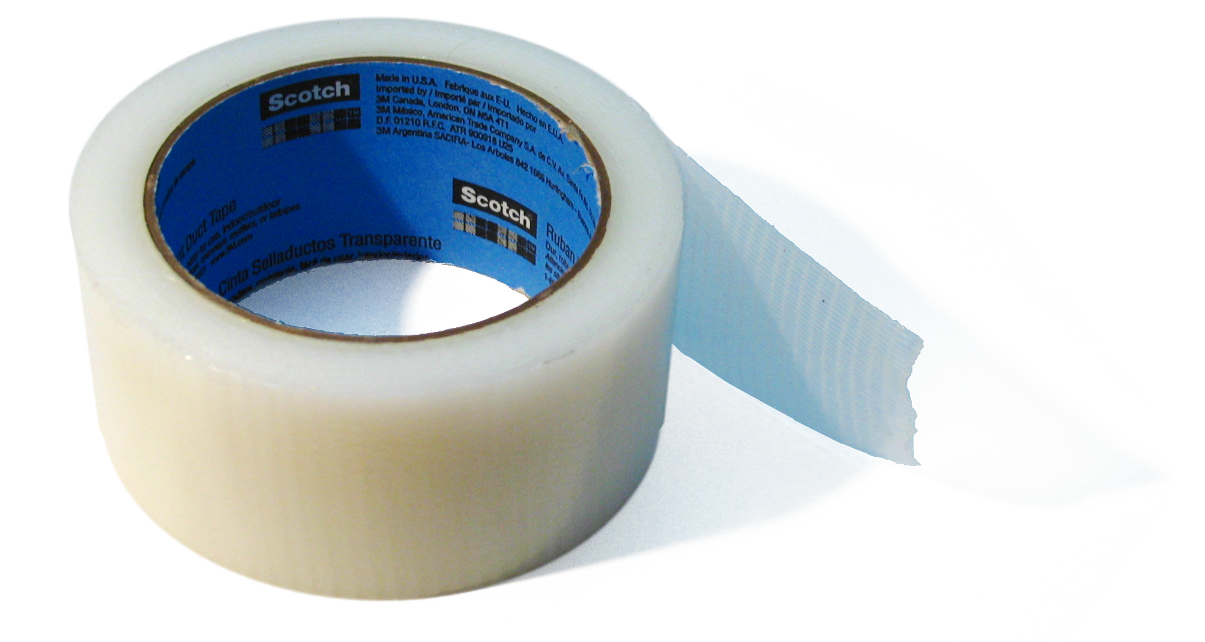
…one roll of tape.

Slide 9
What does it take to start a business? 1. Identify a problem or need. 2. Find a way to solve it. 3. Take action!

Slide 12
1. Need 2. Solution 3. Action

Slide 15
Which skills would you need if you were starting a business… 1. Like the book business? 2. Like the promoting business?

Slide 19
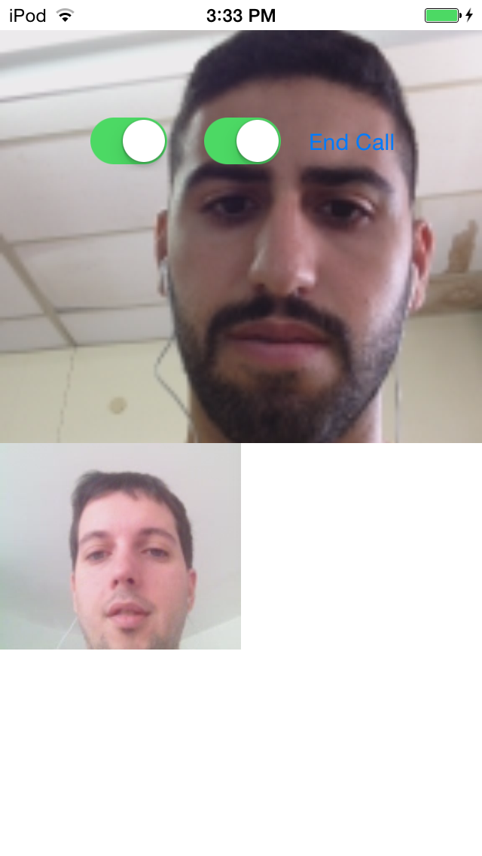

Slide 20
“If I start a business, I will be successful because…” Qualities Skills Passions Strengths Interests

Slide 21
Q & A

